Slide 1
Comparing Lattice Families for Bounded Distance Decoding near Minkowski’s Bound.
By Sasha Lapiha under supervision of Léo Ducas

Slide 2

Noisy channel communication.

Slide 3
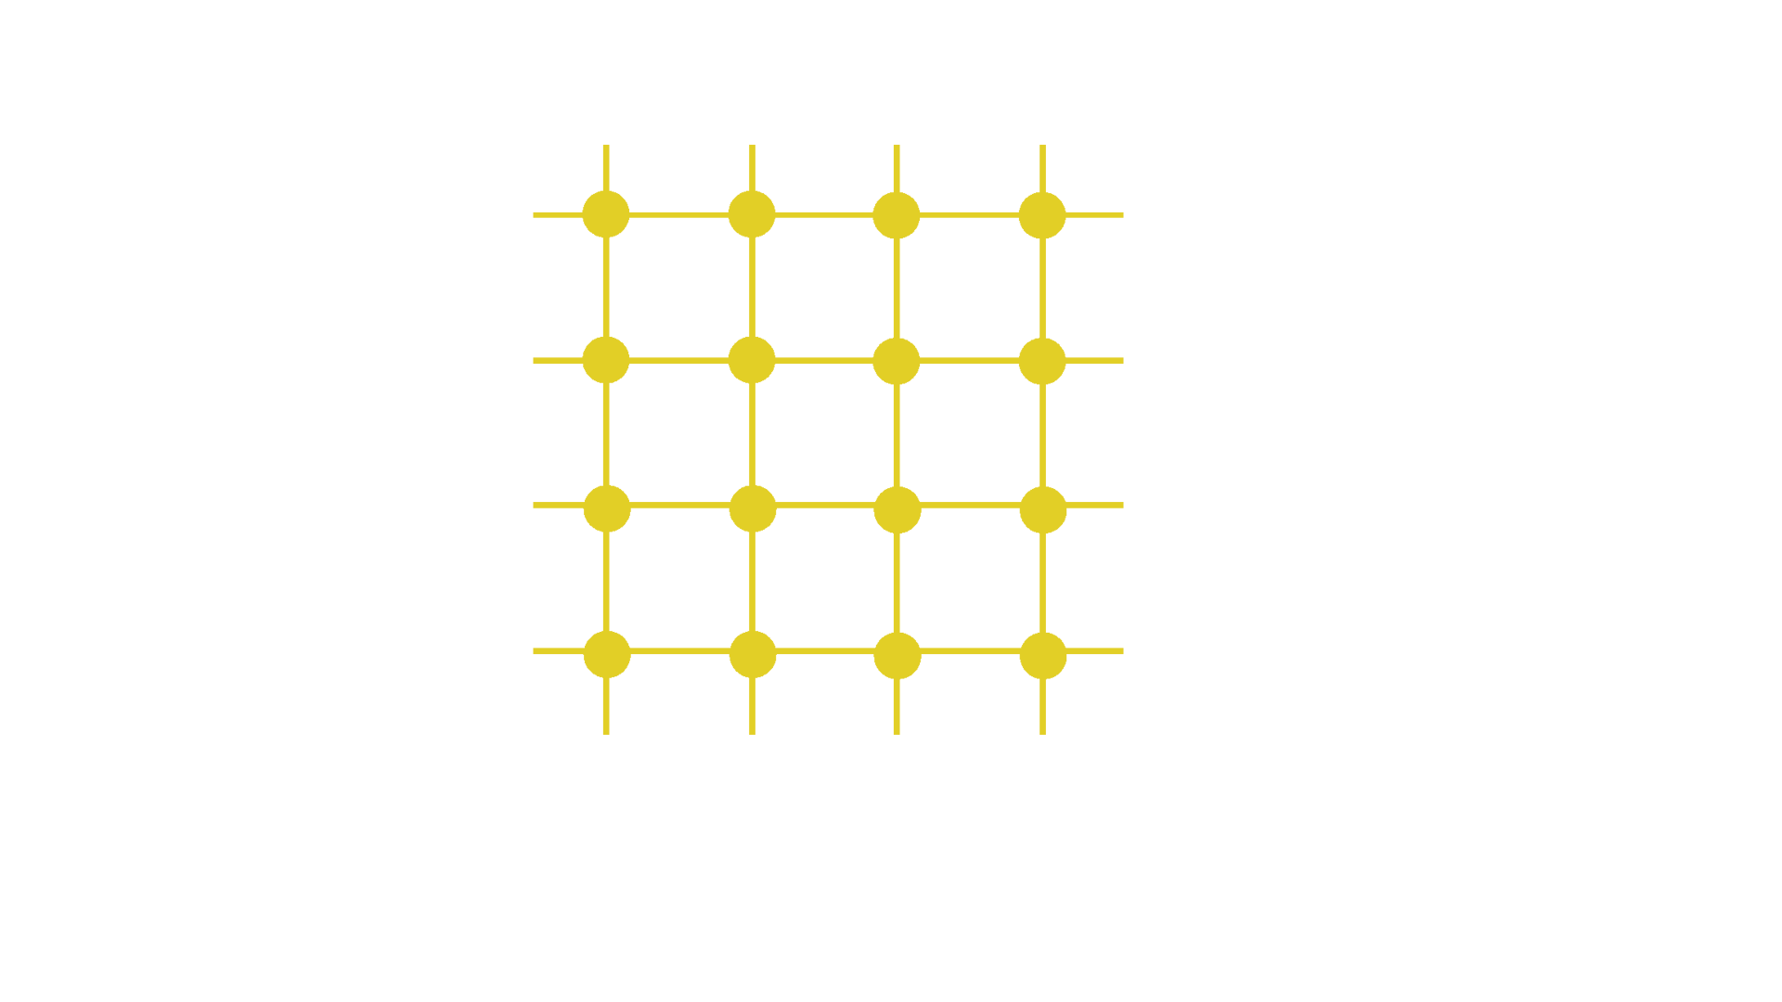
Lattices?
We assume that received message is not further than half of the minimal distance between points in the lattice from its origin.

Slide 4

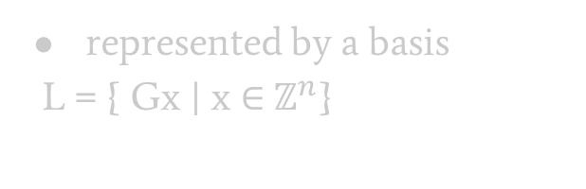
Lattices!
discrete
additive
subgroup of $R^{n}$
represented by a basis
$\text{L}\text{ = \{ }\text{Gx} \text{| }\text{x}\text{ ∈} ℤ^{n}\text{\}}$

Slide 5
What do we need to exchange messages?
Sender:
Compute the basis of the lattice we use (only once)
Encode a message as a lattice point
Transmit the message through the channel
Receiver:
Compute the basis of the lattice we use (only once)
Find the closest lattice point to the received one
Decode the original message

Slide 6
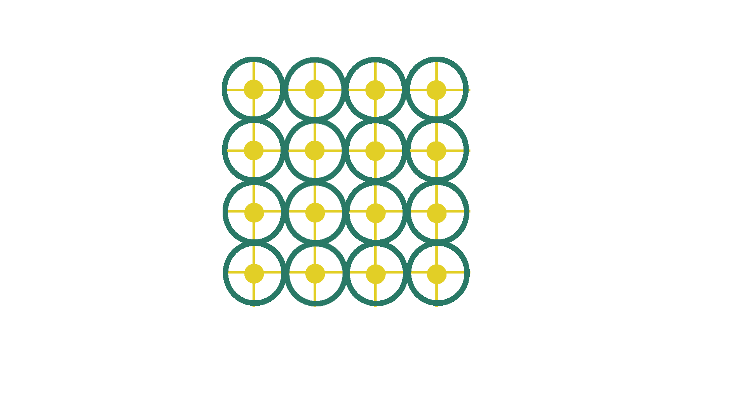

BDD, SVP and Minkowski’s bound.
Bounded Distance Decoding($L,α,t$):
Given a point in $t∈R^{n}$ find a lattice point closest to t.
Promise: The distance between t and L is not greater than $α∙λ_{1}\left(L\right)$.
In our setting: $α≤\frac{1}{2}$

Slide 7
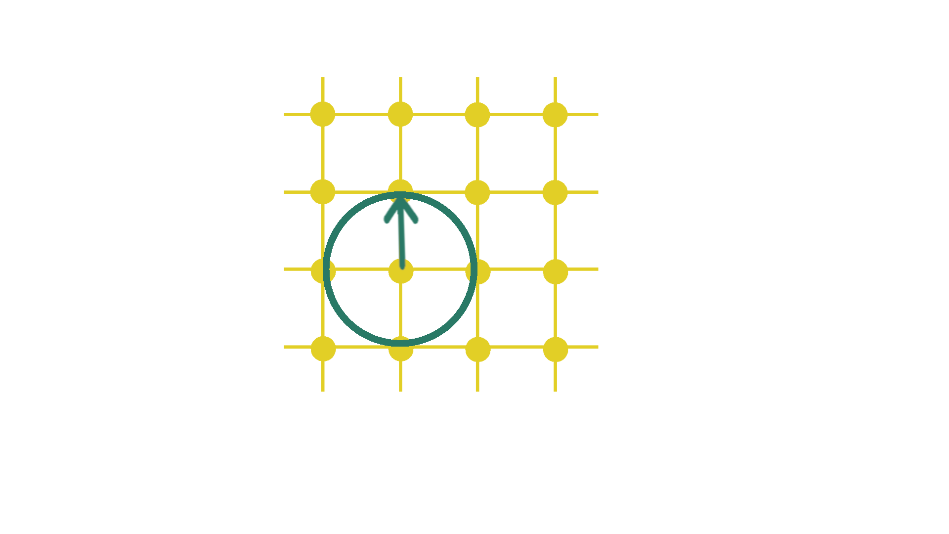

SVP, BDD and Minkowski’s bound.
Bounded Distance Decoding
Shortest Vector Problem($L$):
Given a lattice find its shortest vector.
Considered to be a hard problem for a random lattice of large dimension.

Slide 8
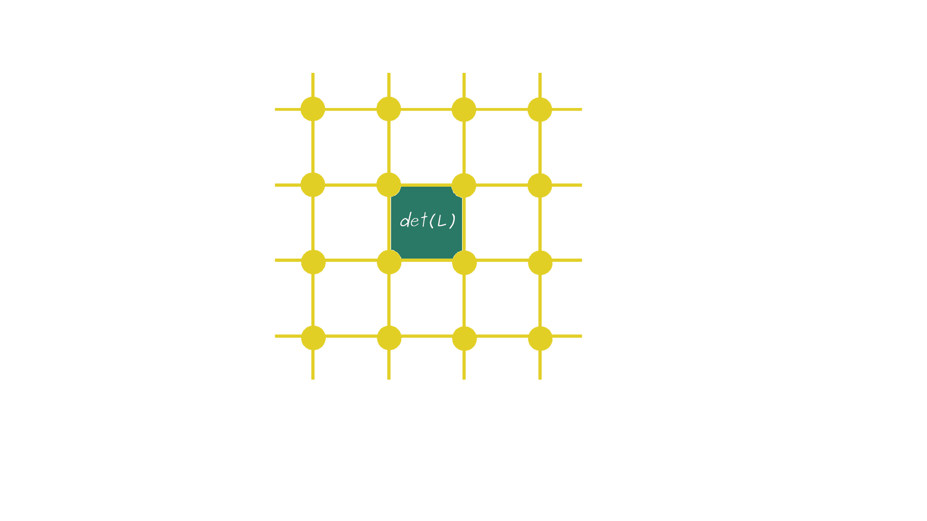

SVP, BDD and Minkowski’s bound.
Bounded Distance Decoding
Shortest Vector Problem
Minkowski’s bound:
$${\left|λ_{1}\left(L\right)\right|}_{1}≤n∙{det⁡(L)}^{1/n}$$
Normalized decoding radius:
$$\overline{r}= \frac{r}{{det⁡(L)}^{1/n}}$$

Slide 9
Main studies our work is based on.
[DP19] :
Polynomial Time Bounded Distance Decoding near Minkowski’s Bound in Discrete Logarithm Lattices
Léo Ducas and Cécile Pierrot
[LLXY17]:
On the closest vector problem for lattices constructed from polynomials and their cryptographic applications.
Zhe Li, San Ling, Chaoping Xing, and Sze Ling Yeo

Slide 10
Our Goals.
Consider two different families of lattices. Compare them to [DP19] concerning:
Decoding radius they offer
Implement the algorithms in SageMath to compare:
Speed of the basis computation
Speed of the decoding
Improve the security of [LLXY17]

Slide 11
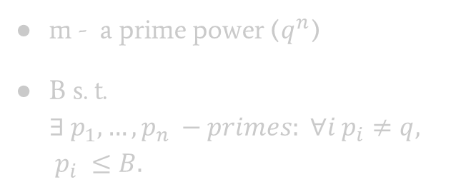


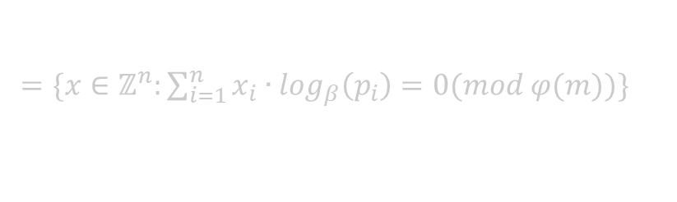
DP19 Lattice.
Definition:
Consider a group morphism:
$ψ: ℤ^{n} → {(ℤ/mℤ)}^{∗}$
$\left(x_{1}, …, x_{n}\right)↦\prod_{i=1}^{n}{{p_{i}}^{x_{i}} }(mod m)$\
$L=\ker\left(ψ\right)$
m - a prime power ($q^{n}$)
B s. t. $∃ p_{1}, …,p_{n} −primes: ∀i p_{i}≠q, p_{i} ≤B.$
This is parity check representation of $L$.
$$L=\left\{\text{x}\text{ ∈} ℤ^{n}\right|Hx ≡0 mod\}$$
$=\{x∈ℤ^{n}:\sum_{i=1}^{n}{{x_{i}∙log}_{β}\left(p_{i}\right)}=0(mod φ(m))\}$

Slide 12
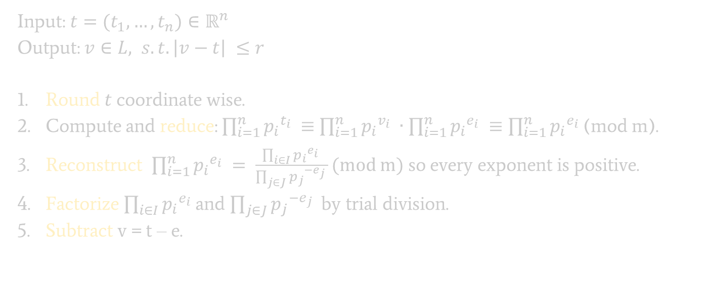
The Decoding Algorithm
Input: $t=(t_{1}, …, t_{n})∈ℝ^{n}$
Output: $v∈L, s.t. \left|v−t\right| ≤r$
Round $t$coordinate wise.
Compute and reduce: $\prod_{i=1}^{n}{{p_{i}}^{t_{i}} }$ $≡$ $\prod_{i=1}^{n}{{p_{i}}^{v_{i}} }∙\prod_{i=1}^{n}{{p_{i}}^{e_{i}} }≡\prod_{i=1}^{n}{{p_{i}}^{e_{i}} }$(mod m).
Reconstruct $\prod_{i=1}^{n}{{p_{i}}^{e_{i}} }= \frac{\prod_{i∈I}{{p_{i}}^{e_{i}} }}{\prod_{j∈J}{{p_{j}}^{{−e}_{j}} }}(mod m)$ so every exponent is positive.
Factorize $\prod_{i∈I}{{p_{i}}^{e_{i}} }$and $\prod_{j∈J}{{p_{j}}^{{−e}_{j}} }$by trial division.
Subtract v = t – e.

Slide 13
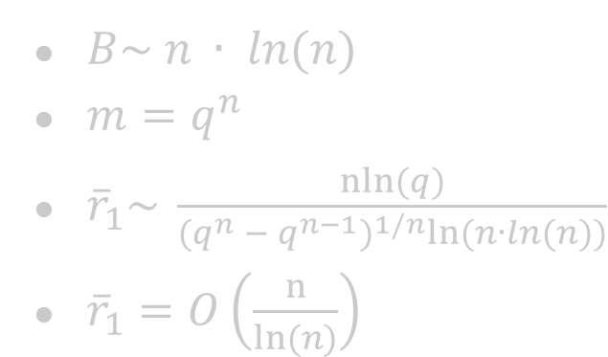
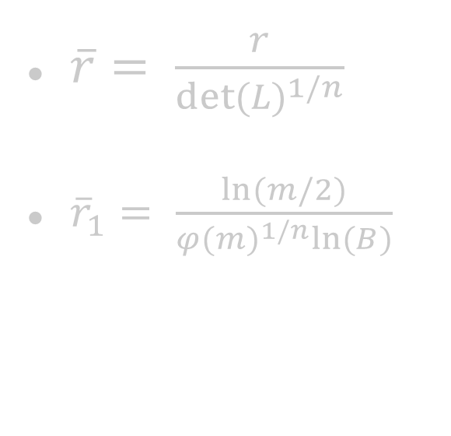
Normalized decoding radius.
$\overline{r}= \frac{r}{{det⁡(L)}^{1/n}}$
${\overline{r}}_{1}= \frac{ln⁡(m/2)}{{φ(m)}^{1/n}ln⁡(B)}$
$B\sim n ∙ ln(n)$
$m=q^{n}$
${\overline{r}}_{1}\sim \frac{nln⁡(q)}{{(q^{n} − q^{n−1})}^{1/n}ln⁡(n∙ln(n))}$
${\overline{r}}_{1}=O\left(\frac{n}{ln⁡(n)}\right)$

Slide 14
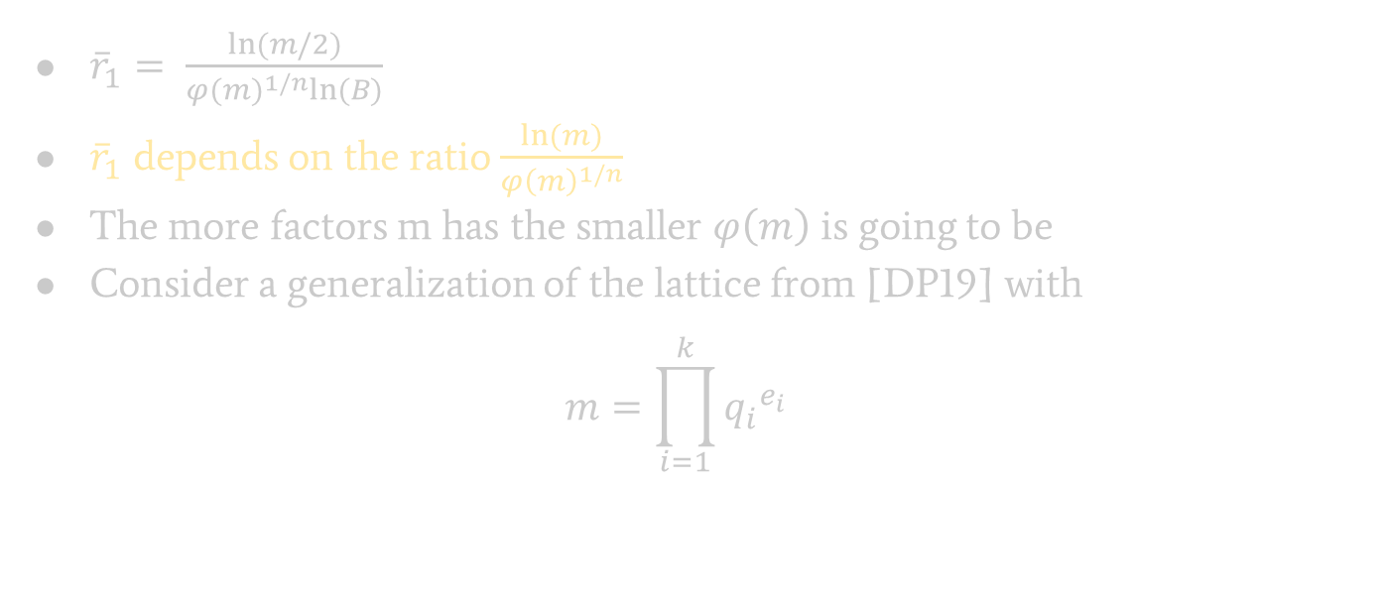
Generalization of DP19. Hopes.
${\overline{r}}_{1}= \frac{ln⁡(m/2)}{{φ(m)}^{1/n}ln⁡(B)}$
${\overline{r}}_{1}$ depends on the ratio $\frac{ln⁡(m)}{{φ\left(m\right)}^{1/n}}$
The more factors m has the smaller $φ\left(m\right)$ is going to be
Consider a generalization of the lattice from [DP19] with
$$m=\prod_{i=1}^{k}{{q_{i}}^{e_{i}}}$$

Slide 15

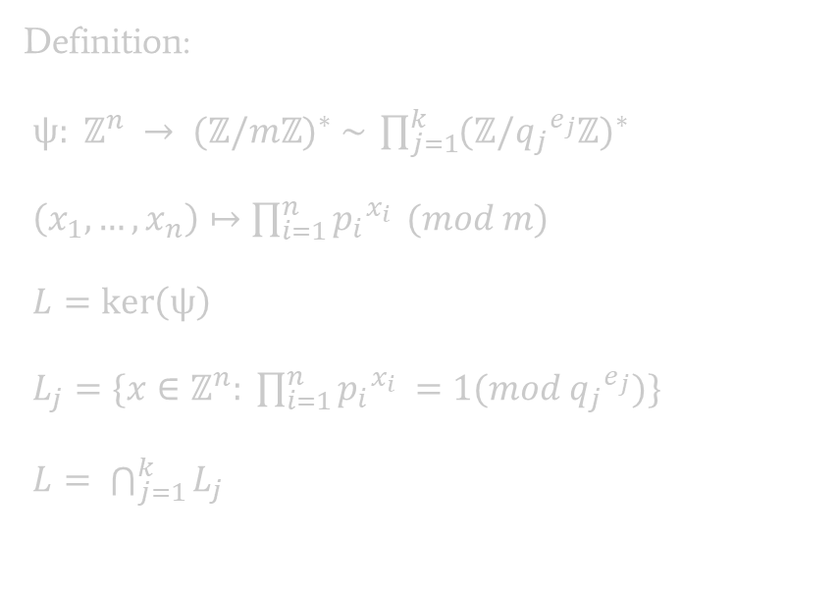
Discrete Logarithm Lattices.
Parameters:
n – lattice dimension
m = $\prod_{i=1}^{k}{{q_{i}}^{e_{i}}}$
B s. t. $∃ p_{1}, …,p_{n} −primes:$
$$∀i ∀j p_{i}≠q_{j}, p_{i} ≤B.$$
Definition:
$ψ: ℤ^{n} → {(ℤ/mℤ)}^{∗} \sim \prod_{j=1}^{k}{{(ℤ/{q_{j}}^{e_{j}}ℤ)}^{∗}}$
$\left(x_{1}, …, x_{n}\right)↦\prod_{i=1}^{n}{{p_{i}}^{x_{i}} }(mod m)$
$L=\ker\left(ψ\right)$
$L_{j}=\{x∈ℤ^{n}: \prod_{i=1}^{n}{{p_{i}}^{x_{i}} }=1(mod {q_{j}}^{e_{j}})\}$
$L= \bigcap_{j=1}^{k}{L_{j}}$

Slide 16

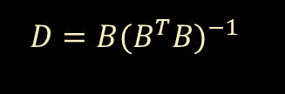
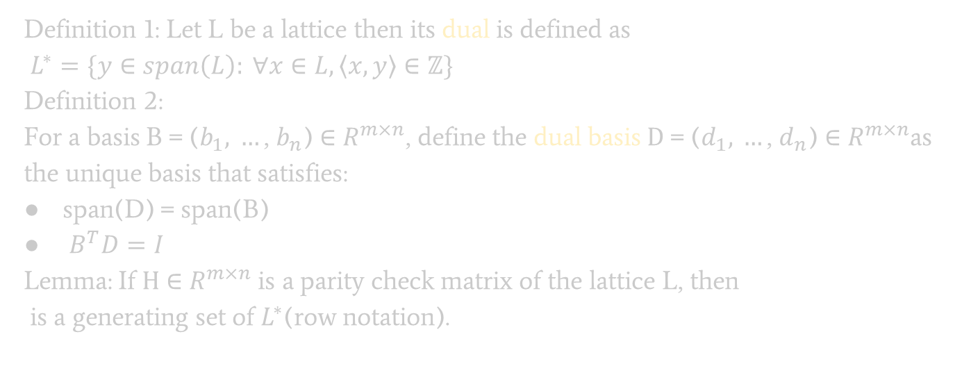
Dual lattices.
Definition 1: Let L be a lattice then its dual is defined as
$L^{∗}=\{y∈span\left(L\right): ∀x∈L, \left\langle x,y\right\rangle ∈ℤ\}$
Definition 2:
For a basis $\text{B} \text{= (}b_{1}\text{, }…\text{, }b_{n}\text{)} \text{∈} R^{m×n}$, define the dual basis $\text{D}\text{ = (}d_{1}\text{, }…\text{, }d_{n}\text{) ∈ }R^{m×n}$as the unique basis that satisfies:
span(D) = span(B)
$B^{T}D=I$
Lemma: If $\text{H}\text{ ∈ }R^{m×n}$ is a parity check matrix of the lattice L, then
is a generating set of $L^{∗}$(row notation).
$D=B{(B^{T}B)}^{−1}$
$$\left({\frac{H}{q} \atop I_{n}}\right)$$

Slide 17


Complexity and best parameters.
$$L_{j}=\left\{x∈ℤ^{n}:\sum_{i=1}^{k}{{x_{i}∙log}_{β_{j}}\left(p_{i}\right)}=0\left(mod φ\left({q_{j}}^{e_{j}}\right)\right)\right\}$$
Get dual bases for every $L_{j}$
Concatenate them
Eliminate linear dependencies
Transform into the primal basis
$n∙k$ discrete logs mod $φ\left({q_{j}}^{e_{j}}\right)$
O(1)
O(poly)
O(poly)

Slide 18
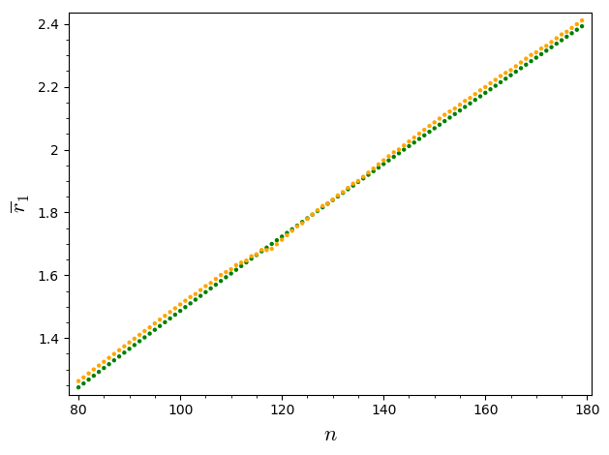
Was it all worth it? Hopes shattered.
DP19
Generalization

Slide 19
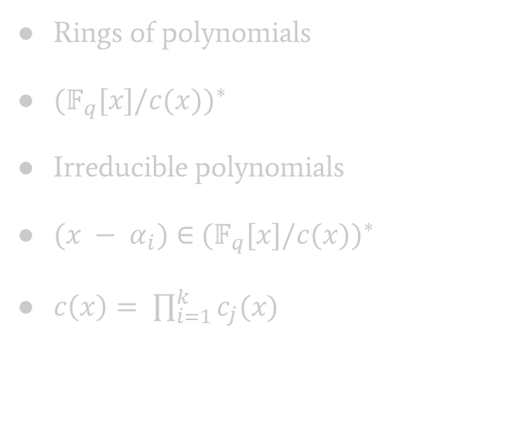

Polynomial Lattices. Intuition and parameters.
Rings of integers
${(ℤ/mℤ)}^{∗}$
Primes
$p_{i}∈$ ${(ℤ/mℤ)}^{∗}$
$m= \prod_{i=1}^{k}{{q_{i}}^{e_{i}}}$
Rings of polynomials
${(𝔽_{q}^{}[x]/c(x))}^{∗}$
Irreducible polynomials
$(x − α_{i})∈$ ${(𝔽_{q}^{}[x]/c(x))}^{∗}$
$c\left(x\right)= \prod_{i=1}^{k}{c_{j}(x)}$

Slide 20
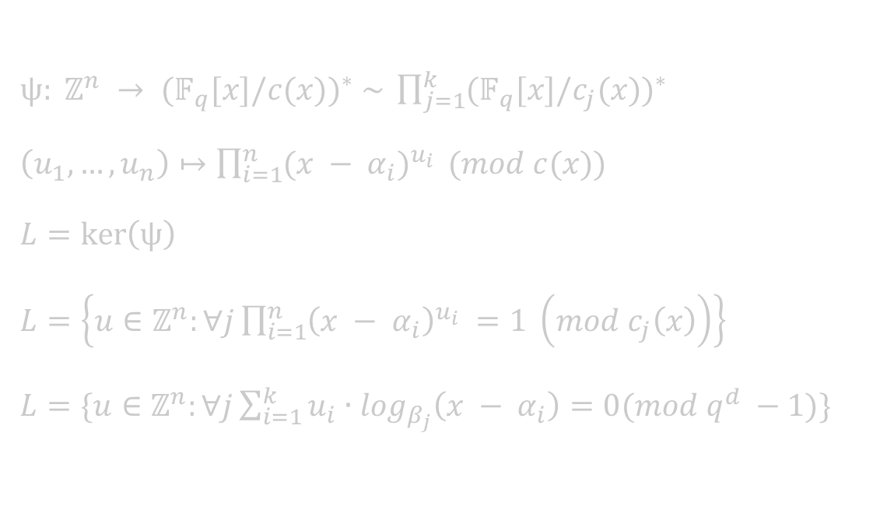
Formal definition.
$ψ: ℤ^{n} → {(𝔽_{q}^{}[x]/c(x))}^{∗} \sim \prod_{j=1}^{k}{{(𝔽_{q}^{}[x]/c_{j}(x))}^{∗}}$
$\left(u_{1}, …, u_{n}\right)↦\prod_{i=1}^{n}{{(x − α_{i})}^{u_{i}} }(mod c(x))\text{\backslash }$
$L=\ker\left(ψ\right)$
$L=\left\{u∈ℤ^{n}:∀j\prod_{i=1}^{n}{{\left(x − α_{i}\right)}^{u_{i}} }=1 \left(mod c_{j}\left(x\right)\right)\right\}$
$L=\{u∈ℤ^{n}:∀j\sum_{i=1}^{k}{{u_{i}∙log}_{β_{j}}\left(x − α_{i}\right)}=0(mod q^{d} −1)\}$

Slide 21
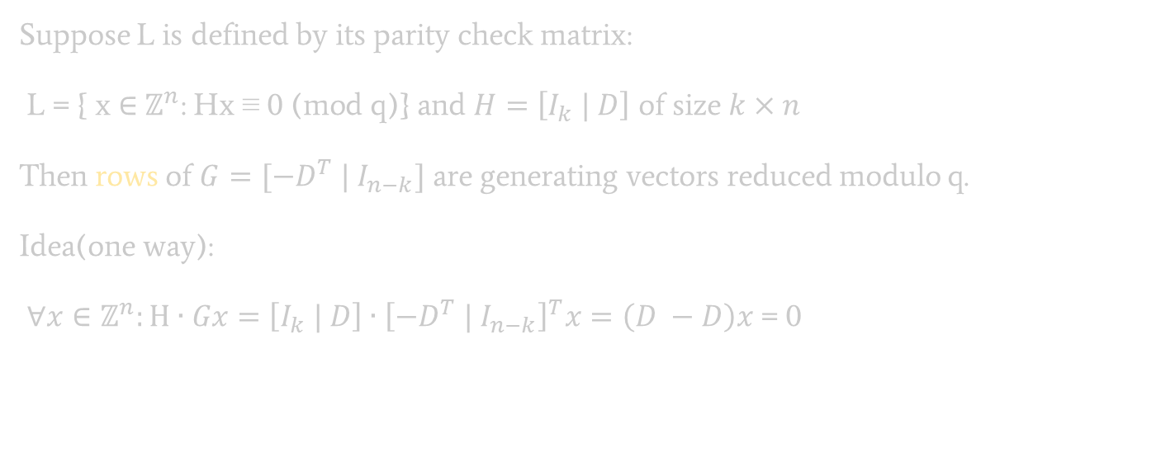
Parity check matrix of a q-ary lattice.
Suppose L is defined by its parity check matrix:
$\text{L}\text{ =}\text{ \{ }\text{x} \text{∈} ℤ^{n}\text{:} \text{Hx}\text{ ≡ 0 (}\text{mod} \text{q}\text{)\}}$ and $H=\left[I_{k} | D\right]$ of size $k×n$
Then rows of $G=[−D^{T} | I_{n−k}]$ are generating vectors reduced modulo q.
Idea(one way):
$∀x∈ℤ^{n}:H∙Gx=\left[I_{k} | D\right]∙{\left[−D^{T} | I_{n−k}\right]}^{T}x=\left(D −D\right)x$ = 0

Slide 22
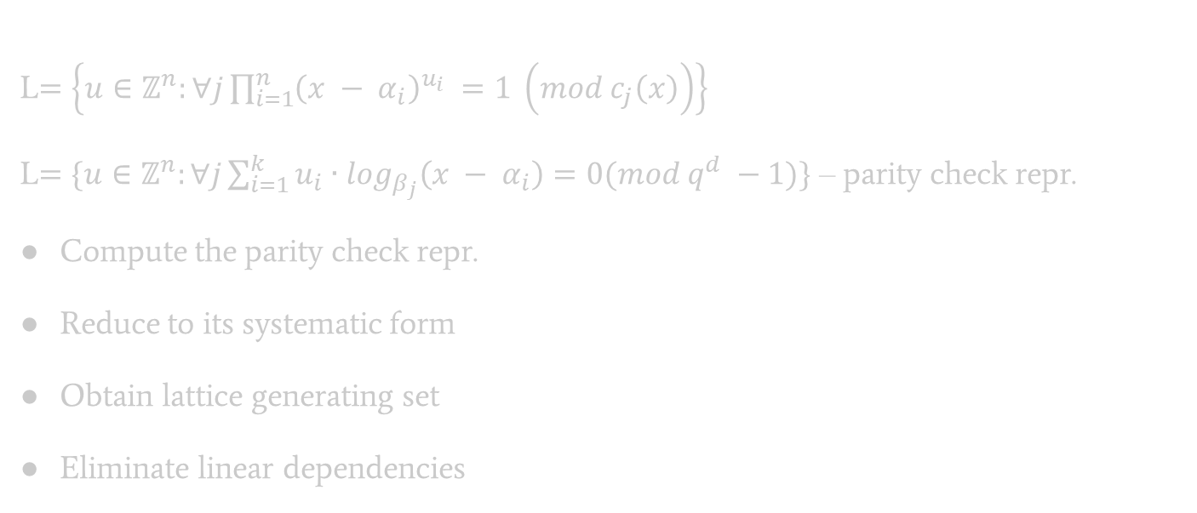

Basis computation algorithm. Complexity.
L$=\left\{u∈ℤ^{n}:∀j\prod_{i=1}^{n}{{\left(x − α_{i}\right)}^{u_{i}} }=1 \left(mod c_{j}\left(x\right)\right)\right\}$
L$=\{u∈ℤ^{n}:∀j\sum_{i=1}^{k}{{u_{i}∙log}_{β_{j}}\left(x − α_{i}\right)}=0(mod q^{d} −1)\}$ – parity check repr.
Compute the parity check repr.
Reduce to its systematic form
Obtain lattice generating set
Eliminate linear dependencies
DL modulo $q^{d} −1$
Gaussian elimination
O(1)
Hermit normal form(or LLL)

Slide 23
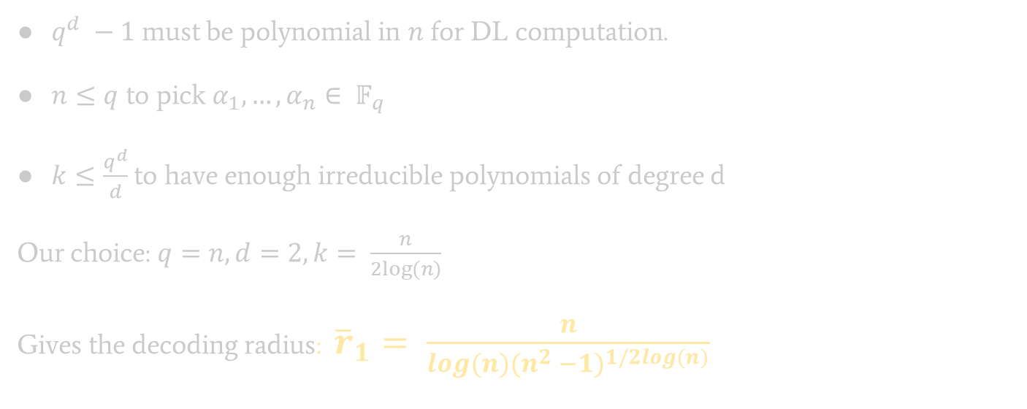
Complexity and parameters.
$q^{d} −1$ must be polynomial in $n$ for DL computation.
$n≤q$ to pick $α_{1}, …, α_{n}∈ 𝔽_{q}^{}$
$k≤\frac{q^{d}}{d}$ to have enough irreducible polynomials of degree d
Our choice: $q=n, d=2, k= \frac{n}{2log⁡(n)}$
Gives the decoding radius: ${\overline{r}}_{1}= \frac{n}{log(n){(n^{2} −1)}^{1/2log(n)}}$

Slide 24
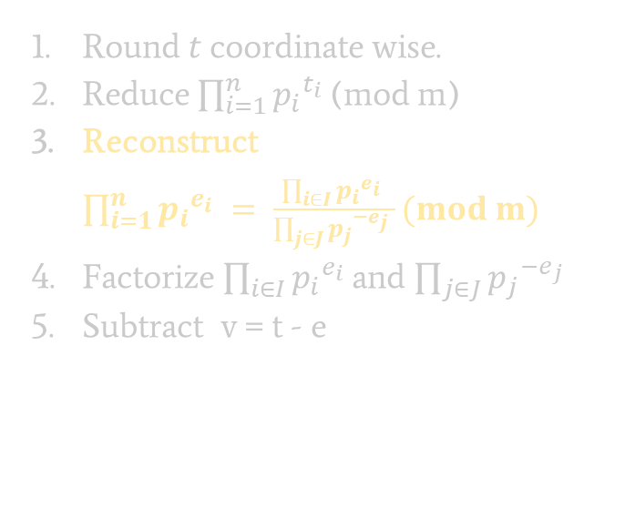
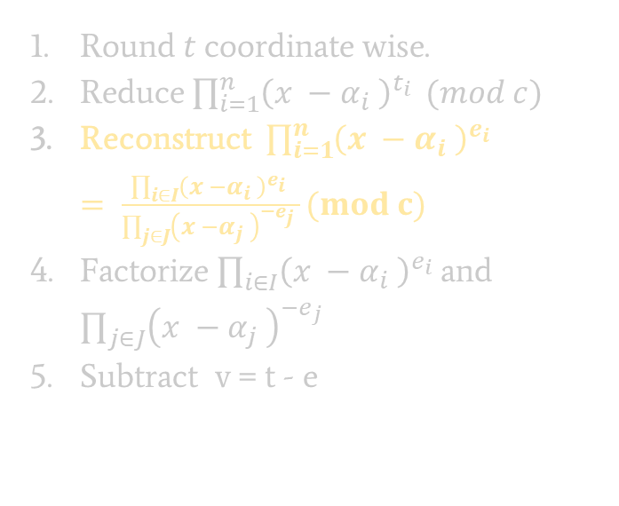
Modifying the decoding algorithm.
Round $t$coordinate wise.
Reduce $\prod_{i=1}^{n}{{p_{i}}^{t_{i}} }$(mod m)
Reconstruct $\prod_{i=1}^{n}{{p_{i}}^{e_{i}} }= \frac{\prod_{i∈I}{{p_{i}}^{e_{i}} }}{\prod_{j∈J}{{p_{j}}^{{−e}_{j}} }}(mod m)$
Factorize $\prod_{i∈I}{{p_{i}}^{e_{i}} }$and $\prod_{j∈J}{{p_{j}}^{{−e}_{j}} }$
Subtract v = t - e
Round $t$coordinate wise.
Reduce $\prod_{i=1}^{n}{{\left(x −α_{i} \right)}^{t_{i}} }(mod c)$
Reconstruct $\prod_{i=1}^{n}{{\left(x −α_{i} \right)}^{e_{i}} }= \frac{\prod_{i∈I}{{\left(x −α_{i} \right)}^{e_{i}} }}{\prod_{j∈J}{{\left(x −α_{j} \right)}^{{−e}_{j}} }}(mod c)$
Factorize $\prod_{i∈I}{{\left(x −α_{i} \right)}^{e_{i}} }$and $\prod_{j∈J}{{\left(x −α_{j} \right)}^{{−e}_{j}} }$
Subtract v = t - e

Slide 25
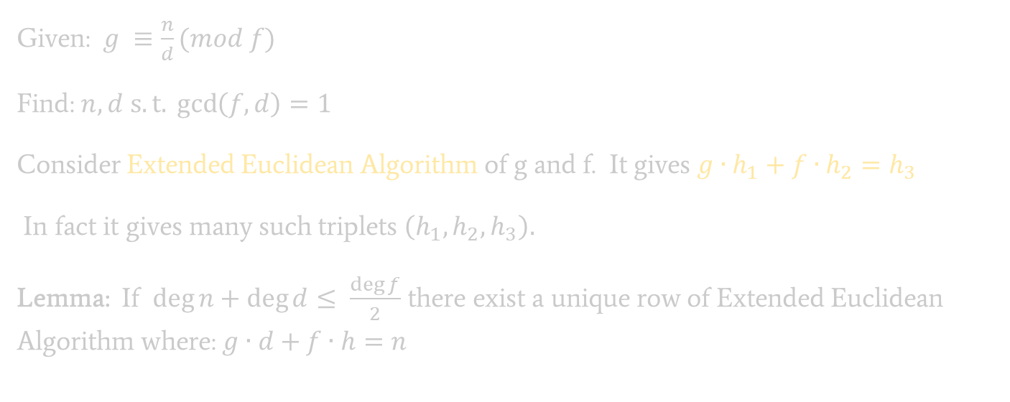
Rational Function Reconstruction. An Insight.
Given: $g ≡\frac{n}{d}(mod f)$
Find: $n,d$ $s.t.\gcd\left(f,d\right)=1$
Consider Extended Euclidean Algorithm of g and f. It gives $g∙h_{1}+f∙h_{2}=h_{3}$
In fact it gives many such triplets $\left(h_{1},h_{2}, h_{3}\right).$
Lemma: If $\deg{n}+\deg{d}≤ \frac{\deg{f}}{2}$ there exist a unique row of Extended Euclidean Algorithm where: $g∙d+f∙h=n$

Slide 26
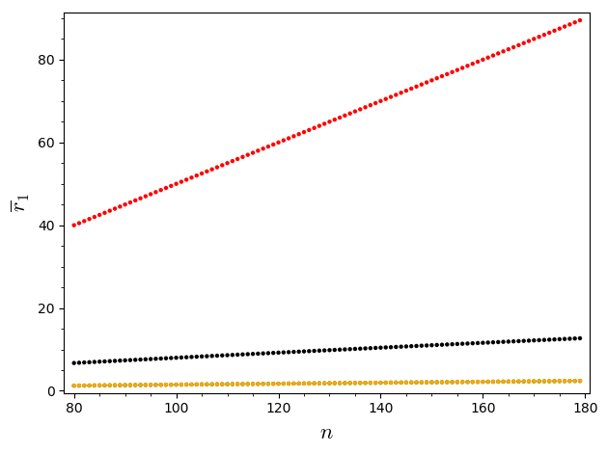
Decoding radius comparison.
DP19
Generalization
26

Slide 27
SageMath Implementation Runtimes.
Dimension: | 100 | 200 | 300 | 400
Integers k=5 | 50.9 | 3035.1(50.5m)
Step 4* | 47.5 | 3013.4
Integers k=20 | 13.6 | 2198.1(36.6m)
Step 4* | 10 | 2177.01
Polynomials | 6.7 | 28.3 | 63.9 | 122.03
Integers k=20 | 0.04 | 0.05
Polynomials | 0.009 | 0.03 | 0.03 | 0.05
* Step 4 refers to the transformation of dual basis to the primal basis.

Slide 28
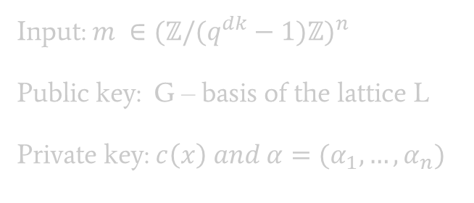
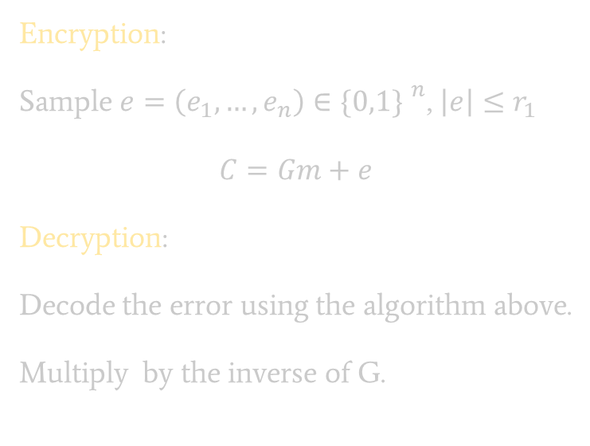
LLXY17 Encryption scheme(Simplified).
Input: $m ∈{(ℤ/(q^{dk}−1)ℤ)}^{n}$
Public key: G – basis of the lattice L
Private key: $c\left(x\right) and α=(α_{1}, …, α_{n})$
Encryption:
Sample $e=\left(e_{1}, …, e_{n}\right)∈{\{0,1\} }^{n}$, $\left|e\right|≤r_{1}$
$$C=Gm+e$$
Decryption:
Decode the error using the algorithm above.
Multiply by the inverse of G.
Needs encoding to provide semantic security!

Slide 29
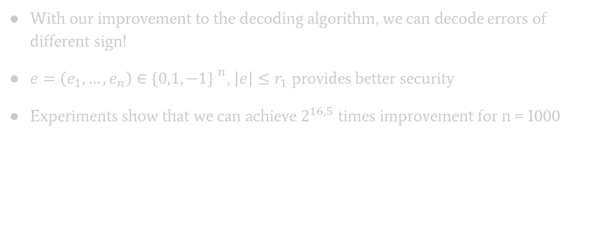
Improvements.(WIP)
With our improvement to the decoding algorithm, we can decode errors of different sign!
$e=\left(e_{1}, …, e_{n}\right)∈{\{0,1, −1\} }^{n}$, $\left|e\right|≤r_{1}$ provides better security
Experiments show that we can achieve $2^{16,5}$ times improvement for n = 1000

Slide 30

Thank you!

