Slide 1
Comparing Lattice Families for Bounded Distance Decoding near Minkowski’s Bound.
By Oleksandra Lapiha under supervision of Léo Ducas

Slide 2

Noisy channel communication.

Slide 3
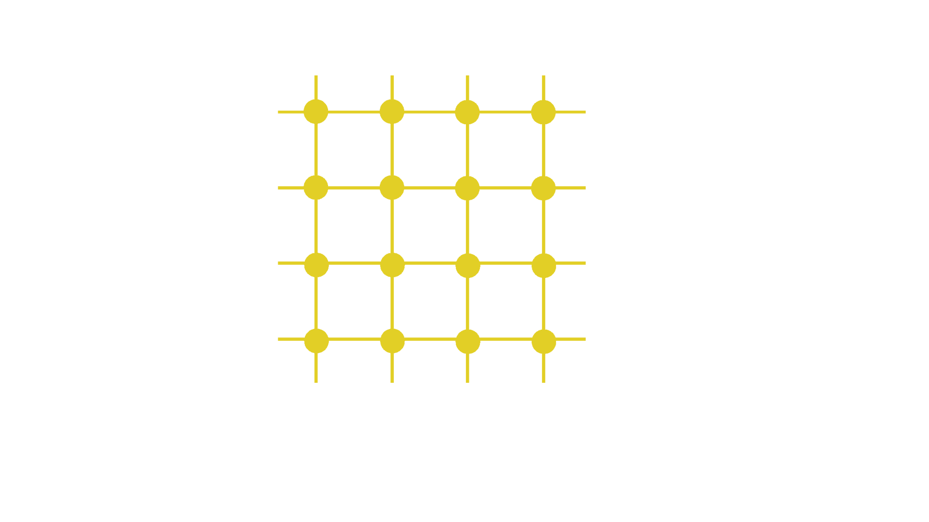
Lattices?
We assume that received message is not further than half of the minimal distance between points in the lattice from its origin.

Slide 4

Lattices!
discrete
additive
subgroup of $R^{n}$
represented by a basis
$\text{L}\text{ = \{ }\text{Gx}\text{ | }\text{x}\text{ ∈} ℤ^{n}\text{\}}$

Slide 5
What do we need to exchange messages?
Sender:
Compute the basis of the lattice we use (only once)
Encode a message as a lattice point
Transmit the message through the channel
Receiver:
Compute the basis of the lattice we use (only once)
Find the closest lattice point to the received one
Decode the original message

Slide 6
How to compare such algorithms?

Slide 7
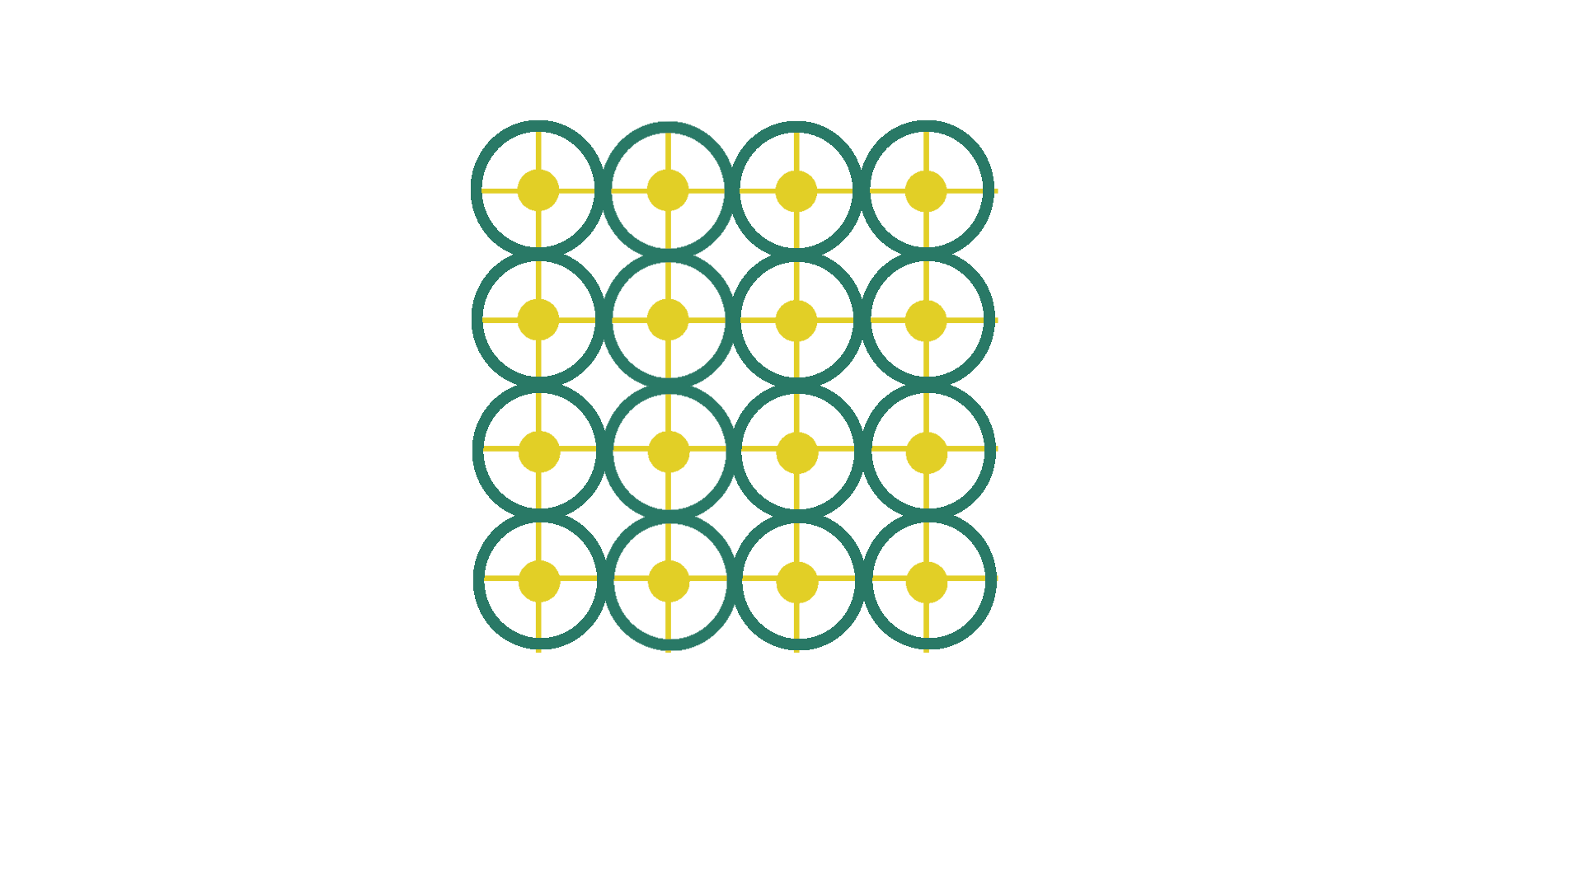

BDD, SVP and Minkowski’s bound.
Bounded Distance Decoding($L,α,t$):
Given a point in $t∈R^{n}$ find a lattice point closest to t.
Promise: The distance between t and L is not greater than $α∙λ_{1}\left(L\right)$.
In our setting: $α≤\frac{1}{2}$

Slide 8
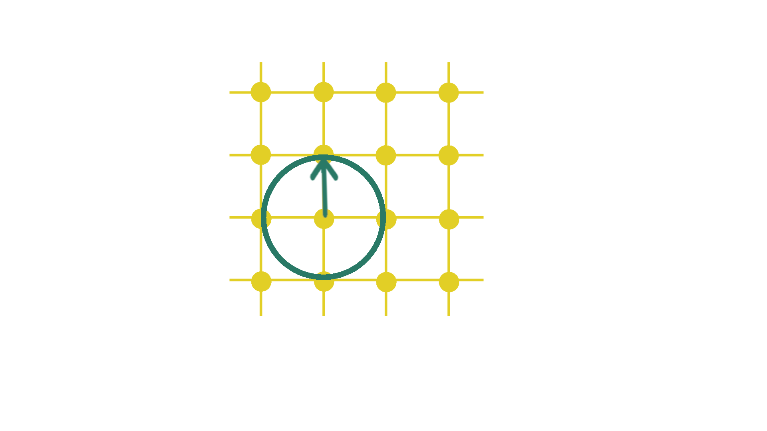

SVP, BDD and Minkowski’s bound.
Bounded Distance Decoding
Shortest Vector Problem($L$):
Given a lattice find its shortest vector.
Considered to be a hard problem for a random lattice of large dimension.

Slide 9
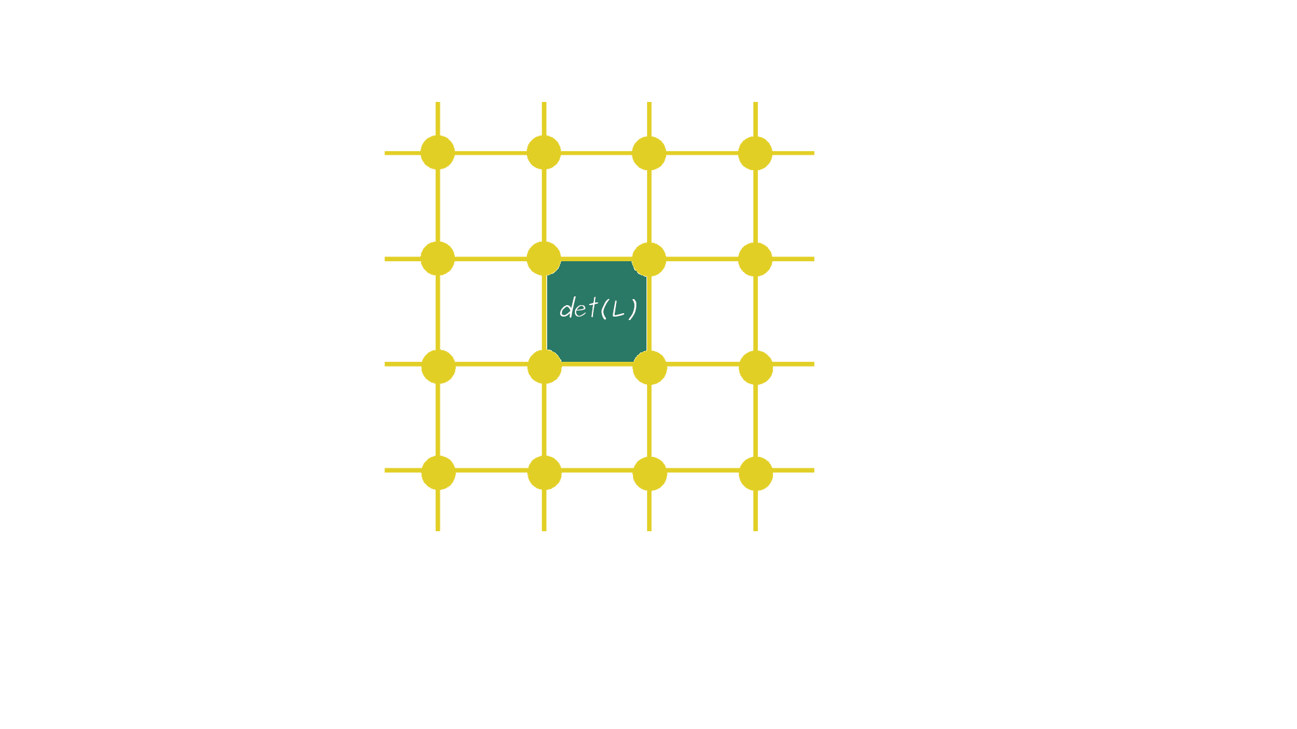

SVP, BDD and Minkowski’s bound.
Bounded Distance Decoding
Shortest Vector Problem
Minkowski’s bound:
$${\left|λ_{1}\left(L\right)\right|}_{1}≤ {\frac{n}{e}∙{\det\left(L\right)}^{\frac{1}{n}}}^{∗}$$
Normalized decoding radius:
$$\overline{r}= \frac{r}{{det⁡(L)}^{1/n}}$$

Slide 10
Main studies our work is based on.
[DP19] :
Polynomial Time Bounded Distance Decoding near Minkowski’s Bound in Discrete Logarithm Lattices
Léo Ducas and Cécile Pierrot
[LLXY17]:
On the closest vector problem for lattices constructed from polynomials and their cryptographic applications.
Zhe Li, San Ling, Chaoping Xing, and Sze Ling Yeo

Slide 11
Our Goals.
Consider two different families of lattices. Compare them to [DP19] concerning:
Decoding radius they offer
Implement the algorithms in SageMath to compare:
Speed of the basis computation
Speed of the decoding
Cryptanalysis of [LLXY17].

Slide 12
The Discrete Logarithm Lattices.

Slide 13

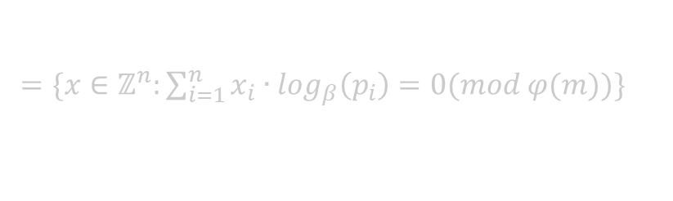

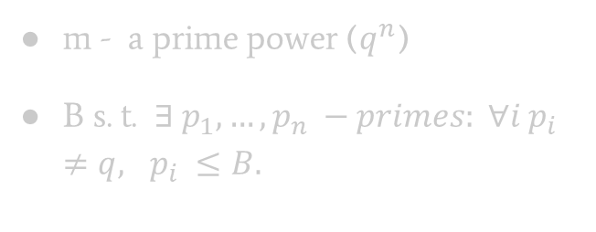
DP19 Lattice.
Definition:
Consider a group morphism:
$ψ: ℤ^{n} → {(ℤ/mℤ)}^{∗}$
$\left(x_{1}, …, x_{n}\right)↦\prod_{i=1}^{n}{{p_{i}}^{x_{i}} }(mod m)$\
$L=\ker\left(ψ\right)$
m - a prime power ($q^{n}$)
B s. t. $∃ p_{1}, …,p_{n} −primes: ∀i p_{i}≠q, p_{i} ≤B.$
This is a parity check representation of $L$.
$$L=\left\{\text{x}\text{ ∈} ℤ^{n}\right|Hx ≡0 mod q\}$$
$=\{x∈ℤ^{n}:\sum_{i=1}^{n}{{x_{i}∙log}_{β}\left(p_{i}\right)}=0(mod φ(m))\}$

Slide 14
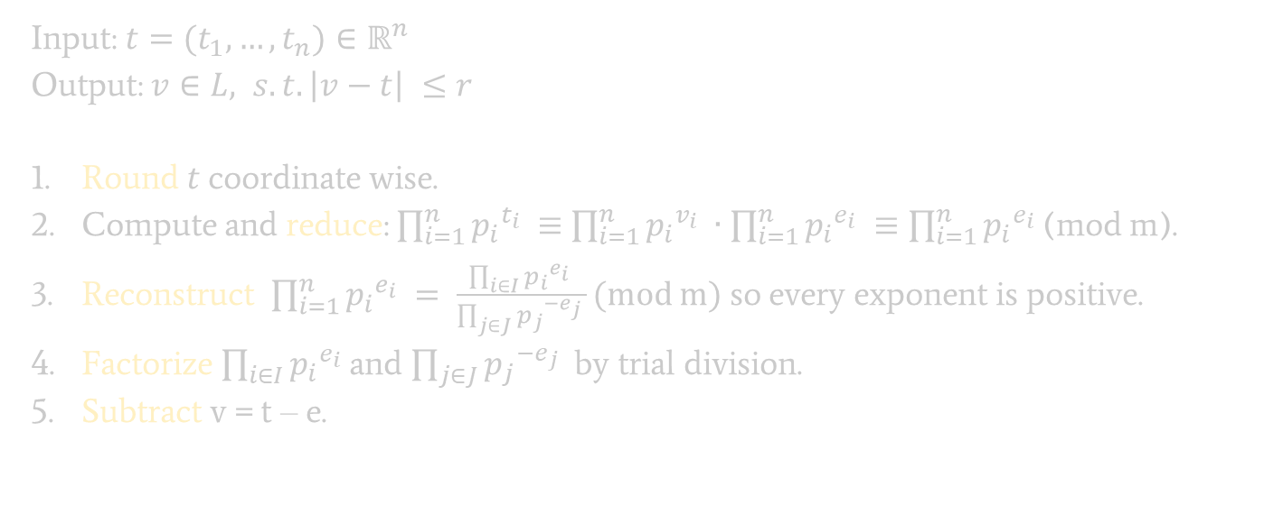
The Decoding Algorithm
Input: $t=(t_{1}, …, t_{n})∈ℝ^{n}$
Output: $v∈L, s.t. \left|v−t\right| ≤r$
Round $t$coordinate wise.
Compute and reduce: $\prod_{i=1}^{n}{{p_{i}}^{t_{i}} }$ $≡$ $\prod_{i=1}^{n}{{p_{i}}^{v_{i}} }∙\prod_{i=1}^{n}{{p_{i}}^{e_{i}} }≡\prod_{i=1}^{n}{{p_{i}}^{e_{i}} }$(mod m).
Reconstruct $\prod_{i=1}^{n}{{p_{i}}^{e_{i}} }= \frac{\prod_{i∈I}{{p_{i}}^{e_{i}} }}{\prod_{j∈J}{{p_{j}}^{{−e}_{j}} }}(mod m)$ so every exponent is positive.
Factorize $\prod_{i∈I}{{p_{i}}^{e_{i}} }$and $\prod_{j∈J}{{p_{j}}^{{−e}_{j}} }$by trial division.
Subtract v = t – e.

Slide 15
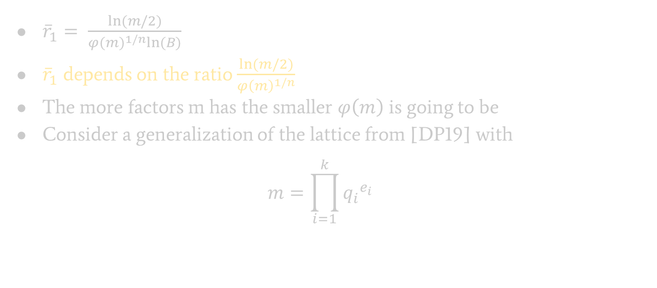
Generalization of DP19. Hopes.
${\overline{r}}_{1}= \frac{ln⁡(m/2)}{{φ(m)}^{1/n}ln⁡(B)}$
${\overline{r}}_{1}$ depends on the ratio $\frac{ln⁡(m/2)}{{φ\left(m\right)}^{1/n}}$
The more factors m has the smaller $φ\left(m\right)$ is going to be
Consider a generalization of the lattice from [DP19] with
$$m=\prod_{i=1}^{k}{{q_{i}}^{e_{i}}}$$

Slide 16

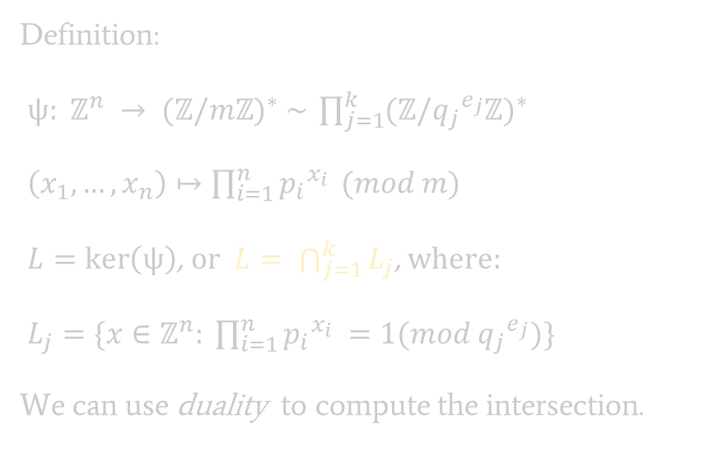
Discrete Logarithm Lattices.
Parameters:
n – lattice dimension
m = $\prod_{i=1}^{k}{{q_{i}}^{e_{i}}}$
B s. t. $∃ p_{1}, …,p_{n} −primes:$
$$∀i ∀j p_{i}≠q_{j}, p_{i} ≤B.$$
Definition:
$ψ: ℤ^{n} → {(ℤ/mℤ)}^{∗} \sim \prod_{j=1}^{k}{{(ℤ/{q_{j}}^{e_{j}}ℤ)}^{∗}}$
$\left(x_{1}, …, x_{n}\right)↦\prod_{i=1}^{n}{{p_{i}}^{x_{i}} }(mod m)$
$L=\ker\left(ψ\right)$, or $L= \bigcap_{j=1}^{k}{L_{j}}$, where:
$L_{j}=\{x∈ℤ^{n}: \prod_{i=1}^{n}{{p_{i}}^{x_{i}} }=1(mod {q_{j}}^{e_{j}})\}$
We can use duality to compute the intersection.

Slide 17
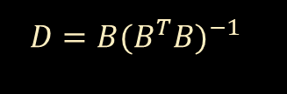
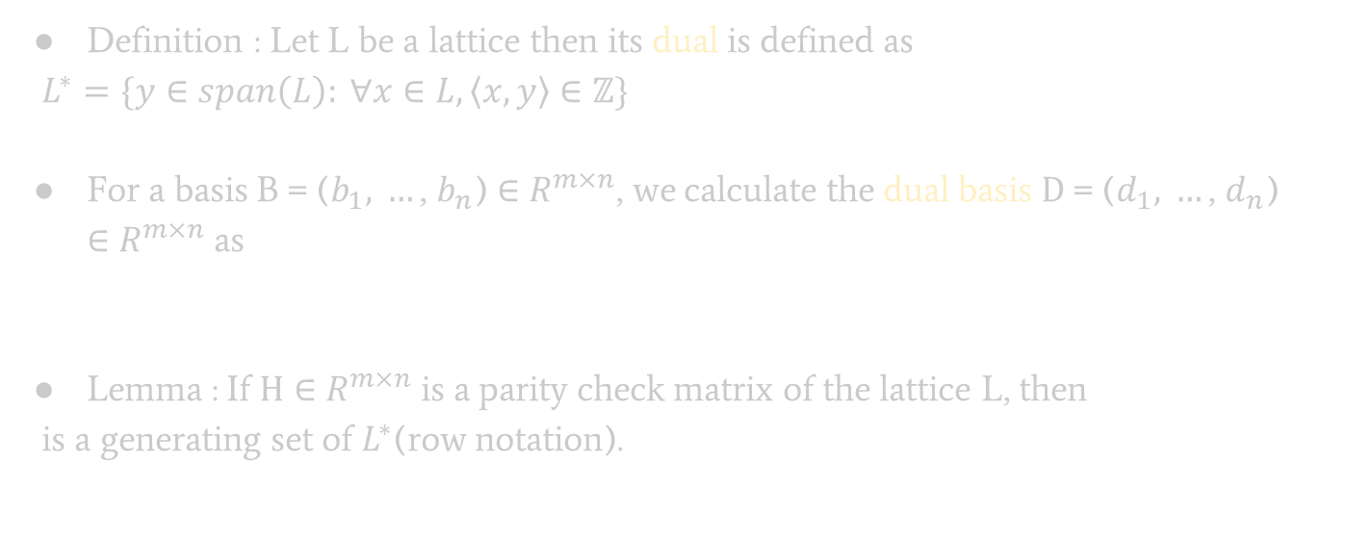

Dual lattices.
Definition : Let L be a lattice then its dual is defined as
$L^{∗}=\{y∈span\left(L\right): ∀x∈L, \left\langle x,y\right\rangle ∈ℤ\}$
For a basis $\text{B} \text{= (}b_{1}\text{, }…\text{, }b_{n}\text{)} \text{∈} R^{m×n}$, we calculate the dual basis $\text{D}\text{ = (}d_{1}\text{, }…\text{, }d_{n}\text{) ∈ }R^{m×n}$ as
Lemma : If $\text{H}\text{ ∈ }R^{m×n}$ is a parity check matrix of the lattice L, then
is a generating set of $L^{∗}$(row notation).
$D=B{(B^{T}B)}^{−1}$
$$\left({\frac{H}{q} \atop I_{n}}\right)$$

Slide 18


Complexity and best parameters.
$$L_{j}=\left\{x∈ℤ^{n}:\sum_{i=1}^{k}{{x_{i}∙log}_{β_{j}}\left(p_{i}\right)}=0\left(mod φ\left({q_{j}}^{e_{j}}\right)\right)\right\}$$
Get dual bases for every $L_{j}$
Concatenate them
Eliminate linear dependencies
Transform into the primal basis
$n∙k$ discrete logs mod $φ\left({q_{j}}^{e_{j}}\right)$
O(1)
O(poly)
O(poly)

Slide 19
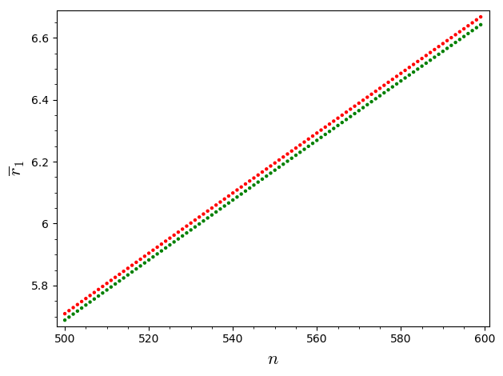
Was it all worth it? Hopes shattered.
DP19
Generalization

Slide 20
The Polynomial Lattices.

Slide 21

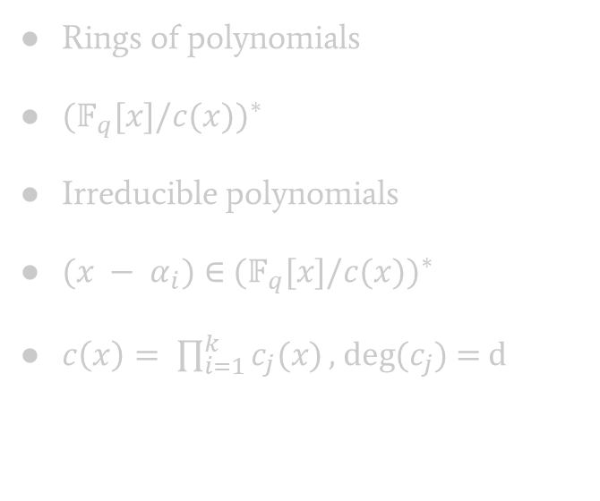
Polynomial Lattices. Intuition and parameters.
Rings of integers
${(ℤ/mℤ)}^{∗}$
Primes
$p_{i}∈$ ${(ℤ/mℤ)}^{∗}$
$m= \prod_{i=1}^{k}{{q_{i}}^{e_{i}}}$
Rings of polynomials
${(𝔽_{q}^{}[x]/c(x))}^{∗}$
Irreducible polynomials
$(x − α_{i})∈$ ${(𝔽_{q}^{}[x]/c(x))}^{∗}$
$c\left(x\right)= \prod_{i=1}^{k}{c_{j}(x)}\text{, }\text{deg}\text{(}c_{j}\text{) = }\text{d}$

Slide 22
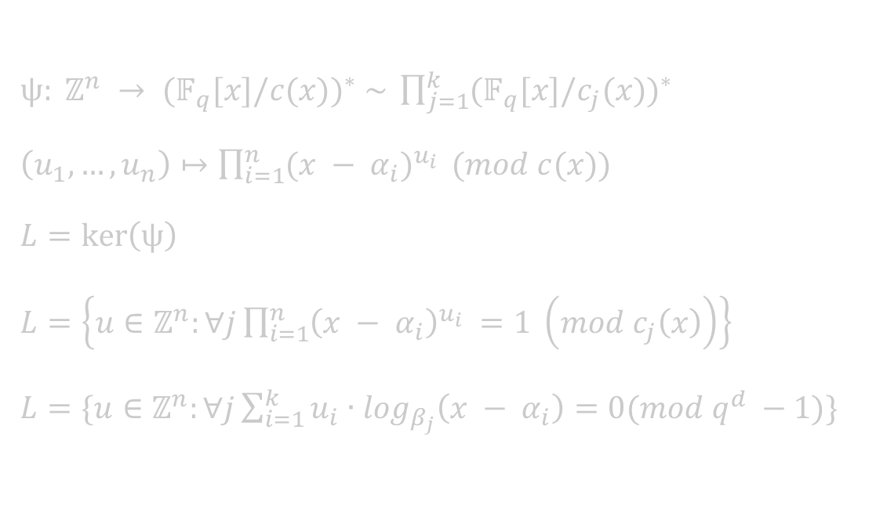
Formal definition.
$ψ: ℤ^{n} → {(𝔽_{q}^{}[x]/c(x))}^{∗} \sim \prod_{j=1}^{k}{{(𝔽_{q}^{}[x]/c_{j}(x))}^{∗}}$
$\left(u_{1}, …, u_{n}\right)↦\prod_{i=1}^{n}{{(x − α_{i})}^{u_{i}} }(mod c(x))\text{\backslash }$
$L=\ker\left(ψ\right)$
$L=\left\{u∈ℤ^{n}:∀j\prod_{i=1}^{n}{{\left(x − α_{i}\right)}^{u_{i}} }=1 \left(mod c_{j}\left(x\right)\right)\right\}$
$L=\{u∈ℤ^{n}:∀j\sum_{i=1}^{k}{{u_{i}∙log}_{β_{j}}\left(x − α_{i}\right)}=0(mod q^{d} −1)\}$

Slide 23
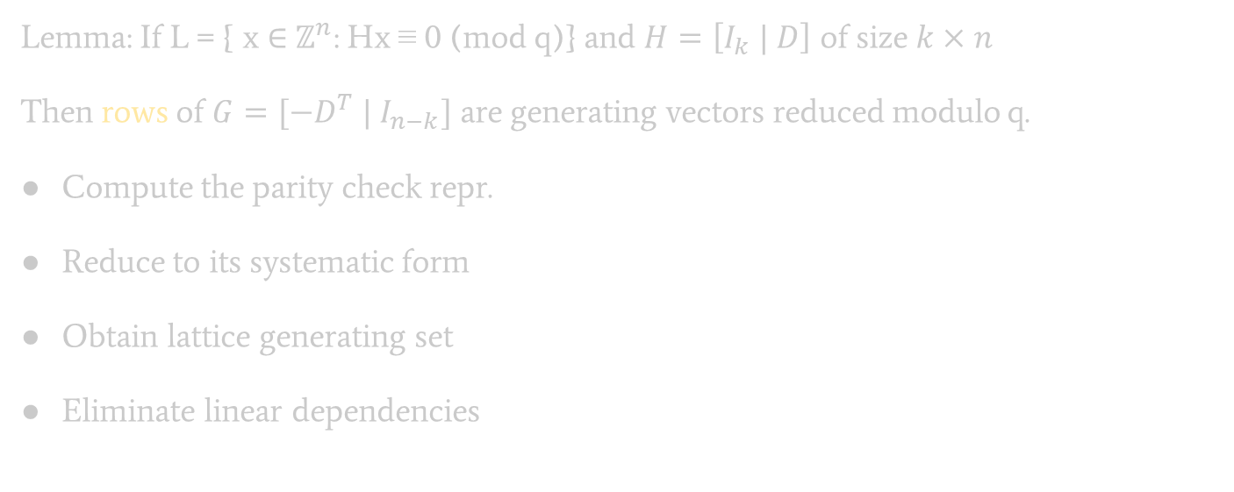

Basis computation algorithm. Complexity.
Lemma: If $\text{L}\text{ = \{ }\text{x}\text{ ∈} ℤ^{n}\text{: }\text{Hx}\text{ ≡ }\text{0 }\text{(}\text{mod} \text{q}\text{)\}}$ and $H=\left[I_{k} | D\right]$ of size $k×n$
Then rows of $G=[−D^{T} | I_{n−k}]$ are generating vectors reduced modulo q.
Compute the parity check repr.
Reduce to its systematic form
Obtain lattice generating set
Eliminate linear dependencies
DL modulo $q^{d} −1$
Gaussian elimination
O(1)
Hermit normal form(or LLL)

Slide 24
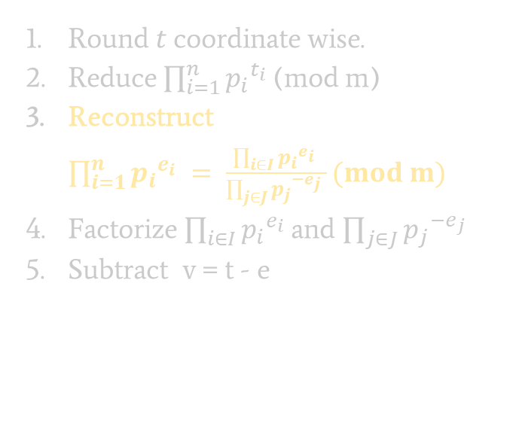
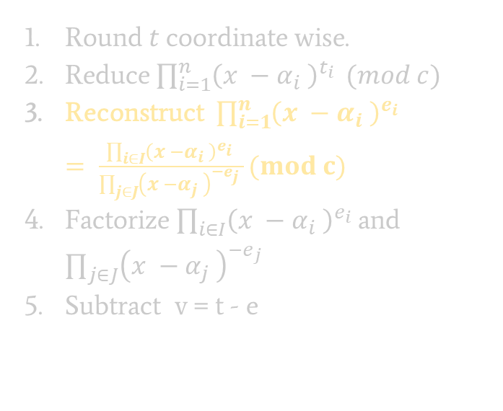
Modifying the decoding algorithm.
Round $t$coordinate wise.
Reduce $\prod_{i=1}^{n}{{p_{i}}^{t_{i}} }$(mod m)
Reconstruct $\prod_{i=1}^{n}{{p_{i}}^{e_{i}} }= \frac{\prod_{i∈I}{{p_{i}}^{e_{i}} }}{\prod_{j∈J}{{p_{j}}^{{−e}_{j}} }}(mod m)$
Factorize $\prod_{i∈I}{{p_{i}}^{e_{i}} }$and $\prod_{j∈J}{{p_{j}}^{{−e}_{j}} }$
Subtract v = t - e
Round $t$coordinate wise.
Reduce $\prod_{i=1}^{n}{{\left(x −α_{i} \right)}^{t_{i}} }(mod c)$
Reconstruct $\prod_{i=1}^{n}{{\left(x −α_{i} \right)}^{e_{i}} }= \frac{\prod_{i∈I}{{\left(x −α_{i} \right)}^{e_{i}} }}{\prod_{j∈J}{{\left(x −α_{j} \right)}^{{−e}_{j}} }}(mod c)$
Factorize $\prod_{i∈I}{{\left(x −α_{i} \right)}^{e_{i}} }$and $\prod_{j∈J}{{\left(x −α_{j} \right)}^{{−e}_{j}} }$
Subtract v = t - e

Slide 25
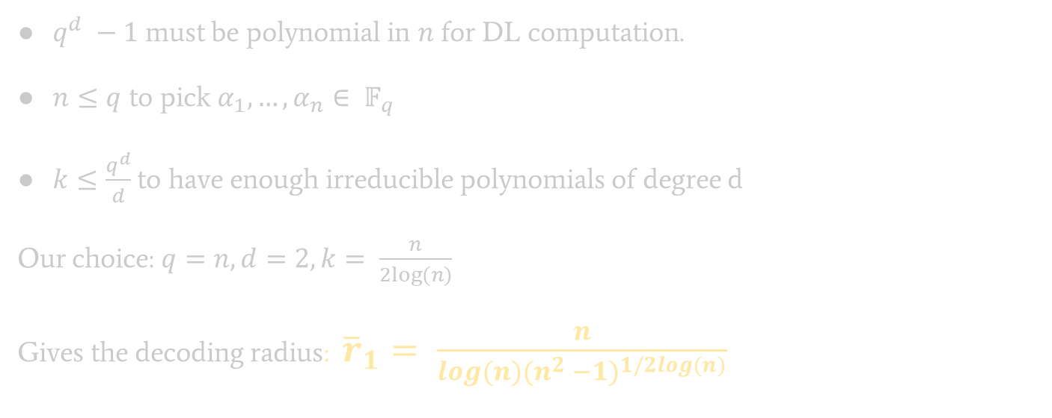
Complexity and parameters.
$q^{d} −1$ must be polynomial in $n$ for DL computation.
$n≤q$ to pick $α_{1}, …, α_{n}∈ 𝔽_{q}^{}$
$k≤\frac{q^{d}}{d}$ to have enough irreducible polynomials of degree d
Our choice: $q=n, d=2, k= \frac{n}{2log⁡(n)}$
Gives the decoding radius: ${\overline{r}}_{1}= \frac{n}{log(n){(n^{2} −1)}^{1/2log(n)}}$

Slide 26
Comparison Results.

Slide 27
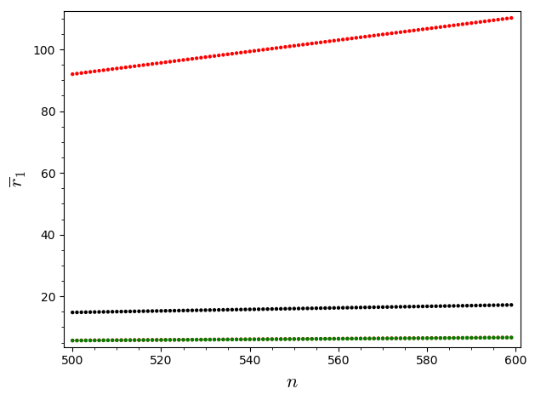
Decoding radius comparison.
Integer Rings
Polynomials
Theoretical upperbound
27

Slide 28
SageMath Implementation Runtimes.
Dimension: | 100 | 200 | 300 | 400
Integers | 13.6 | 2198.1(36.6m)
Step 4* | 10 | 2177.01
Polynomials | 6.7 | 28.3 | 63.9 | 122.03
CPU: Intel i5
RAM: 8GB
OS: Win 10
Integers | 0.04 | 0.05
Polynomials | 0.009 | 0.03 | 0.03 | 0.05
* Step 4 refers to the transformation of dual basis to the primal basis.

Slide 29
The LLXY17 Cryptanalysis.

Slide 30
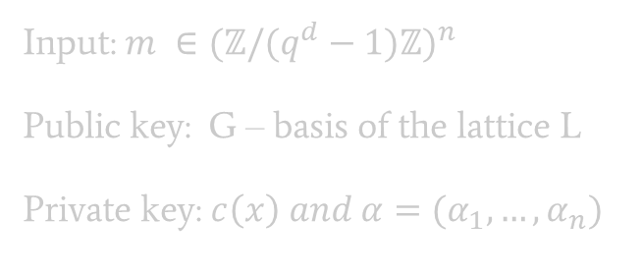
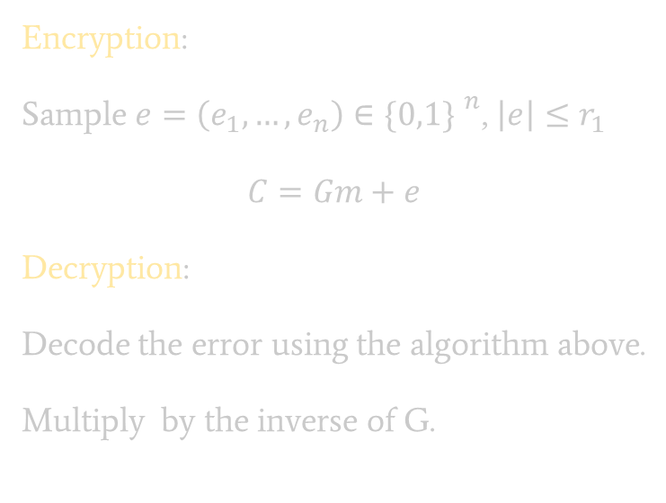
LLXY17 Encryption scheme(Simplified).
Input: $m ∈{(ℤ/(q^{d}−1)ℤ)}^{n}$
Public key: G – basis of the lattice L
Private key: $c\left(x\right) and α=(α_{1}, …, α_{n})$
Encryption:
Sample $e=\left(e_{1}, …, e_{n}\right)∈{\{0,1\} }^{n}$, $\left|e\right|≤r_{1}$
$$C=Gm+e$$
Decryption:
Decode the error using the algorithm above.
Multiply by the inverse of G.
Needs encoding to provide semantic security!

Slide 31
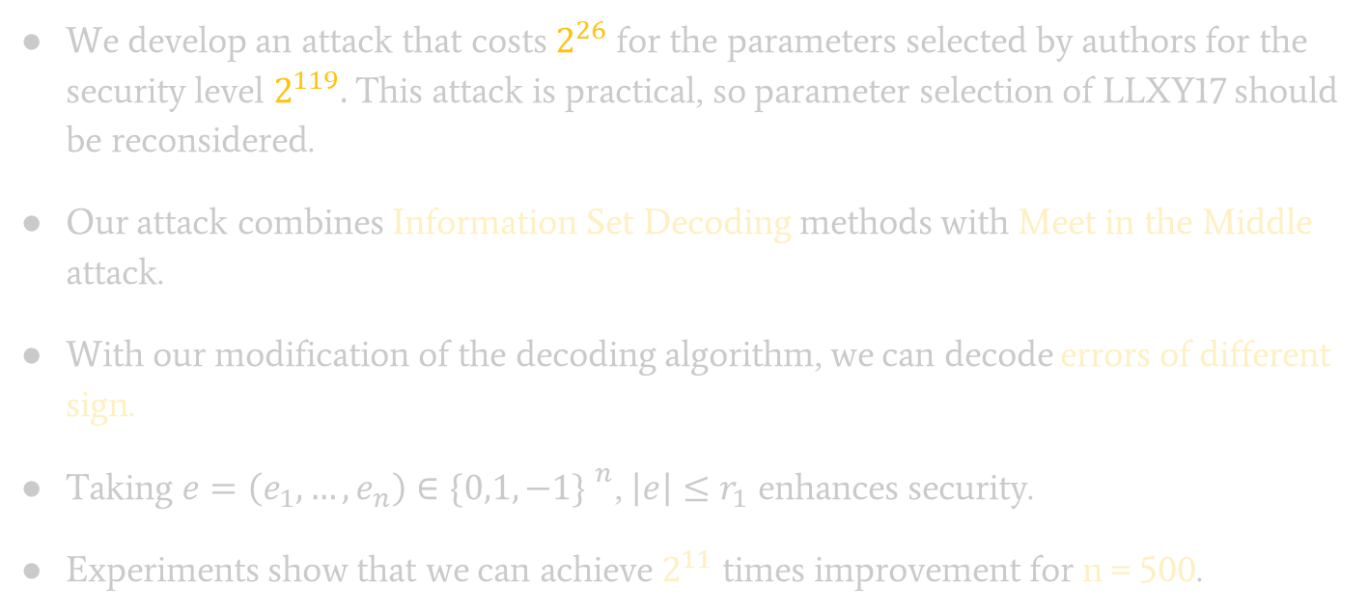
Cryptanalysis and Improvements.
We develop an attack that costs $2^{26}$ for the parameters selected by authors for the security level $2^{119}.$ This attack is practical, so parameter selection of LLXY17 should be reconsidered.
Our attack combines Information Set Decoding methods with Meet in the Middle attack.
With our modification of the decoding algorithm, we can decode errors of different sign.
Taking $e=\left(e_{1}, …, e_{n}\right)∈{\{0,1, −1\} }^{n}$, $\left|e\right|≤r_{1}$ enhances security.
Experiments show that we can achieve $2^{11}$ times improvement for n = 500.

Slide 32

Thank you!

