Slide 1

GoodThought NGO Impact Intelligence
Funding, Operational Performance & Strategic Grant Readiness Analysis — 2020 to 2022
SQL ANALYTICS
POWER BI
POSTGRESQL

Slide 2

Project Overview & Objectives
GoodThought NGO operates across education, healthcare, food relief, environmental sustainability, youth empowerment, and community development. This analysis evaluates 3 years of operational data (2020–2022) across 3 PostgreSQL tables with 5,000 rows each.
Donor Engagement
Regional Equity
Grant Readiness
Analyze contribution patterns by category
Assess funding distribution across regions
Prioritize high-impact initiatives for proposals

Slide 3
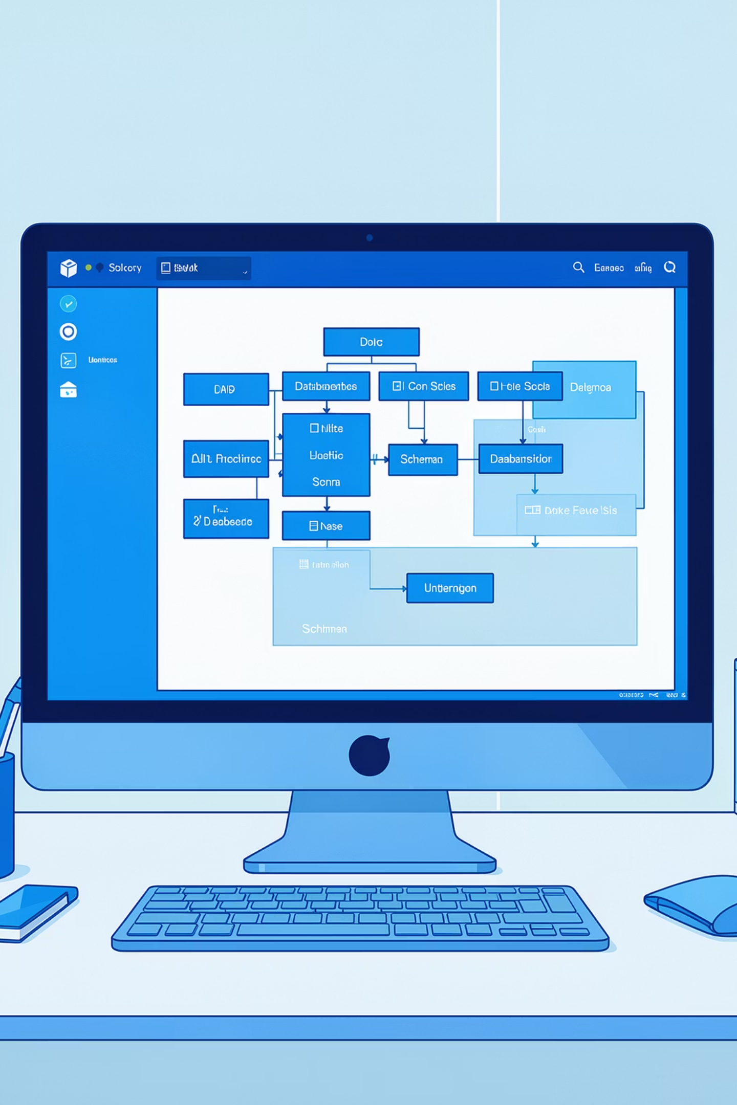
Data Preparation & Validation
01
02
Date Type Conversion
Missing & Duplicate Checks
start_date, end_date, and donation_date converted from VARCHAR/TEXT to proper DATE format.
Validated critical fields; detected duplicate transactions and repeated donor records.
03
Integrity Fixes
Negative budgets corrected to positive values; 174 reversed date records had start/end dates interchanged.

Slide 4
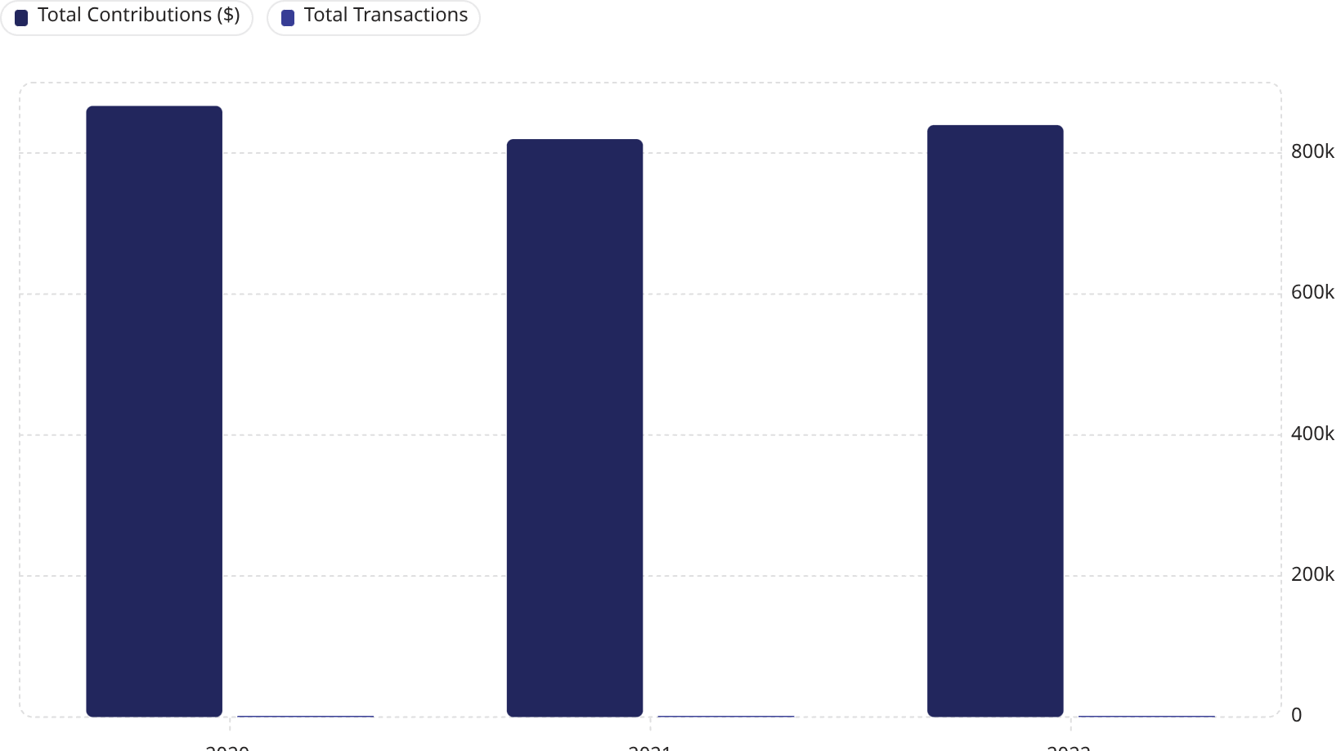
Donor Contribution Trends (2020–2022)
Key Observations
Total contributions peaked in 2020 at $866,914, dipped in 2021, then partially recovered in 2022 to $839,805.
Average contribution per transaction remained stable: $511 (2020) → $497 (2021) → $508 (2022), signaling consistent donor engagement despite volume fluctuations.

Slide 5

Donor Segments & Funding Behavior
$860K
$840K
$826K
Organizations
Individuals
Corporate
1,083 unique donors · 1,693 transactions · Avg $508/donation
1,060 unique donors · 1,680 transactions · Avg $500/donation
1,002 unique donors · 1,627 transactions · Avg $508/donation
Organizations lead in total contributions ($860K) and average impact score (5.53), making them the most strategic donor segment for long-term sustainability.

Slide 6
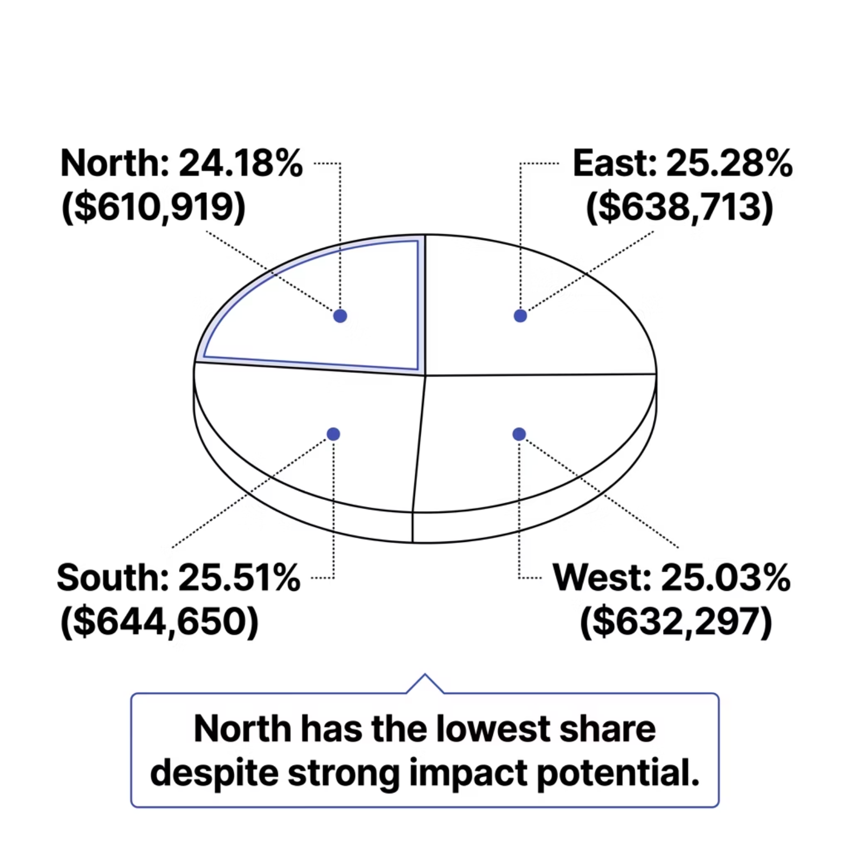


Regional Funding Distribution
Near-Equal Distribution — But North Lags
Funding is broadly equitable across all four regions, ranging from 24.18% to 25.51%. However, the North region receives the least funding ($610,919) while maintaining an average impact score of 5.42 — flagging it as an underfunded, high-potential region.
North Region: Lowest funding share yet strong impact scores — a prime candidate for increased investment.

Slide 7
Budget Efficiency & Impact per Dollar
Top Budget-Efficient Initiatives
Highest Impact per Donation Dollar
Initiative
Region
Impact Score
Efficiency
Initiative
Region
Impact/$
Assignment_4827
South
0.840
Assignment_933
South
9.77
0.249
Assignment_2585
West
0.687
Assignment_4230
South
4.62
0.168
Assignment_1718
South
0.663
Assignment_2271
North
4.35
0.167
Assignment_4201
West
0.657
Assignment_3931
East
7.10
0.105
Assignment_600
North
0.519
Assignment_2900
West
9.97
0.047

Slide 8

Grant Priority Initiatives
Low-budget, high-impact initiatives identified as top candidates for future international grant proposals:
Assignment_933 · South
Budget: $39 · Impact: 9.77 · Efficiency: 0.249 — Highest ranked
Assignment_3931 · East
Budget: $68 · Impact: 7.10 · Efficiency: 0.105
Assignment_2900 · West
Budget: $211 · Impact: 9.97 · Efficiency: 0.047
Assignment_3757 · East
Budget: $263 · Impact: 9.92 · Efficiency: 0.038

Slide 9


Strategic Recommendations
Invest in the North
Increase funding to the underfunded North region, which shows strong impact potential.
Target Organizational Donors
Prioritize Organizations — highest contributions, transactions, and impact scores.
Replicate High Performers
Scale top-efficiency initiatives (e.g., Assignment_933) into underperforming regions.
Optimize Grant Proposals
Lead with high impact-per-dollar initiatives to maximize grant competitiveness.

