Slide 1
Customer Shopping Behavior Analysis
Uncovering spending patterns, customer segments, and product preferences from 3,900 transactions to guide strategic business decisions.

Slide 2

Dataset at a Glance
3,900
Transactions
18
Columns
$59.76
Avg. Purchase
3.75
Avg. Rating
Key Features
Demographics: Age, Gender, Location, Subscription Status Purchase Details: Category, Amount, Season, Size, Color Behavior: Discounts, Promo Codes, Frequency, Shipping Type
37 missing values in Review Rating — imputed using median per product category.

Slide 3

Data Preparation in Python
01
Load & Explore
Imported dataset with pandas; used
df.info()
and
.describe()
for initial inspection.
02
Clean & Standardize
Imputed missing ratings, renamed columns to snake_case, dropped redundant
promo_code_used.
03
Feature Engineering
Created
age_group
bins and
purchase_frequency_days
from purchase data.
04
Database Integration
Loaded cleaned DataFrame into PostgreSQL for structured SQL analysis.

Slide 4
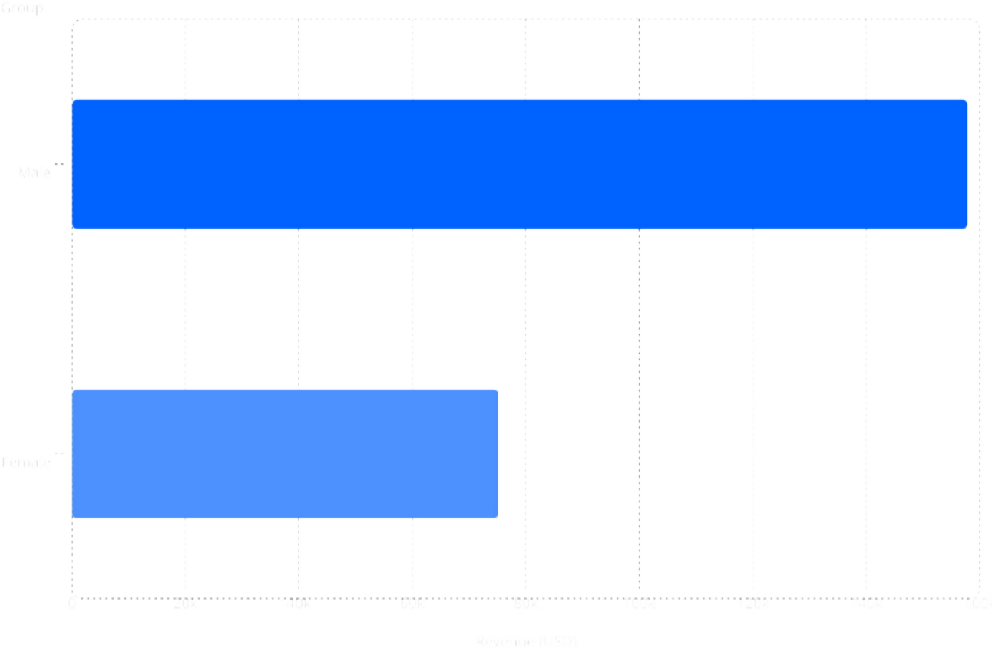
Revenue & Spending Insights
158
k
75.2
k
Key Findings
Male customers generated $157,890 vs. female customers' $75,191
839 customers used discounts yet still spent above the average purchase amount
Express shipping users averaged $60.48 vs. Standard at
$58.46

Slide 5
Top-Rated Products & Discount Dependency
Top 5 Products by Rating
Most Discount-Dependent Products
Product | Avg. Rating
Gloves | 3.86
Sandals | 3.84
Boots | 3.82
Hat | 3.80
Skirt | 3.78
Product | Discount Rate
Hat | 50.00%
Sneakers | 49.66%
Coat | 49.07%
Sweater | 48.17%
Pants | 47.37%

Slide 6
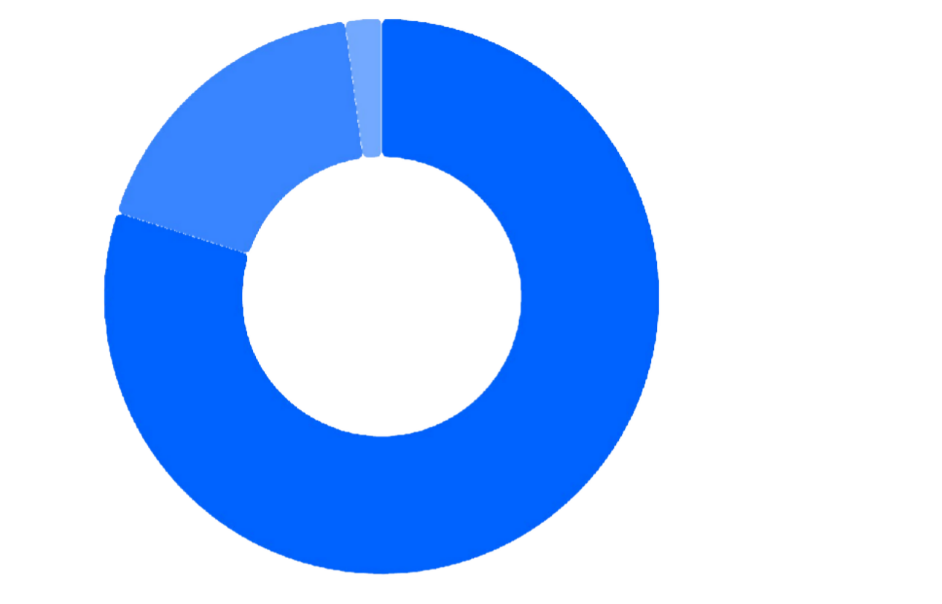

Customer Segmentation
2.13%
17.97%
Loyal··7· 9.9%
Returning·1·17· 7.9.977%% New··2·..13%
79.9%
Segment Breakdown
The vast majority of customers are classified as Loyal
(3,116), with 701 Returning and only 83 New customers.
Customers with more than 5 purchases: 2,518 non-subscribers vs. 958 subscribers — indicating a loyalty-subscription gap to address.

Slide 7
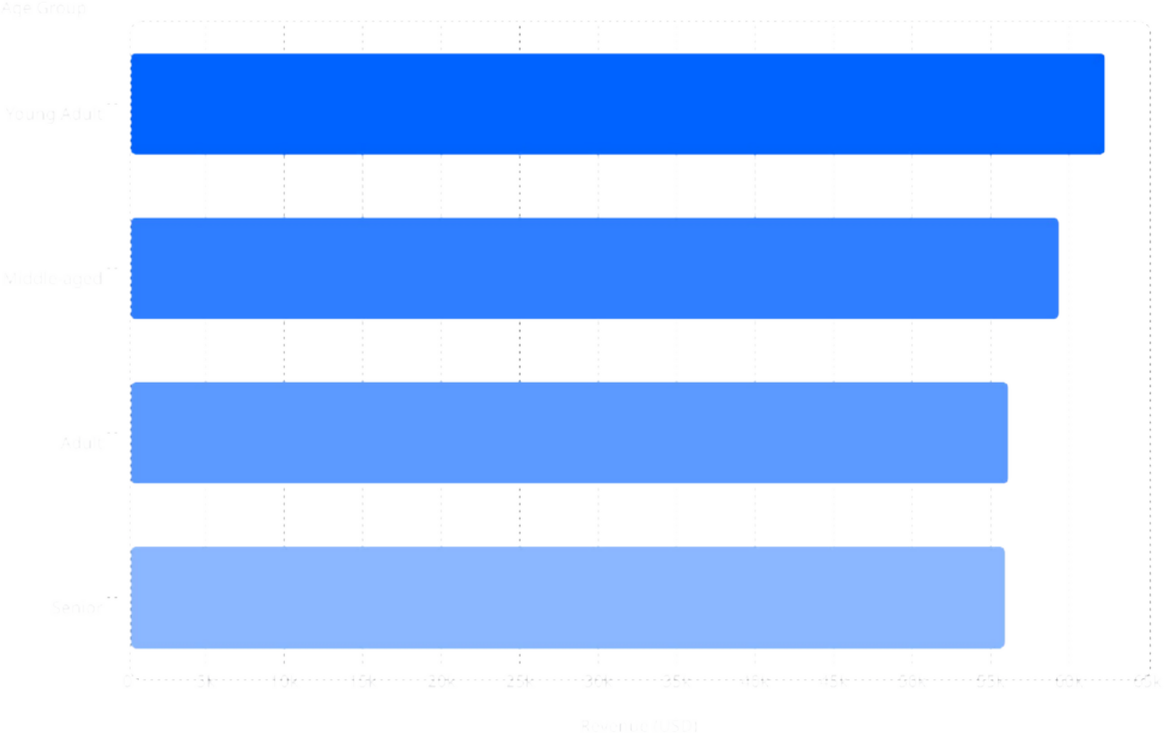
Subscription & Revenue by Age Group
62.1
k
59.2
k
56
k
55.8
k
Subscription Status
Status
Custome rs
Avg. Spend
Total Revenue
Subscribe rs
1,053
$59.49
$62,645
Non- Subscribe rs
2,847
$59.87
$170,436
Young Adults lead revenue at $62,143. Avg. spend is nearly identical across subscription groups.

Slide 8
Top Products by Category
👗 Clothing
Blouse — 171
Pants — 171
Shirt — 169
💍 Accessories
Jewelry — 171
Sunglasses — 161
Belt — 161
👟 Footwear
Sandals — 160
Shoes — 150
Sneakers — 145
🧥 Outerwear
Jacket — 163
Coat — 161

Slide 9





Business Recommendations
Boost Subscriptions
Promote exclusive benefits to convert the 73% non- subscriber base.
Loyalty Programs
Reward repeat buyers to accelerate movement into the Loyal segment.
Review Discount Policy
Balance sales boosts with margin control — especially for Hat, Sneakers, and Coat.
Targeted Marketing
Focus on Young Adults and express-shipping users — highest revenue contributors.
Product Positioning
Highlight top-rated (Gloves, Sandals) and best-selling products in campaigns.

