Slide 1
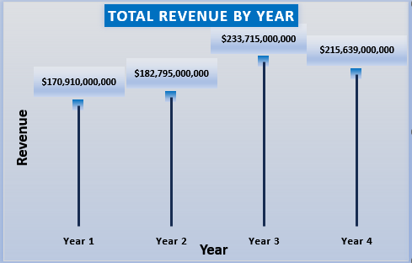
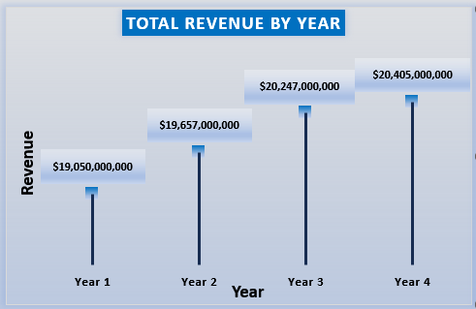
Comparison Of Yearly Revenue For AAPL & ABT Company
AAPL experienced a revenue increase in Year 3 followed by a decline in Year 4, indicating some volatility in performance. In contrast, ABT demonstrated steady and consistent revenue growth over the same period.
AAPL COMPANY
ABT COMPANY

Slide 2
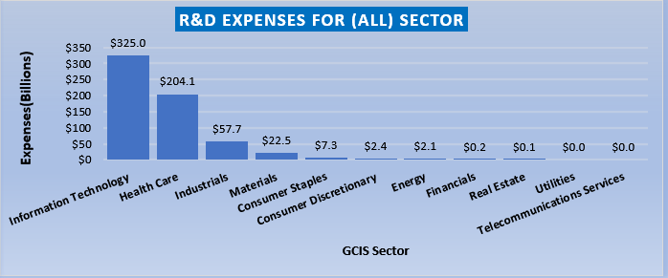
Research And Development
The Information Technology and Healthcare sectors incurred the highest expenses on Research and Development (R&D), significantly outpacing other sectors that lagged behind in innovation investments.

Slide 3
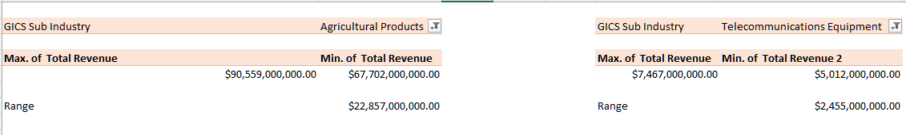
Summary Statistics
The Range for the Agriculture sector Total Revenue at $22.85 Billion is higher than the Range of Total Revenue for the Telecommunications Industry at only $2.45 Billion. It looks like companies in the Agriculture Industry have more significant variability in the total revenues they receive because their range is more spread out.

Slide 4
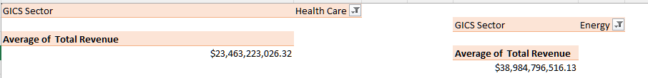
Summary Statistics
The mean total revenue for companies in the Healthcare sector ($23,463,223,026) was slightly higher than that of the Energy sector ($23,142,217,458.76), indicating a marginal revenue advantage for Healthcare companies on average.

Slide 5
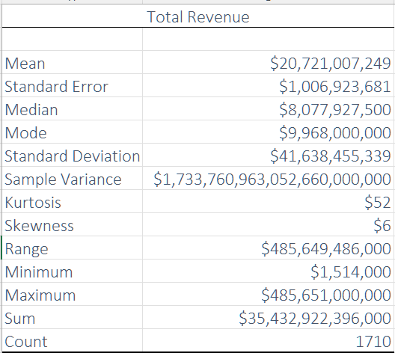
Summary Statistics
The total revenue data from 1,710 companies reveals a highly uneven distribution, characterized by significant variation in company size and performance. The mean revenue stands at approximately $20.72 billion, while the median revenue is much lower at $8.08 billion, indicating that more than half of the companies earn well below the average. This large gap between the mean and median highlights the presence of a few exceptionally large firms that disproportionately raise the average revenue figures.
The standard deviation of about $41.64 billion and a sample variance of roughly 1.73 × 10²¹ underscore the extreme spread in the data. The range, spanning from a minimum of $1.5 million to a maximum of $485.6 billion, further confirms the vast disparity in company revenues.
With a skewness value of 6 and a kurtosis of 52, the distribution is heavily right-skewed and sharply peaked. This means that while most companies are clustered at the lower end of the revenue scale, a small number of high-revenue outliers significantly stretch the upper tail of the distribution. Overall, the data reflects a market environment where a few dominant players generate the bulk of the revenue, while the majority of firms operate at a much smaller scale.
Used CHATGPT TO EXPLAIN SOME CONCEPT MORE

