Slide 1
Salary Prediction Using Linear Regression

Slide 2
Objective
To predict an employee's salary based on their years of experience using Simple Linear Regression.

Slide 3
Solution
1. Conducted Exploratory Data Analysis (EDA) to understand the dataset.
2. Built a Simple Linear Regression model.
3. Evaluated the model with RMSE and R² score.
4. Visualized the relationship between Experience and Salary.
5. Provided insights for business decision-making.

Slide 4
Business Impact
1. Helps HR teams set competitive salary structures.
2. Assists companies in budgeting for new hires.
3. Provides salary expectations for job seekers.
4. Reduces pay disparity by using data-driven insights.

Slide 5
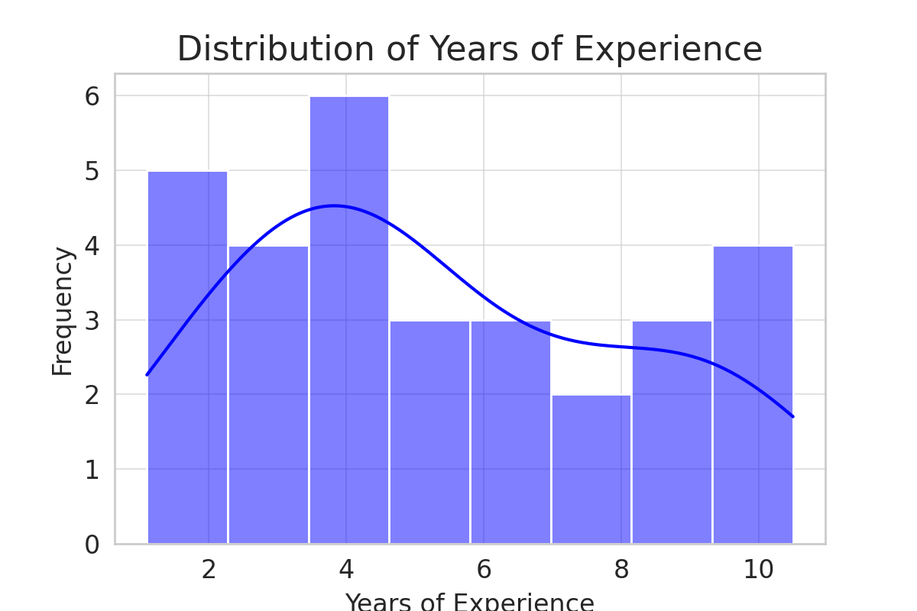

Slide 6
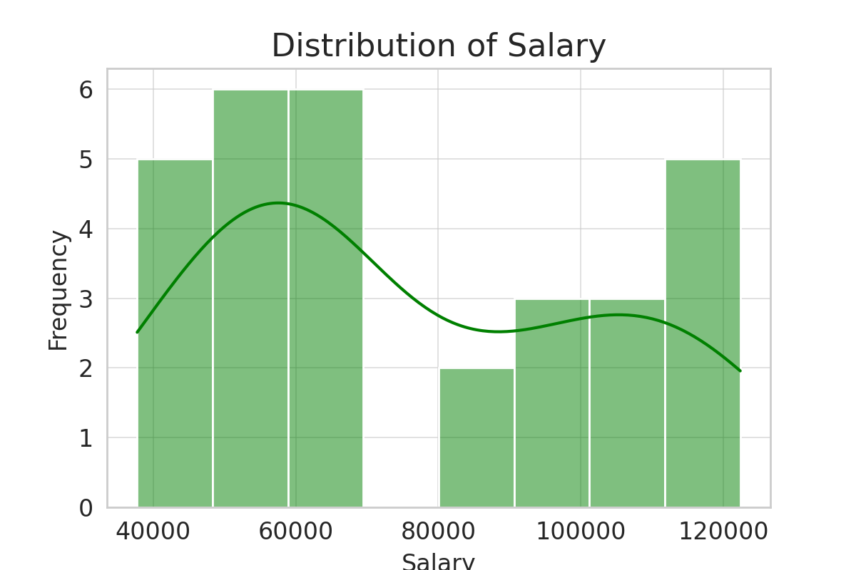

Slide 7
Insights from distribution
Years of Experience Distribution
Data is fairly spread out with no skewness.
Kernel Density Estimation (KDE) shows normal distribution.
Salary Distribution:
Right skewed.
KDE shows salary increases with experience.

Slide 8
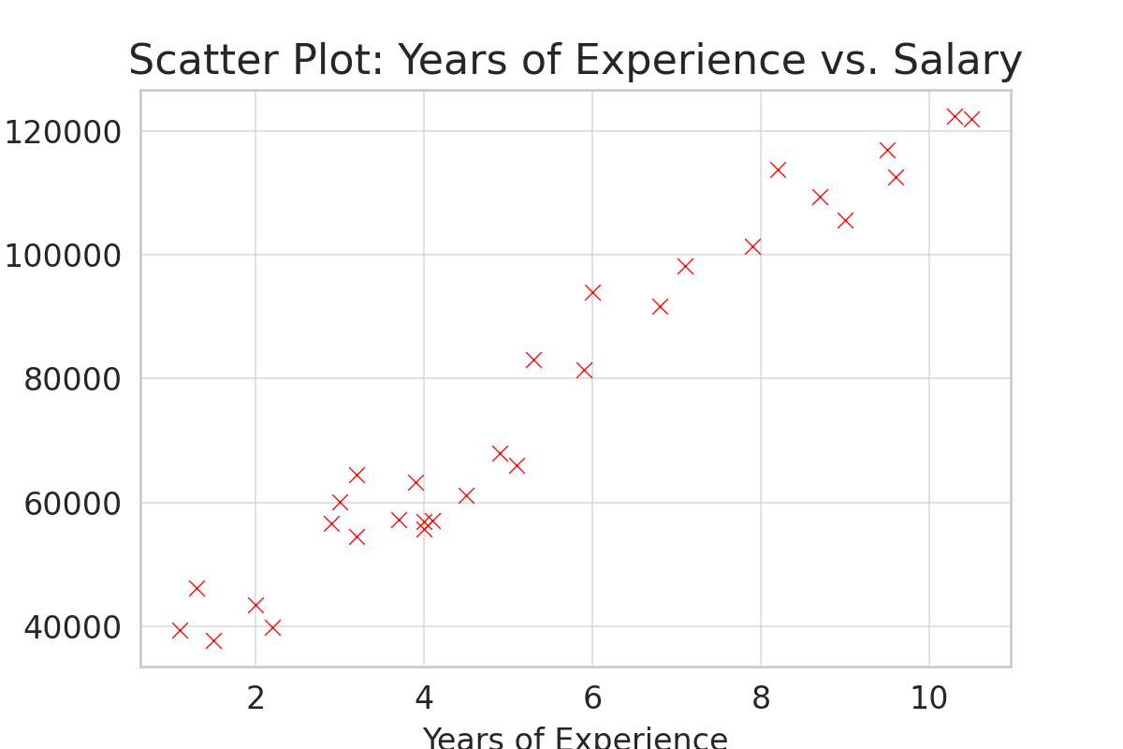

Slide 9
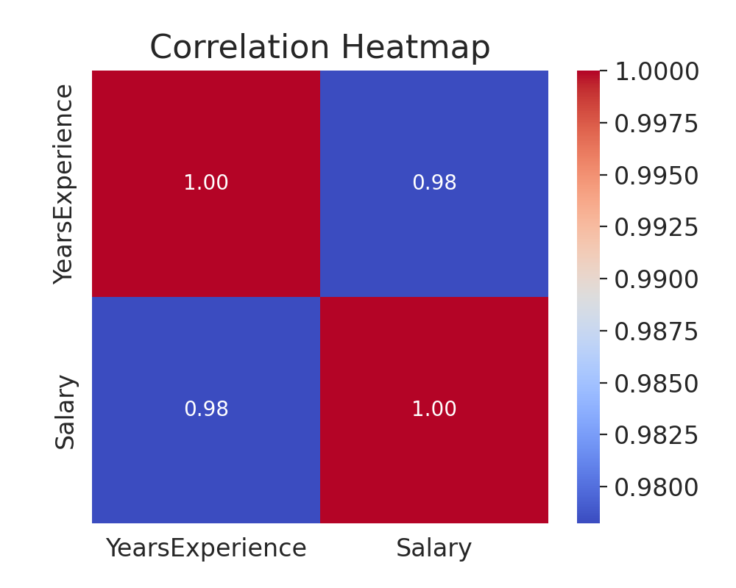

Slide 10
Insights from Relationship Analysis
Scatter Plot:
Positive linear relationship suggests higher experience leads to higher salary
No outliers.
Correlation Heatmap:
Correlation Coefficient is close to 1
Gives strong relationship between years of experience and salary.

