Slide 1
Delivery Time Prediction using Linear Regression

Slide 2
Objective
To predict Delivery Time based on Sorting Time using a Simple Linear Regression model.

Slide 3
Solution Approach
- Performed Exploratory Data Analysis (EDA)
- Visualized data distributions and relationships
- Built and evaluated a Simple Linear Regression model
- Assessed model performance using key metrics

Slide 4
Business Impact
- Helps businesses estimate delivery time efficiently
- Improves logistics and scheduling
- Identifies key factors affecting delivery time

Slide 5
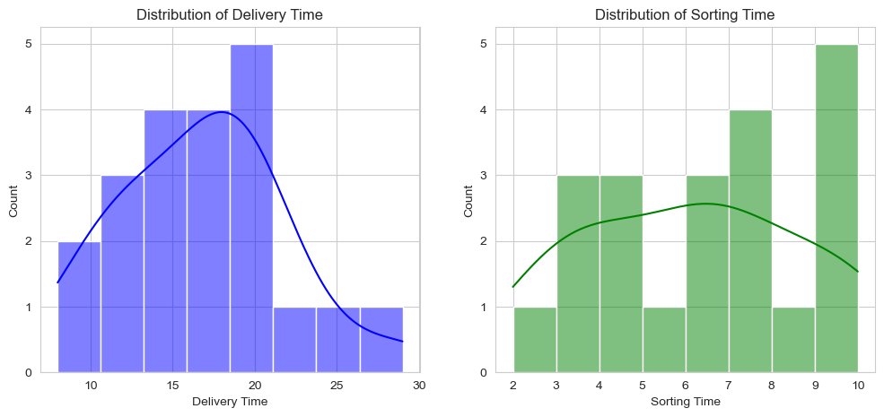
Distribution of Sorting and Delivery Time

Slide 6
Insights from Distribution Analysis
Curves for Delivery Time and Sorting Time are right skewed.
Kernel Density Estimation shows unimodal distribution.

Slide 7
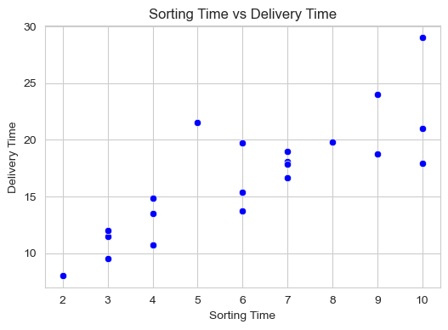
Sorting Time vs Delivery Time

Slide 8
Insights from Scatter Plot
Positive correlation between Sorting Time and Delivery Time.
It suggests that as sorting time increases, delivery time also increases.
Correlation coefficient is approximately 0.826, indicating strong relationship between Sorting Time and Delivery Time.

Slide 9
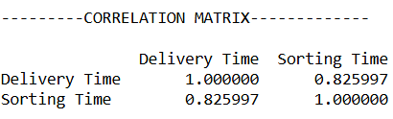

Slide 10
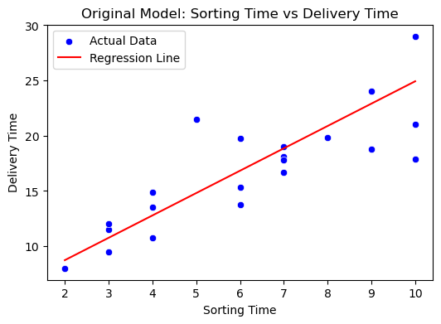
Original Sorting Time vs Delivery Time

Slide 11
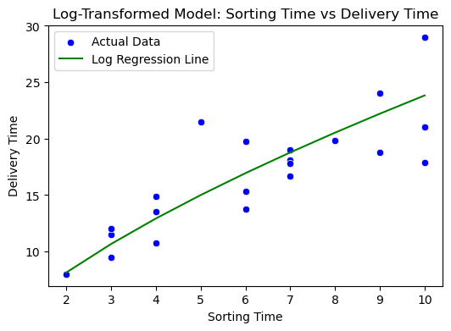
Log Transformed Sorting Time vs Delivery Time

Slide 12
Model Evaluation
Regression Equation:
Delivery Time=4.68+2.02×Sorting Time
2. Performance Metrics:
Mean Absolute Error (MAE): 2.90
Mean Squared Error (MSE): 14.05
Root Mean Squared Error (RMSE): 3.75
R² Score: -1.02 (Negative R² indicates that the model does not generalize well)

