Slide 1
Overview – COM 737 Coursework
• Work Breakdown Structure
• Gantt Chart
• Data Information
• Methodology Used
• Data Modeling
• Risk Management
• Future Improvements.

Slide 2
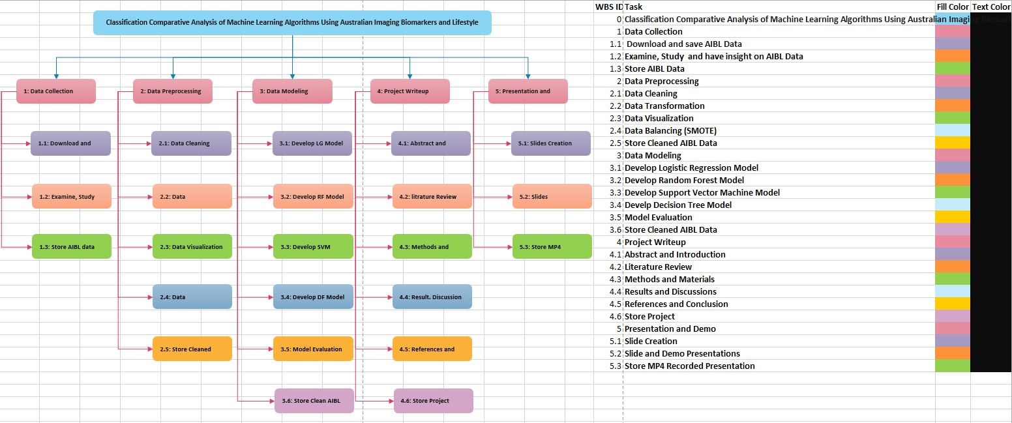
Work Breakdown Structure
WBS

Slide 3
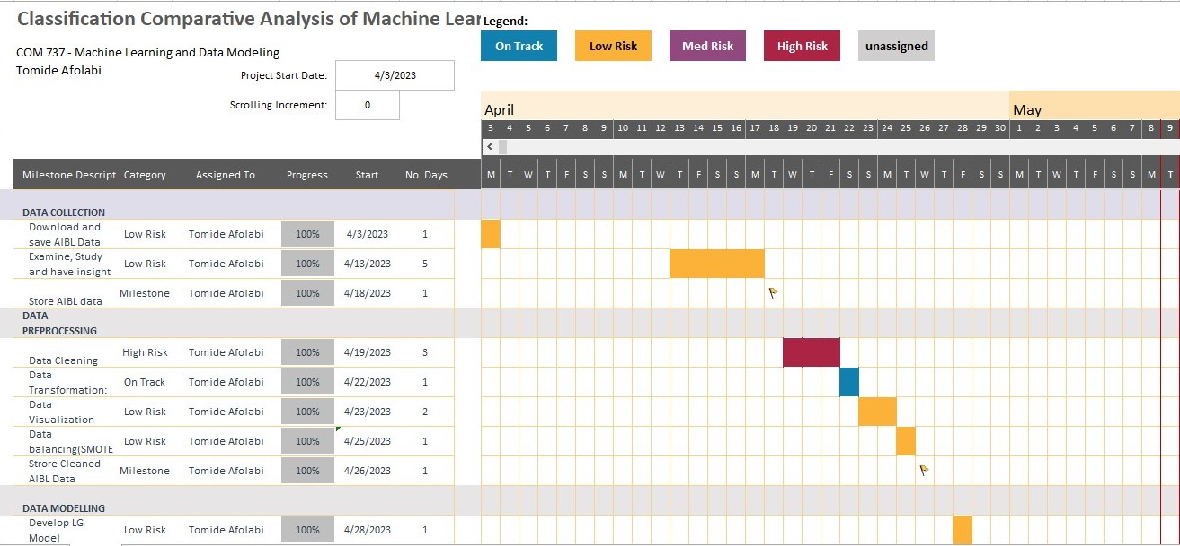
Gantt Chart (Milestone and deliverables)

Slide 4
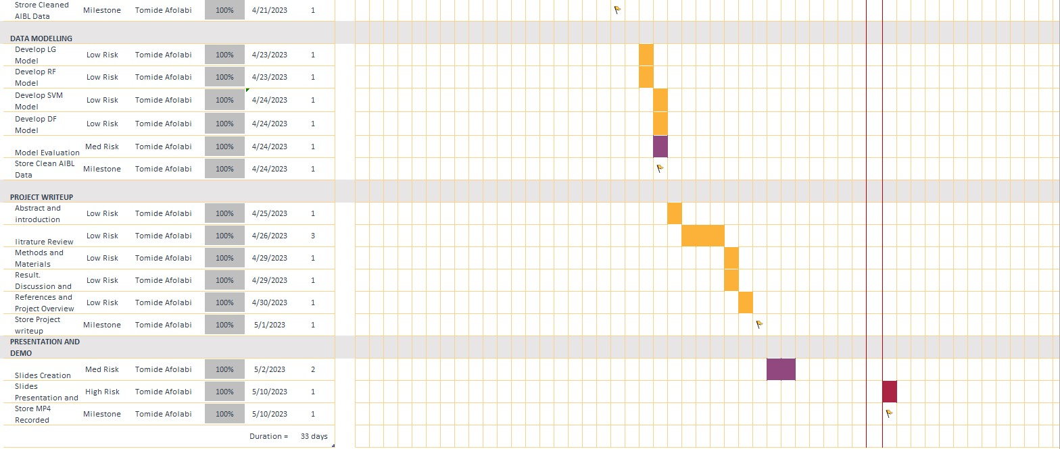
Gantt Chart (Milestone and deliverables)

Slide 5
Data Information
The Australian Imaging, Biomarkers, and Lifestyle Flagship Study of Ageing (AIBL) dataset is a large and diverse dataset.
Initially, the data is multiple classification in nature, consisting of 3 possible values of the target variable. But was reduced to a binary-classification ML problem.
It is a homogenous data having observations with the same data type. (numeric).
The data is of the adult / aging population. (55-96 years)

Slide 6
Methodology Used
Data Collection: Download, Examine and save
Data Preparation:
In Python
Correction of incorrect names using .rename() method
Dropping of some irrelevant variable like RID using .drop() method
Min-max normalization was applied using MinMaxScaler() module from sklearn.preprocessing package
Boxplot to identify outliers.
Data balancing using SMOTE(Synthetic Minority Oversampling Technique)
Hold-out: splitting the data to training and testing set using train_test_split module from sklearn.model_selection package.
Feature Selection using Information gain using mutual_info_classif module from sklearn.feature_selection package.

Slide 7
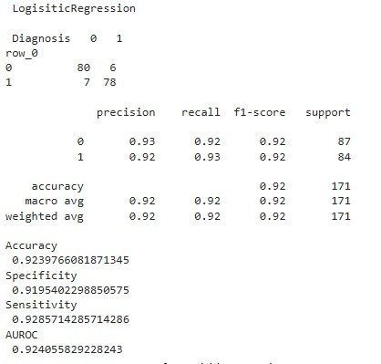
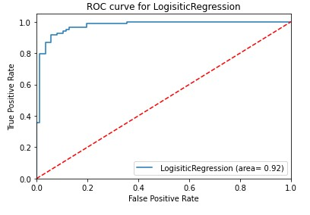
Data Modeling (Logistics Regression)
Results
ROC

Slide 8
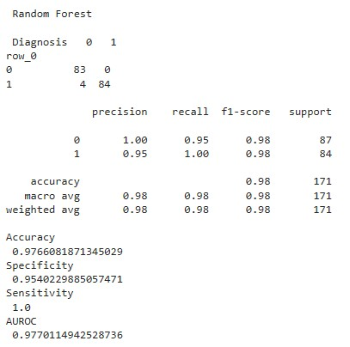
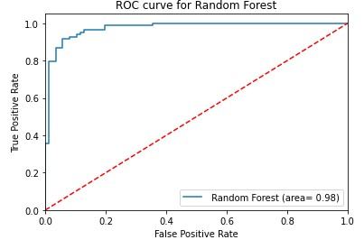
Data Modeling (Random Forest)
Results
ROC

Slide 9
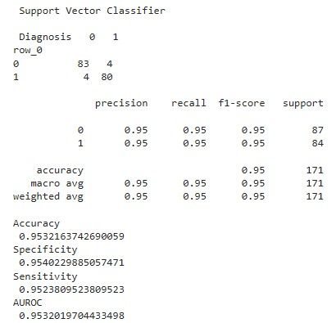
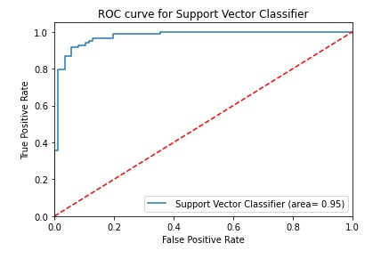
Data Modeling (Support Vector Machine)
Results
ROC

Slide 10
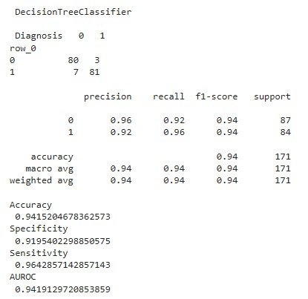
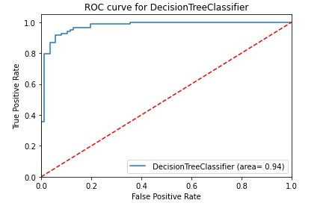
Data Modeling (Decision Tree)
Results
ROC

Slide 11
Risk Management
Risk
Impact
1 = Low
2 = Medium
3 = High
Likelihood
1 = Unlikely
2 = Likely
3 = Very likely
Mitigation
Losing hardware / software
3
2
Ensure I have backed up the work on google drive
Health wise: Sickness
2
1
Ensure I rest in the time left.

Slide 12
Future Improvement
A comparison between supervised machine learning and unsupervised machine learning algorithm in classification problem.
Using other ML algorithms and understanding their performance in binary classification can help gain a better understanding of data science problems.

