Slide 1
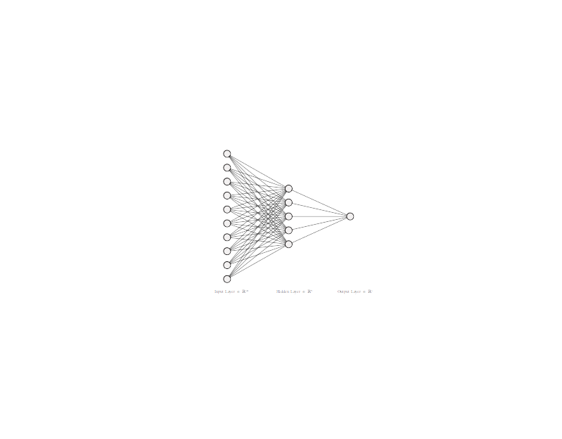
Games played
Last game date
OPS
Years Played
Hall of Fame
MVP
All Star Games
Gold Glove
Rookie of the Year
World Series MVP
Silver Slugger

