Slide 1

New York City Air BnB
BY
AKINBOWALE MICHEAL TIMILEYIN

Slide 2
TABLE OF CONTENTS
CONTENT PAGE
Project Description. 3
Key Question. 4
Findings & insights 6
Summary of Findings 13
Action & Recommendatons. 15

Slide 3
Project Description:
To better understanding of the ranges in price and the effect in different neigbhbourhood
The impact of rating and review on the price

Slide 4
Key Question
What is the average price of Airbnb listings in each neighbourhood and how does it vary by room type?
Which neighborhoods have the highest and lowest average prices for Airbnb listings?
How many listings are there per room type, and how does the price and availability vary by room type?
What is the impact of ratings and reviews on the price and popularity of Airbnb listings?
What are the top hosts and neighbourhoods in terms of customer satisfaction, based on ratings and reviews?

Slide 5
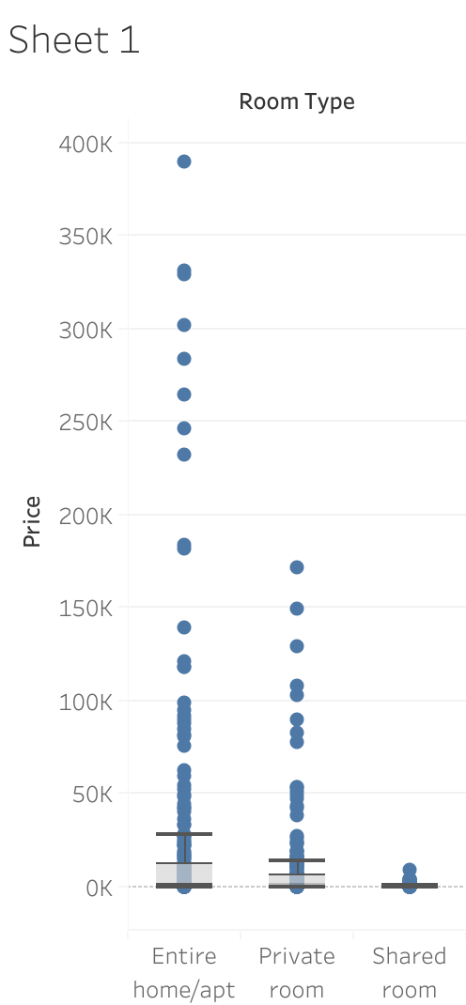
Key finding
The average price of BnB listing in Williamsburg Neighbourhood in Entire home/apt js 389,742 highest and the lowest is in Arden Height 228.
The average price of BnB listing in Williamsburg Neighbourhood in Private room is 171,265 highest and the lowest is in Arden Average price 1710.
The average price of BnB listing in shared room is Hell kitchen 9488 highest and the lowest is 76 by Arverne.

Slide 6
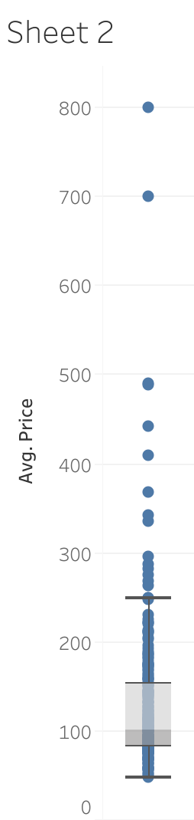
Key Finding
The average price of BnB listing in Williamsburg Neighbourhood
Entire home/apt js 389,742 highest and the lowest is in Arden Height 228.
The average price of BnB listing in Williamsburg Neighbourhood
Private room is 171,265 highest and the lowest is in Arden Average price 1710.
The average price of BnB listing in shared room is Hell kitchen 9488 highest
the lowest is 76 by Arverne.

Slide 7
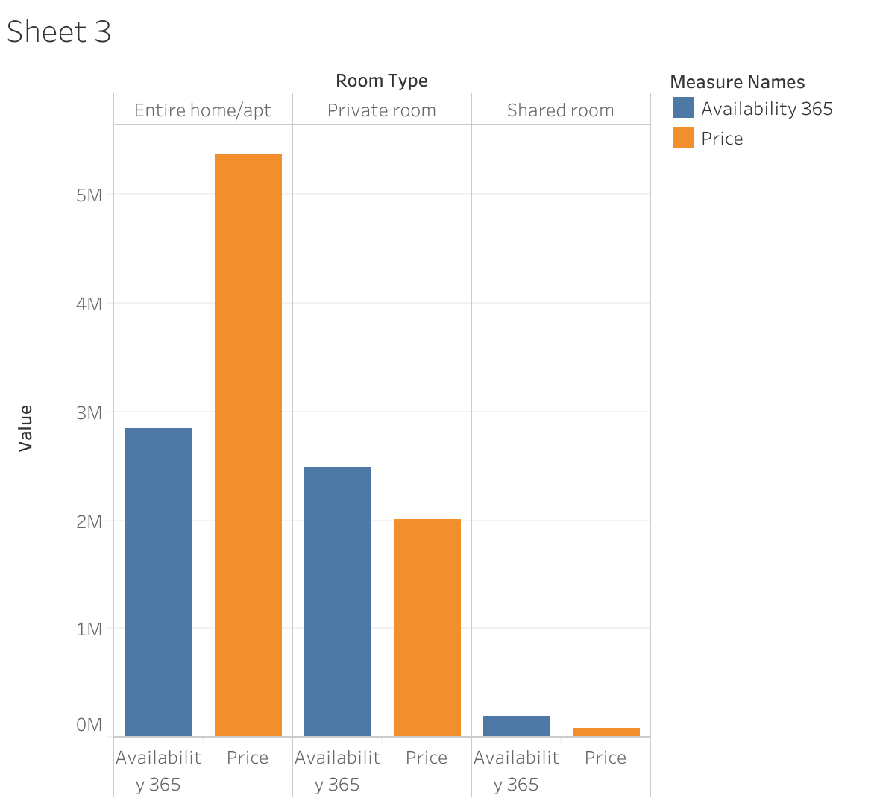
Key Findings
Entire home/apt takes the highest price of 5,381,480 and availability 365 of 2,843,783
Private room takes price of 2,004,450 and availability 365 of 2,482,739
Shared room take a price of 81,348 and availability 365 of 187,921

Slide 8
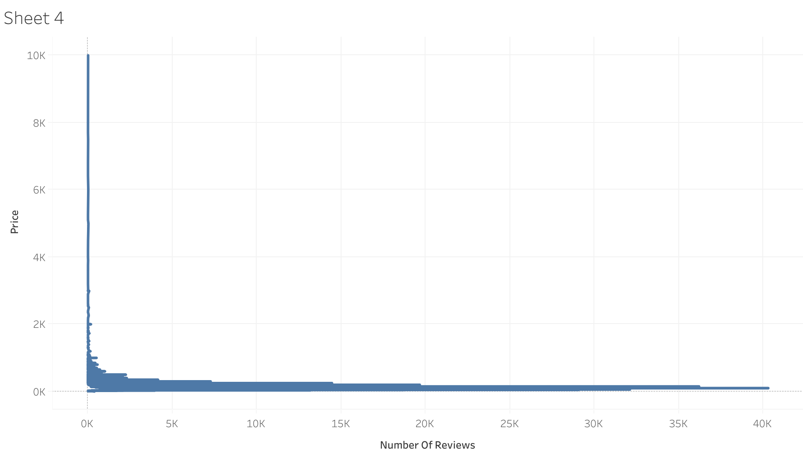
Key Findings
The lowest price of 100 got the highest number of review of 40,293

Slide 9
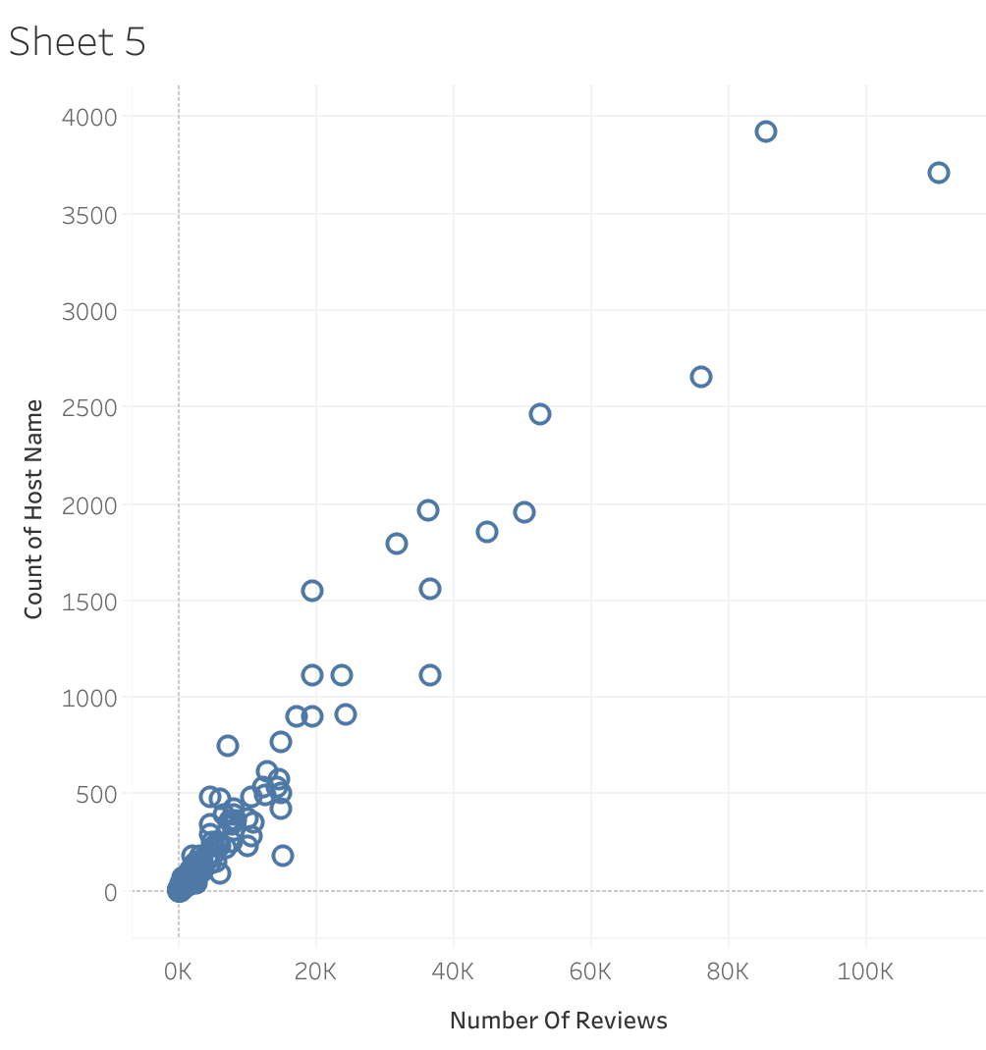
Key Finding
The top neighbourhood is Bedford-Stuyvesant and the count of host name is 3,714
Number review is 110,352

Slide 10
Summary Of Findings
Williamsburg is the the best neighbourhood for the business because it has the highest number of Price
The higest number of reviews goes to the chepeat room.
Entire home/apt takes the highest price and availability 365

Slide 11
Action and Reccomendation
Neighbourhood: Williamsburg is the best neighbourhood for the business
Entire home/apt room type is the best booked and its with the best price so it should be more focused on.
Room 100 get the highest number of review and host.

