Slide 1
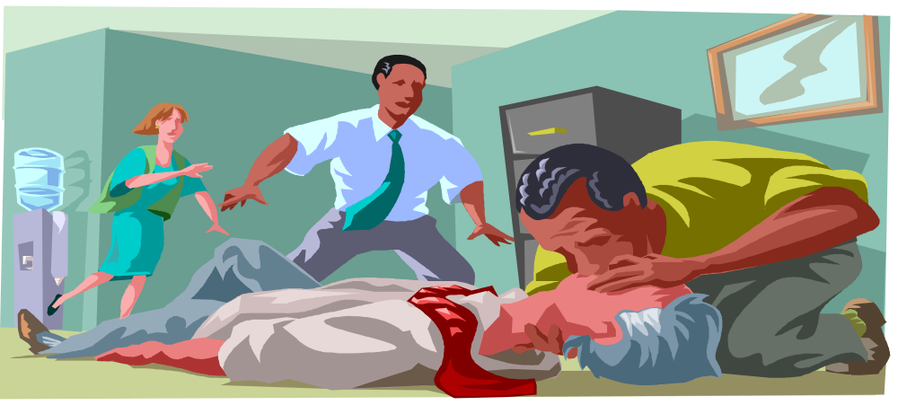
BASIC FIRST AID
Emergency First Aid
and CPR

Slide 2
This presentation is not intended as a substitute for professional medical care
NOTICE

Slide 3
EMERGENCY FIRST AID
If you are the first on the scene of accident that results in an injury or serious illness, you may be the only link between a victim and emergency medical care. Your role is to take action, whether by providing first aid, seeking medical help or calling the company emergency number. Your actions may improve the victims chance of recovery.
The following slides will provide specific information on basic first aid procedures.

Slide 4

BLEEDING
Apply direct pressure to the wound (at this time a direct pressure bandage may be used)
Elevate (do not further harm)
Pressure Point additional pressure may be applied to a pressure point to help reduce bleeding.

Slide 5


CARE FOR SHOCK
Keep the victim laying down (if possible).
Elevate legs 10-12 inches… unless you suspect a spinal injury or broken bones.
Cover the victim to maintain body temperature.
Provide the victim with plenty of fresh air.
If victim begins to vomit - place them on their left side.
Call emergency number.

Slide 6

FIRST AID FOR SPRAINS AND STRAINS
I-C-E
I - Ice, apply a cold pack. Do not apply ice directly to skin.
C - Compress, use an elastic or conforming wrap - not too tight.
E - Elevate, above heart level to control internal bleeding.

Slide 7
CARE FOR DISLOCATIONS AND FRACTURES
I-A-C-T
I - Immobilize area. Use pillows, jackets, blankets, etc. Stop any movement by supporting injured area.
A - Activate Emergency Medical Services (EMS), call emergency number.
C - Care for shock. See “Care for Shock” slide.
T - Treat any additional secondary injuries.

Slide 8


POISONING
Assess the scene for clues and safety.
Get victim away from poison if necessary.
Provide care for any life threatening conditions.
Check Material Safety Data Sheet (MSDS).
Notify medical staff or on-call Doctor.
Call the emergency number.

Slide 9
OTHER FIRST AID PROCEDURES
Burn Care
Neck and Back Injuries
Heat Exhaustion/Heat Stroke
Hypothermia/Frost Bite
Severe Allergic Reactions
Bites and Stings
Faints/Passing Out

Slide 10
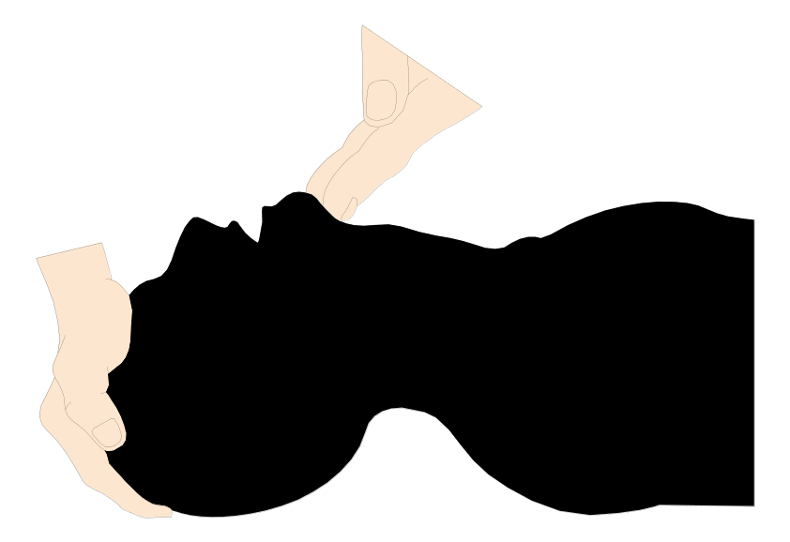
CARDIOPULMONARY RESUSCITATION CPR ABC’s
AIRWAY - Open the airway with the tilt-chin method.
Breath - give two breaths.
Check circulation.
If there is no pulse or breathing…..(next slide)

Slide 11

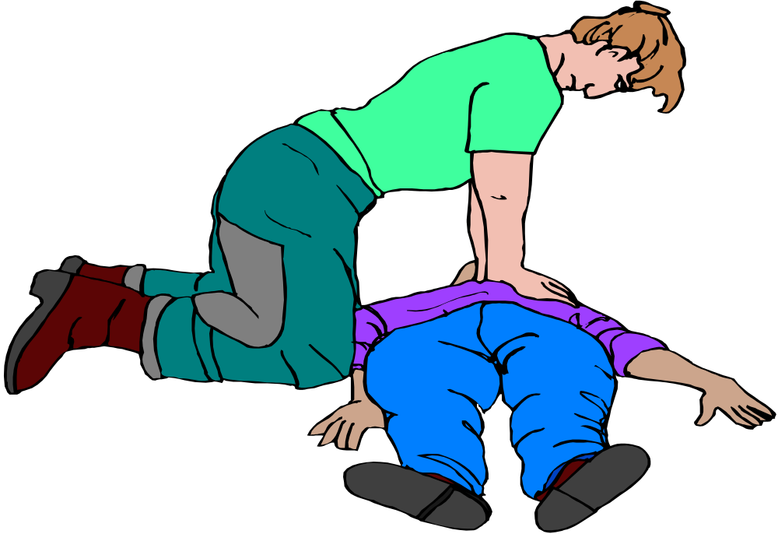

CPR Continued
… Perform chest compressions.
  15 compressions and two breaths.
Count = 1&2&3&4&5…&15
Call 911.

Slide 12
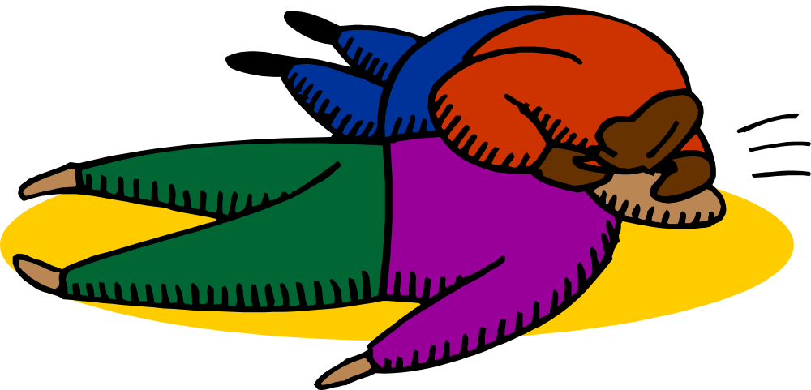
RESCUE BREATHING
1 breath every 5 seconds - 12 per minute.
Compressions : ventilations = 15:2

Slide 13

REMEMBER!!!
UNIVERSAL PRECAUTIONS:
The routine use of appropriate barrier precautions to prevent skin and mucous membrane exposure when contact with blood or other body fluids of any individual may occur or is anticipated.
Universal Precautions apply to blood and to all other body fluids with potential for spreading any infections.

Slide 14
THE END

