Slide 1
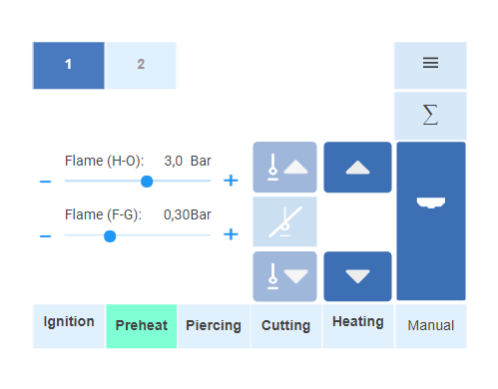
General
Format square (fit to Eckelmann window)

Slide 2
Manual Mode: Height Adjustment
It is the height from the
cutting table for preheat, piercing etc.
When pressing the button,
torch will move to that height
Height can be adjusted with Up Down?
10mm

Slide 3
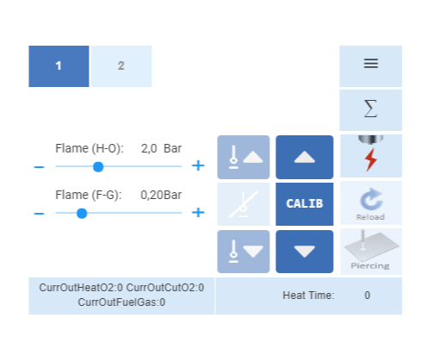
Process Mode: Process is off
When process is off, switch between
Manual control and Height sensor control
8mm
Height/Man
Preheat Height (handling as with existing SW)
8mm

Slide 4
Process Mode: Process is active
When process is on, switch between
Height control on and off

Slide 5
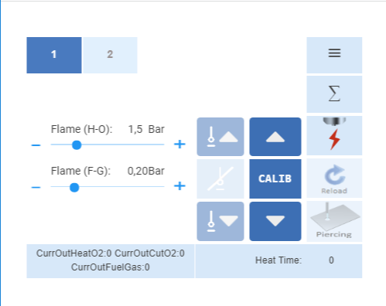
Process mode: Process is active
Actual pressure or flow value
When preheating is active, Menue and error list
can not be opened or will be closed
Flame(H-O): 1,5 1,7
Flame(F-G): 0,2 0,2
30
Current process status
Off, preheat, pierce, cut
50000 | 6mm | PSF3-6
405mm/min 1,6 mm kerf
Preheat
Current status message (latest error etc.)
Touching field open error list (all stations)
Current data set loaded to CU+

Slide 6
Group: Torch Parameter
Ignition detection enable/disable Level 1
Flashback sensitivity Level 1
Flame offset Level 1

Slide 7
Gas
Gas -> Menue name
Lock Gas Flow -> Sub Menue name
Pressure output Lock/Unlock Level 1 -> Parameter
Pressure Test -> Sub Menue name
H-O Slider Enable/Disable
C-O Slider Enable/Disable
F-G Slider Enable/Disable

Slide 8
Service
Help button Level 0 – 2 (based on login level)
System log (Cu+ Histogram PLISTorch Histogram) FOR ALL STATIONS Level 1

