Slide 1
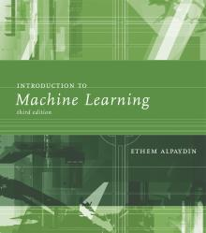
INTRODUCTION TO Machine Learning 3rd Edition
Lecture Slides for
ETHEM ALPAYDIN
© The MIT Press, 2014
alpaydin@boun.edu.tr
http://www.cmpe.boun.edu.tr/~ethem/i2ml3e

Slide 2
CHAPTERs 6-7 RECAP: Clustering and DIMENSIONALITY REDUCTION

Slide 3
k-Means Clustering
Find k reference vectors (prototypes/codebook vectors/codewords) which best represent data
Reference vectors, m_{j}, j =1,...,k
Use nearest (most similar) reference:
Reconstruction error

Slide 4
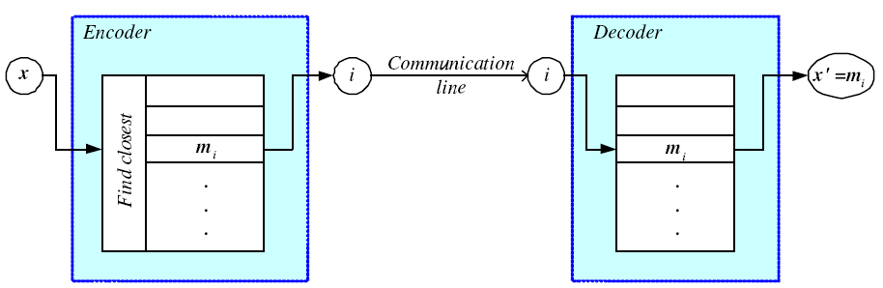
Encoding/Decoding

Slide 5
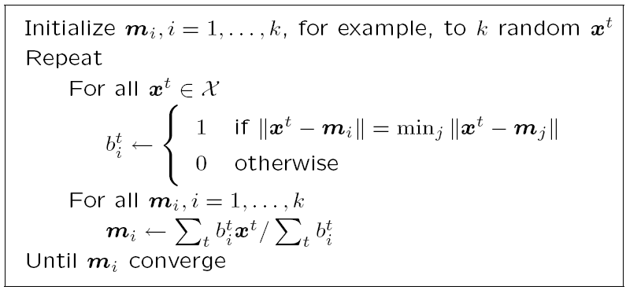
k-means Clustering

Slide 6
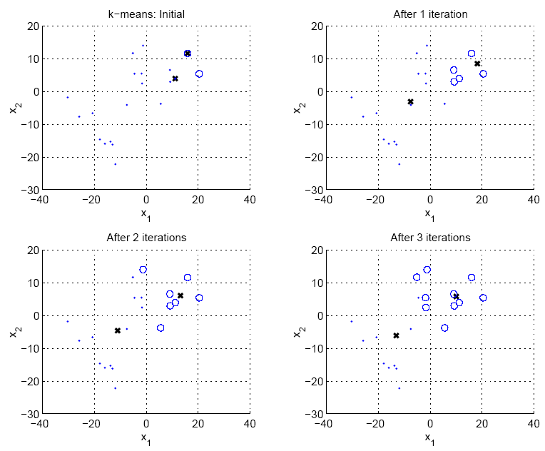

Slide 7
Hierarchical Clustering
Cluster based on similarities/distances
Distance measure between instances x^{r} and x^{s}
Minkowski (L_{p}) (Euclidean for p = 2)
City-block distance

Slide 8
Agglomerative Clustering
Start with N groups each with one instance and merge two closest groups at each iteration
Distance between two groups G_{i} and G_{j}:
Single-link:
Complete-link:
Average-link, centroid

Slide 9
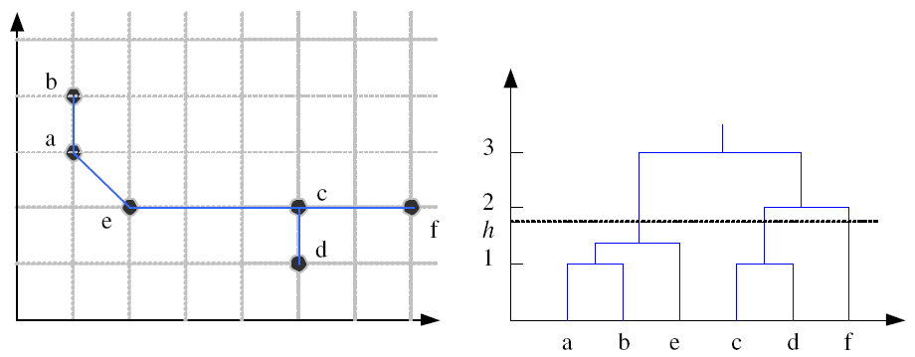
Example: Single-Link Clustering
Dendrogram

Slide 10
Choosing k
Defined by the application, e.g., image quantization
Plot data (after PCA) and check for clusters
Incremental (leader-cluster) algorithm: Add one at a time until “elbow” (reconstruction error/log likelihood/intergroup distances)
Manually check for meaning

Slide 11
Examples
https://github.com/olcaykursun/ML/blob/main/Spring25/kmeans_example_convergence_inertia.ipynb
https://github.com/olcaykursun/ML/blob/main/Spring25/color_quantization_china_elbow.ipynb

Slide 12
Why Reduce Dimensionality?
Reduces time complexity: Less computation
Reduces space complexity: Fewer parameters
Saves the cost of observing the feature
Simpler models are more robust on small datasets
More interpretable; simpler explanation
Data visualization (structure, groups, outliers, etc) if plotted in 2 or 3 dimensions

Slide 13
Feature Selection vs Extraction
Feature selection: Choosing k<d important features, ignoring the remaining d – k
Subset selection algorithms
Feature extraction: Project the
original x_{i} , i =1,...,d dimensions to
new k<d dimensions, z_{j} , j =1,...,k

Slide 14
Subset Selection
There are 2^{d} subsets of d features
Forward search: Add the best feature at each step
Set of features F initially Ø.
At each iteration, find the best new feature
j = argmin_{i} E ( F ∪ x_{i} )
Add x_{j} to F if E ( F ∪ x_{j} ) < E ( F )
Hill-climbing O(d²) algorithm
Backward search: Start with all features and remove one at a time, if possible.
Floating search (Add k, remove l)

Slide 15
Principal Components Analysis
Find a low-dimensional space such that when x is projected there, information loss is minimized.
The projection of x on the direction of w is: z = w^{T}x
Find w such that Var(z) is maximized
Var(z) = Var(w^{T}x) = E[(w^{T}x – w^{T}μ)²]
= E[(w^{T}x – w^{T}μ)(w^{T}x – w^{T}μ)]
= E[w^{T}(x – μ)(x – μ)^{T}w]
= w^{T} E[(x – μ)(x –μ)^{T}]w = w^{T} ∑ w
where Var(x)= E[(x – μ)(x –μ)^{T}] = ∑

Slide 16
Maximize Var(z) subject to ||w||=1
∑w₁ = αw₁ that is, w₁ is an eigenvector of ∑
Choose the one with the largest eigenvalue for Var(z) to be max
Second principal component: Max Var(z₂), s.t., ||w₂||=1 and orthogonal to w₁
∑ w₂ = α w₂ that is, w₂ is another eigenvector of ∑
and so on.

Slide 17
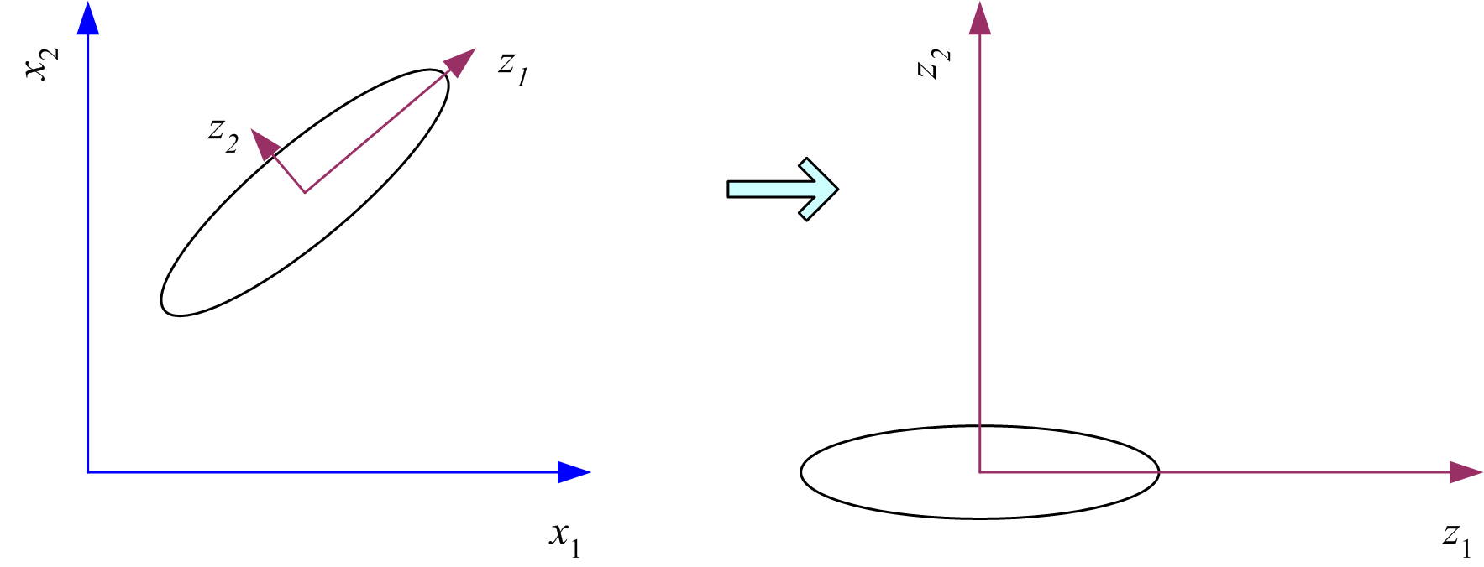
What PCA does
z = W^{T}(x – m)
where the columns of W are the eigenvectors of ∑ and m is sample mean
Centers the data at the origin and rotates the axes

Slide 18
How to choose k ?
Proportion of Variance (PoV) explained
when λ_{i} are sorted in descending order
Typically, stop at PoV>0.9
Scree graph plots of PoV vs k, stop at “elbow”

Slide 19
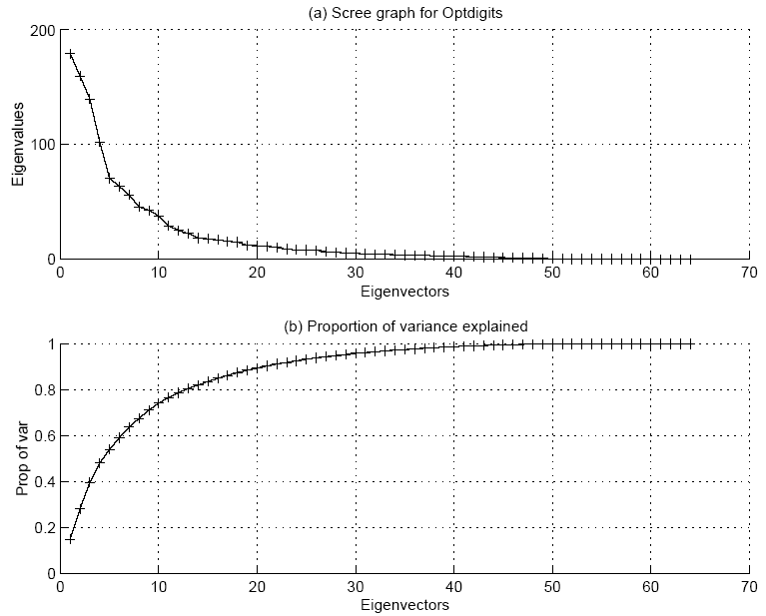

Slide 20
