Slide 1
Linear Discriminant Trees
Olcay Taner Yıldız, Ethem Alpaydın
Department of Computer Engineering
Boğaziçi University, Istanbul Turkey
yildizol@yunus.cmpe.boun.edu.tr

Slide 2
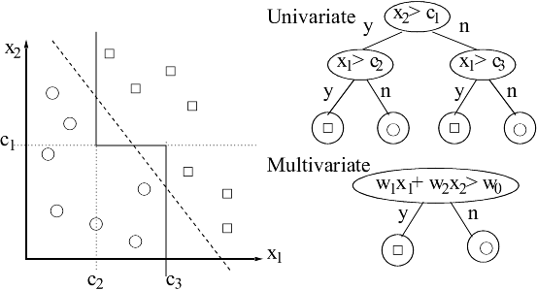
Decision Trees

Slide 3
Decision Tree Algorithms
Univariate Algorithm
  ID3, C4.5 (Quinlan 1986)
Multivariate Algorithms
  CART (Breiman et al., 1984)
  Neural Trees (Guo and Gelfand, 1992)
  OC1 (Murthy, Kasif & Salzberg, 1994)
  LMDT (Brodley and Utgoff, 1995)
Notes:
CART:Stepwise perturbation for coefficients

Slide 4
ID-LDA Tree Construction
Divide K classes in that node into two parts. (Outer Optimization)
Solve two class problem with LDA in that node. (Inner optimization)
For each of two child nodes repeat step 1 and step 2 recursively until each node has only one class in it.

Slide 5
Class Separation by Exchange Method (Guo & Gelfand, 1992)
Select an initial partition of C into C^{L} and C^{R}, both containing K/2 classes
Train the discriminant to separate C^{L} and C^{R}. Compute the entropy E₀ with the selected entropy formula
For each of the classes i in C₁ ... C_{k} form the partitions C_{L(i)} and C_{R(i)} by changing the assignment of the class C_{i} in the partitions C^{L} and C^{R}
Train the neural network with the partitions C_{L(i)} and C_{R(i)}. Compute the entropy E_{i} and the decrease in the entropy ΔE_{i}=E_{i}-E₀
Let ΔE* be the maximum of the impurity decreases over all possible i and i* be the i causing the largest decrease. If this impurity decrease is less than zero then exit else set C^{L}=C^{L}(i*), C^{R}=C^{R}(i*), and goto step 2

Slide 6
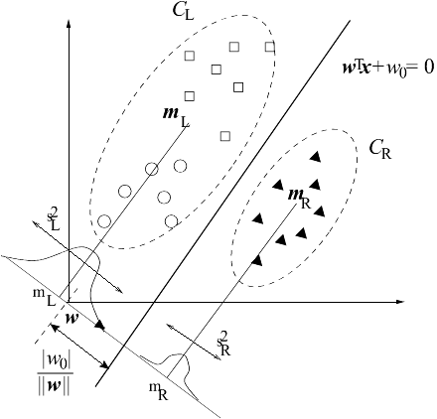
Linear Discriminant Analysis

Slide 7
PCA for Feature Extraction
Singular Matrix Problem S_{w}
Answer: Principal Component Analysis
Find most important k eigenvectors
Feature Extraction
  PCA finds new k dimensions as linear combinations of d features.
  Subset selection finds the best k dimensions discarding d-k features.

Slide 8
Experiments
20 data sets from UCI Repository are used
Three different criteria used
  Accuracy
  Tree Size
  Learning Time
For comparison 5×2 cv F-Test is used. (Alpaydın, 1999)

Slide 9
Results for Accuracy
 | ID3 | CART | ID-LP | OC1 | LMDT | ID-LDA
ID3 | - | 4 | 4 | 5 | 1 | 3
CART | 0 | - | 2 | 1 | 1 | 1
ID-LP | 4 | 6 | - | 3 | 0 | 1
OC1 | 1 | 0 | 1 | - | 1 | 0
LMDT | 4 | 6 | 1 | 4 | - | 1
ID-LDA | 5 | 8 | 2 | 5 | 2 | -
 | ID3 | CART | ID-LP | OC1 | LMDT | ID-LDA
ID3 | - | 2 | 0 | 4 | 1 | 0
CART | 4 | - | 0 | 1 | 1 | 0
ID-LP | 20 | 19 | - | 14 | 11 | 9
OC1 | 2 | 2 | 0 | - | 0 | 0
LMDT | 14 | 9 | 0 | 6 | - | 4
ID-LDA | 13 | 10 | 0 | 8 | 5 | -
Results for Tree Size
 | ID3 | CART | ID-LP | OC1 | LMDT | ID-LDA
ID3 | - | 20 | 17 | 18 | 4 | 10
CART | 0 | - | 1 | 2 | 0 | 0
ID-LP | 0 | 17 | - | 17 | 0 | 1
OC1 | 0 | 8 | 1 | - | 0 | 0
LMDT | 15 | 20 | 19 | 18 | - | 15
ID-LDA | 3 | 20 | 13 | 18 | 0 | -
Results for Learning Time

Slide 10
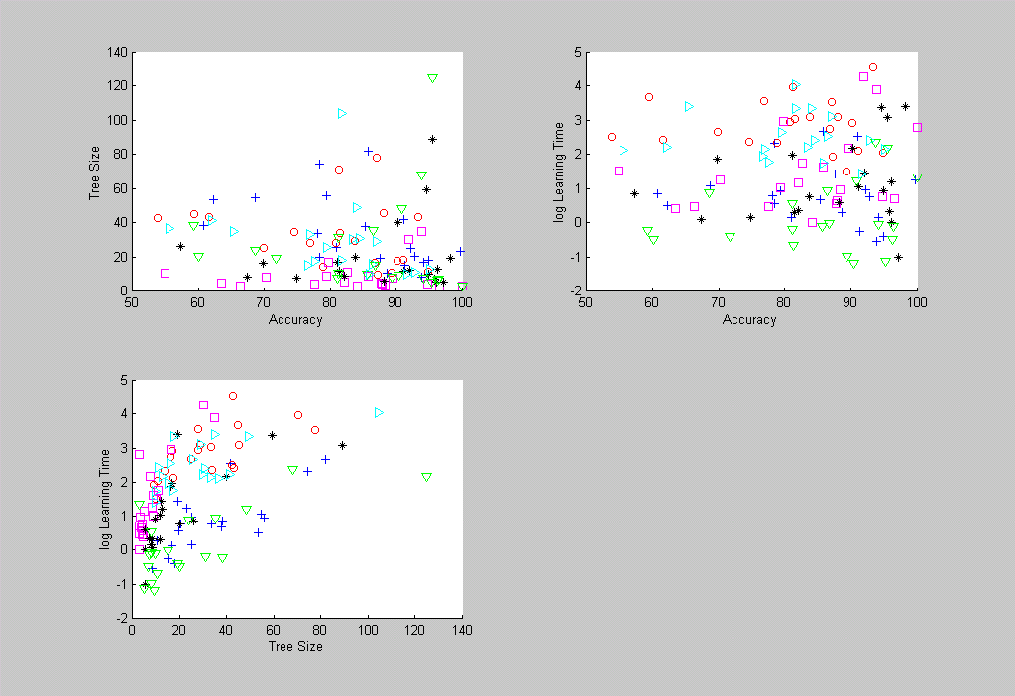

Slide 11
Conclusions
A novel method for constructing multivariate linear decision trees
Binary splits
No iterative training

