Slide 1
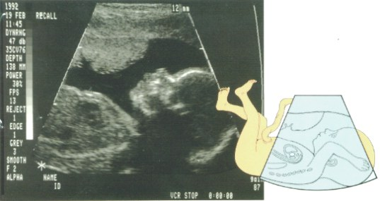
A Comparison of Discriminant Functions and Decision Tree Induction Techniques for Evaluation of Antenatal Fetal Risk Assessment
Nilgün Güler, Olcay Taner Yıldız, Fikret Gürgen, Füsun Varol
Notes:
our purpose is to investigate the doppler ultrasound measurements of umbilical artery (UA) to relate the health conditions of fetuses using discriminant functions and decision trees methods

Slide 2
Doppler Velocimetry
The principle of Doppler ultrasound has been utilized to measure the blood flow in the uterine and fetal vessels.
Indices are computed (PI, RI, S/D ratio) for motinoring fetus.
Notes:
There are different kind of test methods for fetal surveillance. One of them which s a kind of non-invasive method is Doppler velocity. OKU

Slide 3
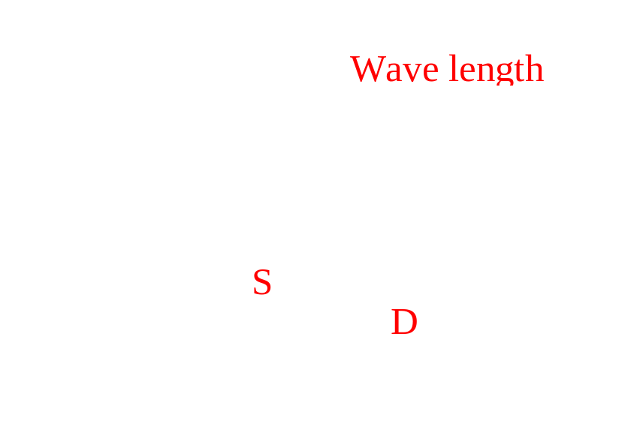
Doppler Ultrasound Indices
Systolic/diastolic (S/D) ratio index, S/D= S / D
Resistance index, RI=(S-D)/S
Pulsality index, PI =(S-D)/mean velocity
Notes:
This shema shows that how to calculate this indices. White Thin line is Wave length.
S is measurement of peak Systolic value.
D is measurement of Diastolic value.
And These equations are shows how to calculate it.

Slide 4
PI, RI, S/D ratio for UA between 20 and 40 weeks
Gestational age (Week)
Pulsality Index
Resistence Index
S/D ratio
20
1.35
0.77
4.40
22
1.25
0.73
3.95
24
1.19
0.72
3.60
26
1.12
0.67
3.40
28
1.08
0.64
3.20
30
0.97
0.63
3.00
32
0.95
0.60
2.80
34
0.90
0.60
2.65
36
0.80
0.55
2.55
38
0.75
0.52
2.40
40
0.72
0.51
2.20
Notes:
The table shows that a part of data that are the examinations of pregnant women in the range between 20 and 40 weeks. In normal pregnancy; The PI, RI and S/D ratio in the umbilical artery decrease with advancing gestation.but an abnormal umbilical artery waveform has a PI (or RI or S/D ratio) value above the normal range.

Slide 5
The proposed antepartum risk assessment system
Doppler indices
Week Index
Decision by
discriminant function
Or decision tree
Fetal risk of hypoxia assessment
S/D ratio
PI
RI
Notes:
This is a our proposed antepartum risk assessment system The system receives weekly doppler ultrasound examinations as input and produces an output correlated with clinical conditions.

Slide 6
Using Methods
Discriminant Functions
  Linear Decision Algorithm (LDA)
  Multi-layer Perceptron (MLP)
Decision tree methods
  C4.5
  CART
Notes:
Discriminant function analysis has been an important decision tool for various pattern recognition applications and generally transform input feature space on the directions of maximum separability. In this study we use Linear Decision Algorithm (LDA) and Multi-layer Perceptron (MLP)
On the other hand, Decision trees test the attributes in order to make an optimal classification decision. ID3 and CART are the most commonly used ones. ID3 selects the best attribute for this purpose, but CART does the same task by choosing the best linear combination of the attributes

Slide 7
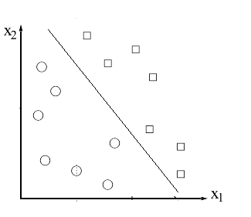

Decision by LDA
The linear discriminant is the classifier that results from applying Bayes rule to the problem of classification, under the following assumptions:
  the data is normally distributed
  the covariances of every class are equal
Decision produced by LDA
Notes:
Okurst
The figure shows how decision produced by LDA
An equation is linear Discrimant function. M1 is mean vector of first group
M2 is mean vector of second group
X is input vector

Slide 8
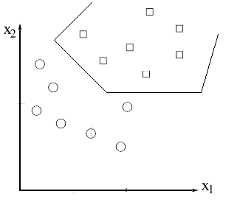
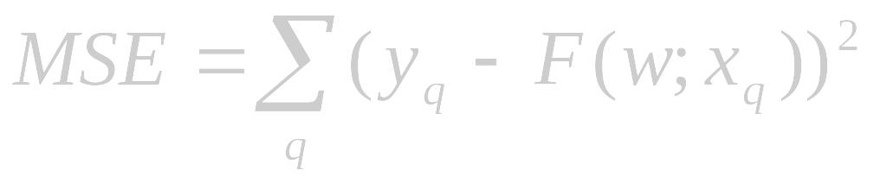
Decision by MLP:
Non-linear discriminant functions.
Feedforward network
Training with Back-propagation algorithm (BP)
Error Function is MSE
Decision produced by MLP
Notes:
Among the ANNs, the elementary multilayer perceptrons (MLP) with sigmoidal transfer function have been successfully applied to solve some difficult and diverse problems as a nonlinear discriminant function
The feedforward network learns from the input data by the supervision of the output data creating single linear discriminant functions by each sigmoid hidden unit and combines them. Thus, this piecewise linear discriminant function works as a nonlinear discriminator.
Training them in a supervised manner with a highly popular algorithm known as the error back-propagation (BP)r. The back-propagation is an optimization technique for implementing gradient descent in weight space for multilayer feedforward networks.
The weights are adjusted to fit linear piecewise discriminant functions to feature space for the best class separability. The difference between the network’s output and the supervisor output is minimized according to a predefined error function (performance criterion) such as mean square error (MSE) (eqn.2) etc. The error function helps to place the discriminators to right location and positions

Slide 9
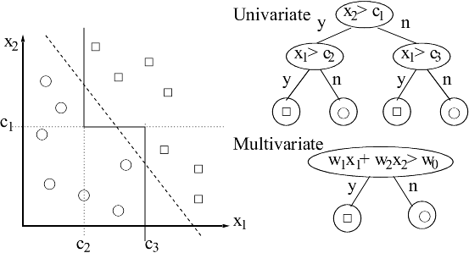
Decision Trees
Normal
Abnormal

Slide 10
Univariate Trees (C 4.5)
Constructs decision trees top-down manner.
Select the best attribute to test at the root node by using a statistical test.
Descendants of the root node are created for each possible value of the attribute. Two for numeric attributes as x_{i}< a and x_{i}> a, m for symbolic attributes as x_{i} = a_{k}, k = 1, …, m.

Slide 11
Classification and Regression Trees (CART)
Each instance is first normalized.
Algorithm takes a set of coefficients W=(w₁,…, w_{n}) and searches for the best split of the form v=Sum_{i}(w_{i}x_{i}) ≤ c for i=1 to n.
Algorithm cycles through the attributes x₁,…, x_{n} at each step doing a search for an improved split.
At each cycle CART searches for the best split of the form v-δ(x_{i}+ γ) ≤ c. The search for δ is carried out for γ = -0.25, 0.0, 0.25.
Best of δ and γ are used to update linear combination.

Slide 12
The number of training and test samples
Data from Umbilical Arter
 | Normal fetuses | Abnormal fetuses | Total
Training samples | 101(72%) | 46(28%) | 147
Test samples | 42(66%) | 21(44%) | 63

Slide 13
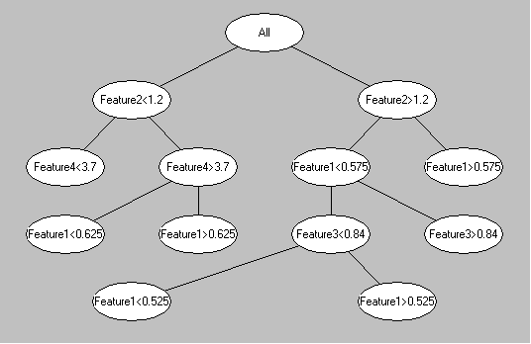
C 4.5 Decision Tree
Normal
Abnormal
Abnormal
Normal

Slide 14
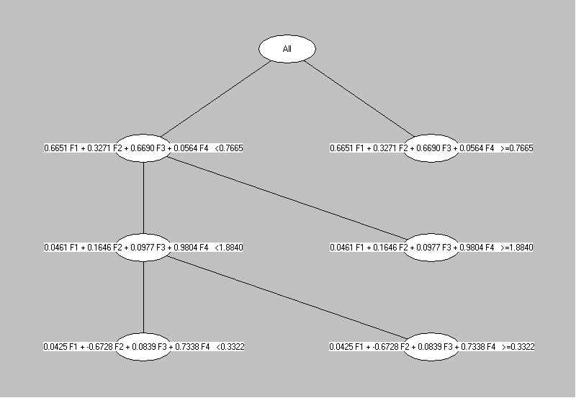
CART Decision Tree
Normal
Abnormal

Slide 15

Statistic assessment of antepartum testing
Sensitivity=D/(D+B)
Specifity=A/(A+C)
Predictive value of positive test =D/(C+D)
Predictive value of negative test=A/(A+B)

Slide 16
Prevalence Data from UA
Sensitivity
Specificity
PPT
PNT
LDA
100%
76%
68%
100%
MLP
100%
93%
88%
100%
C4.5
100%
74%
66%
100%
CART
100%
93%
88%
100%
Notes:
The table shows that our methods results. As you see all methods achieved for identfy the abnormal cases. LDA and ID3 methods are poorer to identfy normal cases.
The highest specificity and sensitivity of systems is achieved by MLP & CART
The others techniques(LDA & ID3) are poorer to specify the predicting normal cases while they are very good at the predicting abnormal cases.

Slide 17
Conclusion
The discriminant functions obtain an optimal decision by the combination of attributes in the linear or piecewise linear form.
The decision trees obtain similar decision by employing a tree that give the result by selection of the best attribute or the linear combination of the best attributes at each decision node.
CART is found to be the best decision maker for antepartum fetal evaluation in decision tree methods.
MLP is also shown to be the most effective class discriminator for the same problem.
This study points a fruitful line of enquiry for helping doctors in the risk assessment of antenatal fetal evaluation.
Notes:
The study points the following facts:
oku

Slide 18
The test proposed for fetal surveillance
Non-stress test (NST)
Echographic evaluation of the fetal growth rate
Doppler velocimetry (Non-invasive)
Fetal biophysical profile by Ultrasound Image
Amniotic fluid volume assessment

Slide 19
Statistic assessment of antepartum testing
Sensitivity=D/(D+B)
Specifity=A/(A+C)
Predictive value of positive test =D/(C+D)
Predictive value of negative test=A/(A+B)

Slide 20
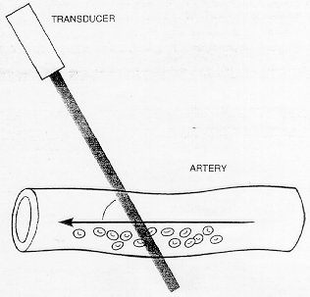
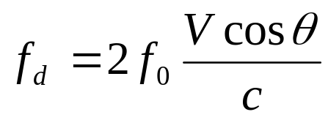
How to extract Doppler Indices:
f_{d} : the change in ultrasound frequency or Doppler shift,
f₀ : the transmitted of the incident ultrasound,
V: the velocity of the reflector or red blood cells,
θ : the angle between the beam and the direction of movement of the reflector or blood cells,
c: the velocity of sound in the medium.

