Slide 1
Comparing Univariate and Multivariate Decision Trees
Olcay Taner Yıldız
Ethem Alpaydın
Department of Computer Engineering
Bogazici University
E-mail: yildizol@yunus.cmpe.boun.edu.tr

Slide 2
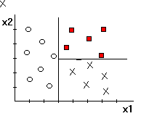
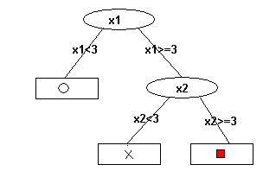
Univariate Trees (ID3)
Constructs decision trees top-down manner.
Select the best attribute to test at the root node by using a statistical test.
Descendants of the root node are created for each possible value of the attribute. Two for numeric attributes as x_{i}< a and x_{i}> a, m for symbolic attributes as x_{i} = a_{k}, k = 1, …, m.

Slide 3
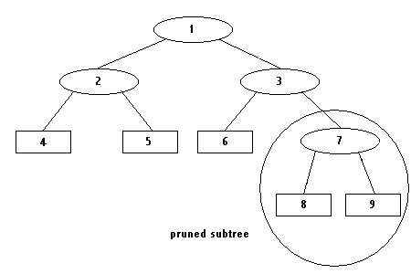
ID3 Continued
Partition Merit Criteria
  Information Gain Entropy = Sum_{i}(p_{i}logp_{i})
  Weak Theory Learning Measure
  Gini Index
Avoiding Overfitting
  Pre-pruning
  Post-pruning

Slide 4
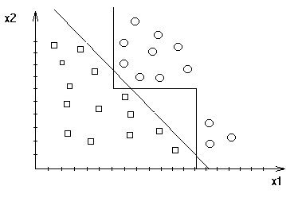
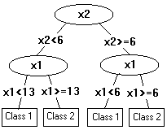
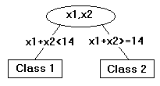
Univariate versus Multivariate

Slide 5
Classification and Regression Trees (CART)
Each instance is first normalized.
Algorithm takes a set of coefficients W=(w₁,…, w_{n}) and searches for the best split of the form v=Sum_{i}(w_{i}x_{i}) ≤ c for i=1 to n.
Algorithm cycles through the attributes x₁,…, x_{n} at each step doing a search for an improved split.
At each cycle CART searches for the best split of the form v-δ(x_{i}+ γ) ≤ c. The search for δ is carried out for γ = -0.25, 0.0, 0.25.
Best of δ and γ are used to update linear combination.

Slide 6
CART continued
Univariate vs Multivariate Splits
Symbolic and Numeric Features conversion
  Color: (red, green, blue)
  red: 100 green:010 blue:001
Feature Selection
  The most important single variable is the one whose deletion causes the greatest deterioration.

Slide 7
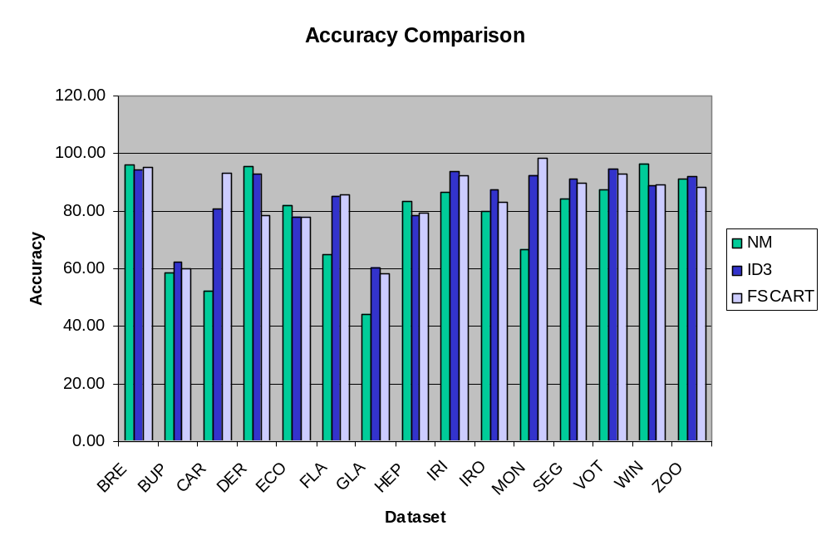

Slide 8
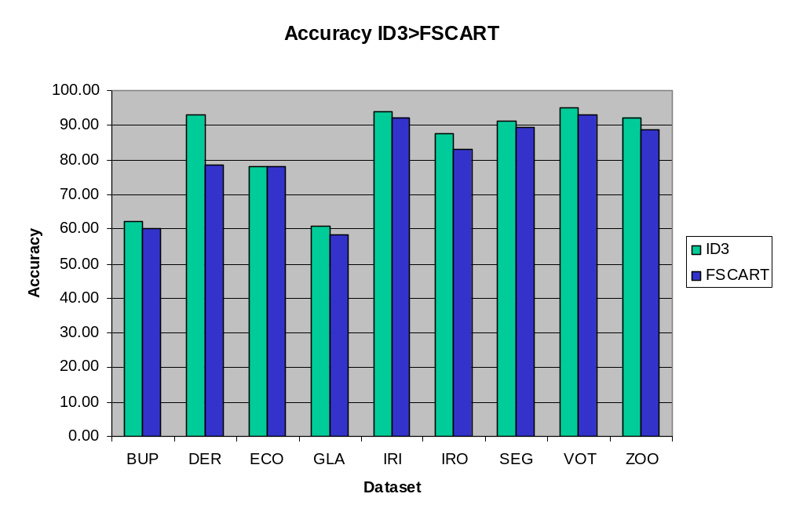

Slide 9
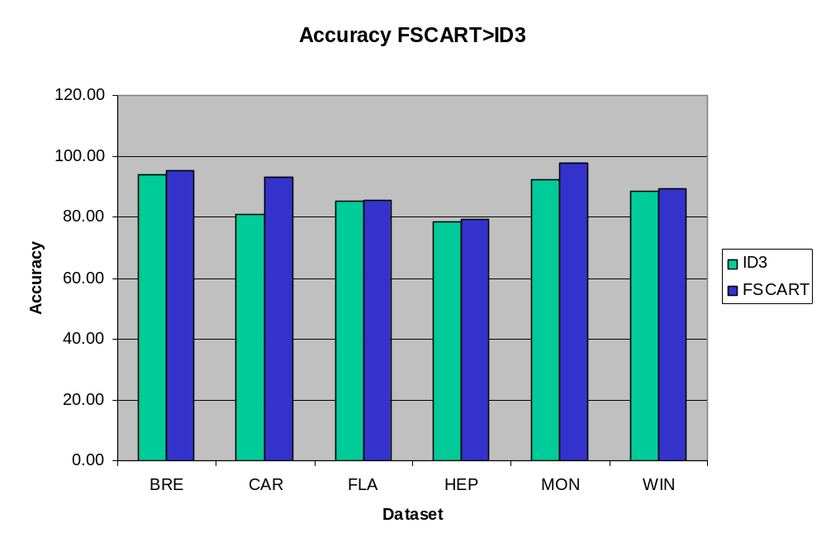

Slide 10
Conclusions for ID3
For three partition merit criteria (Entropy, Weak Theory Learning Measure, Gini Index) there is no significant difference in accuracy, node size and learning time difference between them.
Pruning increases accuracy and post-pruning is better than pre-pruning in case of accuracy and node size at the expense of more computation time.

Slide 11
Conclusions for CART
When feature selection is applied, CART accuracy is statistically significantly increased and node size is decreased in 13 datasets out of 15.
Multivariate method CART does not always increase accuracy and does not always lower node size.

Slide 12

Questions

