Slide 1
Neural Trees
Olcay Taner Yıldız, Ethem Alpaydın
Boğaziçi University
Computer Engineering Department
yildizol@yunus.cmpe.boun.edu.tr

Slide 2
Overview
Decision Trees
Neural Trees
  Linear Model
  Nonlinear Model
  Hybrid Model
Class Separation Problem
  Selection Method
  Exchange Method
Results
Conclusion and Future Work

Slide 3
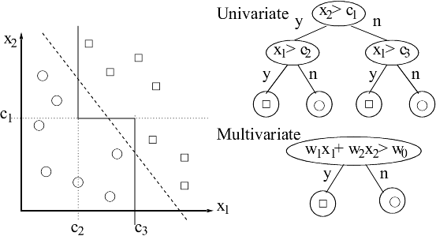
Decision Trees

Slide 4
Neural Trees
A Neural Network at each decision node
Three Neural Network Models
  Linear Perceptron
  Multilayer Perceptron (Guo, Gelfand 1992)
  Hybrid Model (Statistical Test to decide Linear or Nonlinear Model)

Slide 5
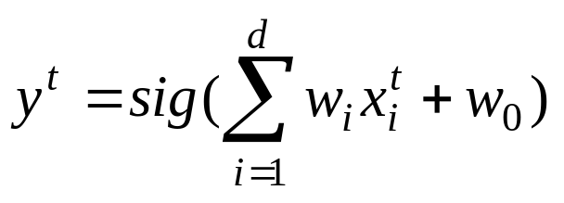
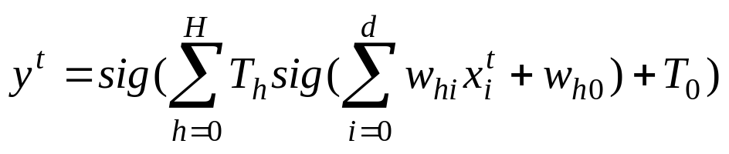
Network Models
Linear perceptron
Multilayer perceptron
Hybrid (According to 5×2 cv F-Test result select multilayer or linear perceptron %95 confidence level)

Slide 6
Training of Neural Trees
Divide k classes in that node into two parts.
Solve two class problem with the neural network model in that node.
For each of two child nodes repeat step 1 and step 2 recursively until each node has only one class in it.

Slide 7
Class Separation Problem
Division of k classes into two can be done in 2^{k-1}-1 different ways. (Too large for big k)
Two heuristic methods
  Selection Method O(k)
  Exchange Method O(k²)

Slide 8
Selection Method
Select two classes C_{i} and C_{j} at random and put one in C^{L} and the other in C^{R}
Train the discriminant with the given partition. Do not consider the instances of other classes yet.
For other classes in the class list, search for the class C_{k} that is best placed into one of the partitions.
Add C_{k} to C^{L} or C^{R} depending on on which side its instances fall more and continue adding classes one by one using steps 2 to 4 until no more classes are left

Slide 9
Exchange Method
Select an initial partition of C into C^{L} and C^{R}, both containing k/2 classes
Train the discriminant to separate C^{L} and C^{R}. Compute the entropy E₀ with the selected entropy formula
For each of the classes k in C₁ ... C_{k} form the partitions C_{L(k)} and C_{R(k)} by changing the assignment of the class C_{k} in the partitions C^{L} and C^{R}
Train the neural network with the partitions C_{L(k)} and C_{R(k)}. Compute the entropy E_{k} and the decrease in the entropy ΔE_{k}=E_{k}-E₀
Let ΔE* be the maximum of the impurity decreases over all possible k and k* be the k causing the largest decrease. If this impurity decrease is less than zero then exit else set C^{L}=C^{L}(k*), C^{R}=C^{R}(k*), and goto step 2

Slide 10
Experiments
20 data sets from UCI Repository are used
Three different criteria used
  Accuracy
  Tree Size
  Learning Time
For comparison 5×2 cv F-Test is used.

Slide 11
Results for Accuracy
 | ID3 | CART | ID-LP | ID-MLP | ID-Hybrid
ID3 | - | 4 | 1 | 1 | 1
CART | 0 | - | 1 | 1 | 1
ID-LP | 4 | 7 | - | 0 | 0
ID-MLP | 4 | 5 | 1 | - | 1
ID-Hybrid | 4 | 8 | 0 | 0 | -

Slide 12
Results for Tree Size
 | ID3 | CART | ID-LP | ID-MLP | ID-Hybrid
ID3 | - | 2 | 0 | 0 | 0
CART | 3 | - | 0 | 0 | 0
ID-LP | 18 | 18 | - | 0 | 0
ID-MLP | 19 | 17 | 6 | - | 2
ID-Hybrid | 18 | 18 | 0 | 0 | -

Slide 13
Results for Learning Time
 | ID3 | CART | ID-LP | ID-MLP | ID-Hybrid
ID3 | - | 20 | 8 | 11 | 15
CART | 0 | - | 0 | 0 | 1
ID-LP | 7 | 19 | - | 10 | 19
ID-MLP | 7 | 20 | 0 | - | 19
ID-Hybrid | 2 | 17 | 0 | 0 | -

Slide 14
Conclusion
Accuracy:
ID-LP = ID-MLP = ID-Hybrid>ID3=CART
Tree Size:
ID-MLP = ID-Hybrid > ID-LP > CART > ID3
Learning Time:
ID3 > ID-LP > ID-MLP > ID-Hybrid > CART
Linear Discriminant Trees (ICML2k)

