Slide 1

The Cray XC30 “Darter” System
Daniel Lucio

Slide 2
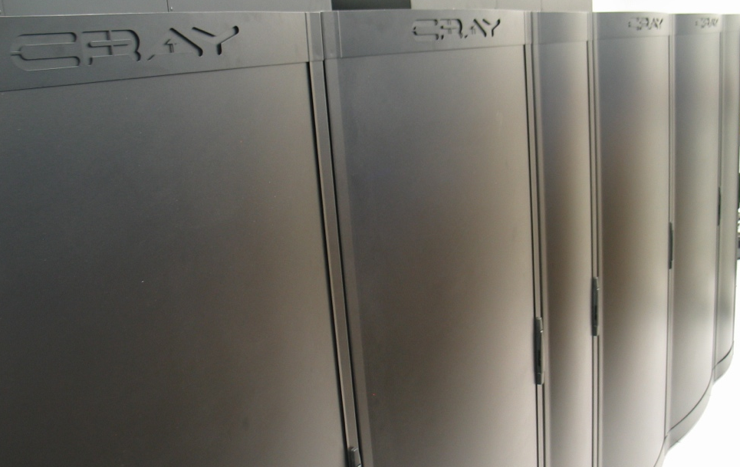
The Darter Supercomputer

Slide 3
The Darter Supercomputer
Funded by the University of Tennessee to study cutting edge computing technologies
Available since April 2013
Next generation network interconnect (developed by DARPA HPCS program)
250 TFlops of peak performance
Uses Intel technology
Native shared library support

Slide 4
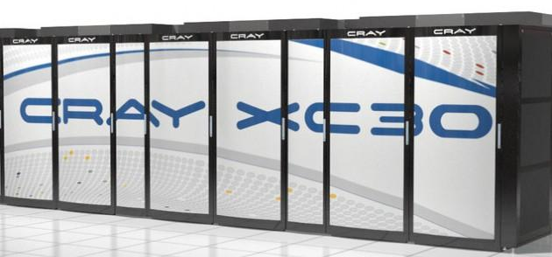
Darter Specs
Cray XC30 (Cascade)
Cray Linux Environment 5.0 upo3
4 compute racks
23,936 compute cores w/hyper threading
24 TB of compute memory
334TB Sonexion parallel file system
748 compute nodes
Cray Aries Interconnect
Each compute node has:
Two 2.6 GHz eight-core Intel SandyBridge (Xeon E5-2670) processors
16 physical cores (32 w/hyper-threading)
32 GB of memoryCray Aries interconnect with 8GB/sec bandwidth

Slide 5
Darter features?
Home areas are the same across all NICS resources
Latest software development tools available
Native Shared libraries support
Hyper-Threading is off by default. Need to use aprun option ‘-j 2’ to turn it on
No GSI access support.
No PGI Compiler available
Software tree is smaller, but you can do requests
http://www.nics.tennessee.edu/request-software-installation-nics

Slide 6
Darter Allocations
Time available through JICS/NICS Discretionary Allocations.
Access to UT academic community, Regional Education Partners and Industrial Partners.
 | Research Allocation | Pilot Allocation | EOT Allocation per event
Darter (core hours) | 500K-1M | 200K | 5K
http://www.nics.tennessee.edu/darter-allocations

Slide 7
Darter vs Kraken facts
 | Darter | Kraken
Allocations | NICS/JICS | XSEDE/NICS
Processor | Intel Xeon | AMD Istanbul
Interconnect | Cray SeaStar | Cray Aries
Network Topology | 3D-torus | Dragongfly
Shared Library support | YES! | no
HPSS access | no | yes
Software Tree status | Updated | Frozen
Default compiler | Cray CCE | PGI

Slide 8
Darter vs Kraken facts
 | Darter | Kraken
Memory per node | 32 | 16
#Cores per node | 16 (32) | 12
Hyper-threading | YES | N/A
Size for Node allocation | 32 | 12
The size of allocation need to be a multiple of 32. This is because PBS expects the number of logical cores to use, and there are 32 logical cores per node.

Slide 9
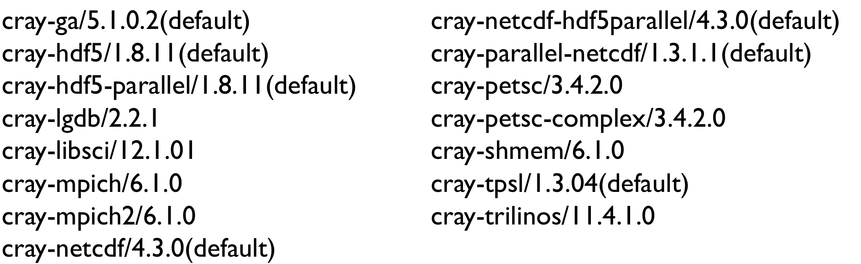
Naming conventions
Cray modules now start with ‘’cray-’
Note: FFTW library still called ‘fftw’

Slide 10
Going from PGI to Intel
PGI | Intel | Description
-fast | -fast -no-ipo | Standard optimization
-mp= nonuma | -openmp | Enable OpenMP support
-Mfixed | -fixed | Fortran fixed format support
-Mfree | -free | Fortran free format support
-byteswapio | -convert big_endian | Read and write Fortran unformatted data files as big endian.
 | -mkl | Link to Intel MKL
-V | --version | Show compiler version

Slide 11
Support for CAF and UPC
The Cray compiler compiler provides native support for Coarray Fortran and Unified Parallel C:
CAF example:
ftn -h caf -o CAFhello CAFhello.f90
UPC example:
cc -h upc -o UPCProg UPCProg.c

Slide 12
Compiler options
Recommended standard optimization arguments:
Cray: none, it does automatically
Intel: -fast -no-ipo
Gnu: -O3 -ffast-math
When using the Intel compiler, you need to use option ‘-mkl’ as a flag at link time to compile against the Intel MKL library.

Slide 13
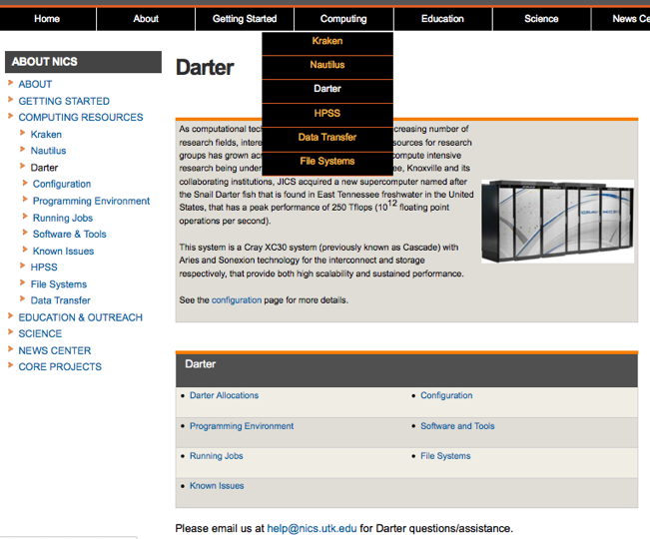
Darter Documentation
http://www.nics.tennessee.edu/computing-resources/darter

Slide 14
Where to go for help?
help@nics.utk.edu
External links:
http://www.cray.com/Products/Computing/XC/Resources.aspx
https://www.olcf.ornl.gov/support/system-user-guides/eos-user-guide/
http://www.nersc.gov/users/computational-systems/edison/
http://user.cscs.ch/hardware/piz_daint_cray_xc30/index.html

