Slide 1
Eos Compilers
Fernanda Foertter
HPC User Assistance Specialist
Notes:
Cray Confidential Cray Proprietary

Slide 2
Available Compilers
Cray, Intel, GNU and PGI
Cray compiler wrappers
  Same command (ftn/cc/CC) regardless of compiler
  Links in MPI/Libsci libraries automatically
  Intel is the default
  Static linking is default
Always use the wrapper!
  module swap PrgEnv-cray PrgEnv-intel

Slide 3
Compiler tips
Some are more aggressive then others at optimization and standards
Safe to assume vendor knows its architecture best (e.g. Intel) and thus better at optimizing for their own
No compiler is superior for all codes
Try different compilers, good way of catching bugs
Test your application against lower optimization levels and included tests
Use system provided libraries

Slide 4
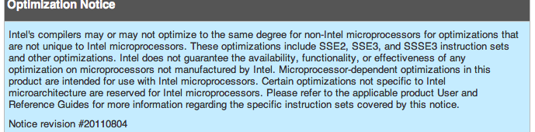
Caution

Slide 5
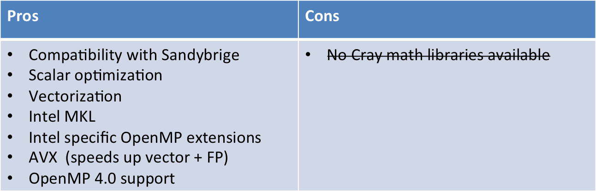
Intel specific tips

Slide 6
Some Intel Compiler Options
Flag | Description
none | Optimizes for speed; no flags, approx –O2 level
-fast | Maximizes speed across the entire program. Aggressive. Includes -ipo -O3 -no-prec-div -static -xHost
-fast -no-ipo | No IPO
-O0 | Disables optimizations
-O1 | Optimizes for speed but keeps binary small
-O2 | Speed + vectorizaiton, inlining
-O3 | O2 + aggressive loop transformations
-mkl=cluster | Single threaded MKL (BLAS/LAPACK/scaLAPACK/FFTW)
-mkl=parallel | Multi-Threaded MKL (No ScaLAPACK)
-xAVX | Default on Eos

Slide 7
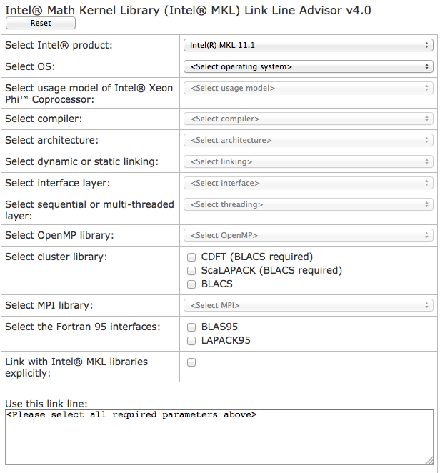
MKL link line builder
Source: http://software.intel.com/en-us/articles/intel-mkl-link-line-advisor

Slide 8
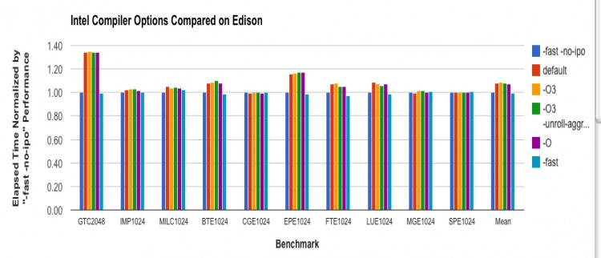
Edison Benchmark Results at NERSC
Not a lot of difference (lower is better)
Source: http://www.nersc.gov/users/computational-systems/edison/performance-and-optimization/compiler-comparisons/

Slide 9
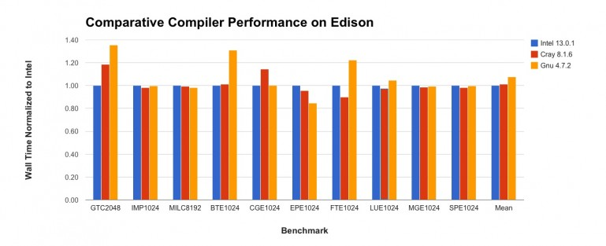
Edison Benchmark Results at NERSC
Not a lot of difference (lower is better)
Source: http://www.nersc.gov/users/computational-systems/edison/performance-and-optimization/compiler-comparisons/

Slide 10
Known Issue: Intel OpenMP Hybrid
The Cray thread affinity settings and Intel's run time OpenMP environment conflict.
Intel has an extra thread at run time, so 2 threads are scheduled on the same core and the job takes twice as long as it should.
Source: Introducing the Intel Compiler on Edison, Michael Stuart, NUG Feb 2013

Slide 11
Intel OpenMP Hybrid
CPU-binding should be turned off
  Allows user compute threads to spread out over available resources
  Helper thread will no longer impact performance
NERSC’s Edison Solution
OMP_NUM_THREADS <=8
  set KMP_AFFINITY compact + aprun -cc numa_node
OMP_NUM_THREADS >8 and <=16
  set KMP_AFFINITY scatter + aprun -cc none
Source: Introducing the Intel Compiler on Edison, Michael Stuart, NUG Feb 2013

Slide 12
OLCF.ORNL.GOV

