Slide 1
Eos Center-wide File Systems
Chris Fuson
  Outline
  1 Available Center-wide File Systems
  2 New Lustre File System
  3 Data Transfer
Notes:
Cray Confidential Cray Proprietary

Slide 2



Eos Center-wide File Systems
Eos
Login Nodes
NFS
/ccs/home
/ccs/proj
/ccs/sw
Spider II
/tmp/work
/tmp/proj
Compute Nodes
Compute nodes can not see NFS areas

Slide 3
Eos Center-wide File Systems
    NFS (/ccs)
      OLCF-wide; same as mounted on other OLCF systems
      Backed-up
      Frequently used items such as source code, binaries, and scripts
      Not available from compute nodes
/ccs/home/<usrid>
/ccs/proj/<projid>
/ccs/sw/xc30
10GB default quota
Login directory
$HOME
50GB default quota
Sharing within project
3rd party software
Also /sw/xc30

Slide 4
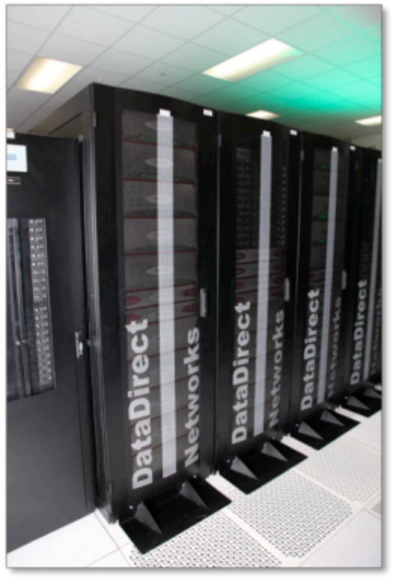

Eos Center-wide File Systems
    Spider
      Center-wide scratch space*
      Temporary; not backed-up
      Available from compute nodes
      Fast access to job-related temporary files and for staging large files to and from archival storage
      Contains multiple Lustre file systems
* Eos only mounts new Spider II file system

Slide 5
Spider I v/s Spider II
Spider I
Spider II
Widow [1-3]
240 GB/s
10 PB
3 MDS
192 OSS
1,344 OST
Current Center-wide Scratch
Not Mounted on Eos
Decommissioned Early 2014
Atlas [1-2]
1 TB/s
32 PB
2 MDS
288 OSS
2,016 OST
Currently Mounted Only on Eos
Available on Additional OLCF Systems Soon

Slide 6
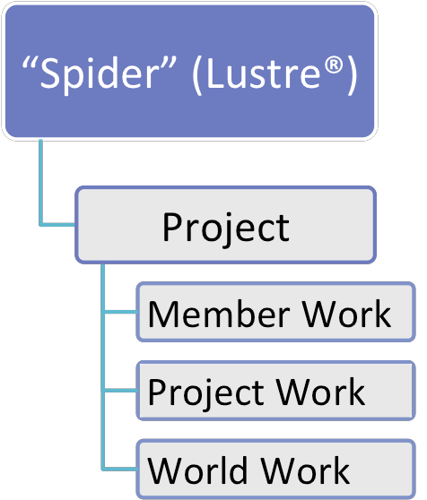
Spider II Change Overview
Before using Spider II, please note the following:
    New directory structure
      Organized by project
      Each project given a directory
      on one of the atlas filesystems
      $WORKDIR now within project areas
        You may have multiple $WORKDIRs
        * Requires Change
    Quota increases
      Increased file system size allows for increased quotas
    All areas purged
      To help ensure space available for all projects

Slide 7
Spider II Directory Structure
ProjectID
Member Work
Purpose: Batch job I/O
Path:
  $MEMBERWORK/<projid>
  $WORKDIR/<projid>
  /tmp/work/<userid>/<projid>
10 TB quota
14 day purge
Permissions:
  User allowed to change permissions to share within project
  No automatic permission changes
Project Work
World Work

Slide 8
Spider II Directory Structure
ProjectID
Member Work
Project Work
Purpose: Data sharing within project
Path:
  $PROJWORK/<projid>
  /tmp/proj/<projid>
100 TB quota
90 day purge
Permissions:
  Read, Write, Execute access for project members
World Work

Slide 9
Spider II Directory Structure
ProjectID
Member Work
Project Work
World Work
Purpose: Data sharing with users who are not members of project
Path:
  $WORLDWORK/<projid>
10 TB quota
14 day purge
Permissions:
  Read, Execute for world
  Read, Write, Execute for project

Slide 10
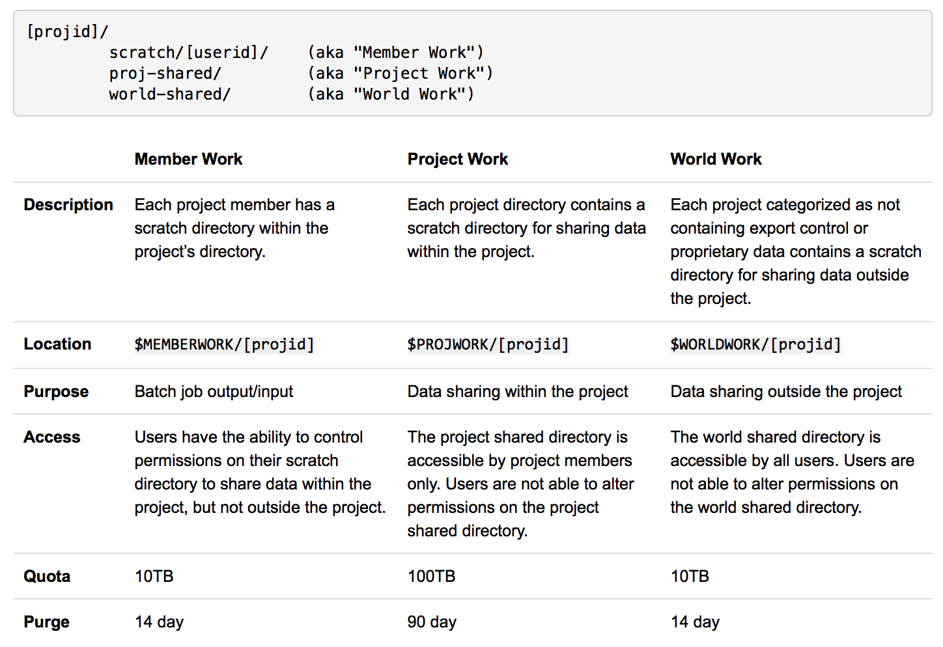
Spider II Directory Structure
    New directory structure
      Organized by project

Slide 11
Before Using New File System on Eos
Modify scripts to point to new directory structure
/tmp/work/$USER/<projid>
$WORKDIR/<projid>
$MEMBERWORK/<projid>
/tmp/work/$USER
$WORKDIR
/tmp/proj/<projid>
No change required
Migrate data
  Eos does not mount Spider I (widow)
  You will need to transfer needed data onto Spider II (atlas)

Slide 12
Data Migration from Spider I to Spider II
Currently only Eos mounts Spider II (atlas)
Eos does not mount Spider I (widow)
Common file system or archive
  NFS (/ccs)
    Small amounts of data
  HPSS
    Retrieve already archived data
    Please do not transfer data to HPSS with only purpose to retrieve onto Spider II
Remote data transfer
  Copy data from remote system that mounts Spider I
  scp
    Small amounts of data
  bbcp
    Multi-streaming
    Larger amounts of data

Slide 13
Data Migration from Spider I to Spider II
DTN
Eos
Spider I
Spider II
bbcp
/tmp/work/<userid>/file.tar
/tmp/work/<userid>/<projid>/file.tar
Eos command line:
$ bbcp -P 2 -v -w 8m -s 16 dtn04:/tmp/work/[userid]/file.tar /tmp/work/[userid]/[projid]/file.tar
Note: Environment variables are not available through remote copy utilities, should use path or /tmp/work, /tmp/proj links

Slide 14
Questions?
More information:
  www.olcf.ornl.gov/support/system-user-guides/eos-user-guide/
Email:
  help@olcf.ornl.gov

