Slide 1
Eos Overview
Eos Composition
Eos Access and Billing
Eos Queue Policy
Eos Compilers, PrgEnv, and Software
Documentation
Know Issues
File System
Suzanne Parete-Koon
Notes:
Cray Confidential Cray Proprietary

Slide 2
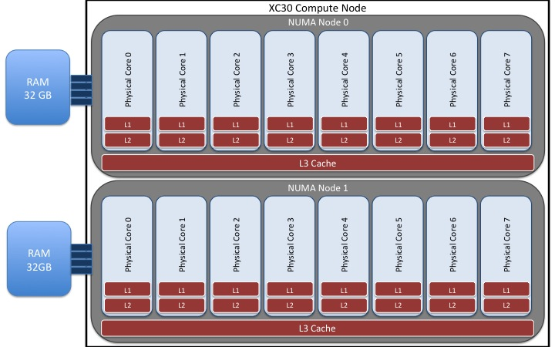
Eos Nodes
744 compute nodes, 16 physical cores/node, 64 GB/node.
  Two NUMA Domains L3 cache = 20 MB
  No Accelerators
  Hyper threading (32 logical core/node)
2 External Logins
Total of 11,904 cores and 47.6 TB DDR3 SDRAM

Slide 3
Eos Access and Billing
For the remainder of this year:
Eos is prioritized as an extra resource for INCITE users.
All INCITE projects will automatically be given an account on Eos.
30 Eos core hours are charged per node.
  Hours count for Usage
  Hours are not subtracted from INCITE Allocation

Slide 4
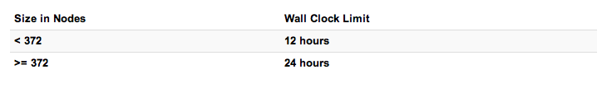
Eos Queue Policy
Queue Policy
  Unlimited running jobs
  Limit of (2) eligible-to-run jobs per user.
  Jobs in excess of the per user limit above will be placed into a held state, but will change to eligible-to-run at the appropriate time.
Feedback?

Slide 5
Compilers and PrgEnv
Our programming environment modules will load the correct pairing of compiler version, message passing libraries, and other items required to build and run.
Programming environments available PrgEnv-Intel, PrgEnv-Cray, PrgEnv-PGI and PrgEnv-GNU.
Intel is the default compiler and programming environment.
Module swap PrgEnv-Intel PrgEnv-Cray
Compiler wrappers ftn, cc,CC still recommended.
Linking is static by default.

Slide 6
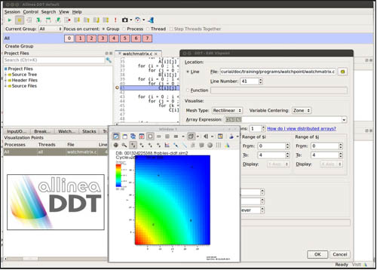
Profiling and Debugging
Saleable debugger DDT
ATP
Profiling Craypat, perftools
Papi Hhardware counters
More to come . . .

Slide 7
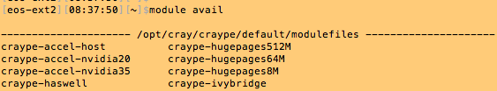
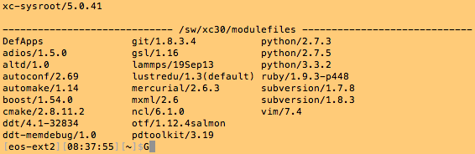
Software
Early times so we are still updating documentation. In the mean time . . .
  % module avail (everything) %Module list (just what’s loaded)
  . . .

Slide 8

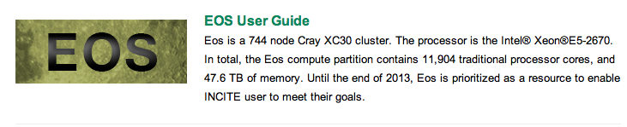
Documentation

Slide 9
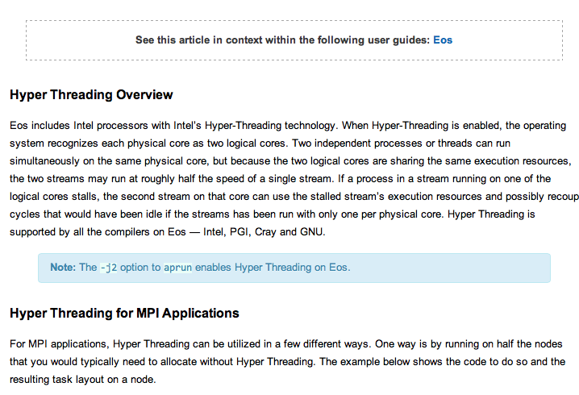
Documentation From a Search

Slide 10
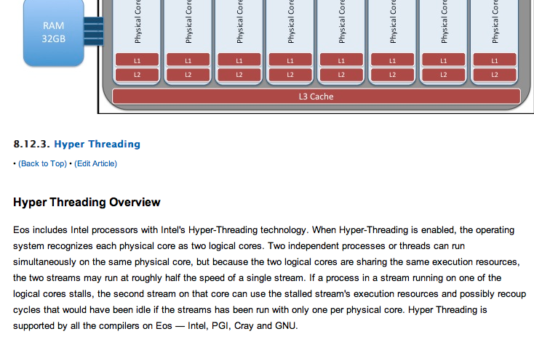
Documentation from a search

Slide 11
Known Issues
cmake with the Intel compiler
  Check for working C compiler fails
  Adds the –rdynaimc flag and tries unsuccessfully to cross compile.
  This has been mended in the Module file
However if you still have trouble:
  explicitly specify the compiler and then force cmake not to check if that compiler works. This can be done with the -D options when you issue cmake:
$ cmake -D CMAKE_CXX_COMPILER=icc
-D CMAKE_C_COMPILER_WORKS=TRUE .
cmake works fine with PGI, GNU and Cray compilers.

Slide 12
New Filesystem
New Spider II Filesystem – only mounted on EOS
Data transfer is required for files not in Home or HPSS
Chris Fuson will tell you more

