Slide 1
Venues social ratings comparing
By Igor Grigorev for Applied Data Science Capstone

Slide 2
Overview
Project idea is to compare data about venues from different social networks:
Instagram’s sentiments
Foursquare’s ratings

Slide 3
Data
Instagram:
Posts about venue => text => nltk => sentiment => venues average sentiment
Foursquare:
San Francisco location => venues => ratings

Slide 4
Methodology
APIs( Foursquare, Instagram)
NLTK( sentiment calculation)
Correlation assessment ( Anscombe's quartet)
folium ( map)

Slide 5
Results
San Francisco interactive map
Graph with Instagram sentiment and Foursquare ratings for every venue
Correlation of Instagram sentiment vs Foursquare ratings

Slide 6
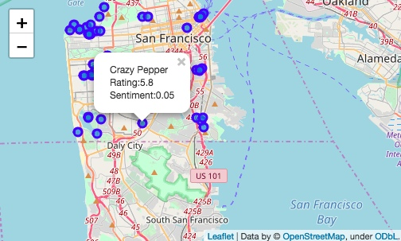
San Francisco interactive map with Instagram sentiment and Foursquare ratings

Slide 7
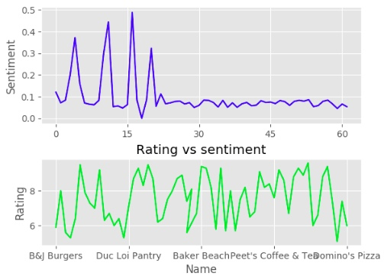
Graph with Instagram sentiment and Foursquare ratings for every venue

Slide 8
Correlation of Instagram sentiment vs Foursquare rating
- Pearson: 0.03
- Kendall: 0.59
- Spearman: 0.54

Slide 9
Conclusion
- Average sentiments for every venue were calculated.
- Correlation of Foursquare ratings vs Instagram sentiments was examined.
- Interactive map with ratings and sentiments values was plotted.

