Slide 1
The Battle of Neighborhood

Slide 2
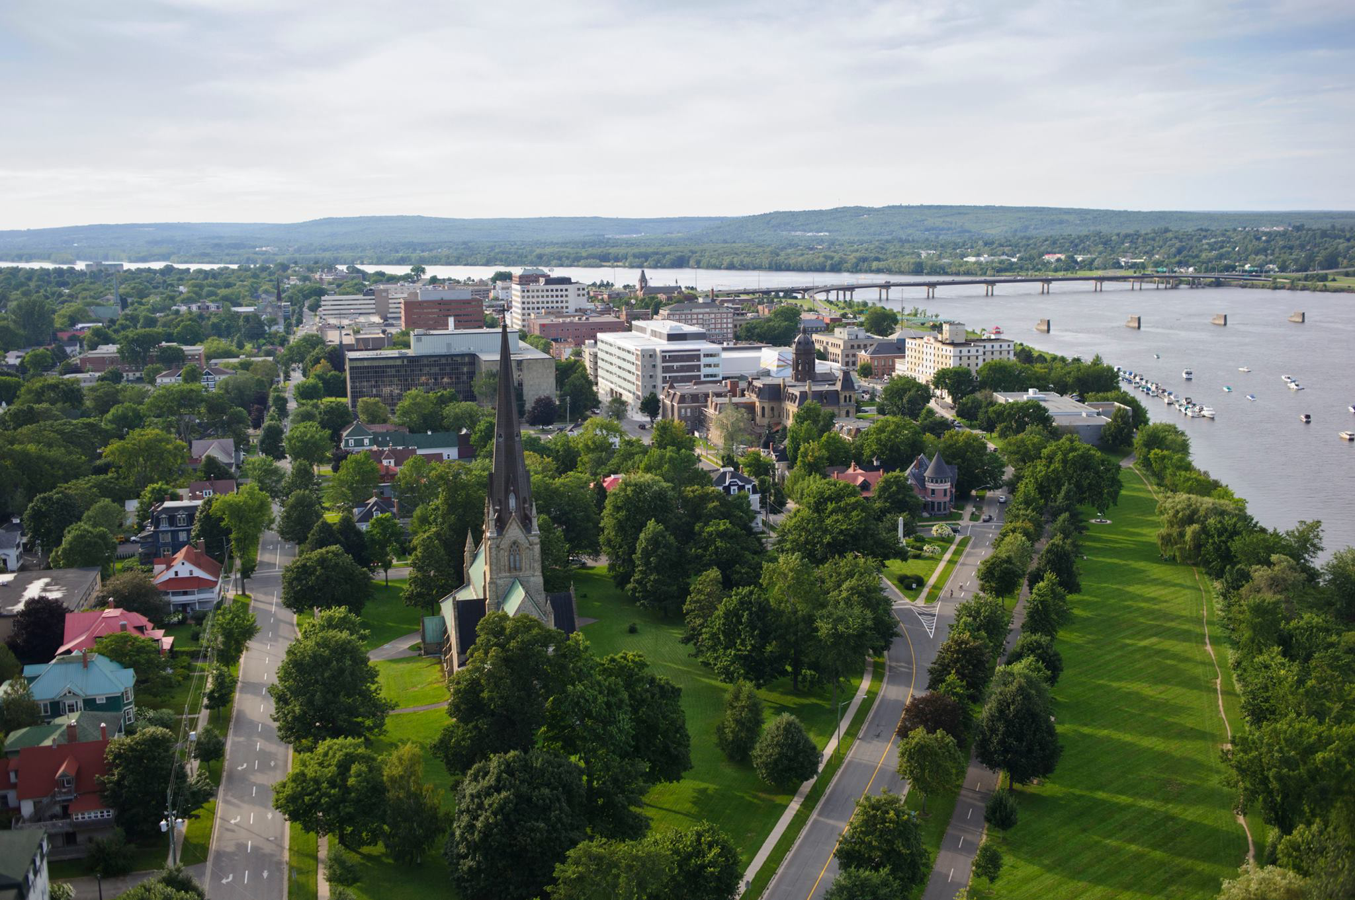
City of Fredericton

Slide 3
Why City of Fredericton?
Fredericton is the Capital City of the only Canadian bilingual Province of New Brunswick and is beautifully located on the banks of the Saint John River. While one of the least populated provincial capital cities with a population base of less than 60 thousand residents, it offers a wide spectrum of venues and is a governement, university and cultural hub.
As the city grows and develops, it becomes increasingly important to examine and understand it quantitiatively. The City of Fredericton provides open data for everyone and encourages entrepreneurial use to develop services for the benefit of its ciitzens.
Developers, policy makers and/or city planners have an interest in answering the following questions:
What neighbourhoods have the highest crime?
Is population density correlated to crime level?
Using Foursquare data, what venues are most common in different locations within the city?
Does the Knowledge Park really need a coffee shop?

Slide 4
Data
Open Data Site: http://data-fredericton.opendata.arcgis.com/
Fredericton Neighborhoods: http://data-fredericton.opendata.arcgis.com/datasets/neighbourhoods--quartiers
Fredericton Crime by Neighborhood: http://data-fredericton.opendata.arcgis.com/datasets/crime-by-neighbourhood-2017--crime-par-quartier-2017
Fredericton Census Tract Demographics: http://data-fredericton.opendata.arcgis.com/datasets/census-tract-demographics--donn%C3%A9es-d%C3%A9mographiques-du-secteur-de-recensement
Fredericton locations of interest: https://github.com/JasonLUrquhart/Applied-Data-Science-Capstone/blob/master/Fredericton%20Locations.xlsx
Foursquare Developers Access to venue data: https://foursquare.com/
Using this data will allow exploration and examination to answer the questions. The neighborhood data will enable us to properly group crime by neighbourhood. The Census data will enable us to then compare the population density to examine if areas of highest crime are also most densely populated. Fredericton locations of interest will then allow us to cluster and quantitatively understand the venues most common to that location.

Slide 5
Methodology
Basic skills from week 3 lab
Majorly relied on Foursquare API to retrieve all venues of each neighborhoods, then group by each neighborhoods and to count how many venues before filter top 10 most common venue types of each neighborhoods

Slide 6
Results
Providence has more venues than Hartford (512 vs 460)
Federal Hill has the most venues in Providence
Downtown has the most venues in Hartford
Most of venues in Federal Hill are restaurants, bars
Venues in Downtown Hartford are more diverse includes: banks, concert hall, gyms…
Bars, Restaurants, Bakeries, and Diners are very common in Providence
Hartford is more about commercial

Slide 7
Conclusion
For travelers:
Providence may more suitable to spend a good amount time of enjoy the local food
Hartford has less food but more commercial
For business owners:
Providence is good place to open small business related to food and travel industry
Hartford is better place to involve in insurance industry

