Slide 1










Data Integration Framework
ARCHITECTURE
DESIGN
BAWAG
2025 - 2026
Nightly Files & Reconciliation

Slide 2





Data Transfer
Mechanism
BAWAG nightly file delivery operates via dual-channel architecture — SFTP and Amazon S3 running in parallel. This ensures resilience, auditability, and flexibility across tranche-based file ingestion aligned to core entity reconciliation.
SFTP Channel
Secure File Transfer Protocol provides a managed, encrypted nightly push of tranche files. Supports structured delivery schedules with acknowledgement and retry handling.
Amazon S3 Channel
Parallel S3 bucket delivery enables scalable, cloud-native ingestion. Event-driven triggers allow downstream processing pipelines to initiate reconciliation automatically on file arrival.
Parallel Reconciliation & Resilience
Both channels operate simultaneously. Central reconciles received tranches back to core entities: Party, Agreement, Collateral and Link tables — ensuring completeness before downstream processing.

Slide 3
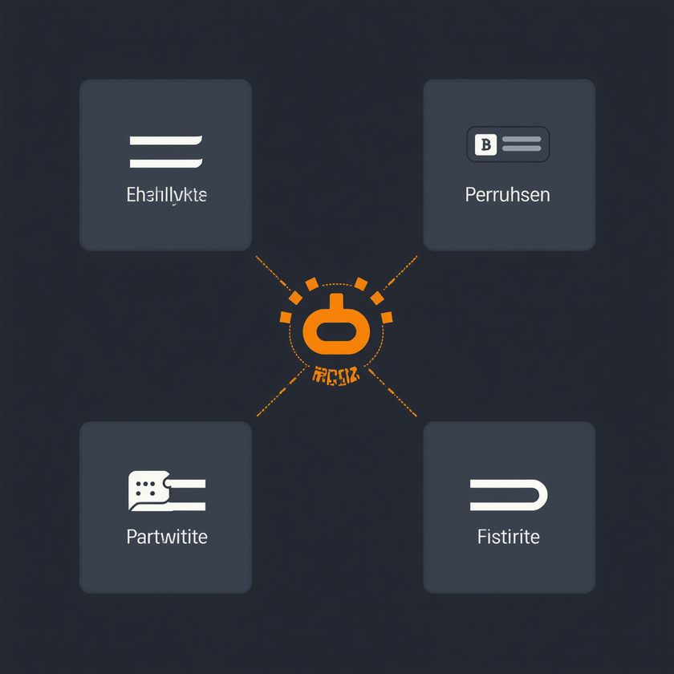
Core Model
Requirements
The BAWAG nightly file architecture is anchored on four core pillar entities. Each entity is designed for extensibility — the model supports additional attributes and relationships beyond the core definition, enabling future-proof integration and reporting flexibility.
Agreement / Account
Party
Central pillar for all financial products. Supports account-level reporting, credit card agreement structures and access device linkage. Extensible beyond core fields.
Counterparty and customer entity. Reconciled centrally across all nightly tranches. Supports individual and corporate party types with extensible attribute sets for reporting.
Collateral
Link Tables
Collateral records linked to agreements and parties. Supports secured lending structures. Extensible to hold additional collateral attributes and valuation metadata per tranche.
Relational bridge tables connecting Agreement, Party and Collateral. Enable many-to-many relationships and cross-entity reconciliation. Critical for consolidated reporting across tranches.

Slide 4
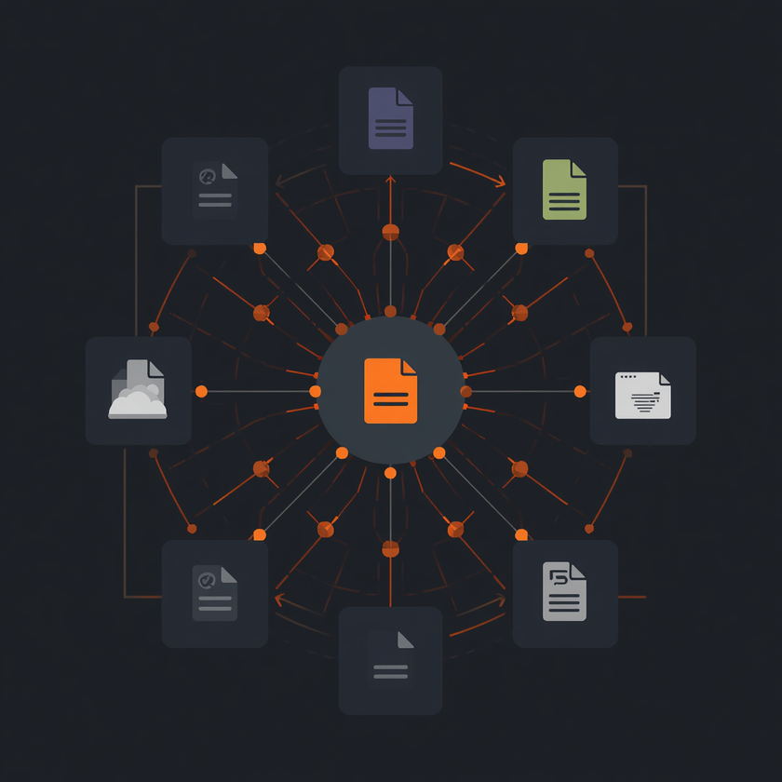
Tranche
Reconciliation
Nightly file series are delivered in tranches from BAWAG. Central reconciliation maps each tranche back to core pillar entities — ensuring data integrity, completeness, and consistency across Party, Agreement, Collateral, and Link Tables before downstream processing begins.
Party Entity Reconciliation
Agreement & Account Matching
Collateral & Link Table Validation
Tranche Completeness Check

Slide 5




Credit Card
Reporting
Cards are treated as Agreement Access Devices within the core model. A key discussion point is whether BAWAG reporting requirements operate at the account level, the device level, or both. The following breakdown outlines the key dimensions of this distinction.
Account Level Reporting
Device Level Reporting
Balances, limits and utilisation tied to the agreement entity.
Individual card transactions and spend behaviour per device.
Card as Access Device
Reporting Scope Decision
Card linked to agreement; device attributes stored separately.
Does BAWAG need account-only, device-only, or unified output?

Slide 6




Transaction
Architecture
The ask is for an integrated set of transaction objects delivered as nightly files. A key design question: does BAWAG require a consolidated reference data set for reporting, or should all transaction files be delivered in full? Transactions are structured around core entities: agreement/account, party, collateral and link tables.
Integrated Transaction Objects
Reference Data Strategy
Card Transactions
Reconciliation & Tranche Control
A unified transaction model linking to core entities: party, agreement and collateral. Avoids fragmented file dumps.
Does BAWAG hold a consolidated reference data set for reporting? Or does each tranche include full reference data per file?
Cards are modelled as agreement access devices. Transaction reporting must cover both account level and device level granularity.
Each nightly tranche reconciles centrally back to core pillar entities. Ensures consistency and completeness across all transaction objects.

Slide 7






Reference Data
Strategy
Consolidated
Dataset?
Full File
Extraction?
Reporting
Alignment

Slide 8
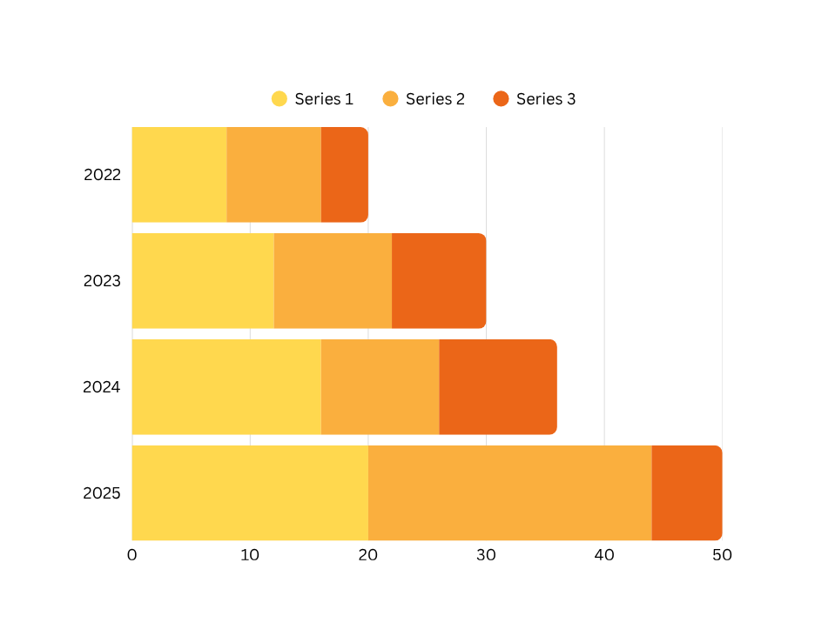
Key Decisions &
Next Steps
Critical decisions are required to finalise the BAWAG nightly file integration architecture. Alignment is needed on data scope, reference data strategy, transaction object consolidation, and the phased tranche delivery timeline before build can commence.
Data Scope
Decision
Transaction
Consolidation
Reference Data
Strategy
Integration
Timeline

Slide 9


BAWAG Architecture Review
THANK
YOU
Data Architecture & Integration Design

