Slide 1
RSA原理与Python3实现
B站：芯片人阿伟
https://space.bilibili.com/243180540

Slide 2
PKCS#1 v2.2
PKCS#1 v2.2 (2016年) rfc8017
MGF1
RSAES-OAEP-ENCRYPT
RSAES-OAEP-DECRYPT
RSASSA-PSS-SIGN
RSASSA-PSS-VERIFY
B站：芯片人阿伟
https://space.bilibili.com/243180540

Slide 3
mask generation function
MGF1 is a mask generation function based on a hash function.
MGF1 (mgfSeed, maskLen)
Options:
Hash hash function (hLen denotes the length in octets of the hash function output)
Input:
mgfSeed seed from which mask is generated, an octet string
maskLen intended length in octets of the mask, at most 2^32 hLen
Output:
mask mask, an octet string of length maskLen
Error: "mask too long"
B站：芯片人阿伟
https://space.bilibili.com/243180540

Slide 4
mask generation function
Steps:
If maskLen > 2^32 hLen, output "mask too long" and stop.
T=empty string
loop counter from 0 to ceil (maskLen / hLen) – 1:
C = I2OSP (counter, 4)
T = T || Hash(mgfSeed || C)
Output the leading maskLen octets of T
B站：芯片人阿伟
https://space.bilibili.com/243180540

Slide 5
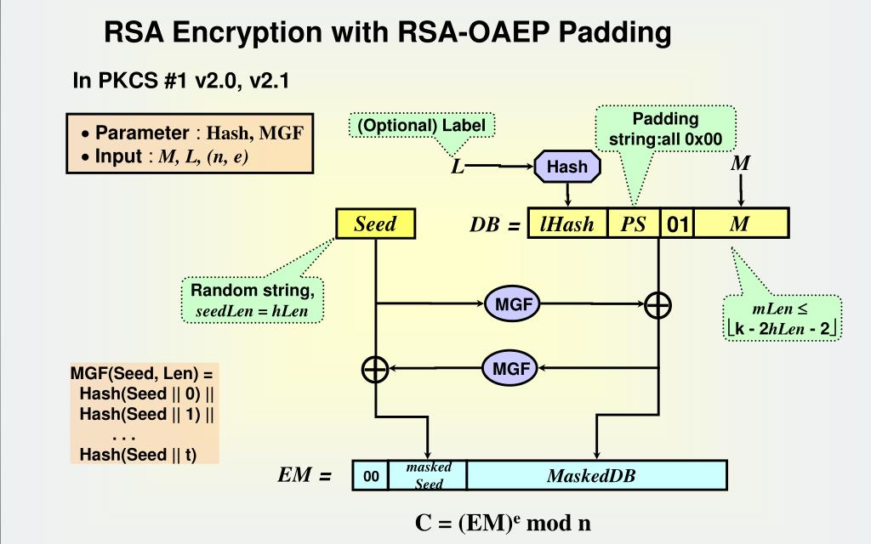
OAEP
B站：芯片人阿伟
https://space.bilibili.com/243180540

Slide 6
OAEP-ENCRYPT
RSAES-OAEP-ENCRYPT ((n, e), M, L)
Options:
Hash hash function (hLen octets output)
MGF mask generation function
Input:
(n, e) recipient’s RSA public key (k denotes the length of n)
M message to be encrypted, mLen <= k - 2hLen – 2
L optional label, if L is not provided, is the empty string
Output:
C ciphertext, an octet string of length k
Errors: "message too long"; "label too long"
B站：芯片人阿伟
https://space.bilibili.com/243180540

Slide 7
OAEP-ENCRYPT
Steps:
Length checking:
len(L) > hash input limitation, output "label too long" and stop.
If mLen > k - 2hLen - 2, output "message too long" and stop.
EME-OAEP encoding:
lHash = Hash(L), let L be empty string if not provided, lHash hLen octets length
PS = (k - mLen -2hLen – 2) zero octets, PS may be zero length
DB = lHash || PS || 0x01 || M, DB is k - hLen – 1 octets length
B站：芯片人阿伟
https://space.bilibili.com/243180540

Slide 8
OAEP-ENCRYPT
seed = hLen octets random string
dbMask = MGF(seed, k - hLen - 1)
maskedDB = DB xor dbMask
seedMask = MGF(maskedDB, hLen)
maskedSeed = seed xor seedMask
EM = 0x00 || maskedSeed || maskedDB
3. RSA encryption:
m = OS2IP (EM)
c = RSAEP ((n, e), m)
C = I2OSP (c, k)
4. Output the ciphertext C
B站：芯片人阿伟
https://space.bilibili.com/243180540

Slide 9
OAEP-DECRYPT
RSAES-OAEP-DECRYPT (K, C, L)
Options:
Hash hash function (hLen octets output)
MGF mask generation function
Input:
K recipient’s RSA private key (k octets), where k >= 2hLen + 2
C ciphertext to be decrypted, an octet string of length k
L optional label, if L is not provided, is the empty string
Output:
M message, an octet string of length mLen, where mLen <= k - 2hLen - 2
Error: "decryption error"
B站：芯片人阿伟
https://space.bilibili.com/243180540

Slide 10
OAEP-DECRYPT
Steps:
Length checking:
if len(L) >= hash input limitation, output "decryption error" and stop.
if len(C) != k, output "decryption error" and stop.
If k < 2hLen + 2, output "decryption error" and stop.
RSA decryption:
c = OS2IP (C)
m = RSADP (K, c), If RSADP outputs "ciphertext representative out of range“ (meaning that c >= n), output "decryption error" and stop.
EM = I2OSP (m, k)
B站：芯片人阿伟
https://space.bilibili.com/243180540

Slide 11
OAEP-DECRYPT
EME-OAEP decoding:
lHash = Hash(L), hLen octets length
EM = Y|| maskedSeed|| maskedDB
Y is 1 octet
maskedSeed are hLen octets
maskedDB are k - hLen – 1 octets
seedMask = MGF(maskedDB, hLen)
seed = maskedSeed xor seedMask
dbMask = MGF(seed, k - hLen - 1)
DB = maskedDB xor dbMask
B站：芯片人阿伟
https://space.bilibili.com/243180540

Slide 12
OAEP-DECRYPT
DB = lHash’ || PS || 0x01 || M
lHash’ are hLen octets
PS are all zero (possibly empty)
If there is no octet with hexadecimal value 0x01 to separate PS from M
if lHash does not equal lHash’
if Y is nonzero, utput "decryption error" and stop.
Output the message M
B站：芯片人阿伟
https://space.bilibili.com/243180540

Slide 13

一键三连
B站：芯片人阿伟
https://space.bilibili.com/243180540

Slide 14
B站：芯片人阿伟
https://space.bilibili.com/243180540

