Slide 1
RSA原理与Python3实现
B站：芯片人阿伟
https://space.bilibili.com/243180540

Slide 2
PKCS#1 v2.2
PKCS#1 v2.2 (2016年) rfc8017
MGF1
RSAES-OAEP-ENCRYPT
RSAES-OAEP-DECRYPT
RSASSA-PSS-SIGN
RSASSA-PSS-VERIFY
B站：芯片人阿伟
https://space.bilibili.com/243180540

Slide 3
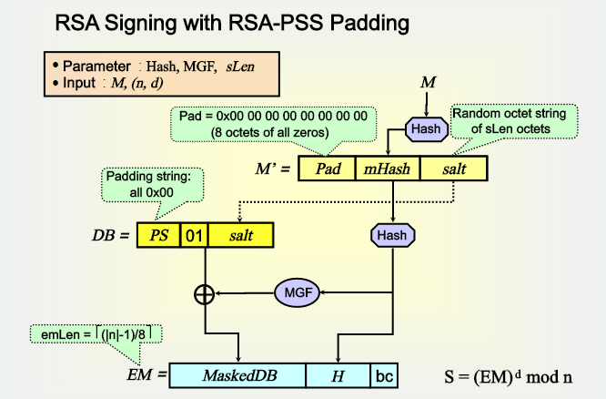
PSS
B站：芯片人阿伟
https://space.bilibili.com/243180540

Slide 4
PSS-SIGN
RSASSA-PSS-SIGN (K, M)
Input:
K signer’s RSA private key
M message to be signed, an octet string
Output:
S signature, an octet string of length k
Errors: "message too long;" "encoding error"
B站：芯片人阿伟
https://space.bilibili.com/243180540

Slide 5
PSS-SIGN
Steps:
EMSA-PSS encoding:
EM = EMSA-PSS-ENCODE (M, 8k)
If the encoding operation outputs "message too long", output "message too long" and stop.
If the encoding operation outputs "encoding error", output "encoding error" and stop.
RSA signature:
m = OS2IP (EM)
s = RSASP1 (K, m)
S = I2OSP (s, k)
Output the signature S.
B站：芯片人阿伟
https://space.bilibili.com/243180540

Slide 6
PSS-VERIFY
RSASSA-PSS-VERIFY ((n, e), M, S)
Input:
(n, e) signer’s RSA public key
M message whose signature is to be verified, an octet string
S signature to be verified, an octet string of length k
Output: "valid signature" or "invalid signature"
B站：芯片人阿伟
https://space.bilibili.com/243180540

Slide 7
PSS-VERIFY
Steps:
if len(S) != k, output "invalid signature" and stop.
RSA verification:
s = OS2IP (S)
m = RSAVP1 ((n, e), s), If RSAVP1 output "signature representative out of range", output "invalid signature" and stop
EM = I2OSP (m, k), If I2OSP outputs "integer too large", output "invalid signature" and stop.
EMSA-PSS verification: Result = EMSA-PSS-VERIFY (M, EM, 8k).
If Result = "consistent", output "valid signature". Otherwise, output "invalid signature".
B站：芯片人阿伟
https://space.bilibili.com/243180540

Slide 8
EMSA-PSS
EMSA-PSS-ENCODE
EMSA-PSS-VERIFY
B站：芯片人阿伟
https://space.bilibili.com/243180540

Slide 9
EMSA-PSS-ENCODE
EMSA-PSS-ENCODE (M, emBits)
Options:
Hash hash function (hLen denotes the length in octets of the hash function output)
MGF mask generation function
sLen intended length in octets of the salt
Input:
M message to be encoded, an octet string
emBits maximal bit length of the integer OS2IP (EM), at least 8hLen + 8sLen + 9
Output:
EM encoded message, an octet string of length emLen = ceil(emBits/8)
Errors: "Encoding error"; "message too long"
B站：芯片人阿伟
https://space.bilibili.com/243180540

Slide 10
EMSA-PSS-ENCODE
Steps:
if len(M) > hash limitation legth, output "message too long" and stop.
Let mHash = Hash(M), an octet string of length hLen.
If emLen < hLen + sLen + 2, output "encoding error" and stop.
salt = sLen random octets string; if sLen = 0, then salt is the empty string.
M’ = (0x)00 00 00 00 00 00 00 00 || mHash || salt; M’ is an octet string of length 8 + hLen + sLen with eight initial zero octets.
B站：芯片人阿伟
https://space.bilibili.com/243180540

Slide 11
EMSA-PSS-ENCODE
Let H = Hash(M’), an octet string of length hLen.
PS = emLen - sLen – hLen - 2 zero octets. The length of PS may be 0.
DB = PS || 0x01 || salt; DB is an octet string of length emLen - hLen - 1.
dbMask = MGF(H, emLen - hLen - 1)
maskedDB = DB xor dbMask
Set the leftmost 8emLen - emBits bits of the leftmost octet in maskedDB to zero.
EM = maskedDB || H || 0xbc
Output EM
B站：芯片人阿伟
https://space.bilibili.com/243180540

Slide 12
EMSA-PSS-VERIFY
EMSA-PSS-VERIFY (M, EM, emBits)
Options:
Hash hash function (hLen denotes the length in octets of the hash function output)
MGF mask generation function
sLen intended length in octets of the salt
Input:
M message to be verified, an octet string
EM encoded message, an octet string of length emLen = ceil(emBits/8)
emBits maximal bit length of the integer OS2IP (EM), at least 8hLen + 8sLen + 9
Output: "consistent" or "inconsistent"
B站：芯片人阿伟
https://space.bilibili.com/243180540

Slide 13
EMSA-PSS-VERIFY
Steps:
if len(M) > hash limitation, output "inconsistent" and stop.
mHash = Hash(M), an octet string of length hLen.
If emLen < hLen + sLen + 2, output "inconsistent" and stop.
If the rightmost octet of EM does not have hexadecimal value 0xbc, output "inconsistent" and stop.
maskedDB = the leftmost emLen - hLen - 1 octets of EM
H = the next hLen octets
If the leftmost 8emLen - emBits bits of the leftmost octet in maskedDB are not all equal to zero, output "inconsistent" and stop.
B站：芯片人阿伟
https://space.bilibili.com/243180540

Slide 14
EMSA-PSS-VERIFY
dbMask = MGF(H, emLen - hLen - 1)
DB = maskedDB xor dbMask
Set the leftmost 8emLen - emBits bits of the leftmost octet in DB to zero.
If the emLen - hLen - sLen - 2 leftmost octets of DB are not zero
if the octet at position emLen - hLen - sLen - 1does not have hexadecimal
value 0x01, output "inconsistent" and stop.
salt = the last sLen octets of DB
B站：芯片人阿伟
https://space.bilibili.com/243180540

Slide 15
EMSA-PSS-VERIFY
M’ = (0x)00 00 00 00 00 00 00 00 || mHash || salt
H’ = Hash(M’)
If H = H’, output "consistent". Otherwise, output "inconsistent".
B站：芯片人阿伟
https://space.bilibili.com/243180540

Slide 16

一键三连
B站：芯片人阿伟
https://space.bilibili.com/243180540

Slide 17
B站：芯片人阿伟
https://space.bilibili.com/243180540

