Slide 1
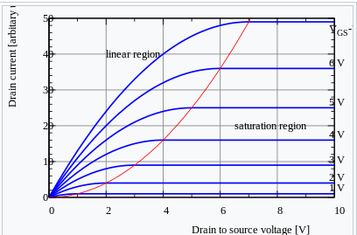
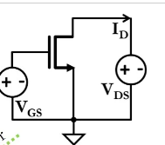
Silicon FF/TT/SS corners & impact on PDN
V_GS=0.75V
V_GS=0.77V
For FF/SS silicon to switch at same freq as TT:
FF/SS silicon need to follow same I-V curve as TT
FF silicon needs lower V_GS or V_DS
▼Vdd
▼Power ∝ CfV²
▼I_D
SS silicon needs higher V_GS or V_DS
▲Higher Vdd
▲Power ∝ CfV²
▲I_D
V_GS=0.73V
V_GS=0.75V
V_GS=0.77V
V_GS=0.73V
V_GS=0.75V
Fig. I_D vs. V_DS curve (or I-V curve) family for FF, TT, SS silicon, respectively
I_D
I_D, SS
I_D, TT
I_D, FF
V_GS SS
V_DS
V_GS TT
V_GS FF
PDN impact
3 sets of current profiles for FF/TT/SS, respectively (e.g., via scaling factors ?)
PDN will be more challenging to SS
Increased Vpp noise, due to higher dI/dt
Less headroom to 825mV ceiling, due to higher Vdd
Other comments

