Slide 1
Milestone 2
Team A6

Slide 2
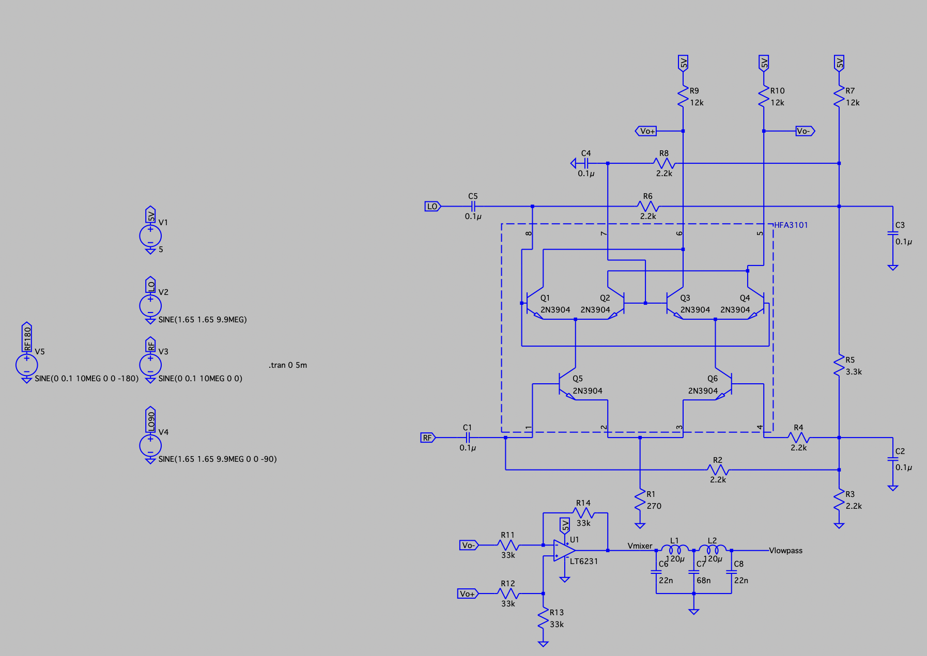
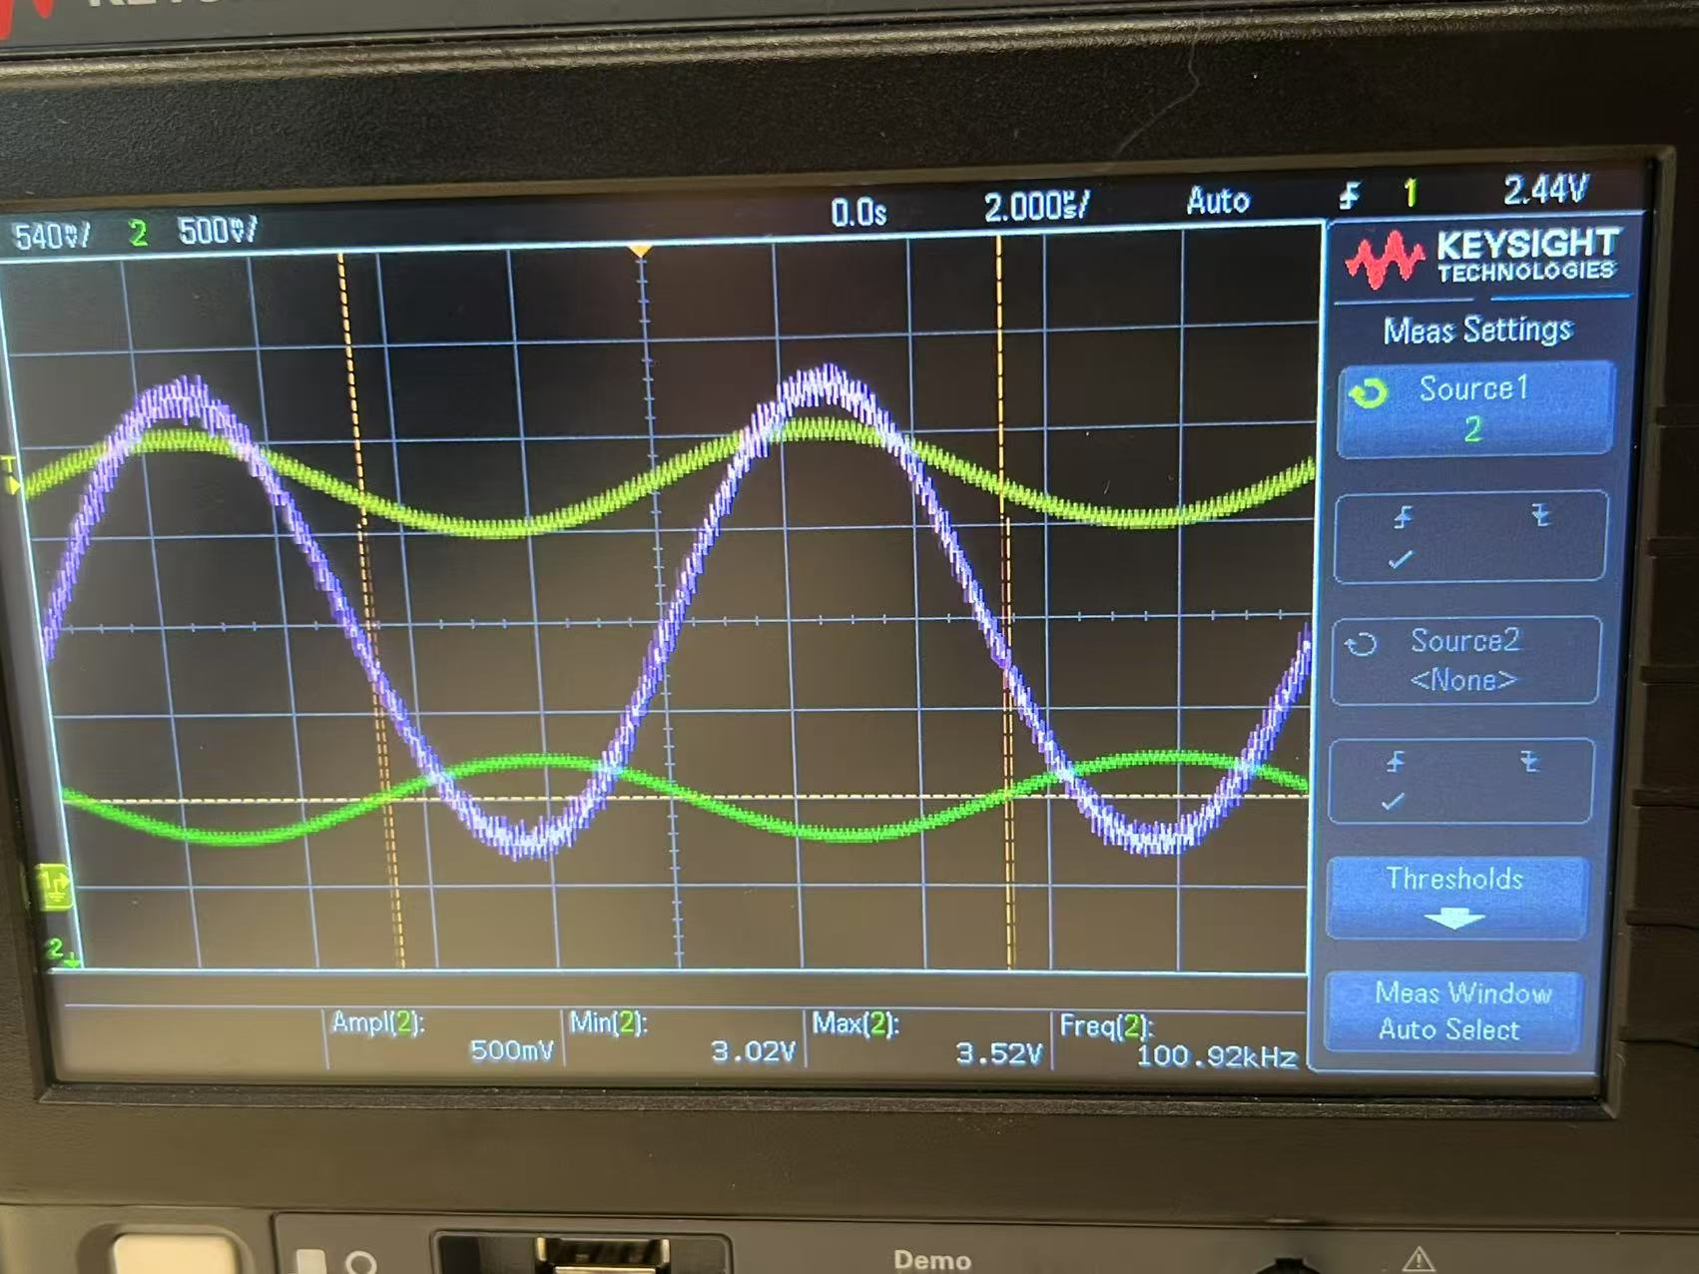
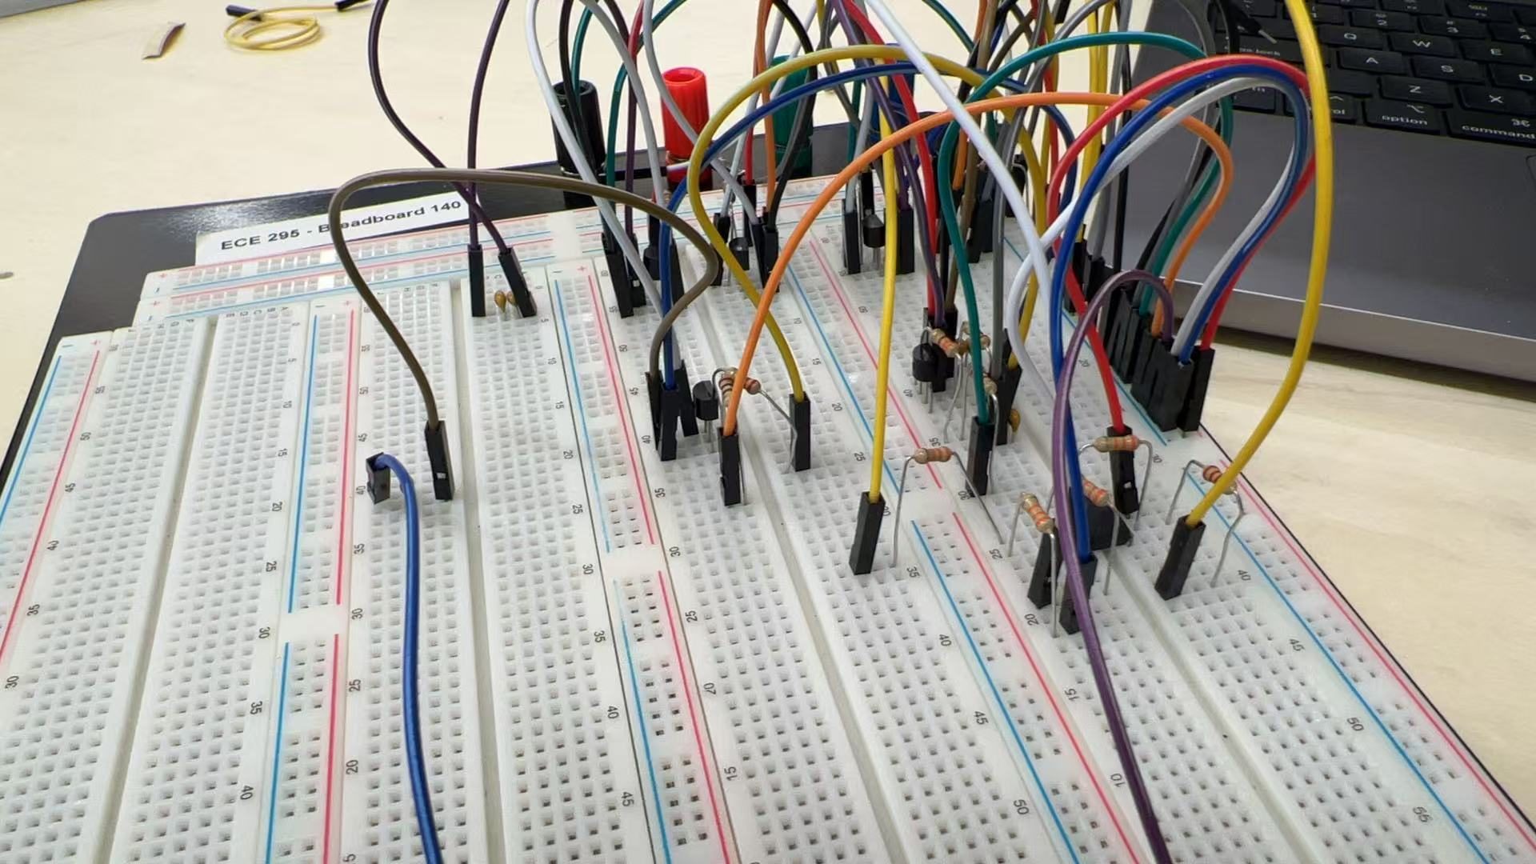
Overview of PCB design
Tests in LTspice and/or on-board for major part
Ensure modules work before pcb design

Slide 3
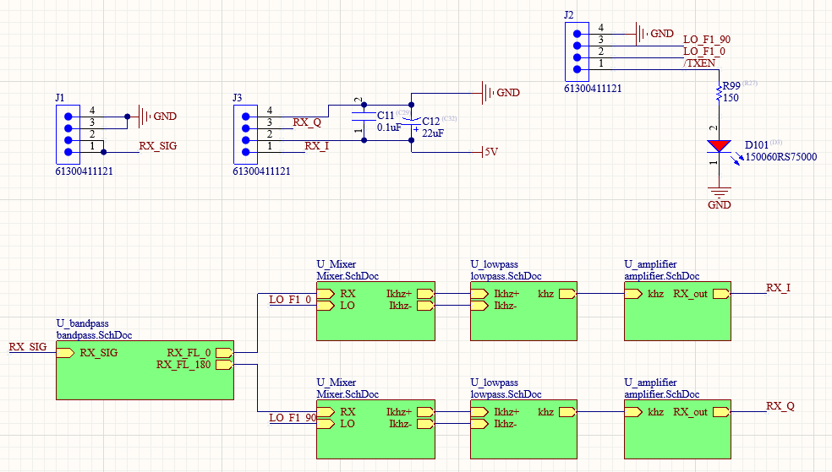
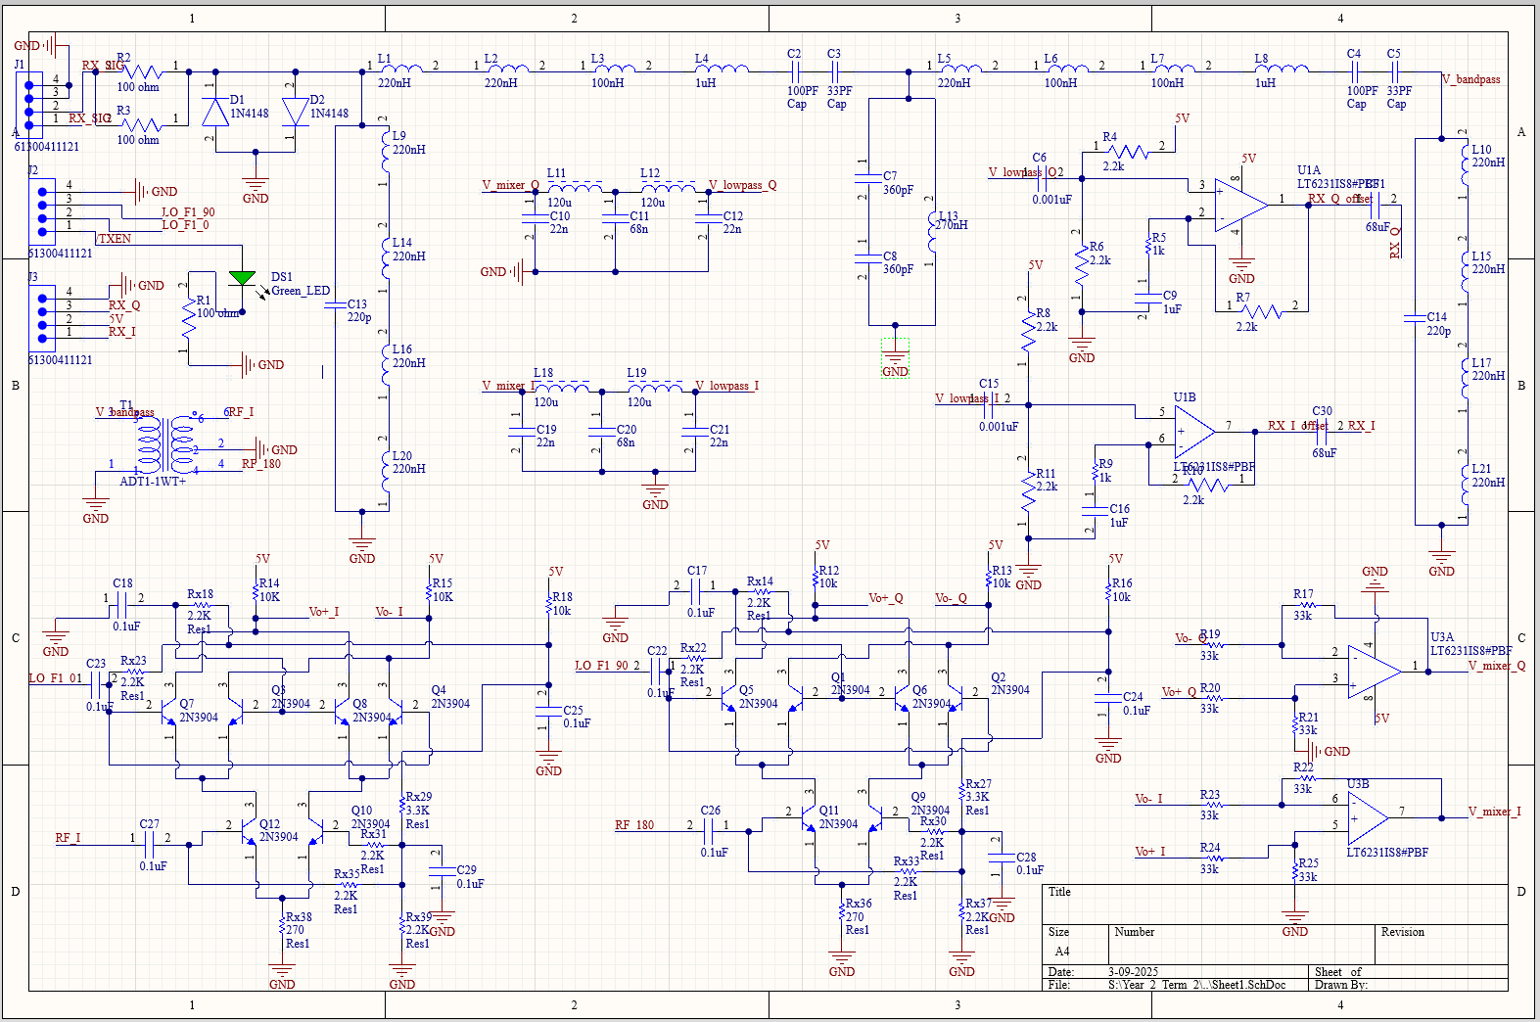
Schematic Overview

Slide 4
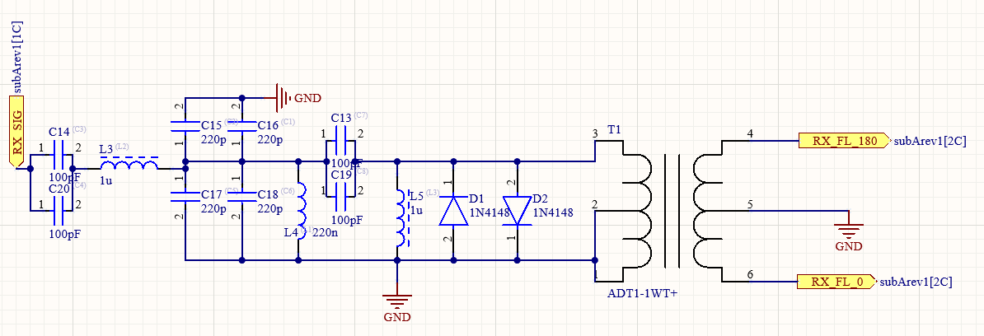
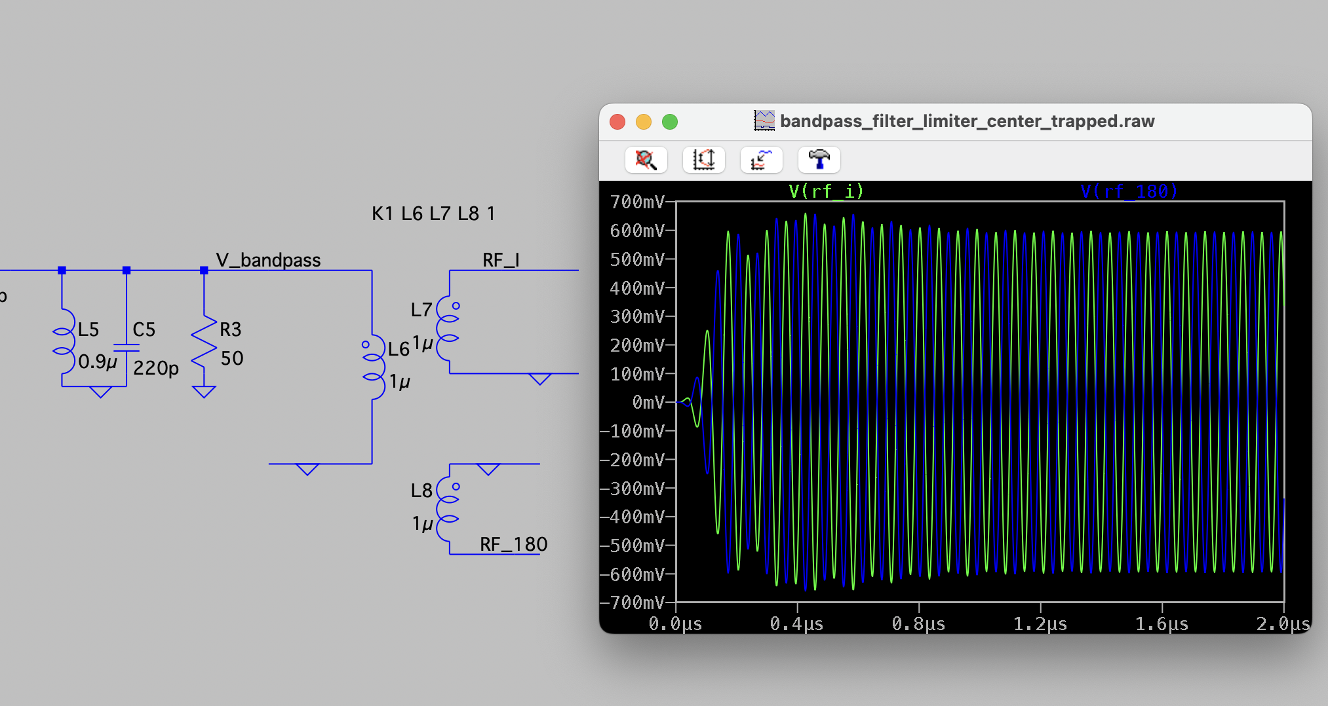
BandPass Filter

Slide 5
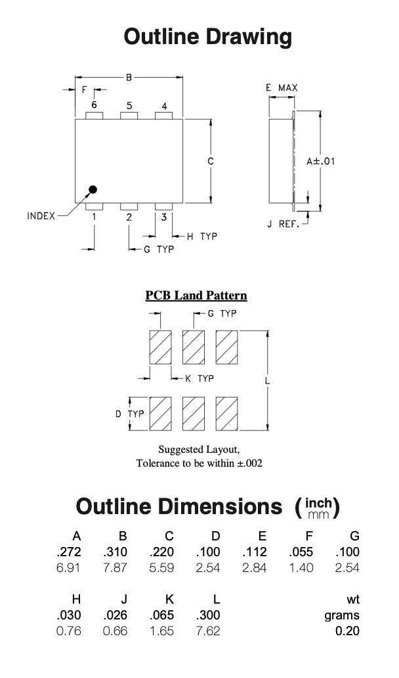
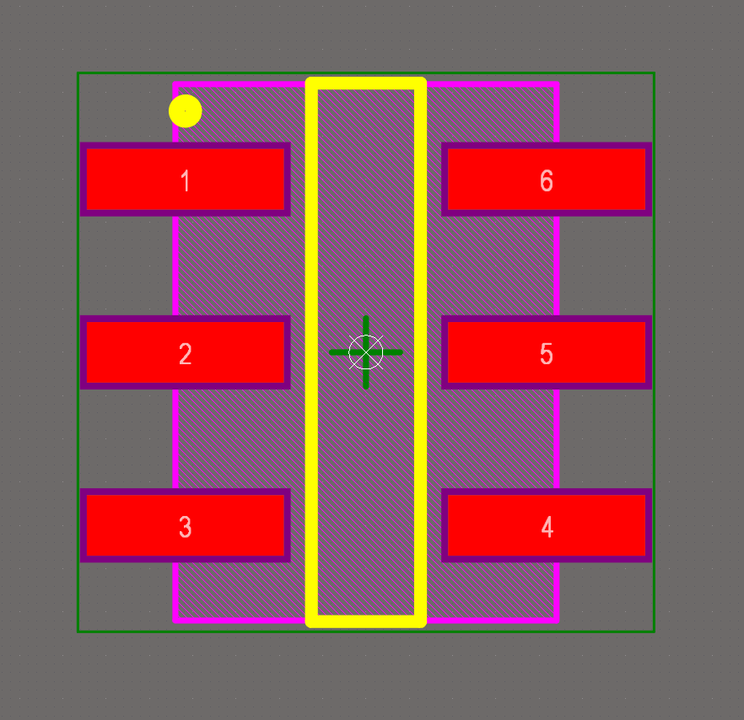
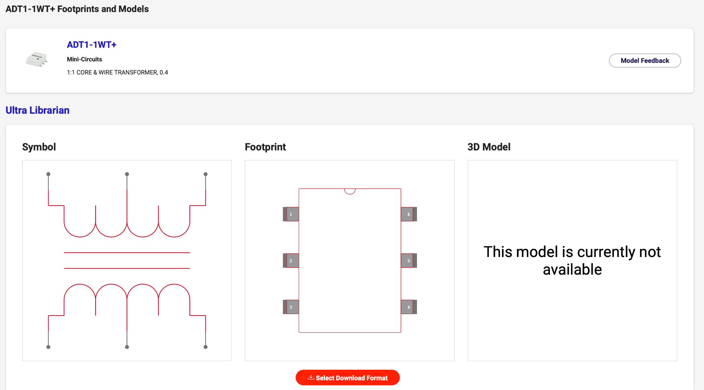
PCB Footprint for ADT1-1WT+ Center Tapped Transformer
[2]
[1]
Notes:
https://www.digikey.ca/en/models/13927938

Slide 6
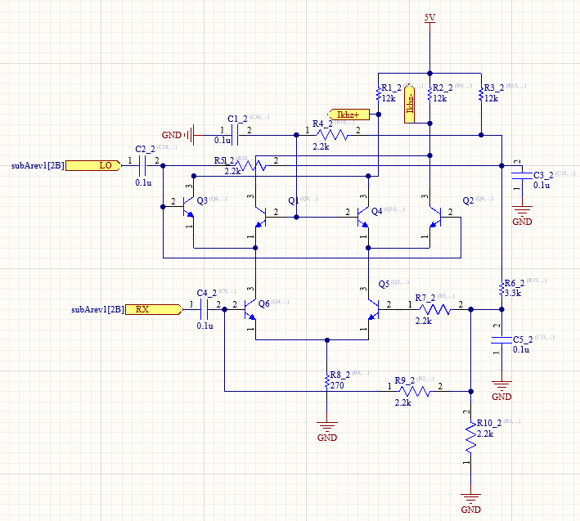
Mixer-Gilbert cell

Slide 7
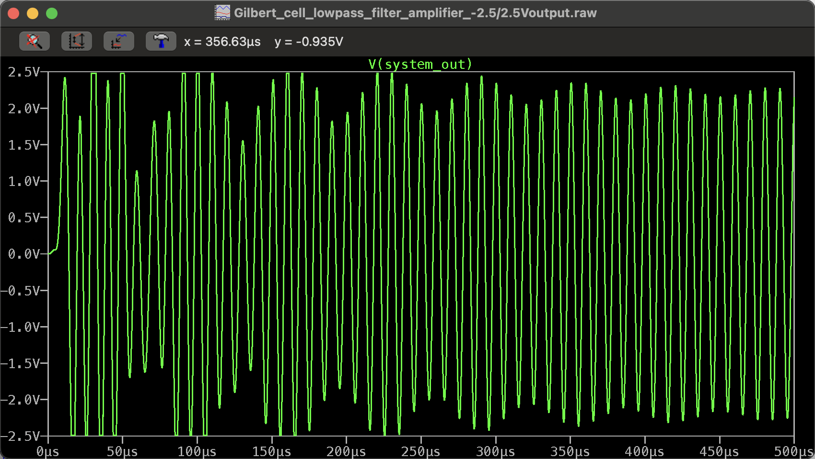
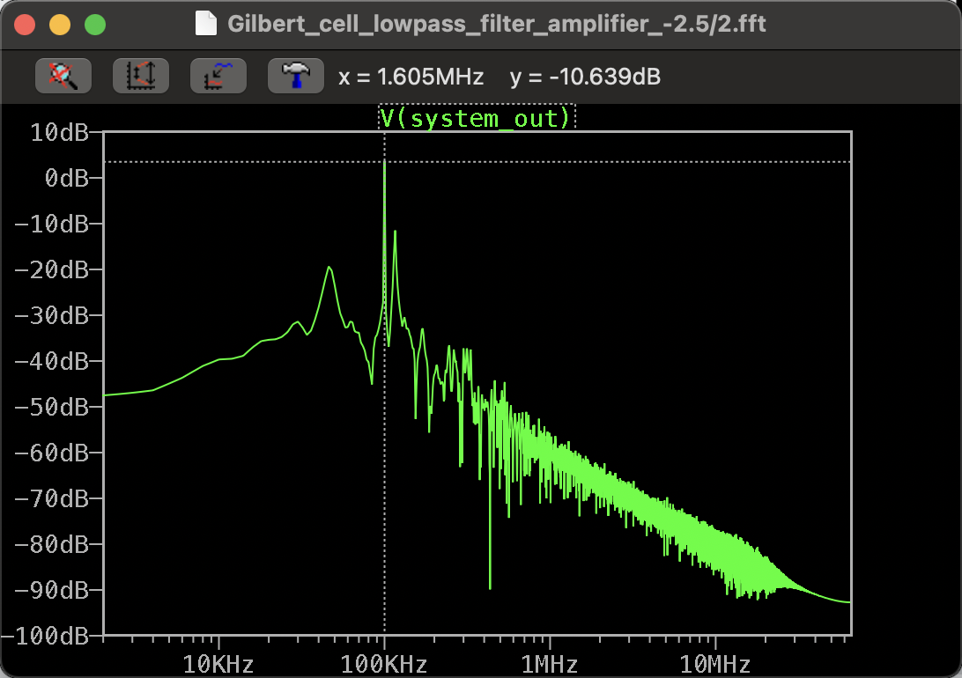
Mixer Output

Slide 8
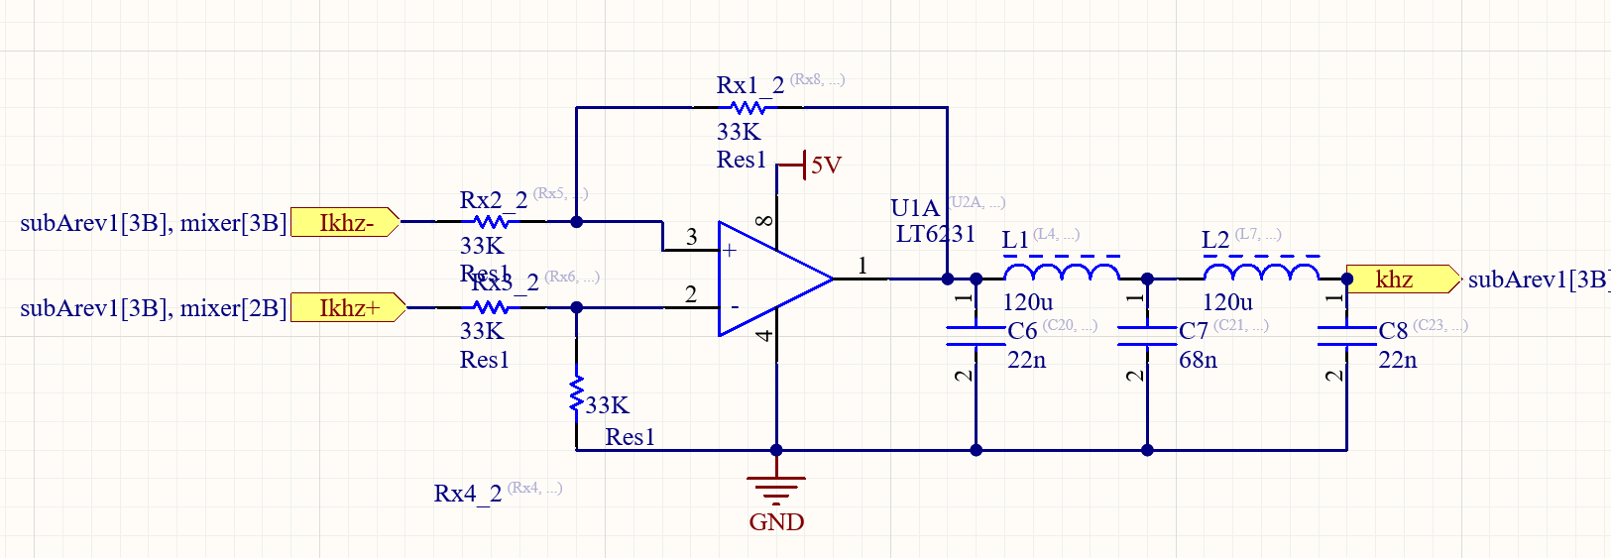
Subtractor and Low pass Filter

Slide 9
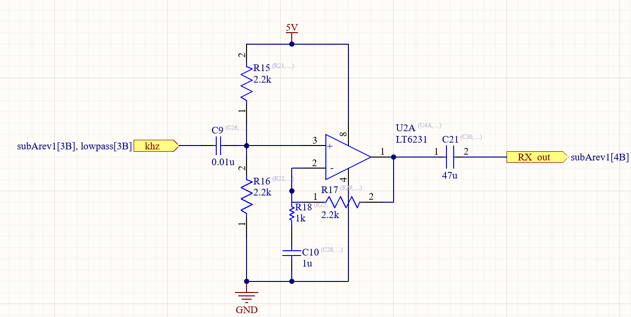
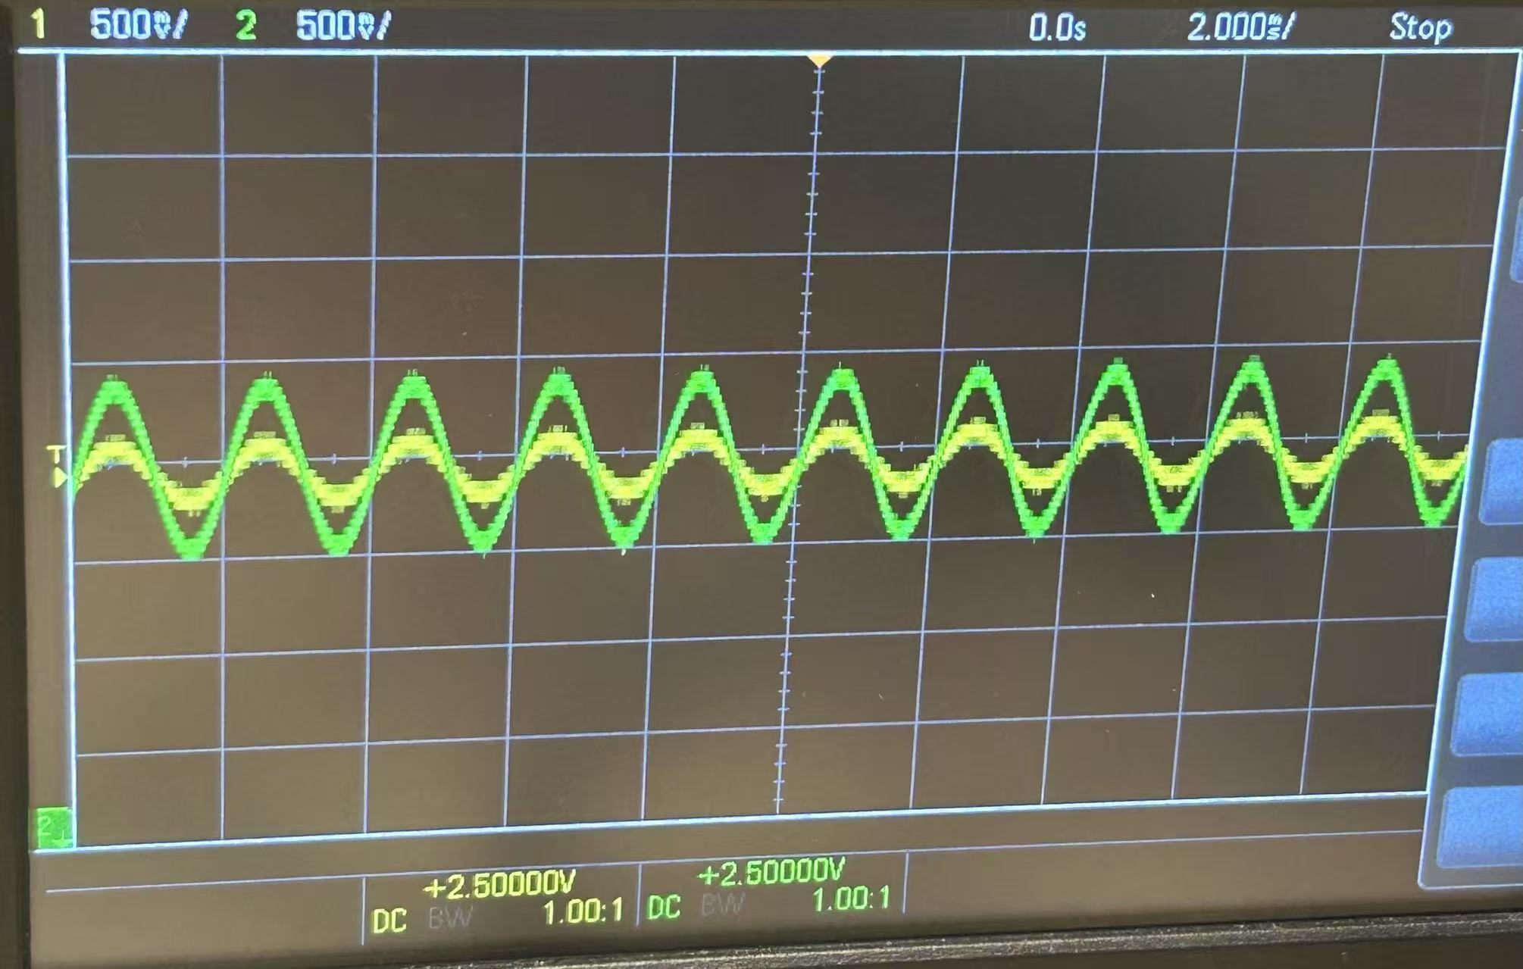
Amplifier
Non-Inverting Op Amp
AC-Coupled output

Slide 10
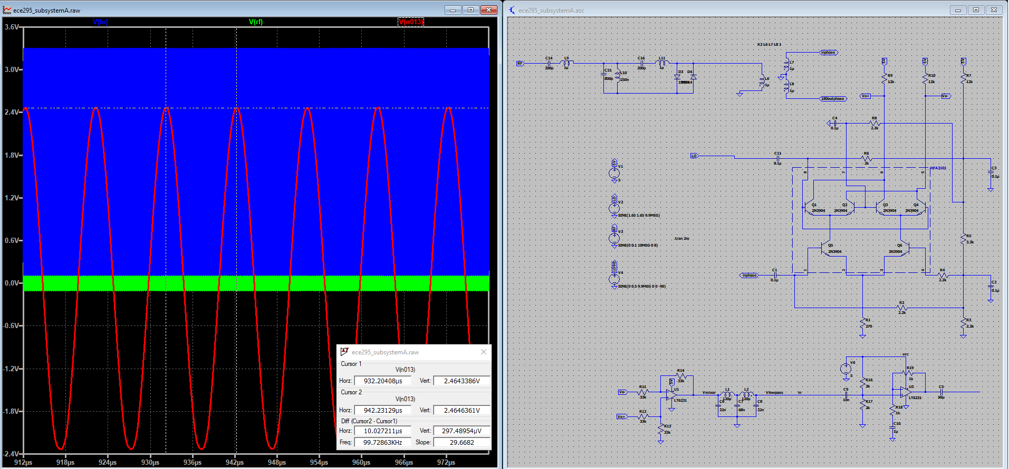
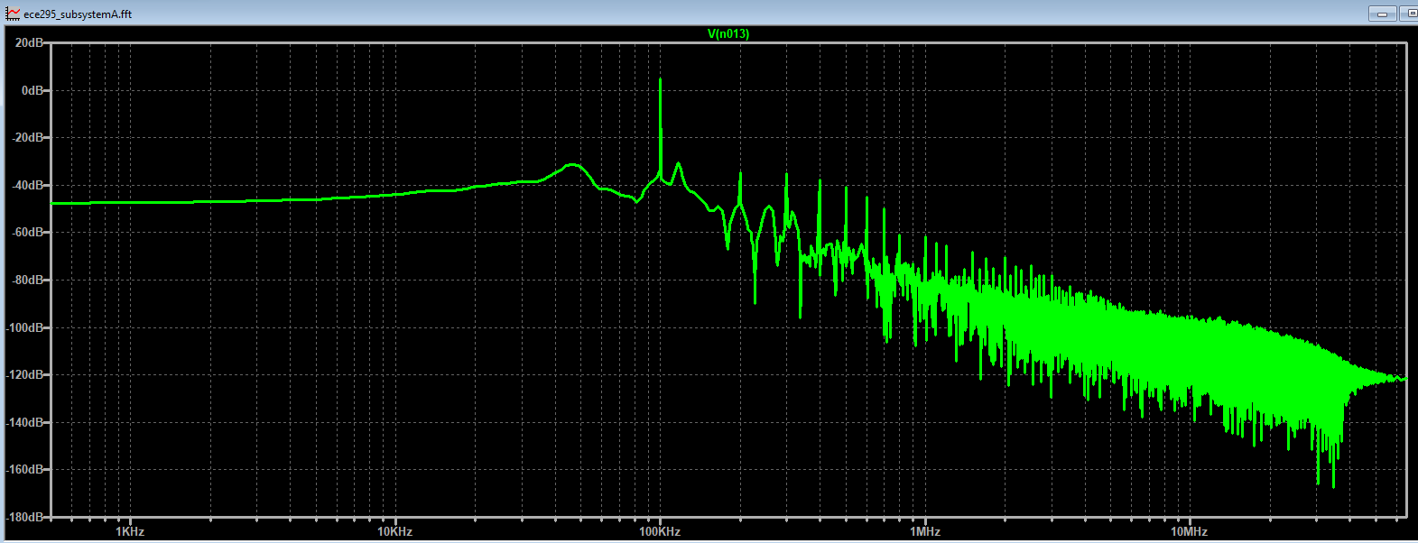
Complete Spice Simulation
Notes:
Reference Db is 1Vrms, 3.3dBm -> 1.46Vrms->4.14Vpp

Slide 11
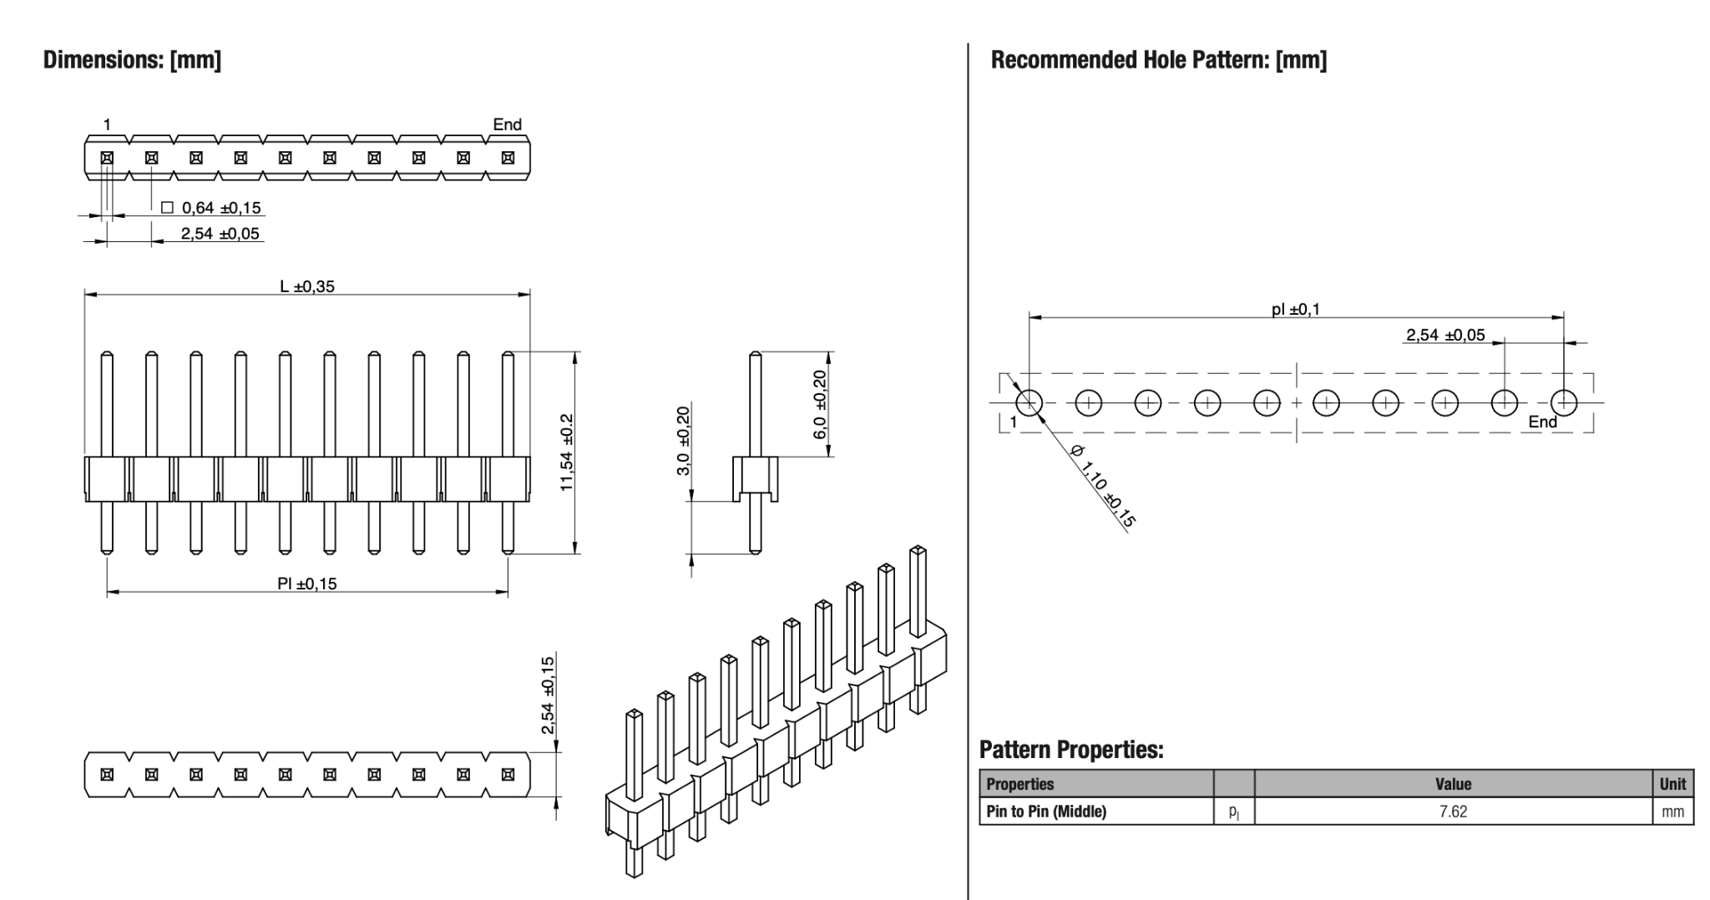
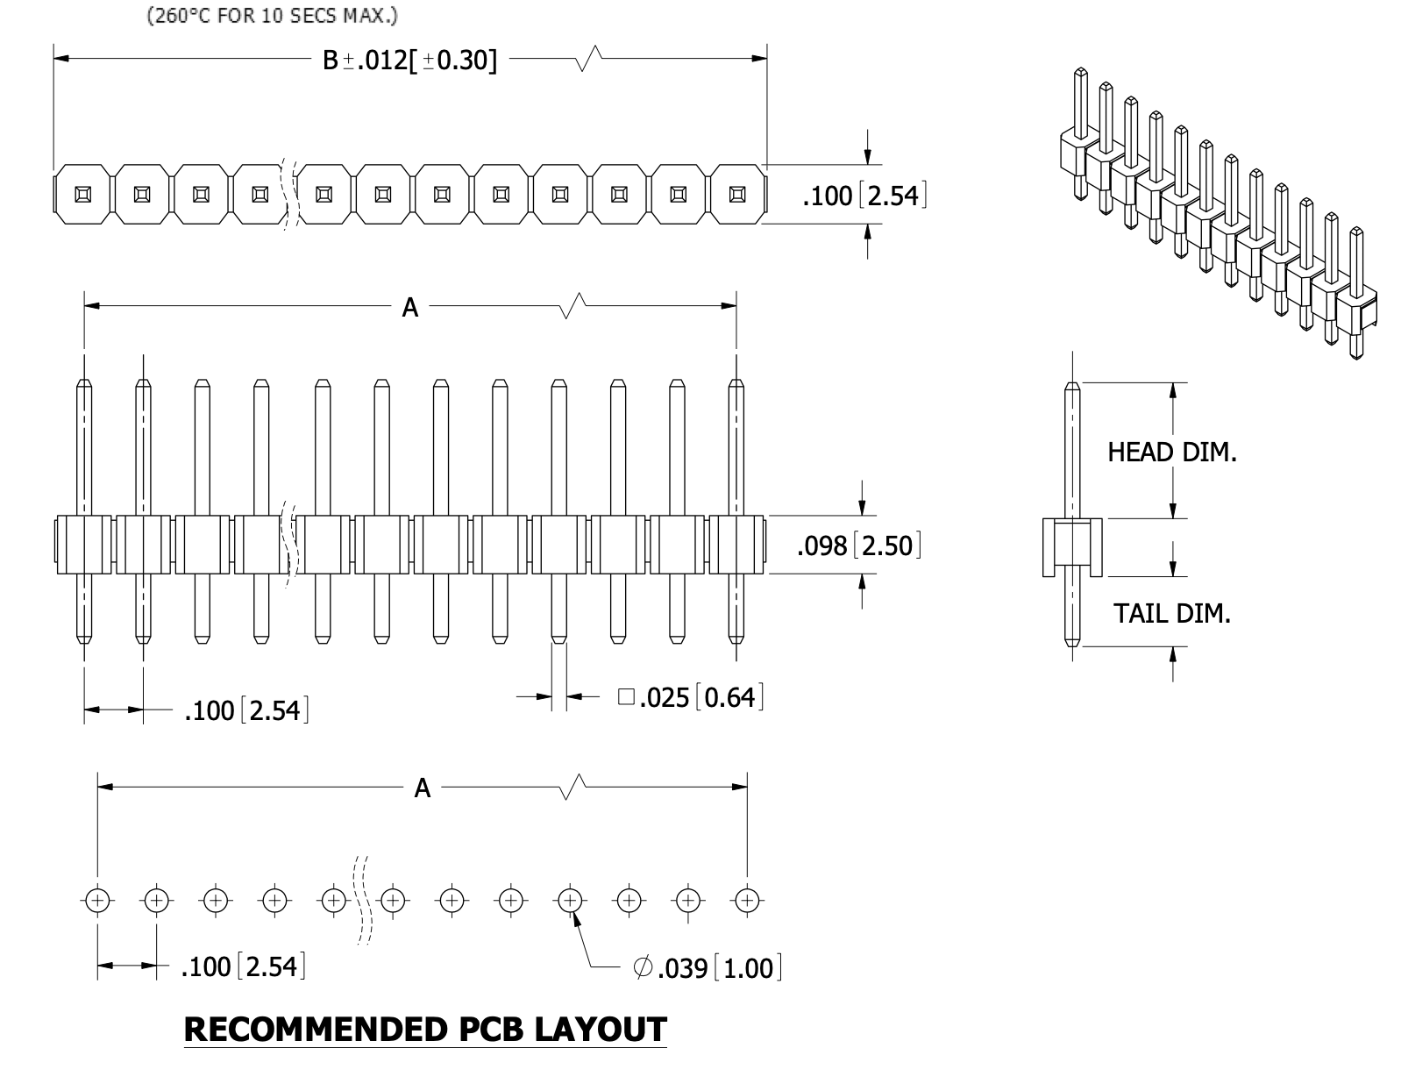
Board Connector Model selection
61300411121
(used model for PCB schematic) [3]
PRPC004SAAN-RC
(ICD document) [4]

Slide 12
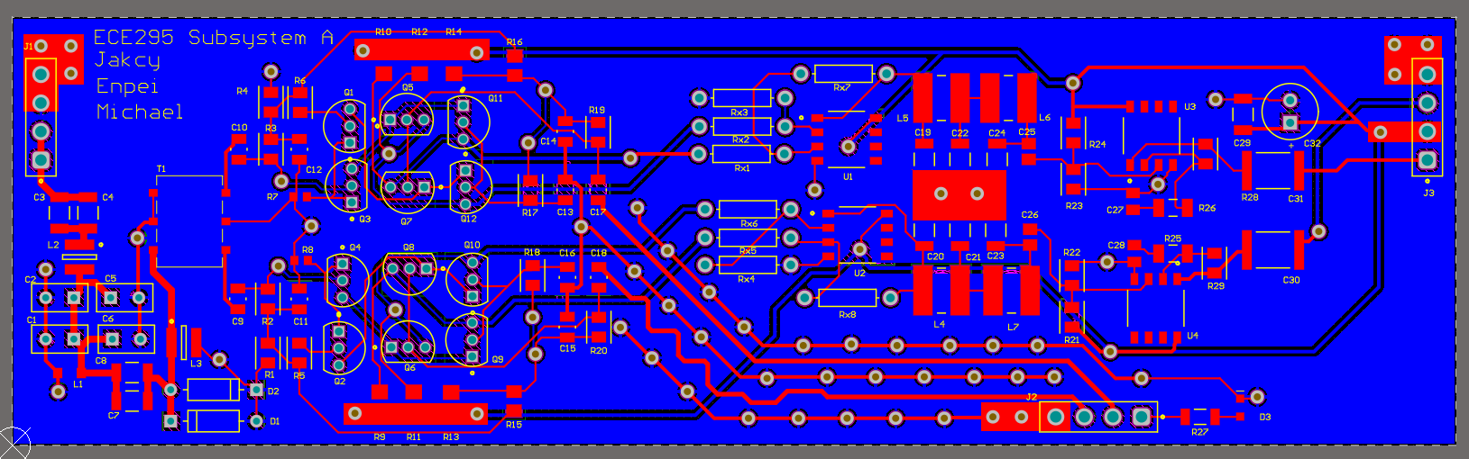
Key Features of PCB Design
Full Customization
no reliance on specialized Mixer ICs that may have long lead times.
precise control over gain, filtering, impedance matching
Signal Integrity and Isolation
purpendicular and thick RF-carrying traces
low EM interference

Slide 13
Q&A

Slide 14
Citation
[1] Surface Mount RF Transformer, Mini-Circuits., Brooklyn, New York, USA
[2] DigiKey, “ADT1-1WT+ Footprints and Models” digikey.ca. Accessed: Mar. 9, 2025. [Online]. Available: https://www.digikey.ca/en/models/13927938
[3] WR-PHD Pin Header, Würth Elektronik eiSos GmbH & Co., Max-Eyth-Str. 174638, Waldenburg, Germany
[4] HEADER MALE .100" PITCH, STRAIGHT, Sullins Connector Solutions.,

