Slide 1


Welcome to:
A gentle introduction
OTM Lab Meeting
02/04/2024
Notes:
2/28/24
2/28/24
1

Slide 2

What and why git????
What is git?
Version control system that…
Tracks changes in computer files
Facilitates/coordinates work on those files between people
Why git???
Free, open-source software!
Easy to manage and share projects/code between people (or labs)!
Main

Slide 3
How to git (step 1):
OTM LAB GitHub
Create GitHub account:
www.github.com
More info about how Git and GitHub works:
https://docs.github.com/en/get-started/using-git/about-git
https://docs.github.com/en/get-started/using-github/github-flow
pulling new changes
Your forked repository
(will contain all the code needed for whatever analysis you want to do)
pulling new changes
pushing new commits
Local copy (on your computer) of your repository where you can edit and run the code

Slide 4

How to git (step 1.5):
Download GitHub for desktop
Log in to your GitHub account!
https://desktop.github.com/download/

Slide 5
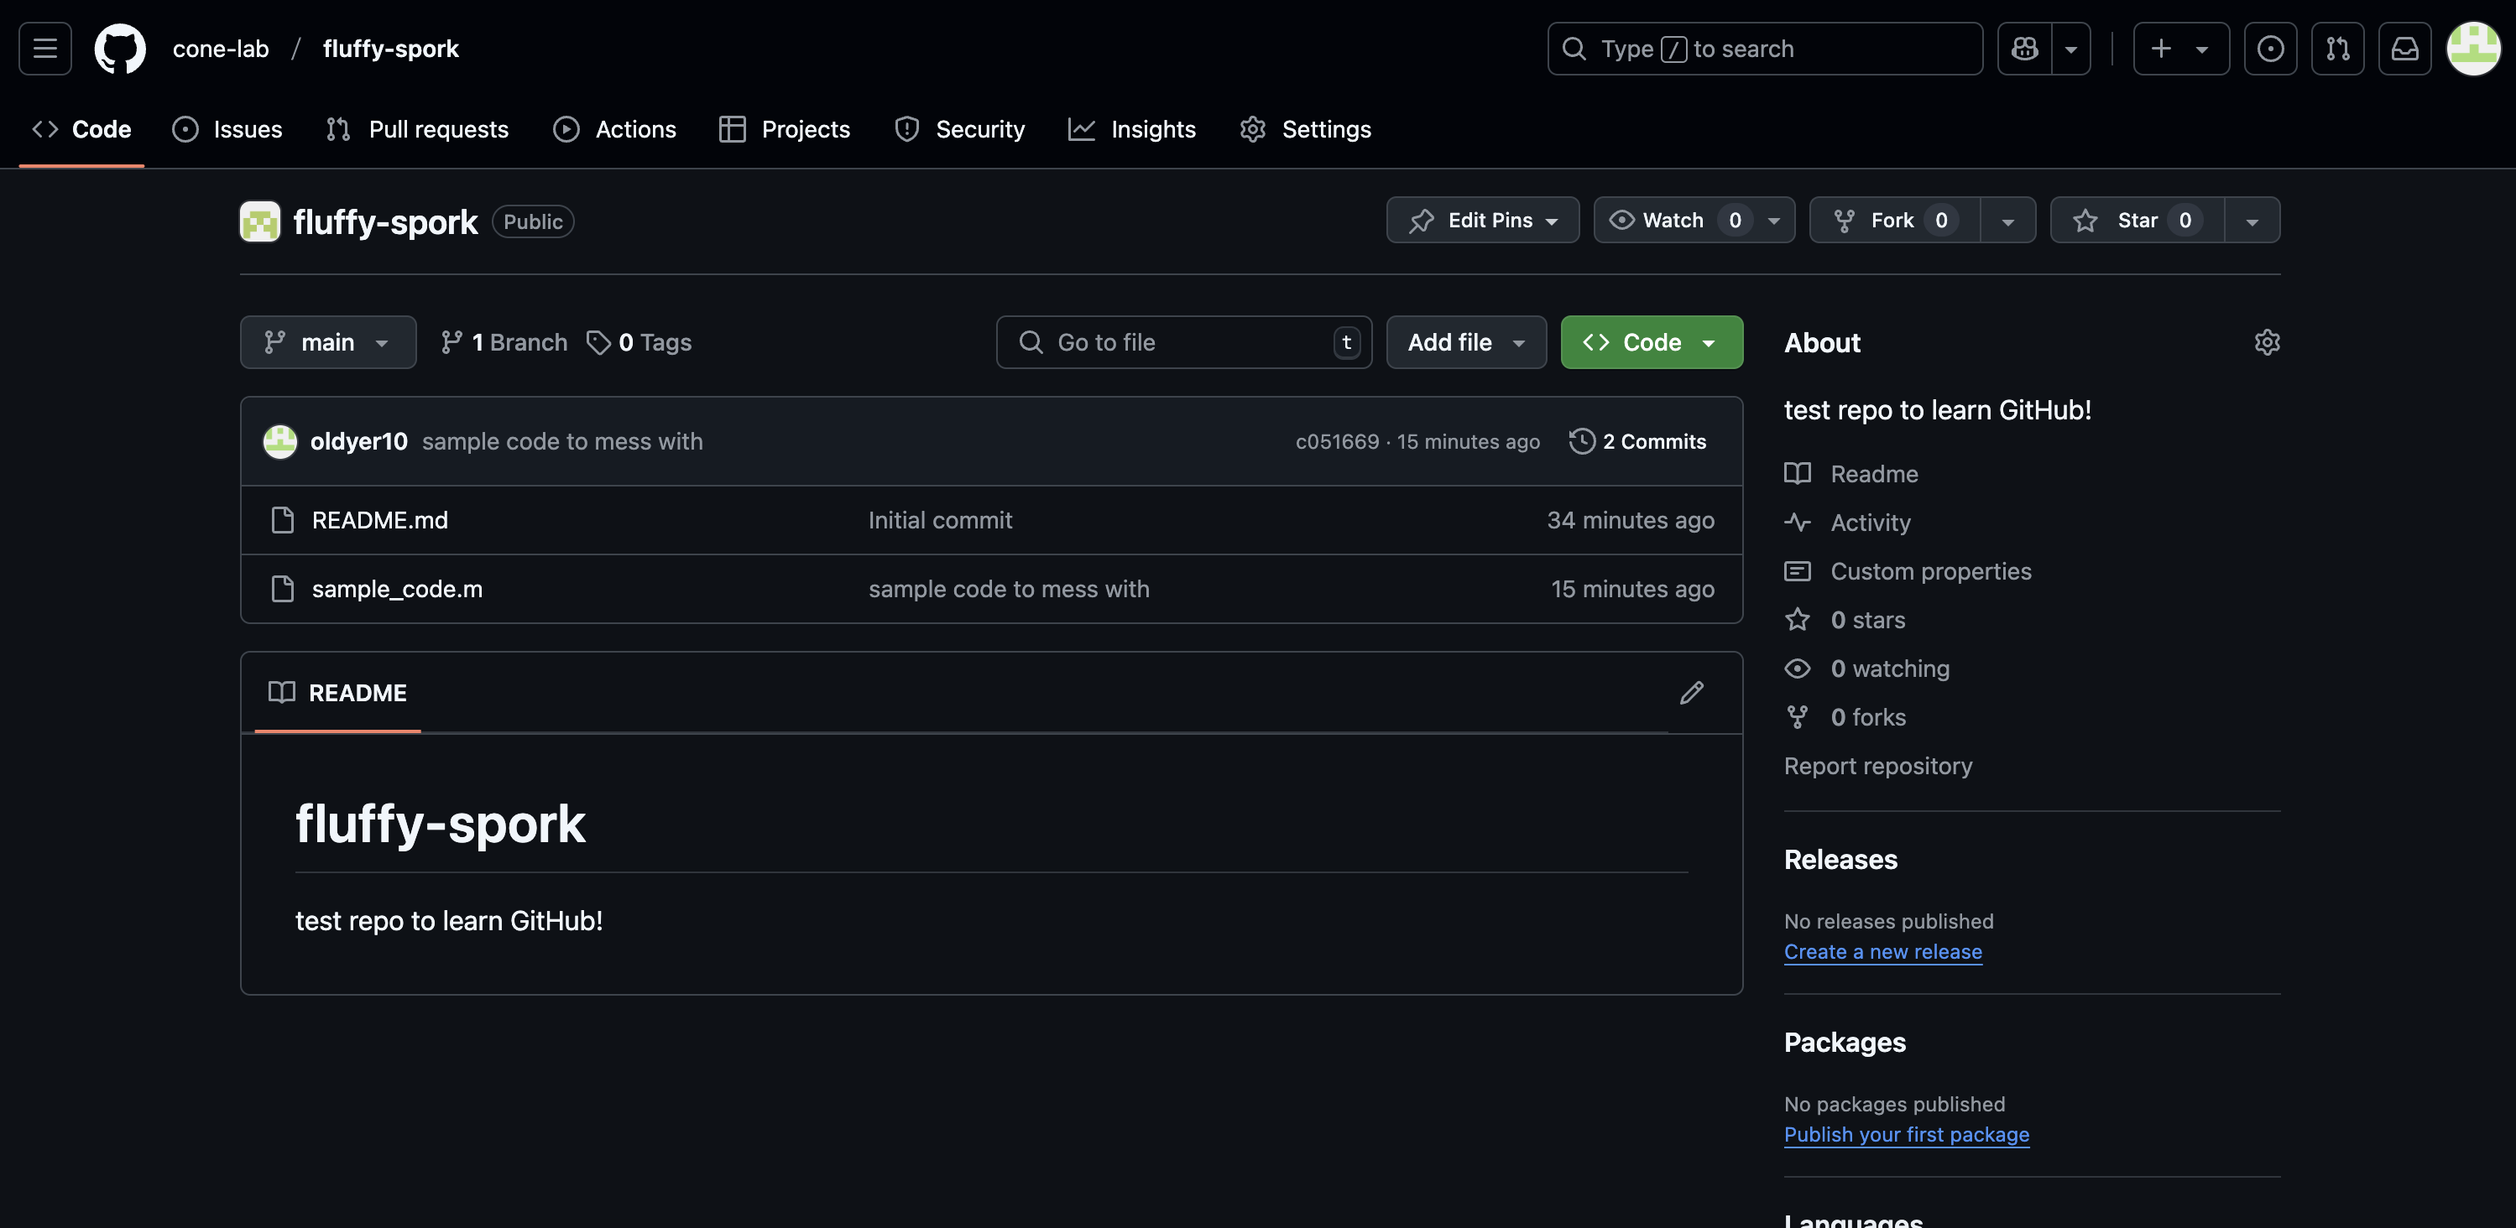
How to git (step 2):
Time to fork!

Slide 6
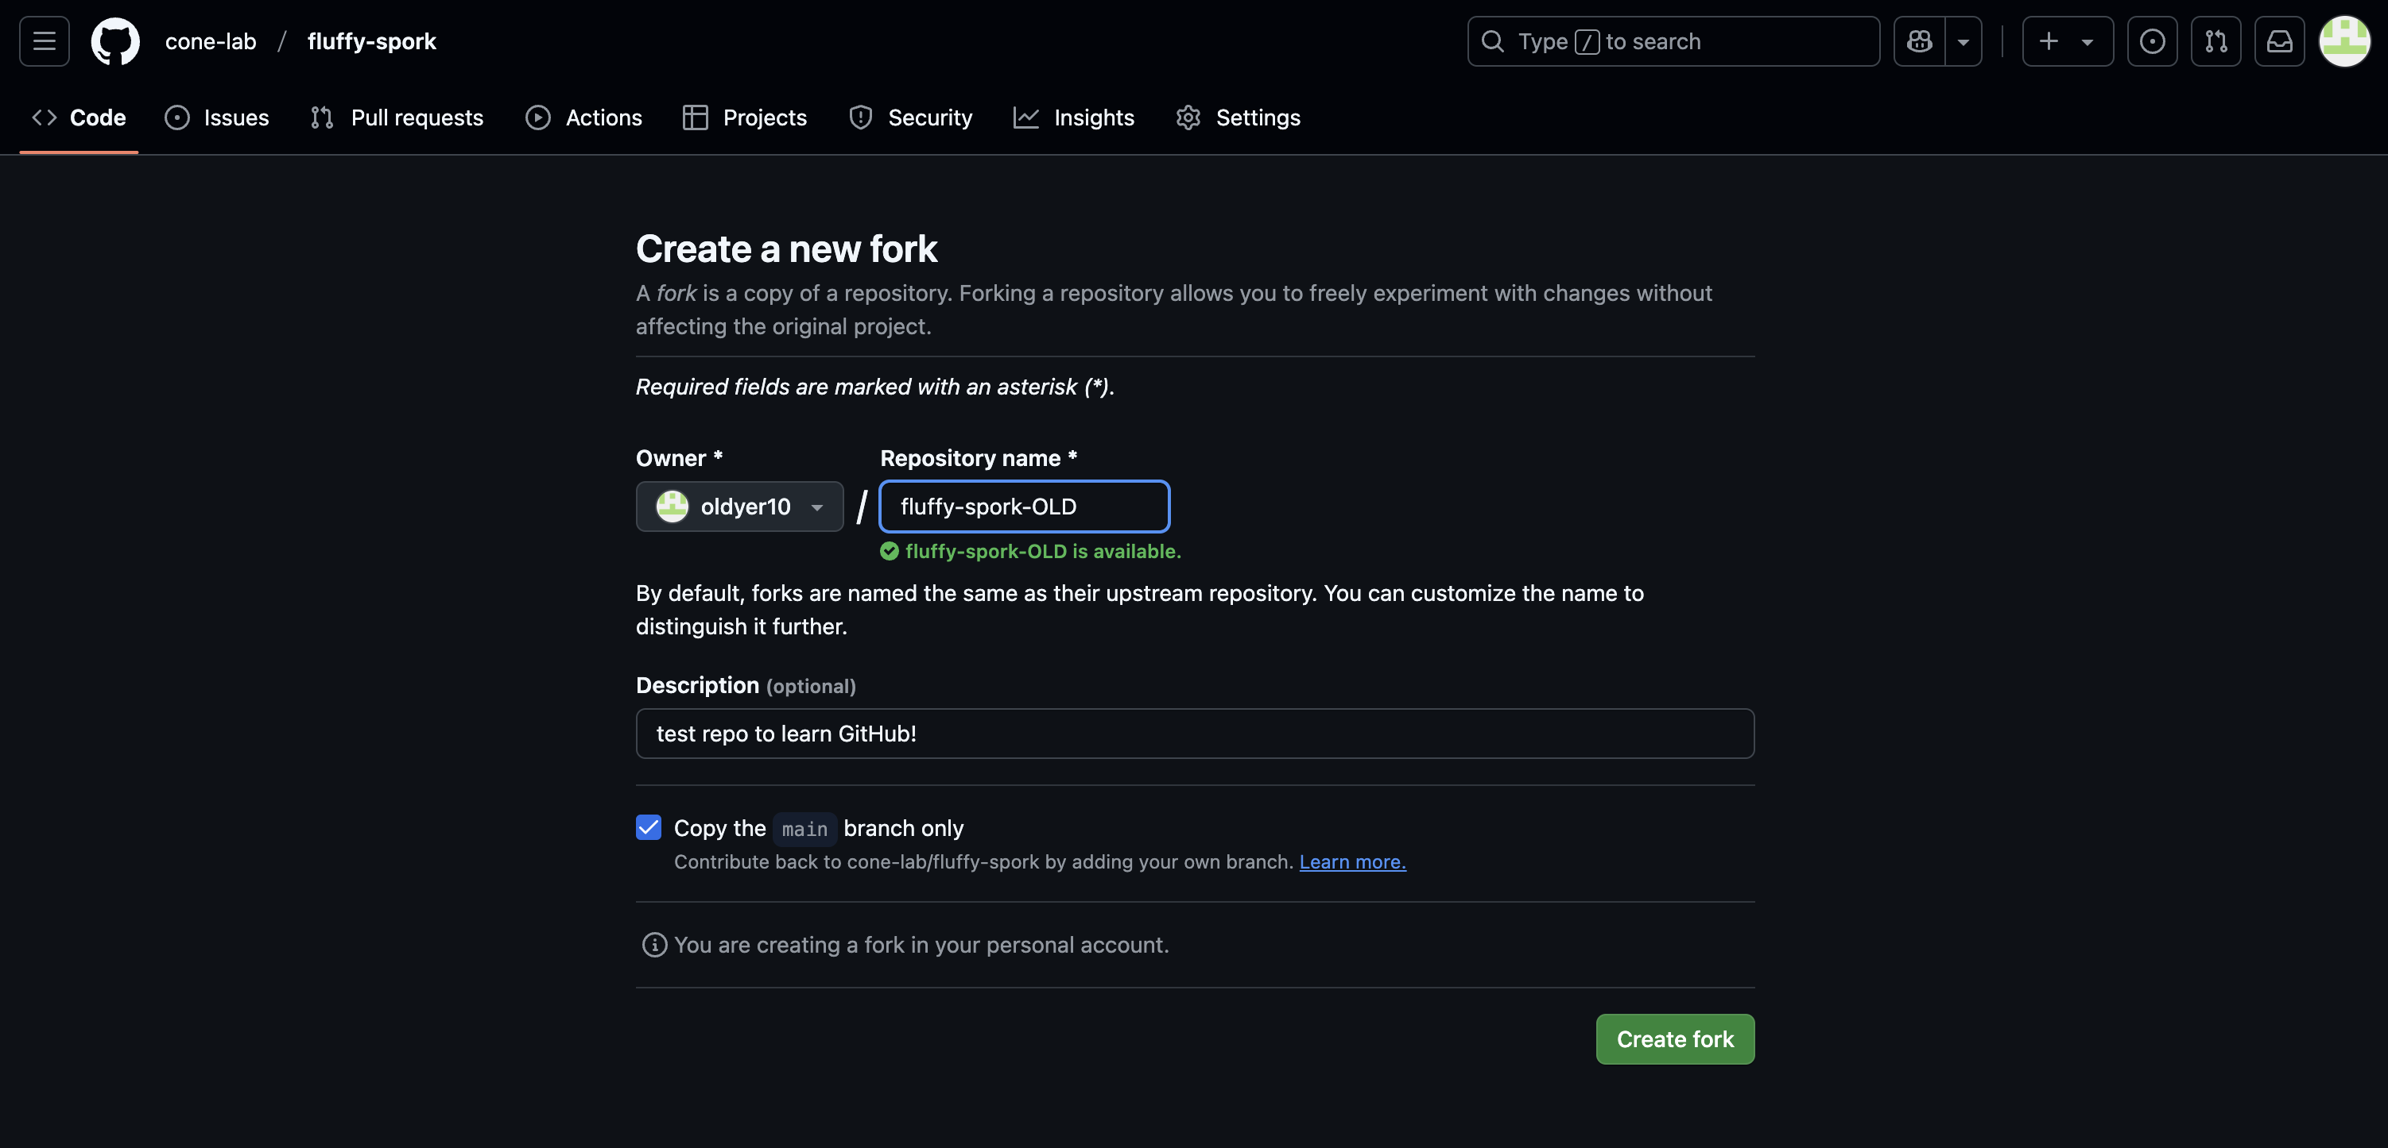
How to git (step 2):
Time to fork!
fork the OTM lab repository to your own personal GitHub

Slide 7
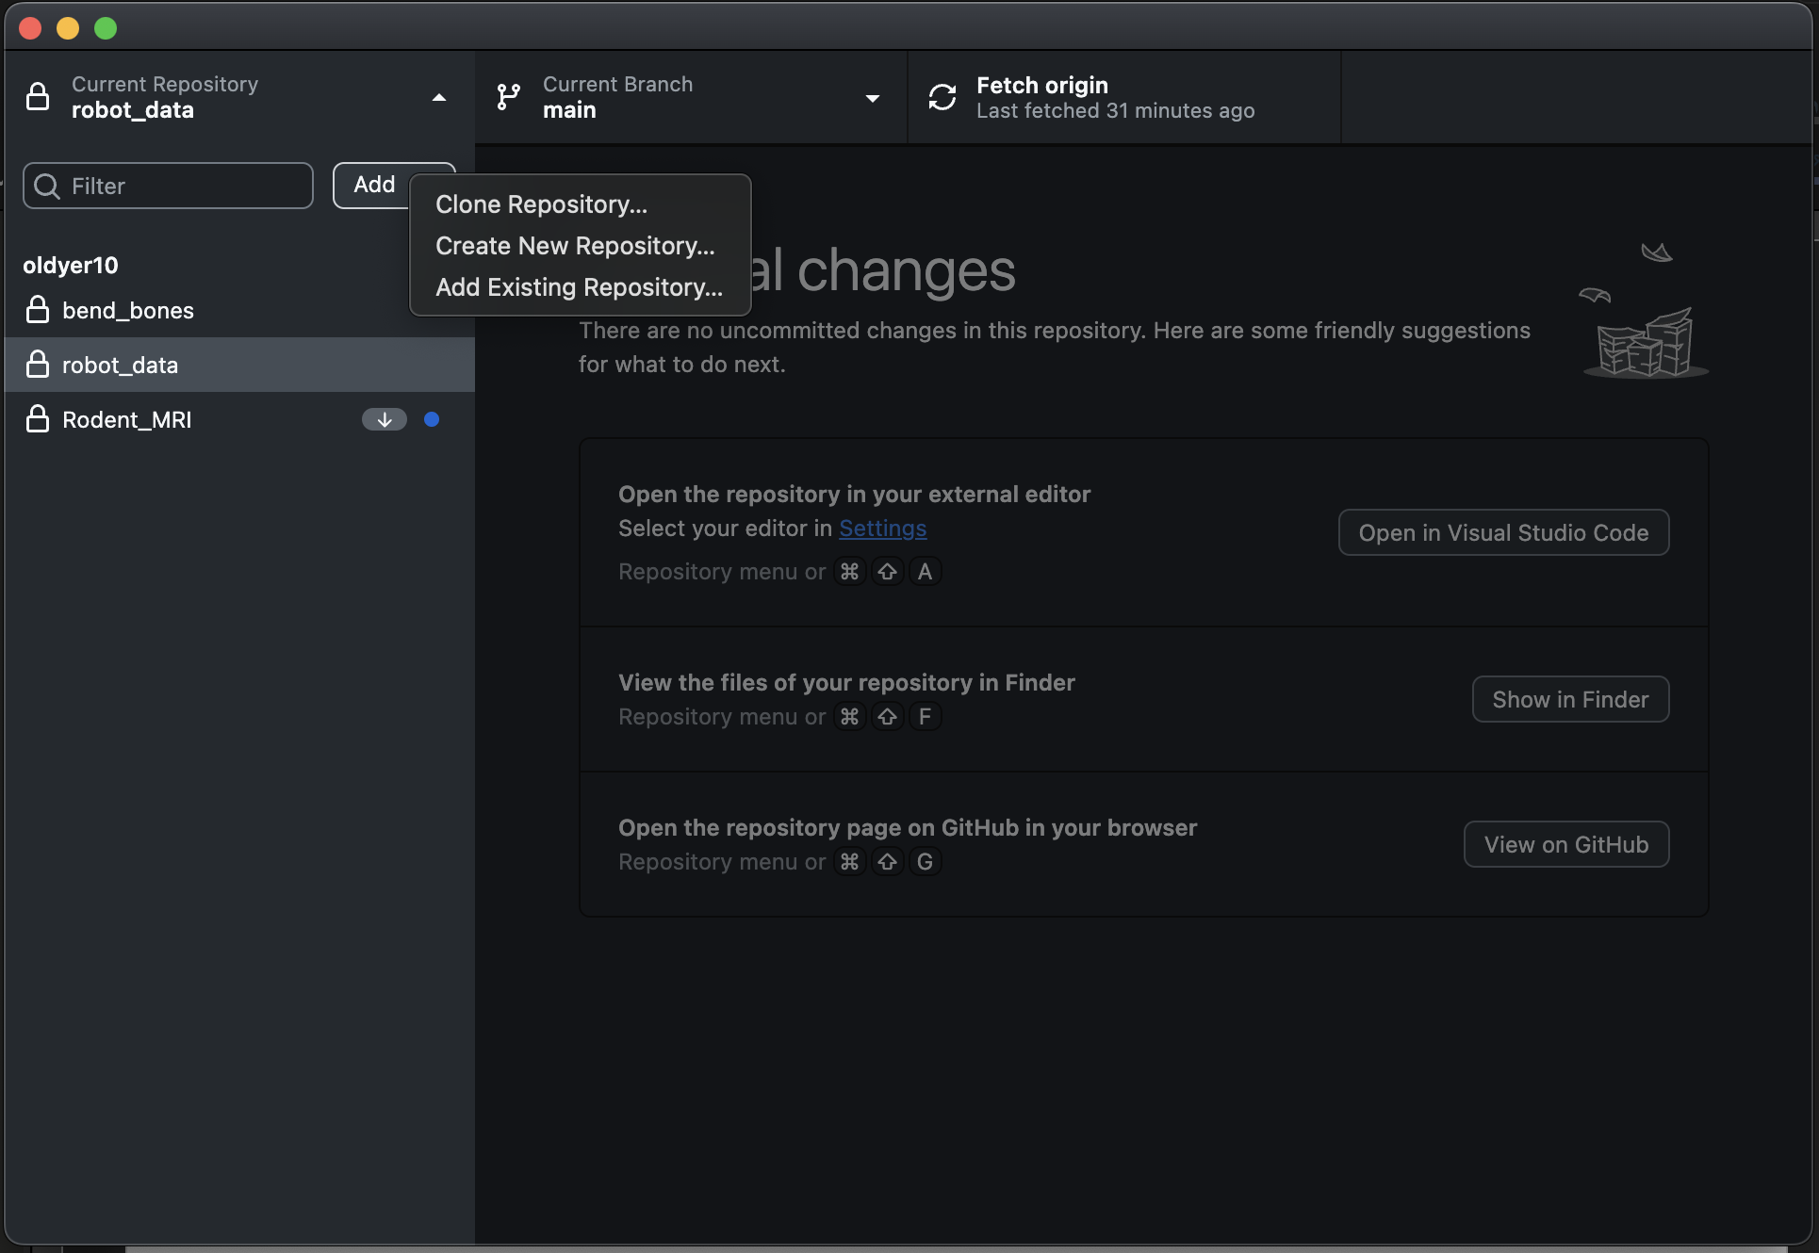
How to git (step 3):
Clone the repository to your computer!

Slide 8
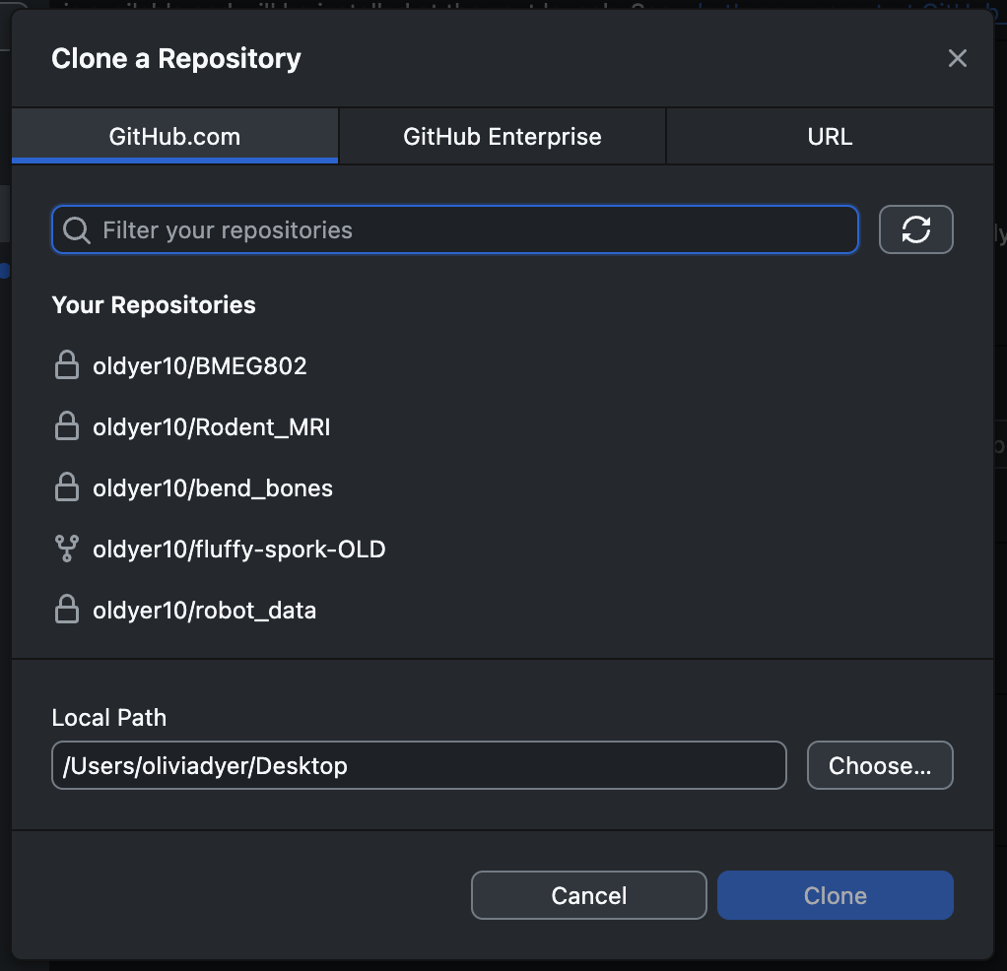
How to git (step 3):
Clone the repository to your computer!
set the file path (location on your computer) of where you want the repository

Slide 9
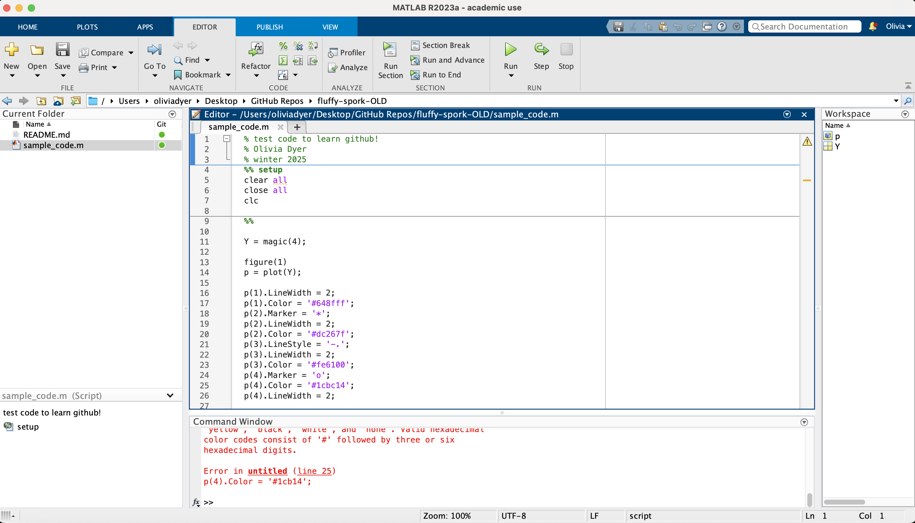
How to git (step 4):
Use and edit your code!

Slide 10
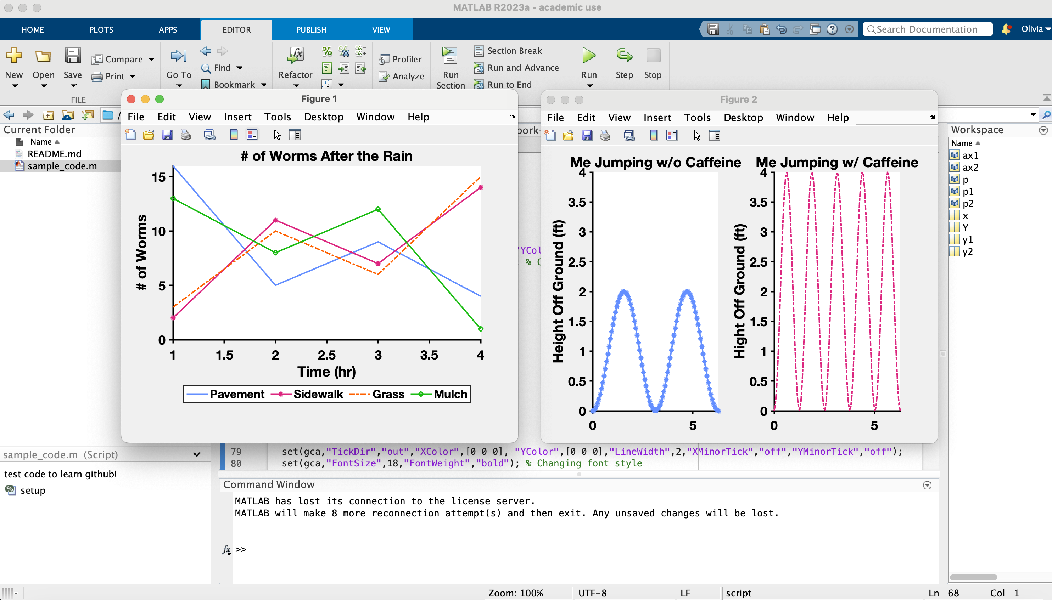
How to git (step 4):
Use and edit your code!
Once you’re done, make sure to save it!

Slide 11
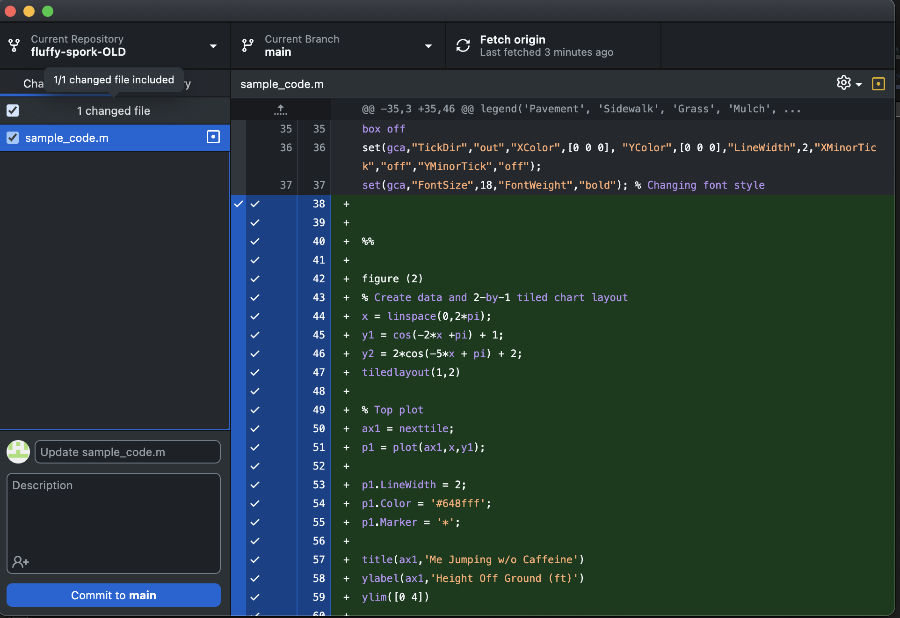
How to git (step 5):
Commit your changes!!
short message goes here!

Slide 12
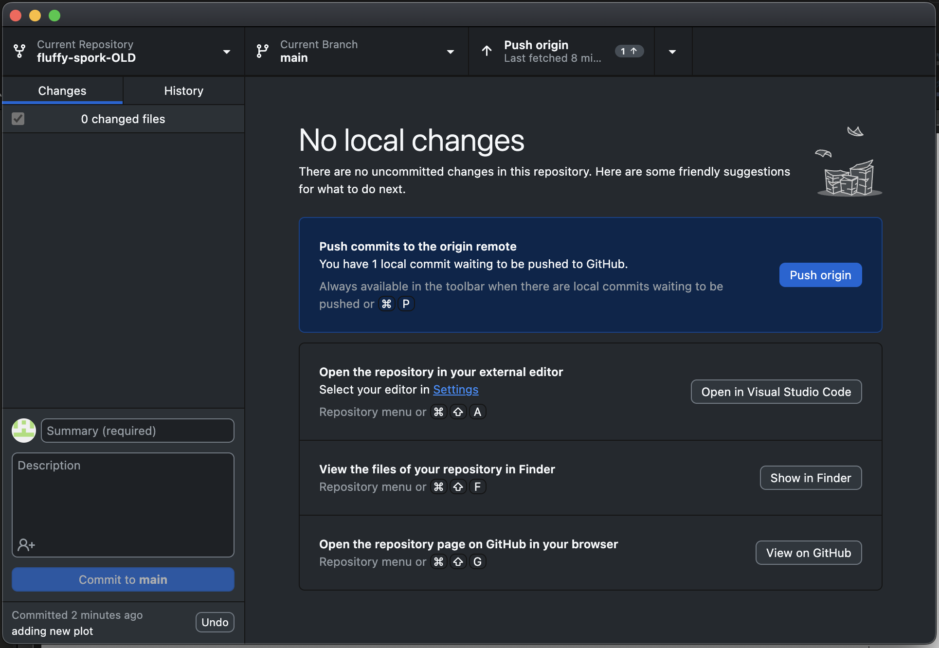
How to git (step 6):
Push your commit!

