Slide 1
A Tutorial on Zero-Knowledge Proofs
Basics and Implementation (Part 1)
By Olive Franzese-McLaughlin

Slide 2
Outline
Verifying Hidden Computations
what is a zero-knowledge proof and how does it work?
secure coin flipping
commitments
addition of two hidden numbers
multiplication of two hidden numbers
definition & security ZKPs
a ZKP for arbitrary circuit evaluation
Implementation
quick-start guide to coding ZKPs using EMP-tool, a C++ library
Initializing repo, executing a “hello world” program with emp-zk
ZKP to verify distance from cluster centers

Slide 3



Outline
Verifying Hidden Computations
what is a zero-knowledge proof and how does it work?
secure coin flipping
commitments
addition of two hidden numbers
multiplication of two hidden numbers
definition & security ZKPs
a ZKP for arbitrary circuit evaluation
Implementation
quick-start guide to coding ZKPs using EMP-tool, a C++ library
Initializing repo, executing a “hello world” program with emp-zk
ZKP to verify distance from cluster centers

Slide 4



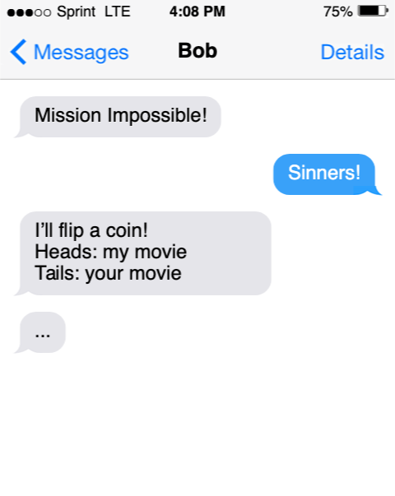
Alice and Bob want to see a movie

Slide 5
Alice and Bob want to see a movie

Slide 6
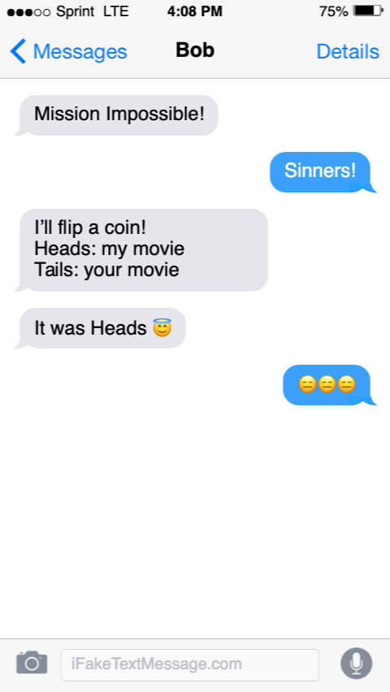
Alice and Bob want to see a movie

Slide 7
Alice and Bob want to see a movie

Slide 8
Alice and Bob want to see a movie
Did Bob really flip a coin?

Slide 9
Alice and Bob want to see a movie
Did Bob really flip a coin?
How can Alice be certain?
Ideas?

Slide 10
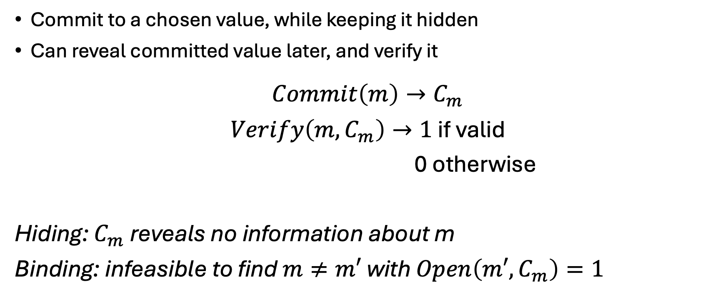
To help us: Cryptographic Commitments
Commit to a chosen value, while keeping it hidden
Can reveal committed value later, and verify it
$$Commit\left(m\right)→C_{m}$$
$Verify\left(m, C_{m}\right)→1$ if valid
0 otherwise
Hiding: $C_{m}$ reveals no information about m
Binding: infeasible to find $m≠m′$ with $Open\left(m′, C_{m}\right)=1$

Slide 11
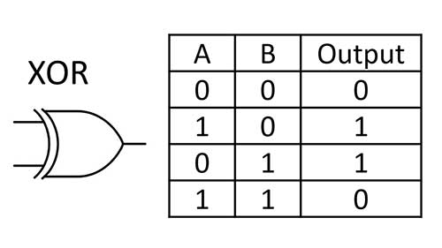

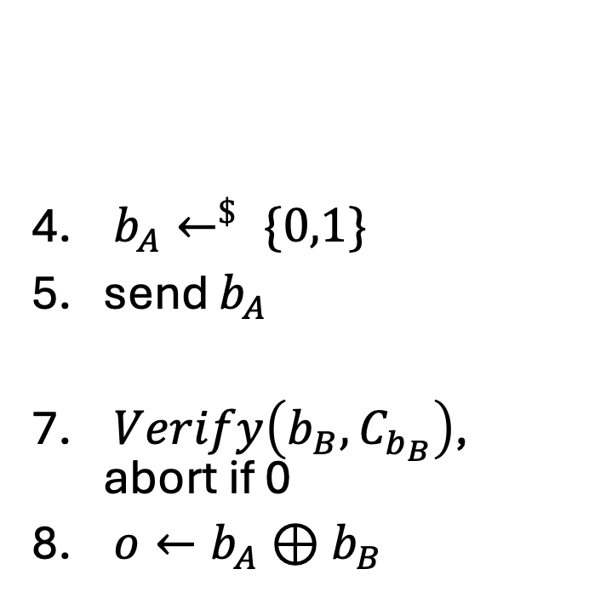
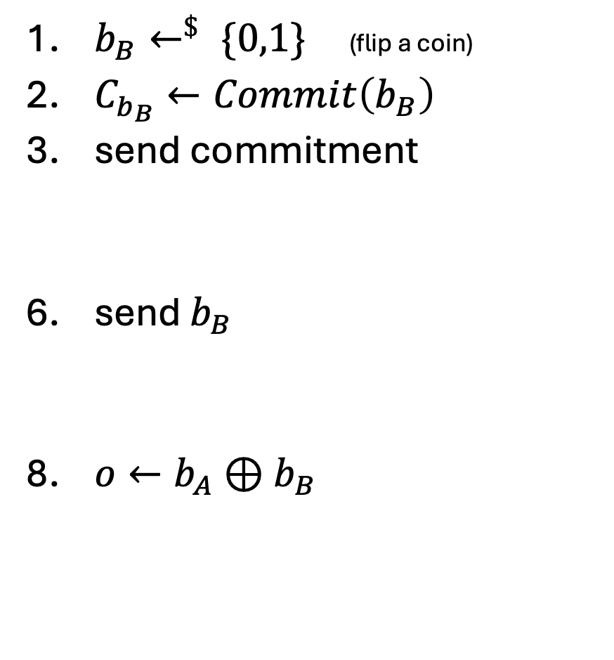


$b_{B}←^{\$} \{0,1\}$ (flip a coin)
$C_{b_{B}}←Commit\left(b_{B}\right)$
send commitment
send $b_{B}$
$o←b_{A}⊕b_{B}$
$b_{A}←^{\$} \{0,1\}$
send $b_{A}$
$Verify\left(b_{B}, C_{b_{B}}\right)$, abort if 0
$o←b_{A}⊕b_{B}$
$$C_{b_{B}}$$
$$b_{A}$$
$$b_{B}$$

Slide 12
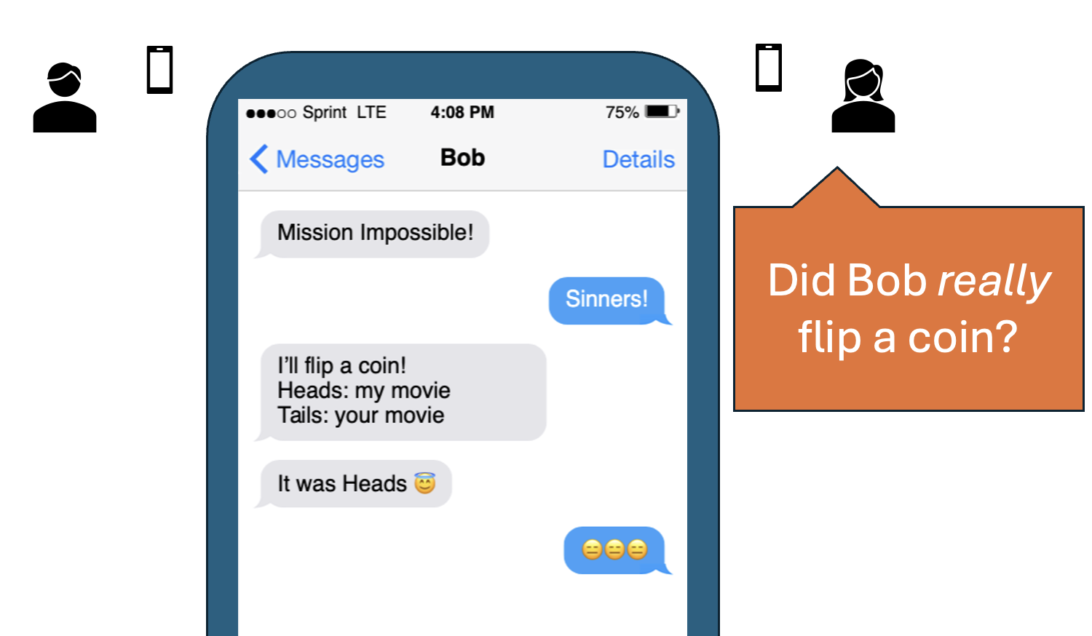

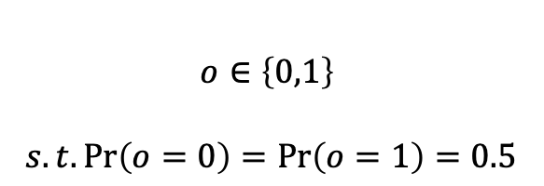



Security Analysis (informal)
What does ‘security’ mean here?
Goal: verify whether output was a fair coin flip
$$m_{1}$$
$$m_{2}$$
$$…$$
$$m_{n}$$
$$o∈\left\{0,1\right\}$$
$$s.t.\operatorname{Pr}\left(o=0\right)=\operatorname{Pr}\left(o=1\right)=0.5$$
Even if Alice OR Bob tries to disrupt the outcome

Slide 13

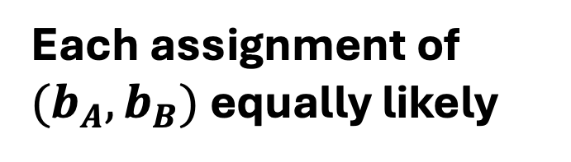
Alice & Bob honest
$b_{B}←^{\$} \{0,1\}$ (flip a coin)
$C_{b_{B}}←Commit\left(b_{B}\right)$
send commitment
send $b_{B}$
$o←b_{A}⊕b_{B}$
$b_{A}←^{\$} \{0,1\}$
send $b_{A}$
$Verify\left(b_{B}, C_{b_{B}}\right)$, abort if 0
$o←b_{A}⊕b_{B}$
$$C_{b_{B}}$$
$$b_{A}$$
$$b_{B}$$
Each assignment of ${{(b}_{A},b}_{B})$ equally likely
$$\operatorname{Pr}\left(o=0\right)=\operatorname{Pr}\left(o=1\right)=0.5$$

Slide 14
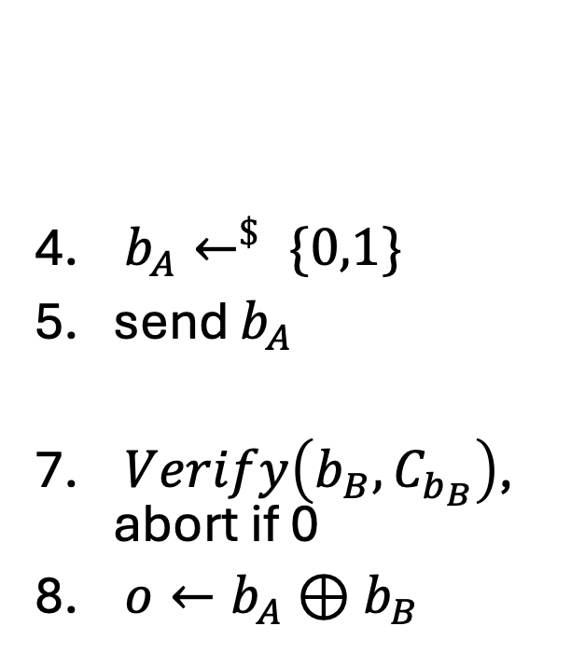
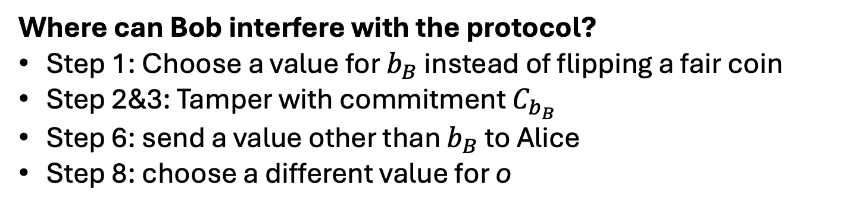
Bob Dishonest
$b_{B}←^{\$} \{0,1\}$ (flip a coin)
$C_{b_{B}}←Commit\left(b_{B}\right)$
send commitment
send $b_{B}$
$o←b_{A}⊕b_{B}$
$b_{A}←^{\$} \{0,1\}$
send $b_{A}$
$Verify\left(b_{B}, C_{b_{B}}\right)$, abort if 0
$o←b_{A}⊕b_{B}$
$$C_{b_{B}}$$
$$b_{A}$$
$$b_{B}$$
Where can Bob interfere with the protocol?
Step 1: Choose a value for $b_{B}$ instead of flipping a fair coin
Step 2&3: Tamper with commitment $C_{b_{B}}$
Step 6: send a value other than $b_{B}$ to Alice
Step 8: choose a different value for o

Slide 15
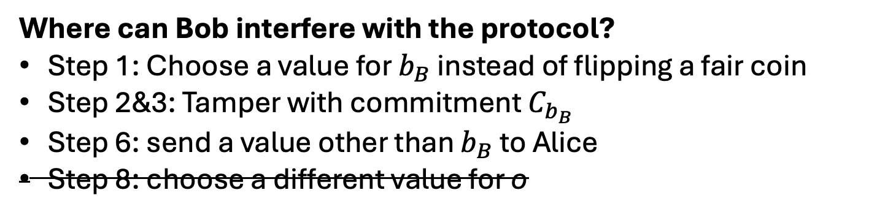
$b_{B}←^{\$} \{0,1\}$ (flip a coin)
$C_{b_{B}}←Commit\left(b_{B}\right)$
send commitment
send $b_{B}$
$o←b_{A}⊕b_{B}$
$b_{A}←^{\$} \{0,1\}$
send $b_{A}$
$Verify\left(b_{B}, C_{b_{B}}\right)$, abort if 0
$o←b_{A}⊕b_{B}$
$$C_{b_{B}}$$
$$b_{A}$$
$$b_{B}$$
Where can Bob interfere with the protocol?
Step 1: Choose a value for $b_{B}$ instead of flipping a fair coin
Step 2&3: Tamper with commitment $C_{b_{B}}$
Step 6: send a value other than $b_{B}$ to Alice
Step 8: choose a different value for o

Slide 16
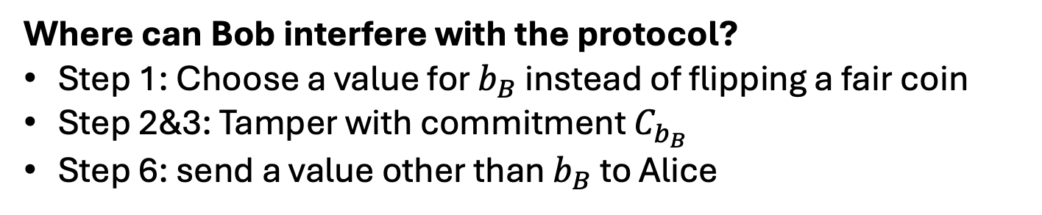
$b_{B}←^{\$} \{0,1\}$ (flip a coin)
$C_{b_{B}}←Commit\left(b_{B}\right)$
send commitment
send $b_{B}$
$o←b_{A}⊕b_{B}$
$b_{A}←^{\$} \{0,1\}$
send $b_{A}$
$Verify\left(b_{B}, C_{b_{B}}\right)$, abort if 0
$o←b_{A}⊕b_{B}$
$$C_{b_{B}}$$
$$b_{A}$$
$$b_{B}$$
Where can Bob interfere with the protocol?
Step 1: Choose a value for $b_{B}$ instead of flipping a fair coin
Step 2&3: Tamper with commitment $C_{b_{B}}$
Step 6: send a value other than $b_{B}$ to Alice

Slide 17
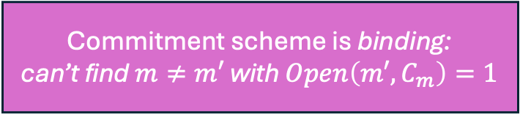
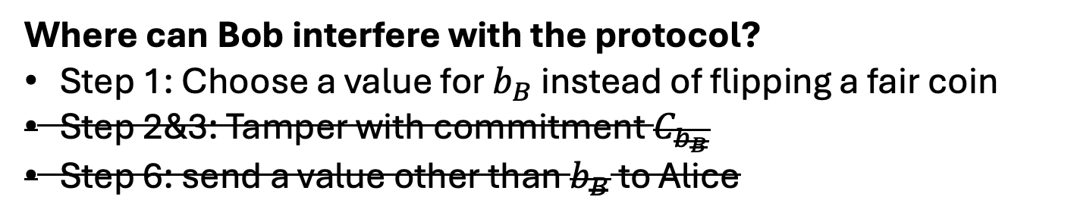
$b_{B}←^{\$} \{0,1\}$ (flip a coin)
$C_{b_{B}}←Commit\left(b_{B}\right)$
send commitment
send $b_{B}$
$o←b_{A}⊕b_{B}$
$b_{A}←^{\$} \{0,1\}$
send $b_{A}$
$Verify\left(b_{B}, C_{b_{B}}\right)$, abort if 0
$o←b_{A}⊕b_{B}$
$$C_{b_{B}}$$
$$b_{A}$$
$$b_{B}$$
Where can Bob interfere with the protocol?
Step 1: Choose a value for $b_{B}$ instead of flipping a fair coin
Step 2&3: Tamper with commitment $C_{b_{B}}$
Step 6: send a value other than $b_{B}$ to Alice
Commitment scheme is binding:
can’t find $m≠m′$ with $Open\left(m′, C_{m}\right)=1$

Slide 18
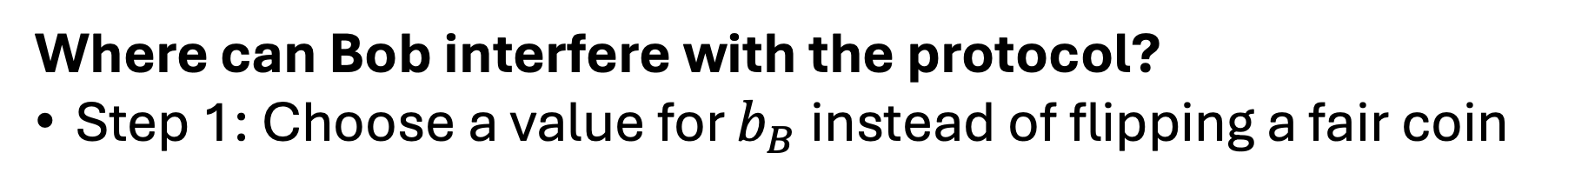
$b_{B}←^{\$} \{0,1\}$ (flip a coin)
$C_{b_{B}}←Commit\left(b_{B}\right)$
send commitment
send $b_{B}$
$o←b_{A}⊕b_{B}$
$b_{A}←^{\$} \{0,1\}$
send $b_{A}$
$Verify\left(b_{B}, C_{b_{B}}\right)$, abort if 0
$o←b_{A}⊕b_{B}$
$$C_{b_{B}}$$
$$b_{A}$$
$$b_{B}$$
Where can Bob interfere with the protocol?
Step 1: Choose a value for $b_{B}$ instead of flipping a fair coin

Slide 19
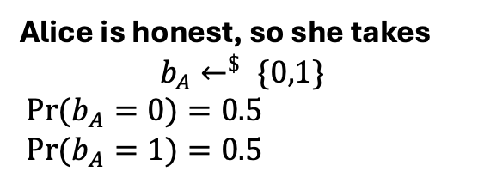




$b_{B}←^{\$} \{0,1\}$ (flip a coin)
$C_{b_{B}}←Commit\left(b_{B}\right)$
send commitment
send $b_{B}$
$o←b_{A}⊕b_{B}$
$b_{A}←^{\$} \{0,1\}$
send $b_{A}$
$Verify\left(b_{B}, C_{b_{B}}\right)$, abort if 0
$o←b_{A}⊕b_{B}$
$$C_{b_{B}}$$
$$b_{A}$$
$$b_{B}$$
Suppose Bob chooses $b_{B}≔1$
Alice is honest, so she takes
$$b_{A}←^{\$} \{0,1\}$$
${Pr⁡(b}_{A}=0)=0.5$
${Pr⁡(b}_{A}=1)=0.5$
(Argument for $b_{B}≔0$ symmetrical)
$$⇒Pr{(o=1)}=0.5$$
$$⇒Pr{(o=0)}=0.5$$

Slide 20
$b_{B}←^{\$} \{0,1\}$ (flip a coin)
$C_{b_{B}}←Commit\left(b_{B}\right)$
send commitment
send $b_{B}$
$o←b_{A}⊕b_{B}$
$b_{A}←^{\$} \{0,1\}$
send $b_{A}$
$Verify\left(b_{B}, C_{b_{B}}\right)$, abort if 0
$o←b_{A}⊕b_{B}$
$$C_{b_{B}}$$
$$b_{A}$$
$$b_{B}$$
Exercise: Alice dishonest

Slide 21


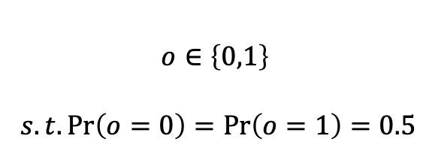

Verifiable Computation between Two Parties
Verify whether output was a fair coin flip
$$m_{1}$$
$$m_{2}$$
$$…$$
$$m_{n}$$
$$o∈\left\{0,1\right\}$$
$$s.t.\operatorname{Pr}\left(o=0\right)=\operatorname{Pr}\left(o=1\right)=0.5$$
Even if Alice OR Bob tries to disrupt the outcome
Next Time: verifying computation of any algorithm

Slide 22
EMP-toolkit basics part 1 (hello world)
Go to: https://github.com/olea-digitalis/emp-zk-tutorial
- No wget natively on mac

Slide 23
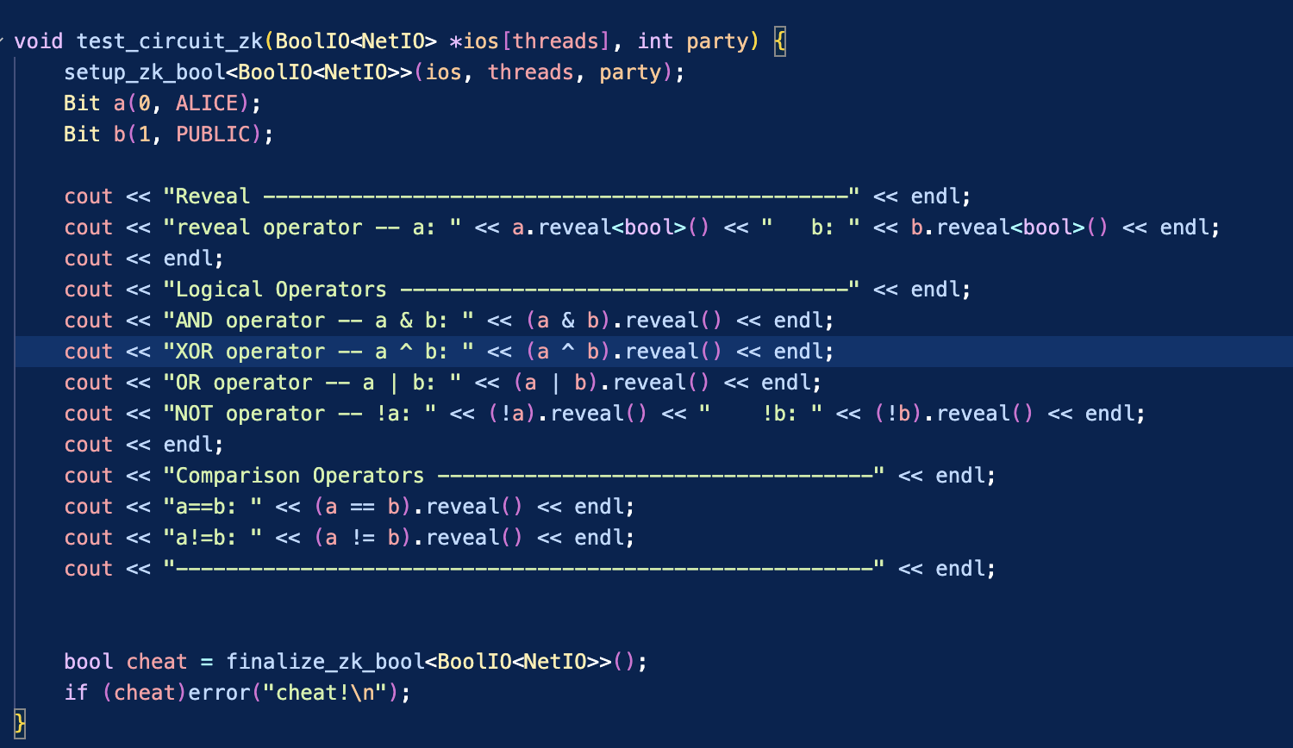

Slide 25



Slide 28



Slide 29


