Slide 1

Ruhulla Sheik

Slide 2
DBMS
A Database Management System (DBMS) is software that manages databases, enabling users to store, retrieve, update, and organize data efficiently. It acts as an intermediary between users/applications and the database, ensuring data integrity, security, and consistency.
Key functions of a DBMS include:
Data Storage: Organizes data in structured formats (e.g., tables in relational DBMS).
Data Retrieval: Allows querying data using languages like SQL.
Data Manipulation: Supports adding, updating, or deleting data.
Data Security: Enforces access controls and authentication.
Concurrency Control: Manages simultaneous data access by multiple users.
Backup and Recovery: Protects data from loss or corruption.
Examples: MySQL, PostgreSQL, Oracle, MongoDB (NoSQL), Microsoft SQL Server.

Slide 3
Types of DBMS
Relational DBMS: Uses tables with rows and columns (e.g., MySQL).
NoSQL DBMS: Handles unstructured/semi-structured data (e.g., MongoDB).
Hierarchical DBMS: Organizes data in a tree-like structure.
Network DBMS: Uses a graph structure.

Slide 4
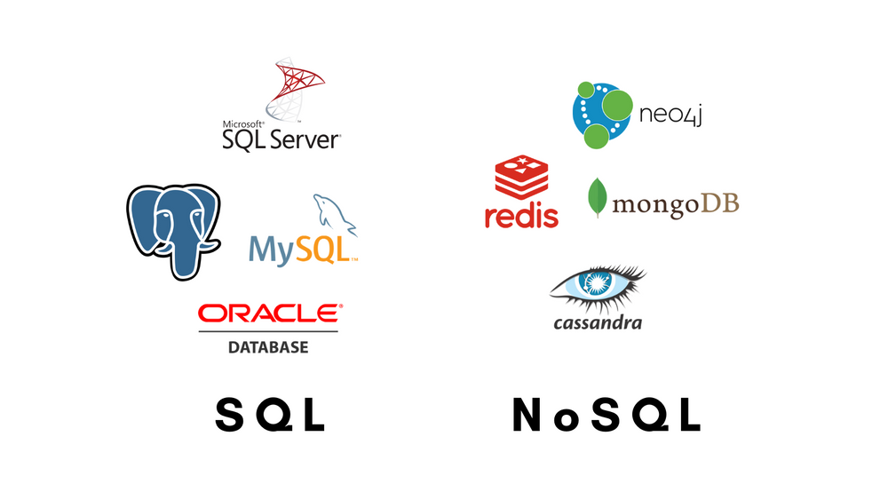
SQL/NoSQL

Slide 5
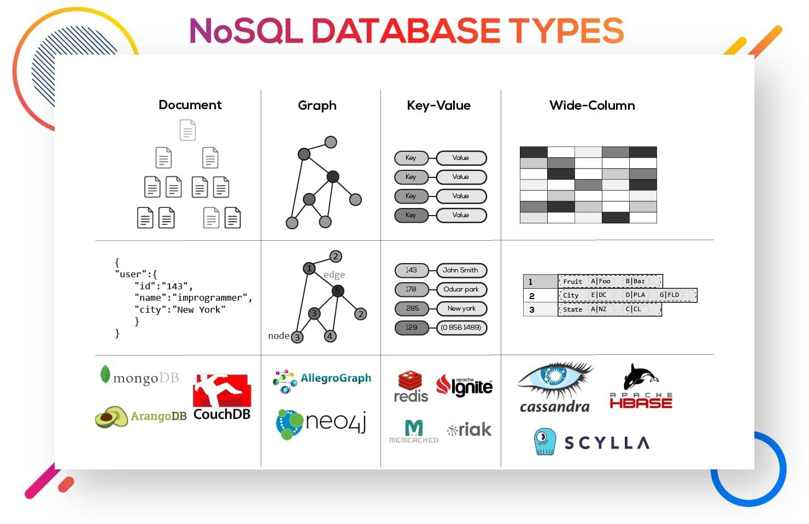
NoSQL DBs

Slide 6
Mongo Installation
Follow the instructions at
workshops/mongo/mongo_installation_windows.md at dev · olearno/workshops · GitHub

Slide 7
Mongo Concepts
Database: A container for collections. Each database is a separate namespace with its own set of collections and permissions. Example: mydb.
Collection: A group of MongoDB documents, similar to a table in a relational database but without a fixed schema. Collections are stored within a database. Example: users.
Document: A single record in a collection, stored as a JSON-like structure (BSON, MongoDB’s binary JSON format). Documents are flexible and can have varying fields. Example: {"name": "John", "age": 30}.
Field: A key-value pair within a document. The key is a string, and the value can be a string, number, array, object, etc. Example: In {"name": "John"}, name is the field, and John is the value.
_id: A unique identifier automatically assigned to each document in a collection. If not provided, MongoDB generates an ObjectId.
Example Structure:
Database: mydb
Collection: users
Document: {"_id": ObjectId("123"), "name": "John", "age": 30}
Document: {"_id": ObjectId("124"), "name": "Jane", "city": "NY"}

Slide 8
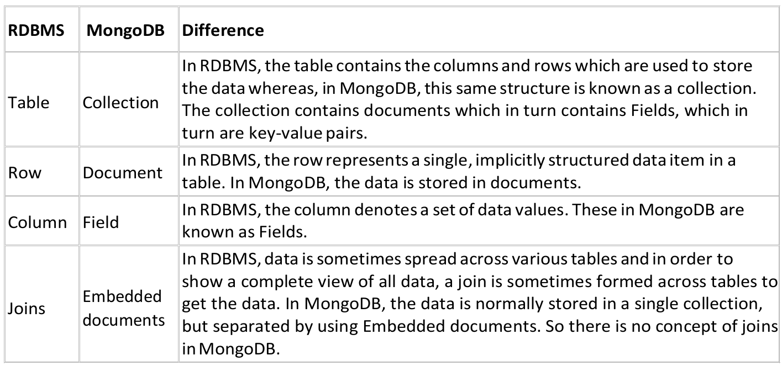
Terminology

Slide 9
Try Commands (Using Shell)
https://github.com/olearno/workshops/blob/dev/mongo/mongo_basic_shell_commands.pdf
https://www.mongodb.com/developer/products/mongodb/cheat-sheet/?msockid=07b4a3b05e98638b209bb67c5f2a6256
https://www.tutorialspoint.com/mongodb/mongodb_tutorial.pdf

Slide 10

Questions ?

Slide 11

Thanks

