Slide 1
PL/SQL
Procedural Language/Structured Query Language
Ruhulla

Slide 2

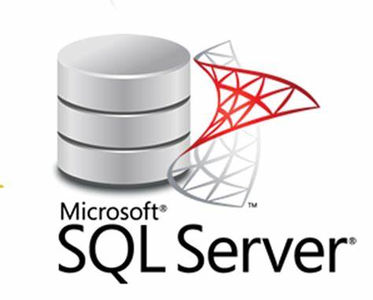
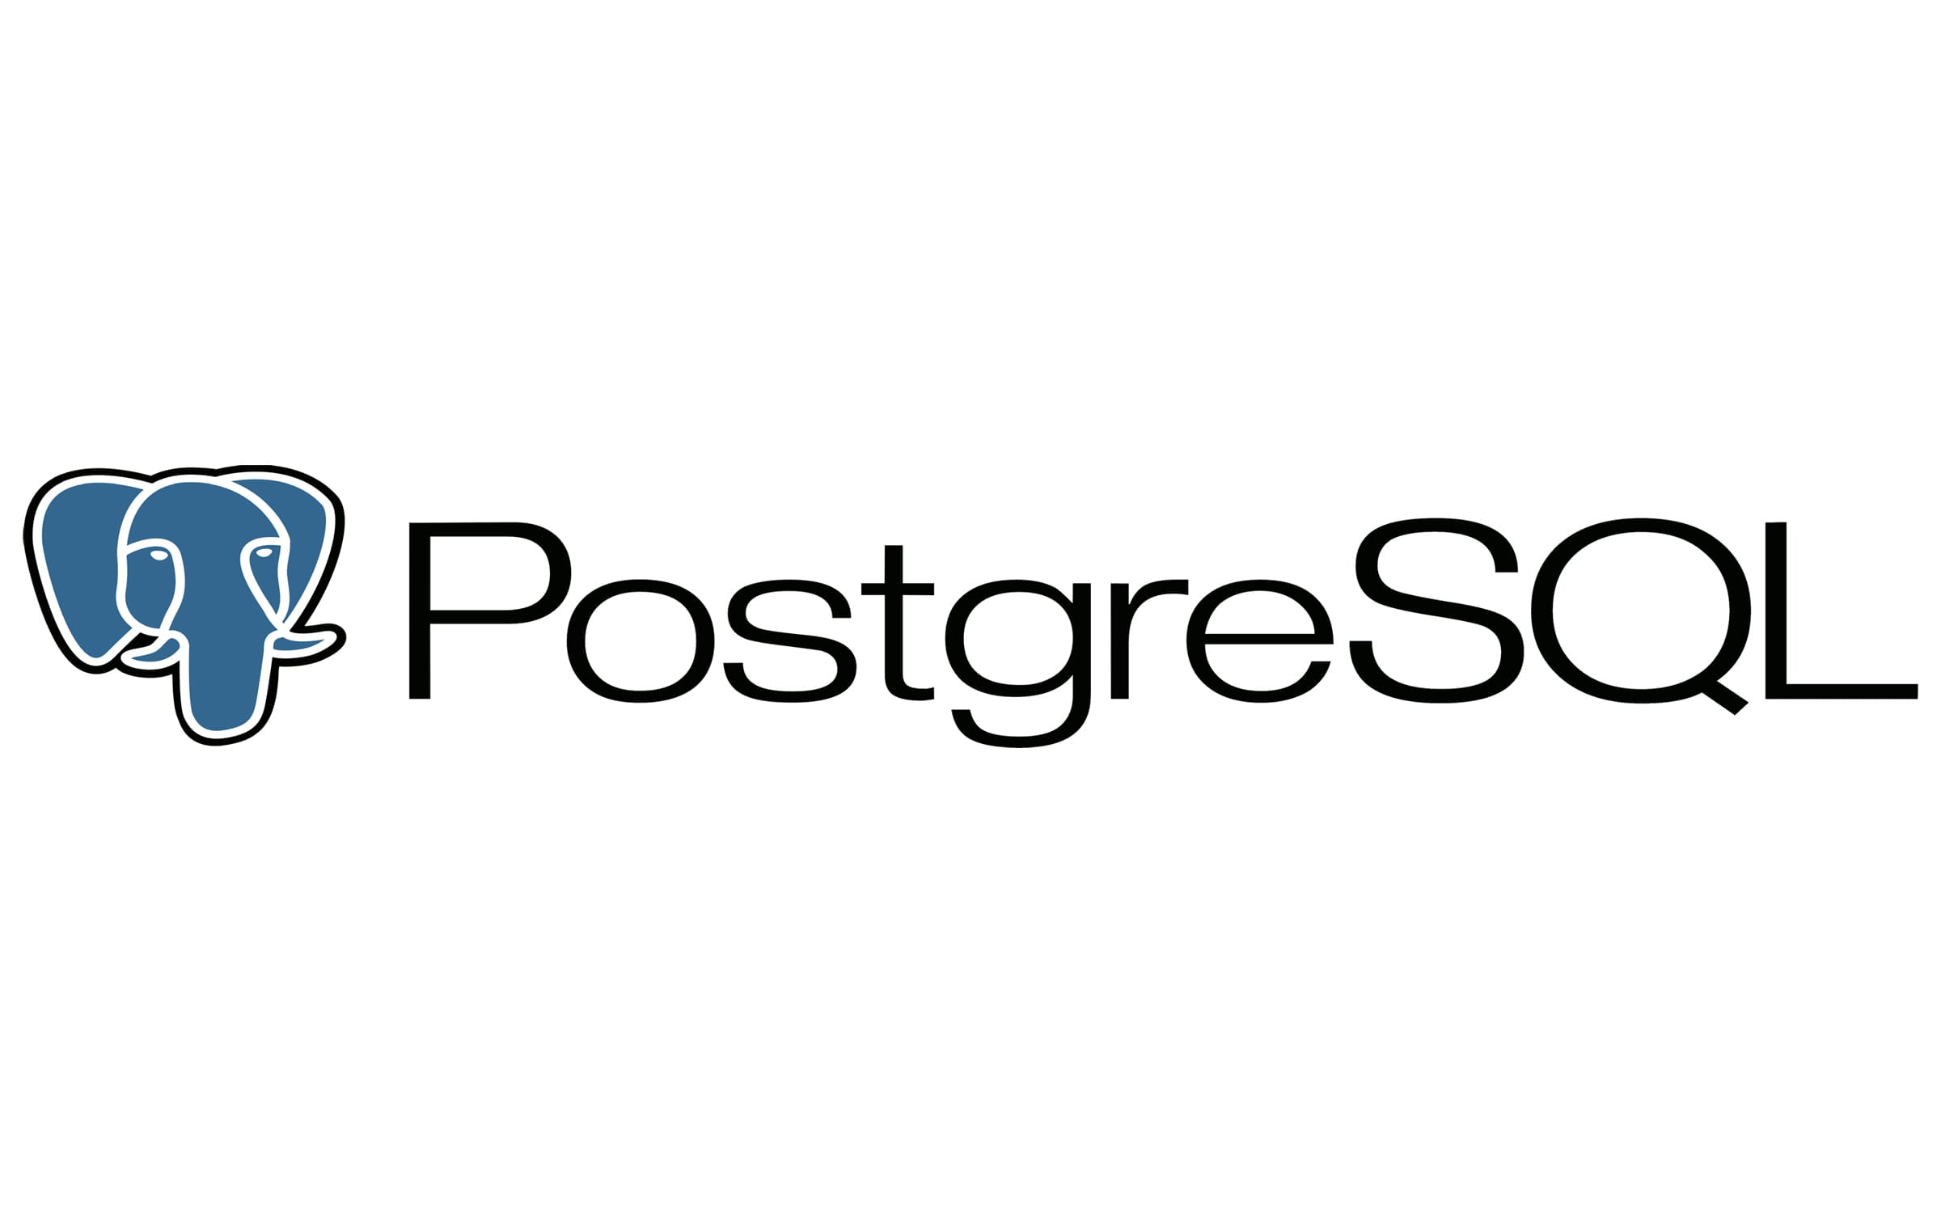

Install DBMS
Install any RDBMS

Slide 3
Query
SELECT name, salary
FROM employees
WHERE department = 'HR';

Slide 4
PLSQL
DECLARE
v_salary NUMBER;
BEGIN
SELECT salary INTO v_salary FROM employees WHERE id = 101;
IF v_salary > 50000 THEN
DBMS_OUTPUT.PUT_LINE('High salary');
ELSE
DBMS_OUTPUT.PUT_LINE('Low salary');
END IF;
END;

Slide 5
PLSQL (Cont.)
<<label>> -- this is optional
DECLARE
-- this section is optional
number1 NUMBER(2);
number2 number1%TYPE := 17; -- value default
text1 VARCHAR2(12) := ' Hello world ';
text2 DATE := SYSDATE; -- current date and time
BEGIN
-- this section is mandatory, must contain at least one executable statement
SELECT street_number
INTO number1
FROM address
WHERE name = 'INU';
EXCEPTION
-- this section is optional
WHEN OTHERS THEN
DBMS_OUTPUT.PUT_LINE('Error Code is ' || TO_CHAR(sqlcode));
DBMS_OUTPUT.PUT_LINE('Error Message is ' || sqlerrm);
END;

Slide 6
Why PL/SQL
PL/SQL (Procedural Language/Structured Query Language) is an extension of SQL that adds procedural capabilities to manage databases more efficiently. Here are some key reasons why PL/SQL is useful, along with a simple example:
Why Use PL/SQL?
Block Structure – PL/SQL organizes code into blocks for better readability and modularity.
Error Handling – It provides robust exception handling to manage runtime errors effectively.
Improved Performance – Reduces network traffic by executing multiple SQL statements in one go.
Procedural Features – Supports loops, conditions, and functions, allowing complex business logic.
Security – Encapsulates business logic inside stored procedures, reducing direct SQL access.

Slide 7
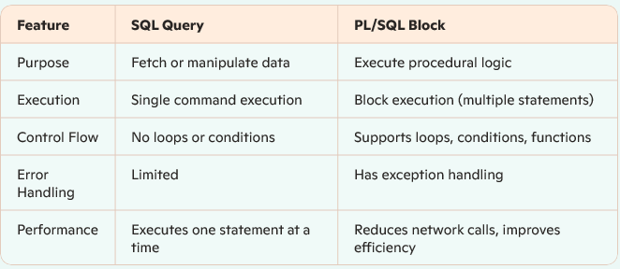
Query vs PLSQL

Slide 8
Realtime scenarios
PL/SQL is widely used in real-world applications where procedural logic is required to handle complex database operations efficiently.
Here are some real-time scenarios where PL/SQL becomes essential:
1. Automated Salary Calculation
In an HR system, PL/SQL procedures can calculate salaries based on employee records, deductions, bonuses, and tax regulations.
Example: A stored procedure calculates net salary and updates the payroll table automatically.
2. Banking Transactions (Funds Transfer)
Banks use PL/SQL to ensure transactional integrity when transferring funds between accounts.
Example: A PL/SQL block checks balances, deducts from the sender, adds to the receiver, and ensures rollback in case of failure.
3. Inventory Management
Companies track stock levels and automate reordering processes using PL/SQL triggers.
Example: A trigger detects when stock falls below a threshold and places an automated purchase request.
4. Loan Processing System
Financial institutions use PL/SQL to validate loan eligibility and calculate EMI amounts.
Example: A function calculates loan eligibility based on customer credit score and transaction history.
5. Audit Logs & Security Tracking
Many organizations need detailed logging for compliance purposes, which PL/SQL can handle efficiently.
Example: A trigger records changes made to customer data for audit purposes.
6. Bulk Data Processing & Report Generation
PL/SQL can process large sets of data efficiently for reporting purposes.
Example: A procedure aggregates sales data from different branches and generates monthly performance reports.

Slide 9

More background
https://www.guru99.com/pdf/pl_sql_preview.pdf

Slide 10
Practice Queries

Slide 11
Covered Topics
Fundamental Concepts
✅ Introduction to PL/SQL ✅ Understanding PL/SQL Blocks (DECLARE, BEGIN, EXCEPTION, END) ✅ Variables & Data Types (NUMBER, VARCHAR2, BOOLEAN, etc.) ✅ Control Statements (IF-ELSE, CASE, loops)
Working with SQL in PL/SQL
✅ Writing & Executing SQL Queries in PL/SQL ✅ Using SELECT INTO for variable assignment ✅ Handling DML Operations (INSERT, UPDATE, DELETE)
Procedures & Functions
✅ Creating and Executing Stored Procedures ✅ Writing User-Defined Functions ✅ Passing Parameters in Procedures and Functions
Exception Handling
✅ Handling Errors using EXCEPTION blocks ✅ Predefined Exceptions (NO_DATA_FOUND, TOO_MANY_ROWS, OTHERS)
Cursors
✅ Using Implicit Cursors for SQL operations ✅ Declaring Explicit Cursors for multi-row processing ✅ Looping through cursor records
Triggers
✅ Creating Triggers for Automatic Execution ✅ BEFORE and AFTER Triggers ✅ Row-level vs. Statement-level triggers
Transactions & Performance Optimization
✅ Using COMMIT, ROLLBACK, and SAVEPOINT ✅ Ensuring Data Integrity with Transactions ✅ Performance Optimization Techniques
Real-World Applications
✅ Writing PL/SQL Code for Inventory Management ✅ Implementing PL/SQL for Sales & Revenue Analysis ✅ Automating Error Handling & Logging ✅ Practical Assignments & Workshop Challenges

