Slide 1
Programming and Database Applications for ISE
INSY 3010
Pseudocode and Problem Solving
Dan O’Leary // dan.oleary@auburn.edu

Slide 2
Computational Thinking
Understanding a problem and breaking it down into a sequence of steps to solve it – an algorithm
Algorithm: a step-by-step procedure for solving a problem or accomplishing some end especially by a computer.
http://www.merriamwebster.com/dictionary/algorithm
How?

Slide 3
“Computational Thinking” Approach
Problem to Program
Understand the problem
  What do I have to accomplish? → Identify requirements
Develop a strategy
  How will I approach the problem? → Break it down (decompose)
Design required algorithms
  How will I solve the problem(s)? → Procedures
Document the solution
  How do I communicate the plan? → Pseudocode
Write the code
  How do I implement the pseudocode? → Python!
Notes:
Iterative process
For smaller problems not all steps need be discrete
For larger problems it must be
Does not include debugging, etc.
5 Hows? ~ 5 Whys?

Slide 4
Writing Algorithms - Pseudocode
Pseudocode is a kind of “structured English” for describing algorithms. It allows the designer to focus on the logic of the algorithm without being distracted by details of language syntax (e.g., Python, C++, or Java).
Alternatively, pseudocode is a narrative for someone who knows the requirement (problem domain) and is trying to learn how the solution is organized.
Before writing the code for a problem in a certain programming language, we describe the entire logic of the algorithm in pseudocode so that implementation becomes a rote mechanical task of translating line by line into source code.
Notes:
separates two hard parts of programming – problem solving (computational thinking) and implementation (programming language)

Slide 5
Trivial Example: MAX value…
Write a program to identify the largest number in a list
Example: 7, 12, 1, -1, 5, 10
Problem?
Strategy?
Algorithm?
Pseudo code
Python
Intuition (look at the list and see it) → Pseudo code
Notes:
simple problem, don’t overthink it!

Slide 6
Trivial Example: MAX value…
Write a program to identify the largest number in a list
Problem?
  Find the max value
Strategy?
  Look through the list and select the highest number
Algorithm?
  assume the first value in the list is the largest
  look at each value in the list
    if that value is larger than the current max, update max
  print the result

Slide 7
Trivial Example: MAX value…
Write a program to identify the largest number in a list
Pseudocode:
  SET Max to value of first item in List
  FOR every other Item in List
    IF Item > Max
      Max = Item
  PRINT Max
Note:
  Semi-formal language
  Indenting shows structure

Slide 8
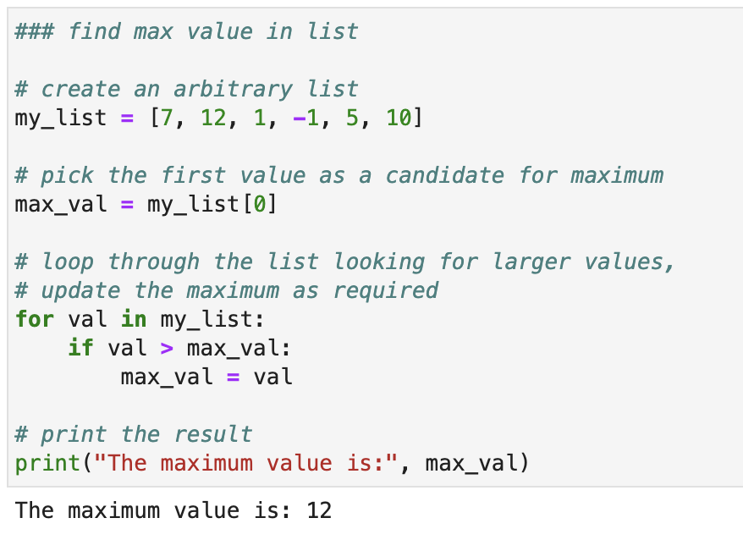
The Four Pillars of Programming
Assignment
Sequence
Selection
Repetition
Spot them in this code?

Slide 9
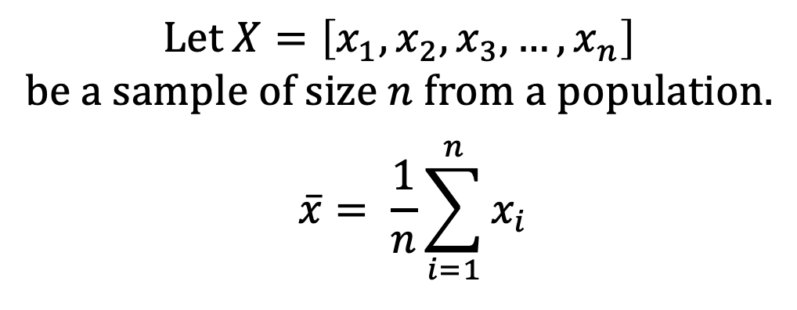
2nd Example: Sample Mean…
Compute the sample mean for a list of numbers
Problem?
Strategy?
Algorithm?
Pseudo code
Python
Notes:
simple problem, don’t overthink it!

Slide 10
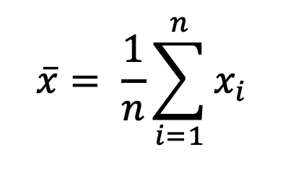
2nd Example: Sample Mean…
Compute the sample mean for a list of numbers
Problem?
  Find the average value
Strategy?
  Divide the total of all values by the number of values
Algorithm?
  Loop through the list to count number of items and sum values
  Calculate average by dividing the list total sum by number of items
  Print the result
Notes:
simple problem, don’t overthink it!

Slide 11
2nd Example: Sample Mean…
Compute the sample mean for a list of numbers
Pseudocode:
  SET Count = 0, Total = 0
  FOR each Item in the List
    INCREMENT Count
    INCREMENT Total by Item
  Avg = Total / Count
  Print Avg
Note:
  “INCREMENT Count” and “Count = Count + 1” are equivalent
Notes:
simple problem, don’t overthink it!

