Slide 1
No hiding in the back.
Please take a seat in the first 3-5 rows.

Slide 2
Programming and Database Applications for ISE INSY 3010
Class Intro
Dan O’Leary // dan.oleary@auburn.edu

Slide 3
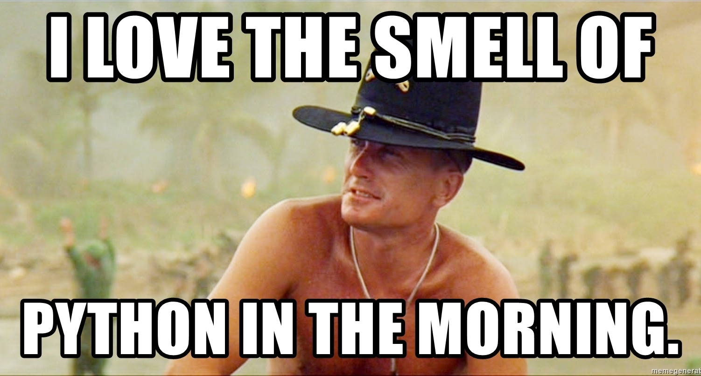

Afternoon
Notes:
Warm-Up with menti
https://www.mentimeter.com/app
anyone know the origin of this meme?

Slide 4

I promise… it is not foreshadowing!
Notes:
I promise… it is not foreshadowing

Slide 5

War Eagle!
Welcome to Fall 2026
INSY 3010 Programming & Database Applications for ISE

Slide 6

Agenda
Get acquainted
Course mantra
Why?
Class details
Expectations

Slide 7
About Me
BS Mechanical Engineering Auburn, 1992
25 years founding / running two different software businesses
Master of Engineering Management (ISE), 2020
Ph.D Industrial Engineering, 2024
Real-time analysis and visualization, machine learning, data science
Long-time instructor for INSY 3010 (10+ offerings)
Also: product development (u/g), eng econ (g), ds/ml/ai (u/g)

Slide 8
Teaching Assistants
Munirul Alam
PhD Student and Graduate Assistant, ISE
mua0007@auburn.edu
Office and office hours TBD
Abhro Shome Pias
PhD Student and Graduate Assistant, ISE
abp0115@auburn.edu
Office and office hours TBD
Notes:
or by appointment, via zoom or in-person

Slide 9
Key Point…
Can write code
Have built software development businesses
But I don’t really consider myself a programmer
And definitely not a software engineer
Nor do I expect you to become one in 4 months
Software Engineering and using Python / SQL to solve problems are very different things.

Slide 10
Class Goal
Students should be able to interpret and break down problems, devise a sequence of steps to solve them, translate those steps into proper Python and/or SQL syntax by applying common patterns, iterate and debug until a correct general solution is produced.

Slide 11
Course Mantra credit Dr. Jeff Smith
We are not computer scientists, software engineers, professional programmers, database architects, or database administrators.
This class is about providing the basic programming and database skills that Industrial Engineers need to be successful.
Do. You must do. Watching me (or anybody else) do and completely understanding everything I (they) do is not the same as you doing.
Practice. Practice. Practice.
Notes:
Preparing to teach this course I met with all of the other instructors and Tas
My approach will draw from aspects of each, plus my own take

Slide 12
Why is it hard to learn to program?
New language – syntax, grammar, spelling must be precise
New way of thinking – algorithmically, decomposing problems
New technology – tools can be complex
Not “one way” – many ways to solve every problem
Moving target – constantly, rapidly evolving / expanding
Skill – learned by practice, not memorization
build a set of tools, approaches, methods
develop intuition for problems and solutions; recognize patterns
Notes:
very much like a foreign language

Slide 13
Best way to learn Python?
No single way is sufficient.
Read it – code and books about code
Observe and discuss it – lectures, code-alongs, collaborations
Write it – try things; break, fix, iterate
Study it – compare solutions, try different approaches
See one, Do one, Teach one

Slide 14
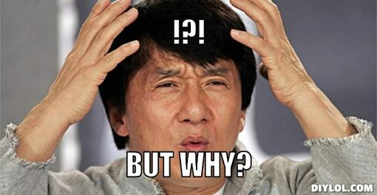

Slide 15
Process
Understand the problem
Break it into parts
Plan the solution
Apply known patterns
Implement in code
Refine through iteration
First and foremost, this is a class about thinking and problem solving. Core engineering skills. Transferrable, valuable.
Python / SQL are just the language of our solutions.

Slide 16
Transferable Skills
Breaking Down Problems
Create solutions (any kind) – start with understanding the problem
Harder and more important than it seems
Algorithmic / Computational Thinking
“I just don’t think that way” → Exactly!
Principles Apply to Other Languages
Syntax varies, fundamentals the same
Types, Conditionals, Flow Control, Objects, etc.
Learning one language makes it easier to learn a second, third, …

Slide 17
Exercise: Estimate the total num of texts sent in AU / day.

Slide 18
Exercise: Estimate the total num of texts sent in AU / day.
Estimate the population of the city.
Estimate the percentage that owns a mobile phone.
Estimate the average number of text messages sent per person-day.
Multiply!

Slide 19
“Fermi Problems”
Often used in interviewing
Test “computational thinking” – how to decompose problems
Essential engineering skill
Other examples:
How much data is transferred by Auburn Wi-Fi in a week?
What is an efficient process to organize a bookshelf?
How would you manage seating assignments in JHS?
Describe how you might model the spread of a rumor on campus.

Slide 20
Most Modern Engineers Deal with Code
Automate processes, computational modeling, systems integration
Python, R, Matlab, shell scripts, XLS macros, etc.
Not the same as being a Software Engineer
“Scientific Computing”
If you aren’t writing it, you are…
Contributing to systems that rely on software
Managing people / partners that are writing it
Competing with others that are
“Software is Eating the World” – Marc Andreessen, 2011
Notes:
give you the tools to keep up

Slide 21

Why Python?
Quick Results
High-level (readable), interpreted (instant feedback)
Concise, readable code
“Easy” to learn, free
Insanely Extensible
>850k packages on the Python Package Index (www.pypi.org)
Any domain specific problem you can imagine
Interface with just about any hardware / software system (glue)
Widely Used
All domains and industries
Insurance, health care, banking, aerospace, finance, science, etc.

Slide 22
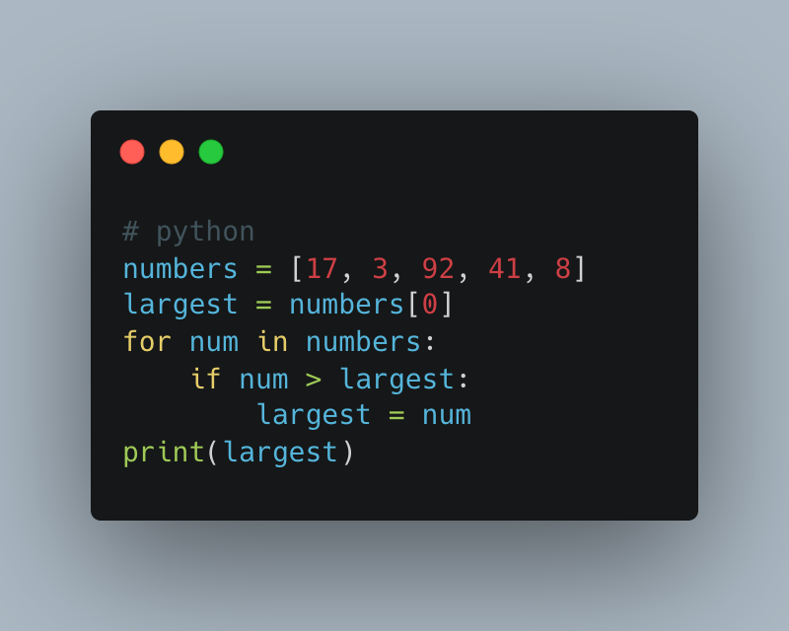

Slide 23
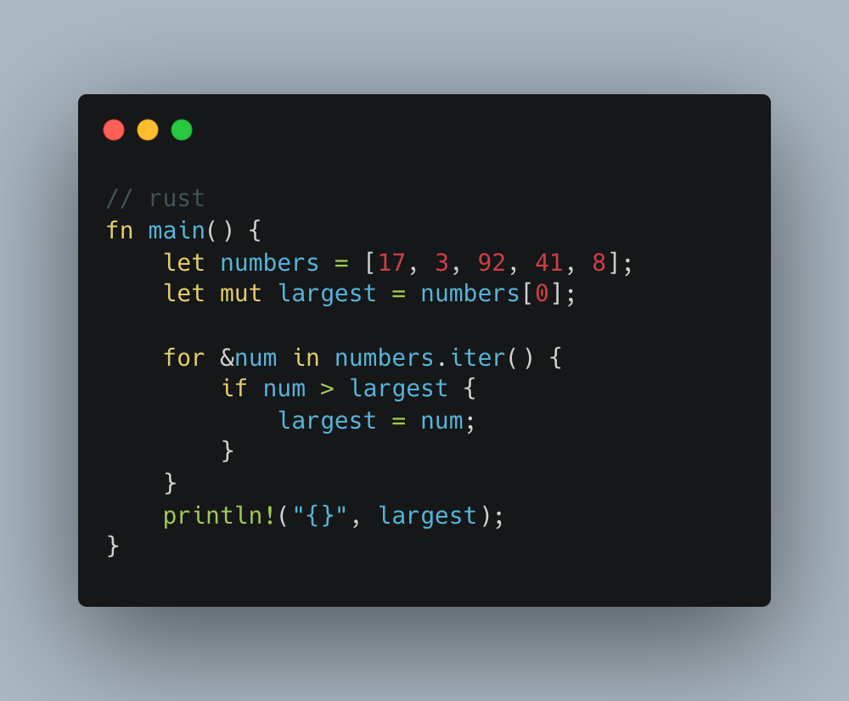
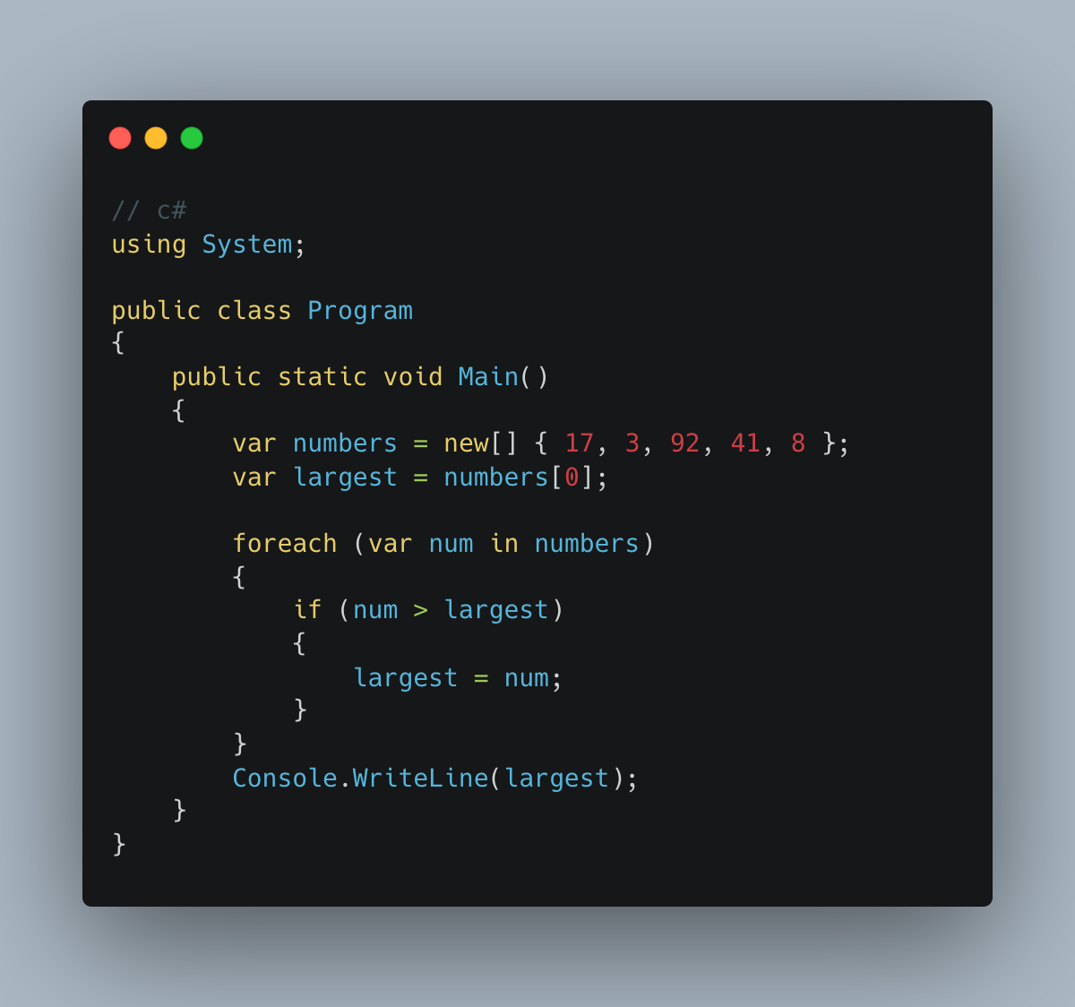

Slide 24
Why SQL?
Trusted with the world’s data for more than 50 years
Ubiquitous – many database engines use SQL dialects
Securely, efficiently deals with very large data sets
Freely available on many platforms
Readable and quick to learn the basics
High demand in job market

Slide 25
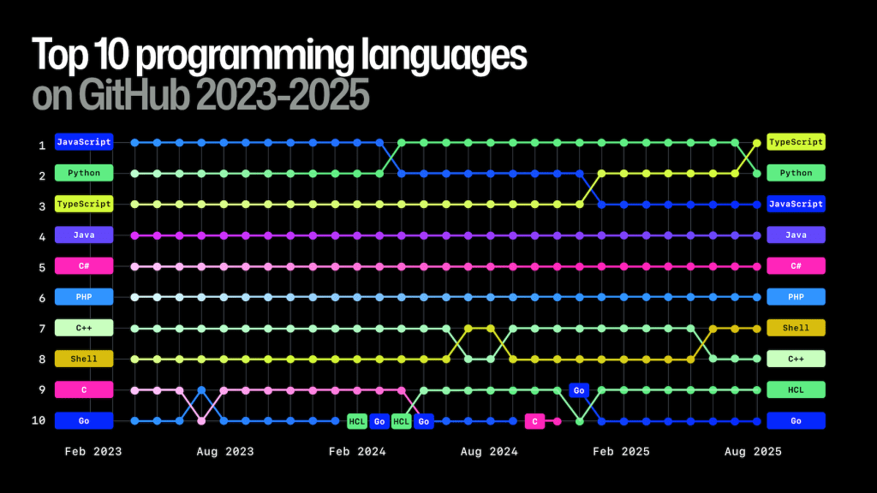
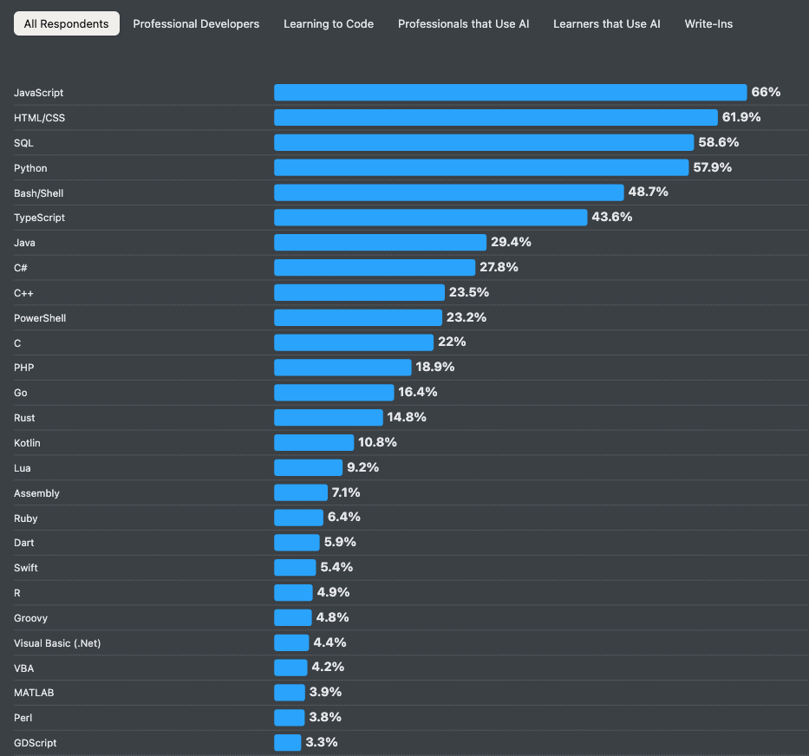
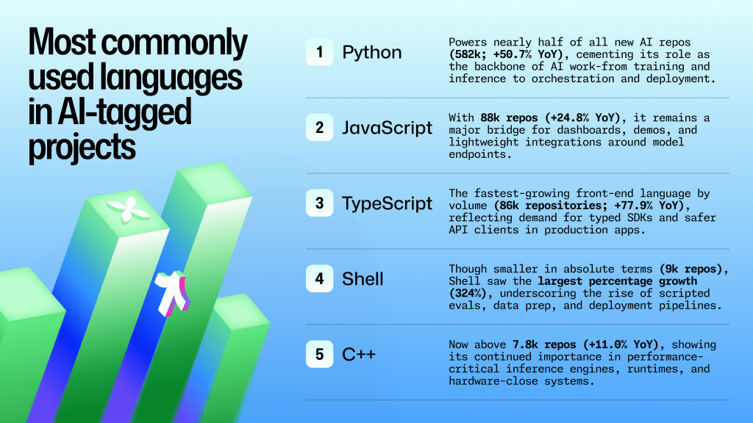

https://survey.stackoverflow.co/2025/
https://github.blog/news-insights/octoverse/ (2025)

Slide 26
Worth the Investment
Compensation, Opportunities ≈ Value You Bring:
Ability to read code
Ability to write code
Understand software engineering concepts
Communicate / collaborate with software engineers
Ability to automate things, improve personal or group efficiency
Get things done
To many, code is still “magic.”
Even low-level wizards are very valuable.

Slide 27
General Course Format
Lectures Tues / Thurs 2:00 – 3:15
Recitations Thurs 3:30
Mix of PPT lecture, coding examples, code-along, and group work
No zoom: simulcast / recordings not planned
Notes:
Currently 52 students, two of which are only in 3520

Slide 28
Recitations
Focus on supplemental instruction and hands-on practice through:
Additional worked examples and practice problems
Time and support to work on homework assignments
Review of completed homework and exam material
Active learning and peer collaboration
Attendance optional but encouraged and incentivized
Not every week – about 10-12 of the 15 weeks

Slide 29
Primary Concepts credit Dr. Jeff Smith
Program flow
Thinking “computationally”
Data types and structures
Implementing algorithms
Basic Python syntax
Relational database structures
SQL queries
Integration
Intro to data science
Basic tools of software development
Algorithm - A procedure for solving a mathematical problem (as of finding the greatest common divisor) in a finite number of steps that frequently involves repetition of an operation; broadly : a step-by-step procedure for solving a problem or accomplishing some end especially by a computer.
(Merriam-Webster - http://www.merriam-webster.com/dictionary/algorithm)

Slide 30
The Plan, Approximately
29 lectures
1 x course intro
7 x Python fundamentals
7 x Python intermediate concepts
6 x Relational databases and SQL
6 x Python-SQL integration, file handling, and data tools
3 x tests (intro, intermediate, SQL)
10 Recitations
Plus final exam

Slide 31
Instructional Materials
Provided by instructor – PowerPoint Slides and Jupyter Notebooks
Additional Sources
Python for Everybody (PY4E)
Free Book (PDF, HTML), materials, video lectures, etc.
Other Alternatives
Automate the Boring Stuff with Python (chapters and videos)
Think Python, 3rd Edition (full book, PY4E is based on it)

Slide 32
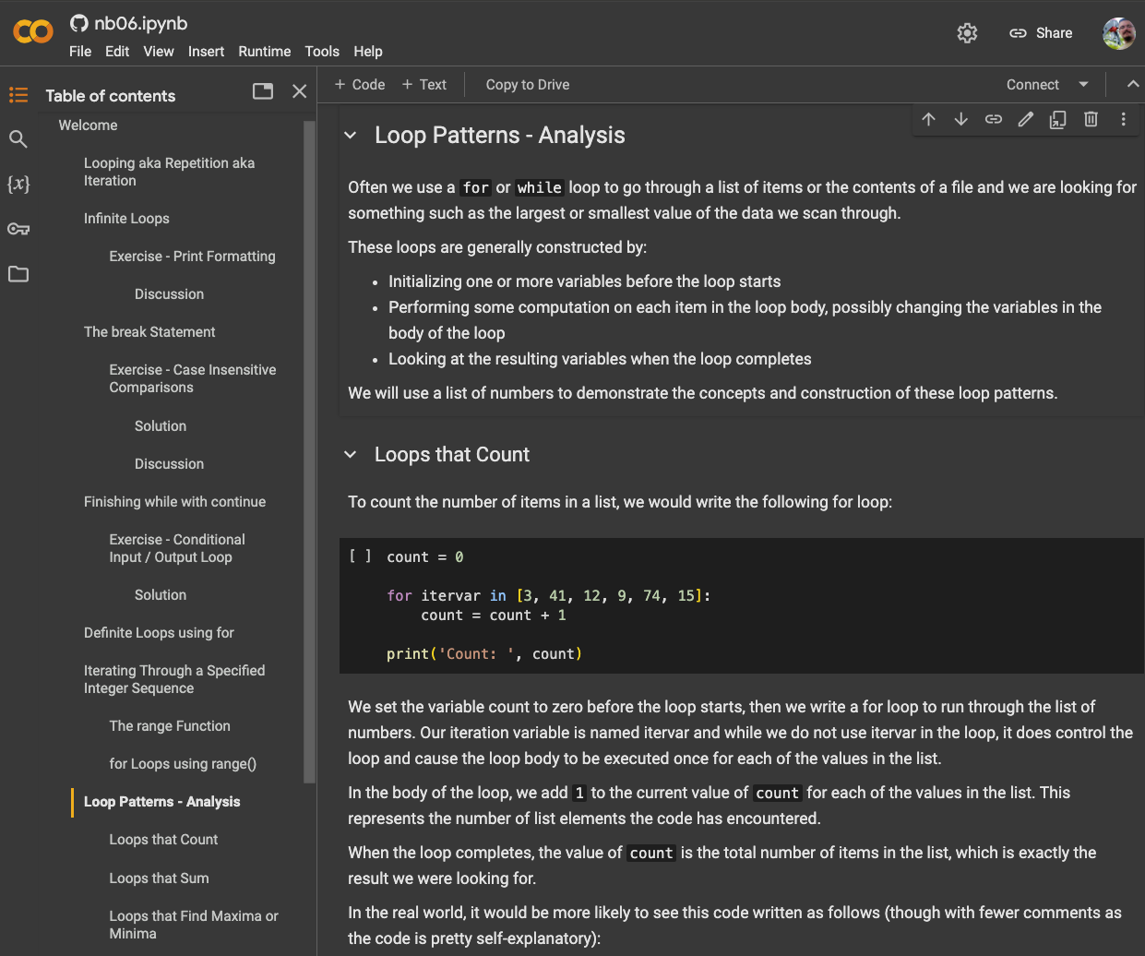
Google Colab colab.google

Slide 33
Grading
Breakdown
1% “Readiness”
5% Homework
25% Quizzes
39% Tests (3)
10% Project
20% Final
Average Performance (prior)
(Combined) Test scores about 75%: 0.75 x 59% total grade = 44.25 points
Assume 90% on homework and project: 0.90 x 41 = 36.9 points
Total: 44.25 + 36.9 = 81.15 points

Slide 34
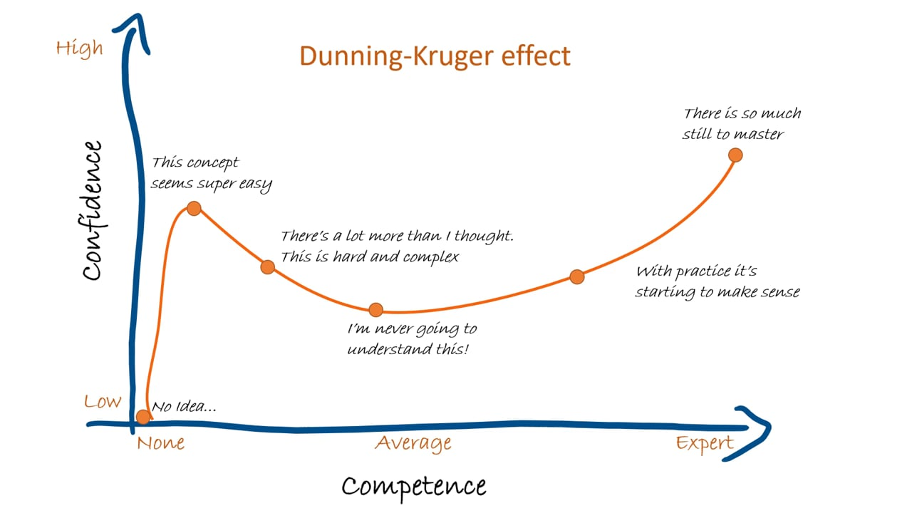
BEWARE!
Notes:
beware the DK effect

Slide 35
My Expectations
Curiosity & Engagement – ask questions
Work Ethic – takes lots of practice
Quality – work you are proud of
Professionalism – polite, prepared, punctual
Integrity – demonstrate good character, do your own work
…and a little flexibility (mutual)
Show up and do the work in a way that shows you care
I promise to reciprocate
Notes:
We will all grow some in the process
Don’t approach this class (or life) from the “what do I have to do” POV, but from the “what can I learn from this”

Slide 36
AI Tools
See syllabus
Study groups are ok / encouraged, but…
Graded work must represent individual effort without human or AI assistance unless explicitly authorized otherwise
Some assignments will allow / encourage / require
Expectations will be increased accordingly
Transition: teaching how to write code → how to build software
Reading, understanding code still very important and valuable

Slide 37
What’s Next?
Watch for Canvas announcements!!
Begin Python fundamentals
Readiness activities due Aug 24

