Slide 1
Data Mining Techniques and Applications for Operations INSY 7130
Lecture 01a – Class Intro
Dan O’Leary // dan.oleary@auburn.edu

Slide 2
What is “Data Mining”?
(not rhetorical)

Slide 3
Data Mining
Umbrella term for methods that help us discover patterns in data.
In this course:
Finding patterns
Determining whether they are stable, meaningful, and useful
Includes similarity measures, representations, nearest neighbors, dimensionality reduction, embeddings, clustering methods, association rules, anomaly detection, time-series analysis and forecasting
Largely “unsupervised,” but not all

Slide 4
Today's Agenda
Get acclimated and acquainted
Syllabus, objectives, expectations
Introduce course material

Slide 5
Course Details
Credits: 3 hours
Prerequisite: No formal course prerequisite. Introductory probability and statistics plus prior Python or R experience are strongly recommended. INSY 6500 preferred, not required.
Lectures: Tuesday and Thursday 11:00 - 12:15, Library 4027
Instructional Delivery Method: Hybrid
Recording: Sessions are recorded and available to students
Semester: August 17, 2026 - December 04, 2026
Final Exam: Monday, December 07, 10:30 - 12:30, Library 4027

Slide 6
About Me
BS Mechanical Engineering Auburn, 1992
25 years founding / running two smallish software companies
Master of Engineering Management (ISE), 2020
Ph.D Industrial Engineering, 2024
Lecturer: product development / eng econ, computational / ds
Coordinator, ISE Graduate Certificate in DS/ML
Research & curriculum development: BET, MEM, Product Innovation
Real-time analysis and visualization, machine learning, data science

Slide 7
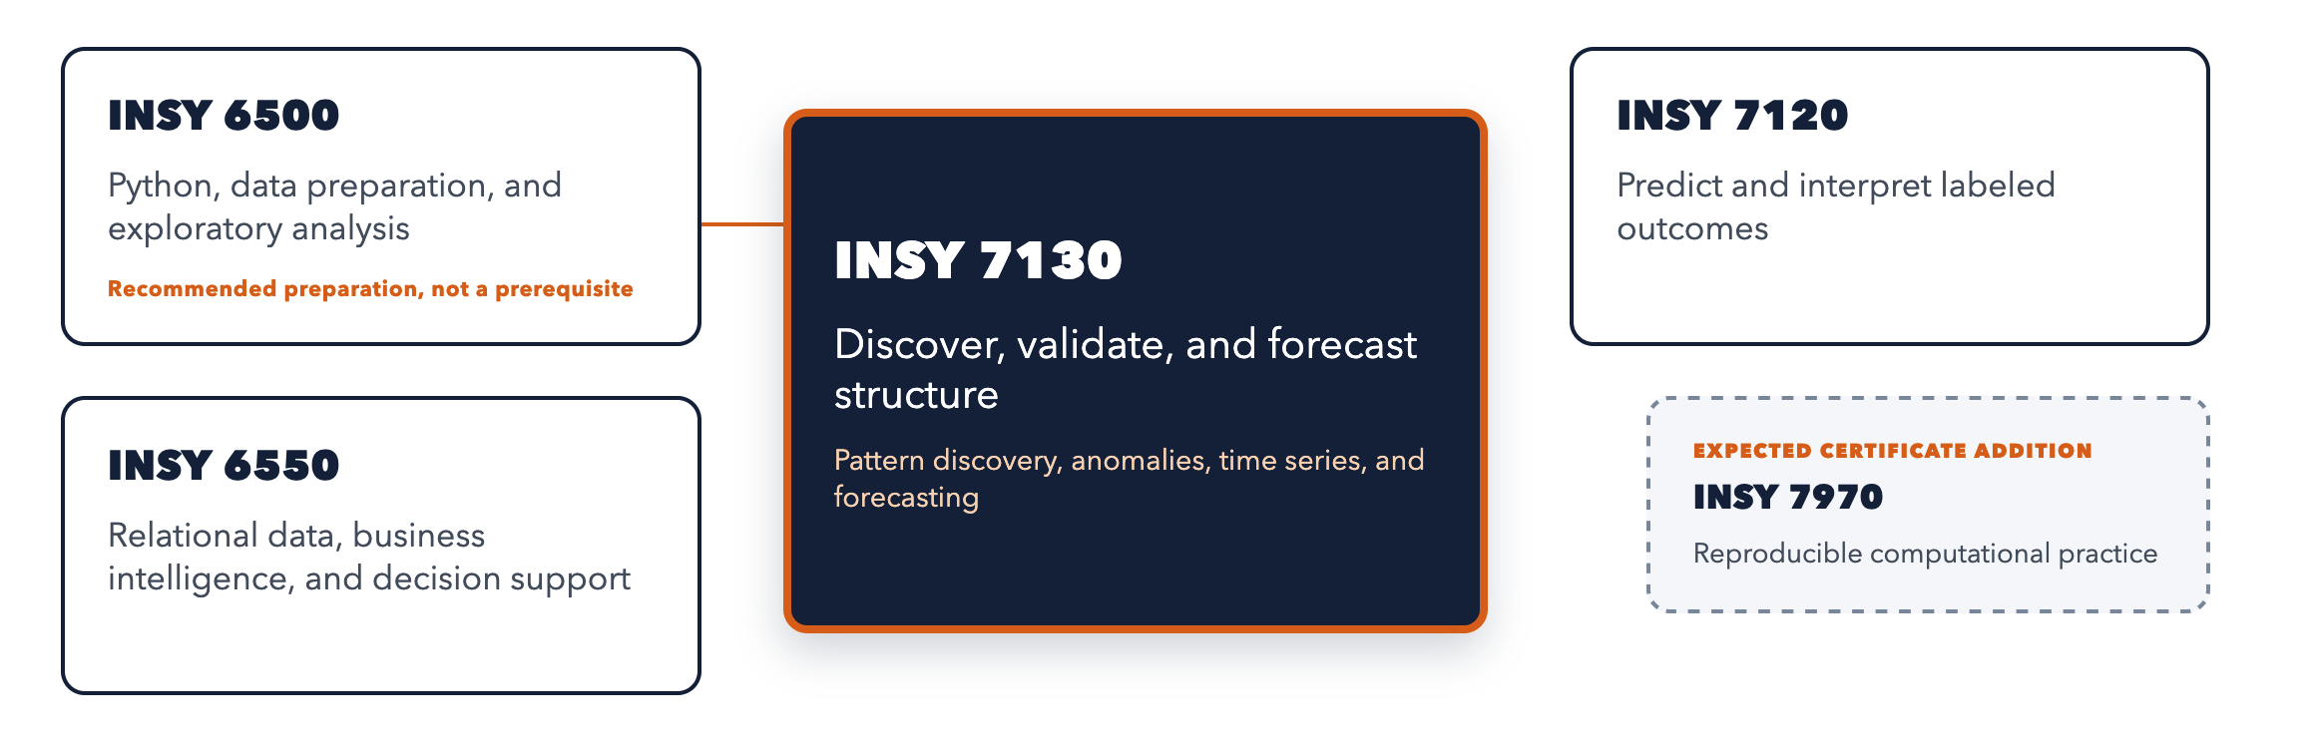
You are Here… A course for finding, checking, and using structure in data

Slide 8
Graduate Certificate
These courses courses available to all grad students in ISE
On-campus and distance students (primarily MEM)
Open to grad students in other programs with approval
As stand alone courses – don’t have to be in the certificate
As part of the “Modeling & Data Analytics for Operations” certificate
Complete your choice of three
Great complement to your MS / MEM / PhD!

Slide 9
Program Changes Proposed / Pending
Renaming Program and Courses
e.g. Applied Data Science & Machine Learning
Moving 7k courses to 6k
Expanding offerings:
6k Modern Software Development Practices for DS/ML
6k Intro to Neural Nets and Deep Learning
7k TBD courses focused on applying SOTA DS/ML to specific research areas

Slide 10

Where this Might Take You…
Data Analyst
Manufacturing, Healthcare, Finance
Business Intelligence Developer
Retail, Logistics
Graduate Research
Using Python for thesis/dissertation analysis
Data Engineer
Building data pipelines and automation
ML Engineer (with INSY 7120)
Predictive modeling roles

Slide 11
Course Description
This applied course examines analytical problems in which meaningful labels are absent or observations are ordered and dependent. Students use Python to represent and compare observations, discover multivariate patterns, and analyze temporal structure for forecasting. Throughout the course, they formulate defensible questions, compare credible baselines, test sensitivity and stability, evaluate forecasts without temporal leakage, and connect results to operational decisions without overstating the evidence.

Slide 12
Course Objectives
Formulate appropriate analytical questions and assess whether available data can support them
Choose and justify representations and analytical approaches for unlabeled and temporally ordered data
Implement and compare reproducible Python analytical workflows
Evaluate results using appropriate baselines, uncertainty, sensitivity, and validation evidence
Communicate conclusions, limitations, and operational implications responsibly

Slide 13
Tentative Plan – 5 Units… (1/2)
Evidence and analytical validation
Reproducibility, baselines, uncertainty, resampling, sensitivity, stability, and what makes a finding credible.
Similarity and representation foundations
How scaling, distance, neighbors, PCA and embeddings determine what patterns can appear and how to check those choices.
Clustering methods and validation
Finding groups with several approaches, then assessing their stability, assumptions, and operational meaning.

Slide 14
Tentative Plan – 5 Units… (2/2)
Pattern mining and anomaly detection
Discovering co-occurrence patterns and unusual observations, with attention to multiplicity, thresholds, false alarms, and usefulness.
Time-series analysis and forecasting
Temporal structure, dependence, stationarity, forecasting, rolling evaluation, uncertainty intervals, and temporal anomalies.

Slide 15
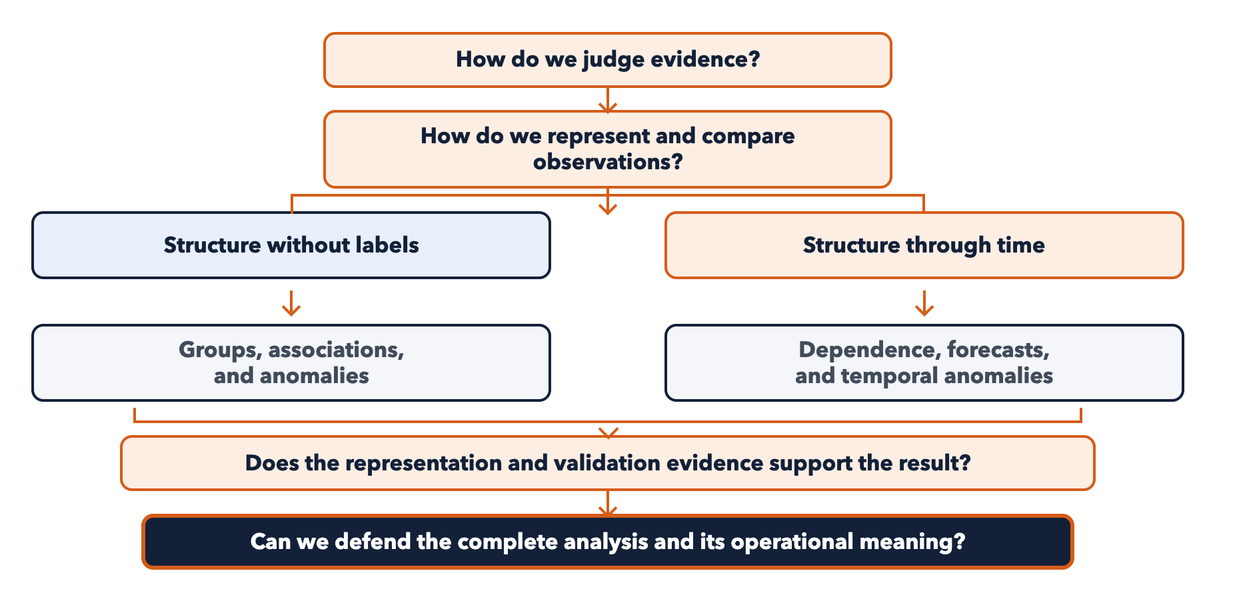

Slide 16
Assessment (1/2)
20% Homework
5 x assignments, small(ish), lightly graded
50% Tests
20% Test 1 – Units 1 and 2
20% Test 2 – Units 3 and 4
10% Test 3 – Unit 5
30% Project
Develop and validate a substantial, portfolio worthy analysis
You provide the data and the questions
Research / work related material encouraged

Slide 17
Assessment (2/2)
Tests 1 and 2 will have 2 parts:
In-class concepts
Take home application
Test 3 will only have the in-class concepts part (final exam week)
Unit 5 application will be assessed with the project

Slide 18

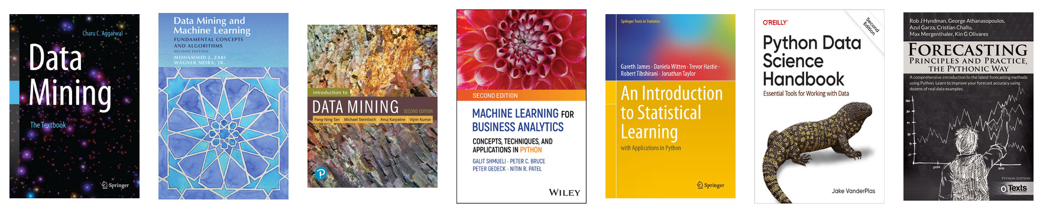
Textbooks (1/2)

Slide 19
Textbooks (2/2)
Charu C. Aggarwal, Data Mining: The Textbook
Mohammed J. Zaki and Wagner Meira Jr., Data Mining and Machine Learning
Pang-Ning Tan et al., Introduction to Data Mining
Galit Shmueli et al., Machine Learning for Business Analytics
Gareth James et al., An Introduction to Statistical Learning (Python)
Jake VanderPlas, Python Data Science Handbook
Rob J. Hyndman et al., Forecasting: Principles and Practice (Python)
Official library documentation and other technical references, including scikit-learn, SciPy, statsmodels, and mlxtend guides

Slide 20
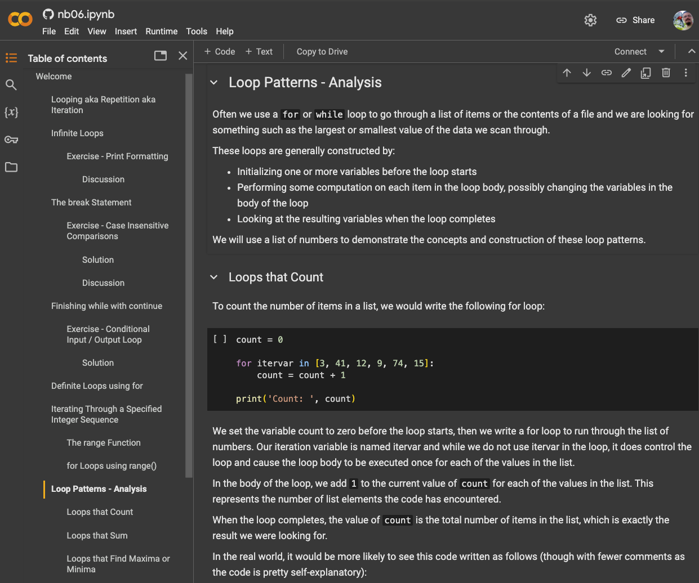
Google Colab colab.google

Slide 21
Instructional Framework
Concepts – fundamental ideas and building blocks
e.g., supervised vs unsupervised learning
Principles – key guidelines / insights that inform how we approach problems
e.g., bias-variance tradeoff
Methods – algorithms and techniques used to implement solutions
e.g., polynomial regression
Theory – foundations and proofs that explain why methods work
e.g., gradient descent for optimizing a loss function

Slide 22
AI Tools
Incredibly useful for learning, understanding, productivity
Know Python and DS/ML/AI very well
Not perfect
Use with caution, best as a partner not a replacement
Use ethically - submit your own work
Not available during tests
The durable human contribution is judgment.

Slide 23
Judgment
The practiced ability to decide what is worth doing and what is good enough
using critical thinking to test the evidence
domain expertise to understand context and consequences
and taste to choose among plausible alternatives
while owning the decision and its results.
Developed through practice and training: producing, testing, comparing, failing, critique, feedback, and observed outcomes.
Automate repetition, not apprenticeship.

Slide 24
What is “Data Science”?
(not rhetorical)

Slide 25
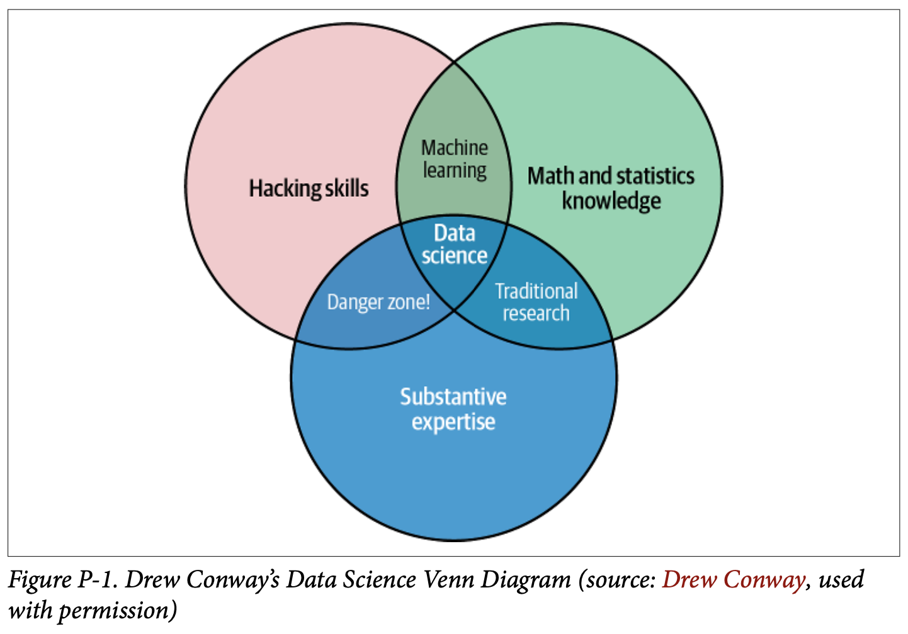
Data Science is…
…not a new domain of knowledge to learn, but a new set of skills that you can apply within your own area of expertise. – VanderPlas

Slide 26
DS vs ML vs AI
Data Science (DS) – statistical methods focused on insights from data
Machine Learning (ML) – algorithms & models focused on prediction
Artificial Intelligence (AI) – computational methods focused on simulating human-like intelligence and decision-making
Lots of overlap between these
I prefer to think of AI as a goal or desired outcome of applied methods related to DS/ML and other domains
AI is whatever machines haven’t done yet. – Larry Tesler
Tesler’s Theorem – moving goalposts, aka “AI Effect”
https://en.wikipedia.org/wiki/Larry_Tesler and D. Robinson (next pg)

Slide 27
Areas of expertise…
What is yours?
How to you hope to use these skills in your education, research, career?

Slide 28
To Do
Take the survey
Read the syllabus, esp. “Getting Help Effectively”

