Slide 1
INSY 7130
LOF and Isolation Forest

Slide 2
Approaches To Outlier Detection
Which pump readings deserve inspection?
  High vibration may reflect load, a sensor problem, or a fault
A detector turns a meaning of “unusual” into a score
  Different comparisons can prioritize different readings
We will explore two methods:
  Distance- / density-based similarity, aka “support”
  Ease of isolation
Then use scores to flag observations for review

Slide 3
Reference Observations
Comparing a possibly failing pump with healthy pumps can be appropriate
  Check whether load, design, and environment are comparable
Two reference situations
  Find unusual members within a mixed collection
  Assess new readings against a healthy baseline, aka “novelty”
Our focus: observations within one collection
Notes:
Sources:
- https://scikit-learn.org/stable/modules/outlier_detection.html

Slide 4
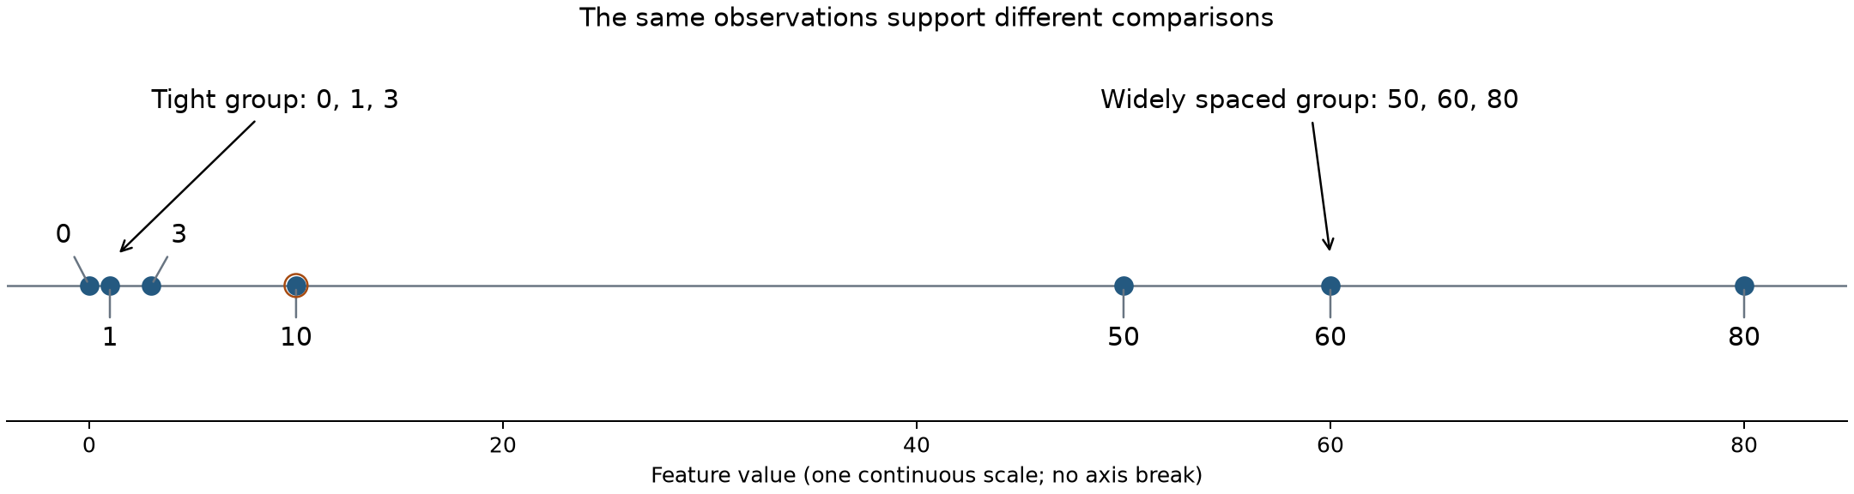
Seven Observations
Invented values of one feature: 0, 1, 3, 10, 50, 60, 80
The gap from 3 to 10 is smaller than either gap in the wide group

Slide 5
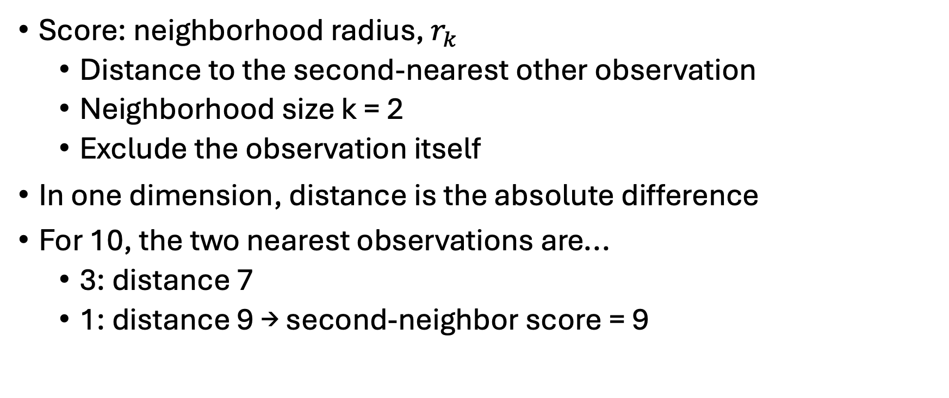
Neighbor-Distance Scores
Score: neighborhood radius, $r_{k}$
  Distance to the second-nearest other observation
  Neighborhood size k = 2
  Exclude the observation itself
In one dimension, distance is the absolute difference
For 10, the two nearest observations are...
  3: distance 7
  1: distance 9 → second-neighbor score = 9

Slide 6
Second-Neighbor Distances
Observation | Two Nearest Others | Distances | Score
0 | 1, 3 | 1, 3 | 3
1 | 0, 3 | 1, 2 | 2
3 | 1, 0 | 2, 3 | 3
10 | 3, 1 | 7, 9 | 9
50 | 60, 80 | 10, 30 | 30
60 | 50, 80 | 10, 20 | 20
80 | 60, 50 | 20, 30 | 30

Slide 7
Absolute And Local Spacing
Distance scores place 50 and 80 above 10
  Both need a radius of 30 to collect two neighbors
The wide group is a stretched, shifted copy of the tight group
  Its members have comparable spacing relative to each other
Is a large gap unusual for its surroundings?
  Compare each neighborhood with its neighbors' neighborhoods

Slide 8
Local Outlier Factor
Local Outlier Factor (LOF) compares local packing / density
For 10, neighbors 3 and 1 belong to the tight group
  They can find nearby support much more easily than 10
For 80, neighbors 60 and 50 also have wide spacing
  Its surroundings supply a different reference
How do we quantify that?

Slide 9
Local Density
Start with mean distance to two neighbors
  Small mean: closely packed
  Large mean: widely spaced
Take the reciprocal to express density
  Greater spacing → lower density
LOF will adjust the distances before this calculation

Slide 10
Density Examples
Observation | Neighbor Distances | Mean Distance | Inverse Mean
0 | 1, 3 | (1 + 3) / 2 = 2 | 1 / 2 = .5
10 | 7, 9 | (7 + 9) / 2 = 8 | 1 / 8 = .125
The neighborhood around 0 has the higher density
  Its observations are closer together
Values describe local packing in inverse-distance units

Slide 11
LOF Method
Assess local unusualness using neighbors’ density as reference
1. Find each observation's k nearest neighbors
2. Adjust distances using each neighbor's surrounding scale
  Reachability distance
3. Average adjusted distances, then take the reciprocal
  Local reachability density
4. Divide neighbors' average density by the observation's own density
  Local Outlier Factor

Slide 12
Reachability Adjusts Short Distances
p: observation being scored; o: one of its neighbors
d(p, o): actual distance between p and o
rₖ(o): distance from o to its own kth-nearest other observation
  Exclude o itself; this distance is o's neighborhood radius
Use that radius as a lower bound to moderate short distances
$${reach}_{k}(p,o)=max\{d(p,o),r_{k}(o)\}$$
Notes:
Sources:
- https://sigmodrecord.org/2000/06/07/lof-identifying-density-based-local-outliers/

Slide 13
Local Reachability Density
$${lrd}_{k}(p)=\frac{1}{\text{mean reachability distance to p’s neighbors}}$$
Use the adjusted distances to measure local packing
  Average them, then take the reciprocal
Small adjusted distances give high local reachability density
Repeat for each observation so we can compare densities

Slide 14
LOF Calculation
$${LOF}_{k}(p)=\frac{\text{mean neighbor density}}{\text{own density}}$$
Both densities are local reachability densities
Near 1: comparable local support
Above 1: own density is lower than neighbor average
Next, work through these operations on the seven observations

Slide 15
Apply LOF And Inspect Local Support
Open the notebook section with this title
Calculate reachability distances, local densities, and LOF
Inspect the scores, then reproduce them with scikit-learn
Predict and test a change from two neighbors to three
Return to slides at Isolation Through Random Partitions

Slide 16
Isolation Through Random Partitions
How easily can splits separate an observation?

Slide 17
Splits And Paths
Split observations at a feature threshold
  Values below the threshold go one way; the rest go the other
  Repeat within each resulting group
First illustration: deliberately chosen thresholds
  Begin at 30, then follow the tree
After tracing the tree, we will introduce random selection

Slide 18
A Partition Tree
All: 0, 1, 3, 10, 50, 60, 80 [split at 30]
├── Below 30: 0, 1, 3, 10 [split at 6]
│ ├── Below 6: 0, 1, 3 [split at 2]
│ │ ├── Below 2: 0, 1 [split at .5]
│ │ │ ├── Below .5: 0
│ │ │ └── At least .5: 1
│ │ └── At least 2: 3
│ └── At least 6: 10
└── At least 30: 50, 60, 80 [split at 70]
├── Below 70: 50, 60 [split at 55]
│ ├── Below 55: 50
│ └── At least 55: 60
└── At least 70: 80

Slide 19
Tree Vocabulary
Root: starting group containing all observations
Branches: routes created by a split
Leaf: terminal group at the end of a route
Path: route from root to leaf for one observation
Path length: number of splits encountered
  Start counting at zero, before the first split

Slide 20
Comparing Path Lengths
Observation | Route Through Thresholds | Splits
10 | Below 30; at least 6 | 2
1 | Below 30; below 6; below 2; at least .5 | 4
80 | At least 30; at least 70 | 2
In this tree, 10 and 80 are easier to isolate than 1
A different sequence of cuts can produce different paths

Slide 21
Nested Groups
Hierarchical clustering and partition trees both describe nested groups
Agglomerative clustering joins groups using similarity
  Dendrogram height records the linkage criterion
Here, repeated splits divide groups
  Path length counts partitions along one route

Slide 22
Random Splitting
Within the current group...
  Choose a feature randomly
  Choose a threshold uniformly between its minimum and maximum
Divide the observations, then repeat within each child group
  Feature ranges change as groups get smaller
With one feature, only the threshold choice varies
Notes:
Sources:
- https://cs.nju.edu.cn/zhouzh/zhouzh.files/publication/icdm08b.pdf

Slide 23
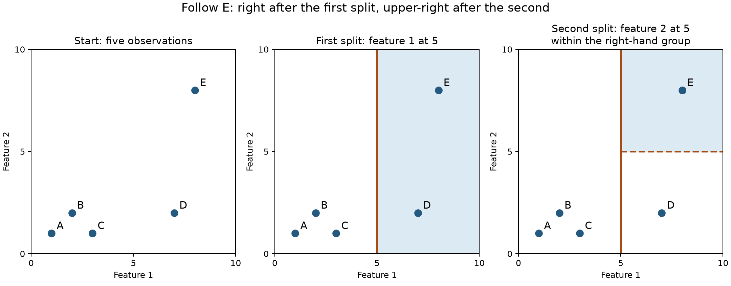
Two-Dimensional Partitions
Chosen cuts: feature 1 at 5, then feature 2 at 5 within the right group
Follow E through two splits; the second cut applies only to D and E

Slide 24
Gaps And Random Cuts
First cut in the seven-point example: uniform between 0 and 80
Any threshold between 60 and 80 isolates 80 immediately
  Interval length 20 out of 80: one-quarter chance
Observation 1 lies between other observations
  One cut cannot isolate it from both sides at once
Wide gaps between observations provide more possible cuts
  Consequence of random, uniform selection
  Wide gaps ≈ isolation

Slide 25
Isolation Forest
One random tree can give a fortunate or unfortunate path
A forest combines many trees with fresh random choices
  Commonly build each tree from a sample of the observations
Route an observation through each tree and average path lengths
  Short average path: consistently easy to isolate
  More trees reduce dependence on one set of random cuts
Notes:
- A scored observation can follow a tree's splits even if it was not sampled to build that tree.
- If asked about Random Forest: shared ensemble structure; isolation uses random cuts without a known fault response.

Slide 26
Isolation Scores
Raw path lengths depend on the number of observations used
  Larger samples ordinarily require more splits
Normalize average path length against a reference for sample size
  Shorter paths → easier isolation → higher score
Score near .5 corresponds to the reference path length
  We will inspect scores alongside the original observations
Notes:
- Practical trees can stop with several records in a leaf; scoring estimates the remaining path length.
- Full normalization is in instructor preparation.

Slide 27
Feature Scaling: LOF And Isolation Forest
LOF uses distances across features
  Changing relative feature scales can change neighborhoods and scores
  With multiple features, LOF usually requires deliberate scaling
Isolation Forest splits one feature at a time
  Linear changes of units preserve corresponding splits
  Isolation Forest generally does not require standardization.

Slide 28
Apply Isolation Forest And Compare Evidence
Open the notebook section with this title
Fit the forest and inspect its scores
Compare LOF and isolation on the same observations
  Explain why their leading observations differ
Return to slides at Scores, Flags, And Investigation

Slide 29
Scores, Flags, And Investigation
Selection and evaluation for either detector

Slide 30
Scores And Selection Rules
A score describes unusualness under a detector's criterion
A selection rule identifies observations for follow-up
  Example: flag an observation when its score exceeds a threshold
A flag records that the rule was met
  Specify the follow-up: sensor check, maintenance investigation, etc.
Apply the rule, inspect selected readings, then establish their condition

Slide 31
Choosing A Threshold
Lower threshold: include more observations from the same scores
  Scores and rankings stay unchanged
Thresholds belong to the detector's score scale
  LOF and isolation scores need their own cutoffs
Choosing an operational threshold requires evidence
  What condition matters? What are the consequences of a missed case or false alarm?

Slide 32
False Alarms And Missed Faults
Decision | Fault Present | Fault Absent
Flag | True positive: fault flagged | False positive: false alarm
Do not flag | False negative: fault missed | True negative: healthy case not flagged
Positive/negative: whether a flag was raised
True/false: whether it matches independently established condition

Slide 33
Interpreting Flags
Three flags need not mean three faults
  Actual conditions must be checked
Checking only flagged readings leaves missed faults unknown
Define the target before judging the flag
  An unusual healthy reading can be a false alarm for fault detection
  It may be useful when discovering new operating regimes

Slide 34
Scores, Flags, And Investigation
Open the notebook section with this title
Predict which observations two LOF thresholds will select
Apply the rules and inspect the selected rows
Count false alarms and missed faults in a separate labeled example
Explain a detector's priority and identify a useful follow-up check

