Slide 1
INSY 7130
03a Distance and Scaling

Slide 2
1 Intro
What is similarity, and what determines which observations are close?

Slide 3
1.1 What Makes Records Close?
Unit 1 showed that an analytical result depends on how we represent and compare the data.
Unit 2 applies that lesson to whole records by treating their numeric attributes as a geometric representation.
Today we ask:
which choices made two records appear close
whether that result survives a reasonable alternative

Slide 4
1.2 Learning Objectives
Represent a numerical record as a feature vector
Inspect how coordinate gaps contribute under different distance measures
Explain how units and scaling change a geometric representation
Separate standard scaling from transformation and importance
State a bounded claim from a representation-sensitivity check

Slide 5
1.3 Relevant Course Readings
Tan et al., Introduction to Data Mining, 2nd ed.
Chapter 2: Sections 2.1.1, 2.3.7, 2.4.3, 2.4.9–2.4.10
Zaki and Meira, Data Mining and Machine Learning, 2nd ed.
Sections 2.3–2.4
Shmueli et al., Machine Learning for Business Analytics, 2nd ed.
Chapter 16, Section 16.2
Notes:
[Sources]
- https://www-users.cse.umn.edu/~kumar001/dmbook/index.php
- https://dataminingbook.info/book_html/
- https://www.oreilly.com/library/view/machine-learning-for/9781119835197/

Slide 6
2 Representation as Geometry
Rows become points only after we choose the coordinates.

Slide 7
2.1 A Row Becomes Coordinates
record → feature vector → point in feature space
A recorded row becomes a point only after we select its numerical features.
The selected features define the axes; their units determine coordinate magnitudes.
Transformations, scales, and weights then determine how gaps appear along those axes.
Notes:
- Order does not matter if every vector uses the same order; inclusion and numerical treatment do matter.
[Sources]
- https://dataminingbook.info/book_html/ - 2nd ed., Sections 2.3–2.4

Slide 8
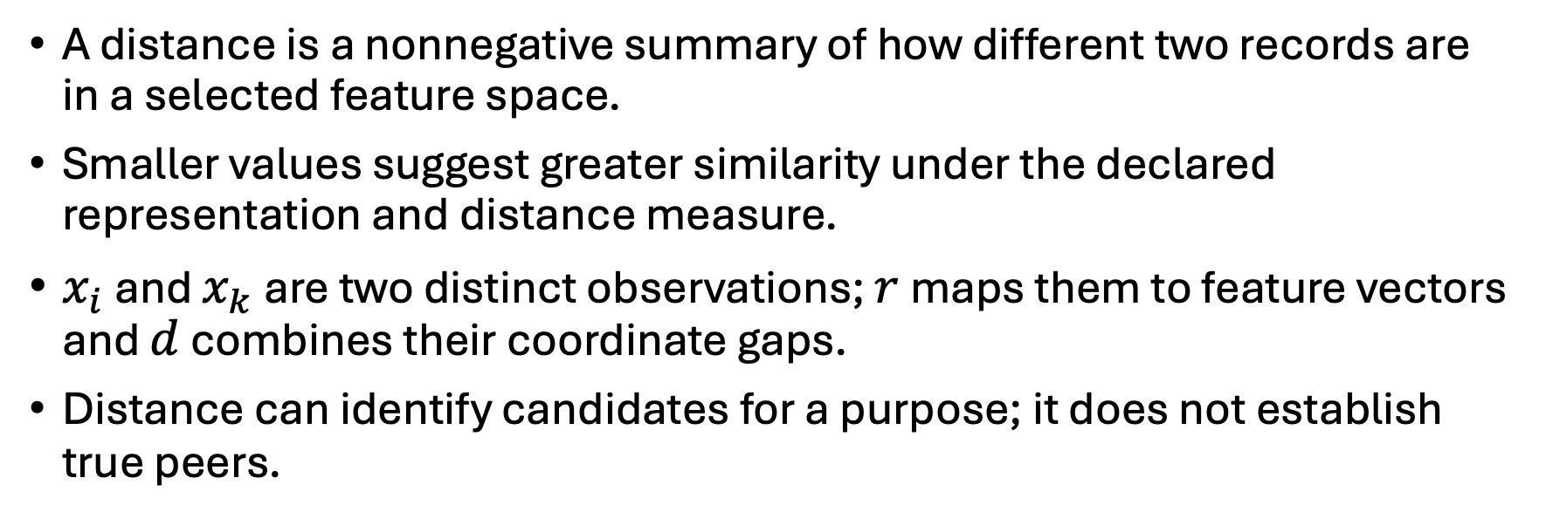
2.2 Distance Summarizes Dissimilarity
$$d\left(r(x_{i}),r(x_{k})\right)$$
A distance is a nonnegative summary of how different two records are in a selected feature space.
Smaller values suggest greater similarity under the declared representation and distance measure.
$x_{i}$ and $x_{k}$ are two distinct observations; $r$ maps them to feature vectors and $d$ combines their coordinate gaps.
Distance can identify candidates for a purpose; it does not establish true peers.
Notes:
- Distance is between represented records, not between the feature names themselves.
- A distance matrix inherits both the representation and the measure; it is not representation-free.
[Sources]
- https://www-users.cse.umn.edu/~kumar001/dmbook/index.php - 2nd ed., Sections 2.4.3 and 2.4.10

Slide 9
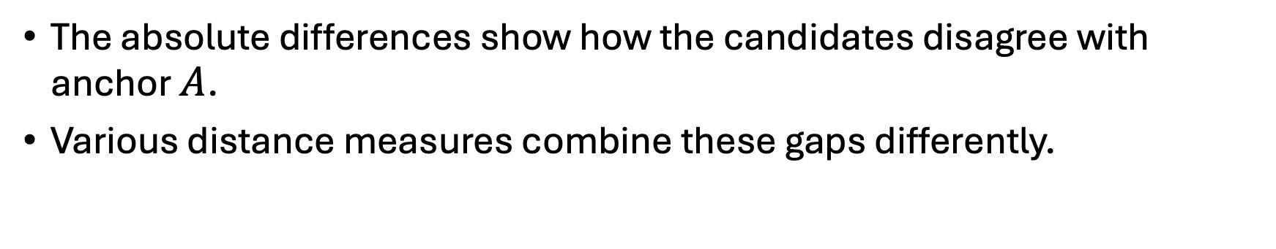
2.3 Start with Coordinate Gaps
$$\begin{aligned}&A=(0,0), B=(3,0), C=(2,2) \\ &|A−B|=(3,0), |A−C|=(2,2)\end{aligned}$$
The absolute differences show how the candidates disagree with anchor $A$.
Various distance measures combine these gaps differently.
Notes:
- Many valid distance measures exist because different discrepancy patterns matter for different purposes.
[Sources]
- https://www-users.cse.umn.edu/~kumar001/dmbook/index.php - 2nd ed., Section 2.4.3

Slide 10
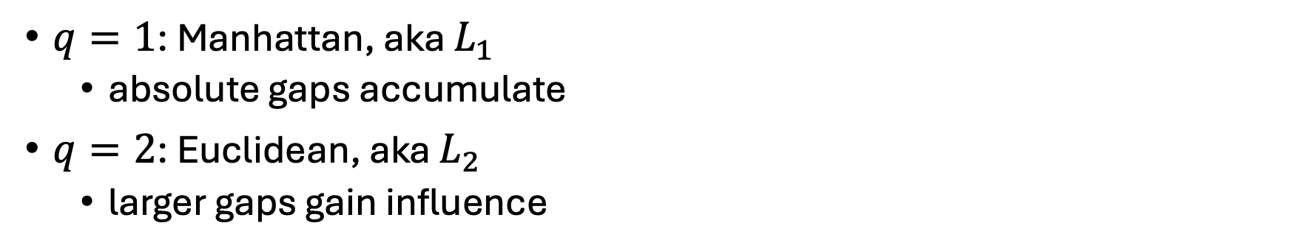
2.4 The Minkowski Distance Family
$$d_{q}(x,y)={\left(\sum_{j=1}^{m}{|}x_{j}−y_{j}|^{q}\right)}^{1/q}$$
$q=1$: Manhattan, aka $L_{1}$
absolute gaps accumulate
$q=2$: Euclidean, aka $L_{2}$
larger gaps gain influence
Notes:
- Use $q$ for the exponent so $m$ can remain the feature count.
- Optional only if asked: the limiting maximum-gap rule is Chebyshev distance.
[Sources]
- https://link.springer.com/book/10.1007/978-3-319-14142-8 - Chapter 3, Sections 3.1 and 3.2.1

Slide 11
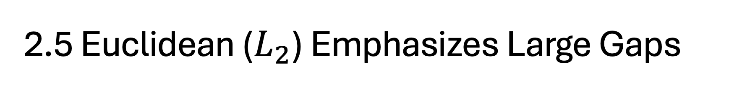
2.5 Euclidean ($L_{2}$) Emphasizes Large Gaps
$$d_{2}(x,y)={\left(\sum_{j=1}^{m}{(}x_{j}−y_{j})^{2}\right)}^{1/2}$$
Euclidean distance squares each coordinate gap.
Doubling one gap makes its squared contribution four times larger.
A concentrated large mismatch therefore gains relative influence.
This is the familiar straight-line distance between two points.
Notes:
[Sources]
- https://www-users.cse.umn.edu/~kumar001/dmbook/index.php - 2nd ed., Section 2.4.3

Slide 12
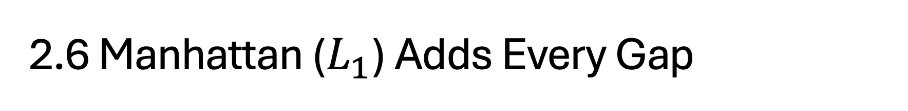
2.6 Manhattan ($L_{1}$) Adds Every Gap
$$d_{1}(x,y)=\sum_{j=1}^{m}{|}x_{j}−y_{j}|$$
Every absolute coordinate gap contributes directly to the total.
Doubling one gap doubles that coordinate's contribution.
Manhattan distance therefore expresses accumulated mismatch.
This is the distance traveled along a grid, like walking city blocks.
Notes:
- “Manhattan” and “city block” name the same rule in the references and SciPy.
- Avoid the shortcut “Manhattan is robust to outliers.” It still uses every full gap and remains scale-sensitive.
[Sources]
- https://www-users.cse.umn.edu/~kumar001/dmbook/index.php - 2nd ed., Section 2.4.3

Slide 13
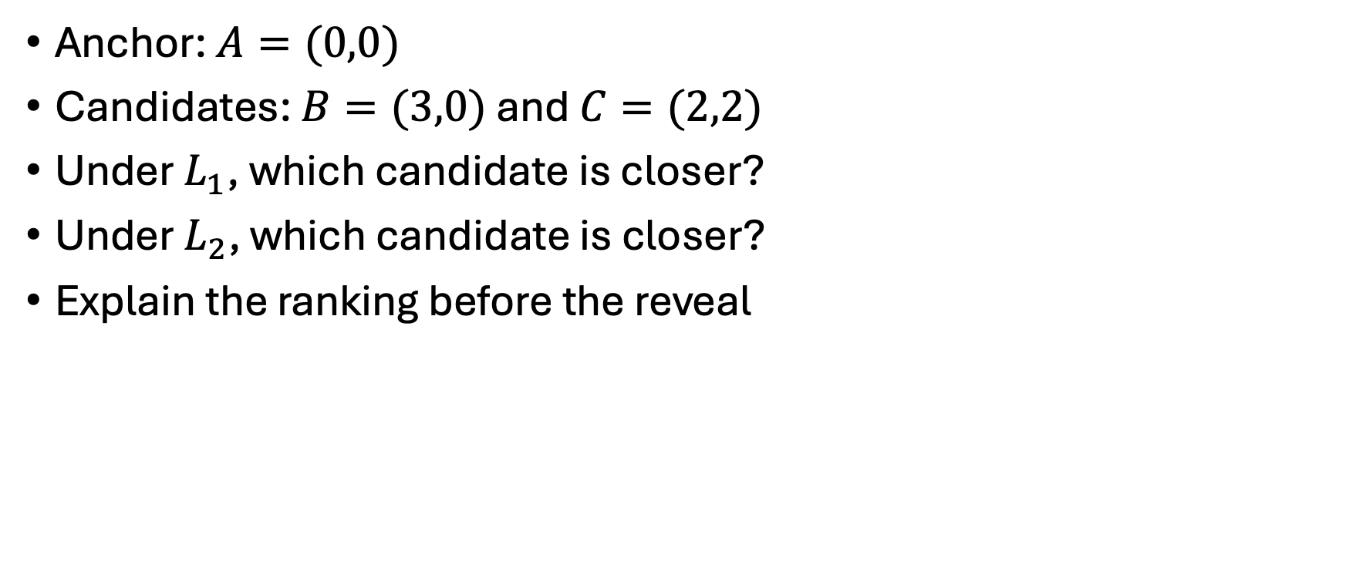
2.7 Predict the Closer Candidate
Anchor: $A=(0,0)$
Candidates: $B=(3,0)$ and $C=(2,2)$
Under $L_{1}$, which candidate is closer?
Under $L_{2}$, which candidate is closer?
Explain the ranking before the reveal

Slide 14
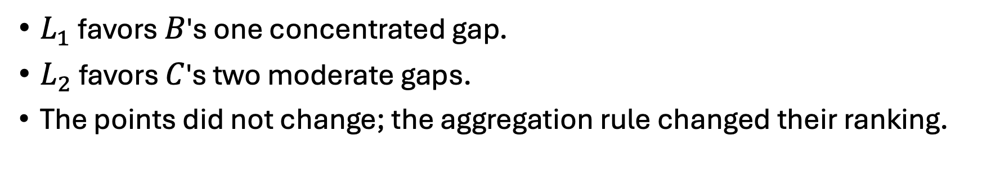
2.8 The Ranking Reverses
Rule | d(A, B) | d(A, C) | Closer
Manhattan L₁ | 3 | 4 | B
Euclidean L₂ | 3 | √8 ≈ 2.83 | C
$L_{1}$ favors $B$'s one concentrated gap.
$L_{2}$ favors $C$'s two moderate gaps.
The points did not change; the aggregation rule changed their ranking.
Notes:
- Compare rankings, not the raw magnitudes of distances from different metrics.
[Sources]
- https://www-users.cse.umn.edu/~kumar001/dmbook/index.php - 2nd ed., Section 2.4.3

Slide 15
2.9 Operational Purpose Selects the Rule
Operational concern | Defensible expression
Total discrepancy accumulates | Manhattan distance
One large mismatch deserves more influence | Euclidean distance
Some features carry different stakes | Explicit feature weights
Choose the rule from the comparison purpose, not from the answer it produces.
Notes:
- These are operational interpretations, not universal meanings attached to metric names.
[Sources]
- https://www-users.cse.umn.edu/~kumar001/dmbook/index.php - 2nd ed., Section 2.4.10
- https://link.springer.com/book/10.1007/978-3-319-14142-8 - Chapter 3, Section 3.2.1.1

Slide 16
3 Units Act Like Weights
The objects can stay fixed while their numerical geometry changes.

Slide 17
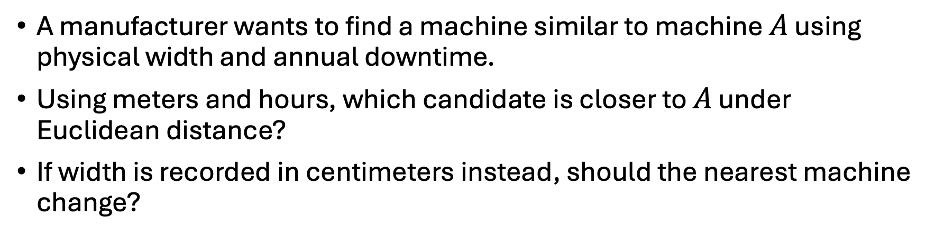
3.1 Candidate Machine Gaps from A
Candidate machine | Difference from A in width | Difference from A in annual downtime
B | 1 meter | 10 hours
C | 2 meters | 0 hours
A manufacturer wants to find a machine similar to machine $A$ using physical width and annual downtime.
Using meters and hours, which candidate is closer to $A$ under Euclidean distance?
If width is recorded in centimeters instead, should the nearest machine change?
Notes:
- This standalone hypothetical example is separate from the notebook dataset.
- The example deliberately exposes the problem of combining unmatched raw units.
[Sources]
- https://dataminingbook.info/book_html/ - 2nd ed., Section 2.4

Slide 18
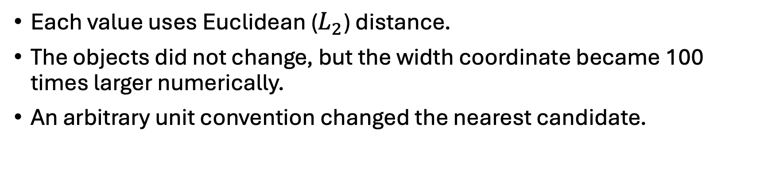
3.2 Ranking Is Sensitive to Units
Representation | d(A, B) | d(A, C) | Closer
meters + hours | 10.05 | 2.00 | C
centimeters + hours | 100.50 | 200.00 | B
Each value uses Euclidean ($L_{2}$) distance.
The objects did not change, but the width coordinate became 100 times larger numerically.
An arbitrary unit convention changed the nearest candidate.
Notes:
- The lesson is not “raw units are always wrong.” Ask whether their implied influence is intended.
[Sources]
- https://dataminingbook.info/book_html/ - 2nd ed., Section 2.4

Slide 19
3.3 Unit Dependence Creates a Problem
A meter-to-centimeter conversion changes notation, not the underlying objects.
If the ranking changes anyway, the raw distance depends on an arbitrary unit choice.
We therefore need to declare what a meaningful unit of discrepancy is for every feature.
Scaling supplies one answer; explicit domain weights may supply another.
Notes:
- This creates the need for scaling without implying that raw units are always wrong.
[Sources]
- https://dataminingbook.info/book_html/ - 2nd ed., Section 2.4

Slide 20
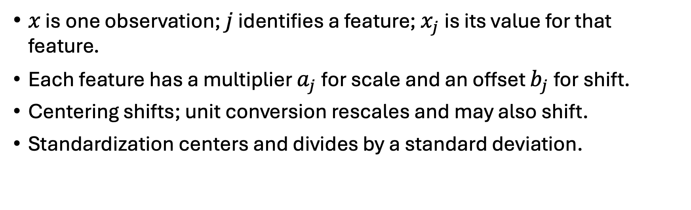
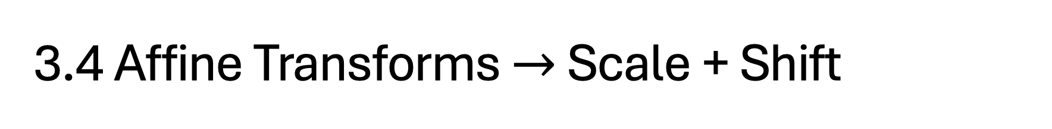
3.4 Affine Transforms $→$ Scale + Shift
$$z_{j}=a_{j}x_{j}+b_{j}$$
$x$ is one observation; $j$ identifies a feature; $x_{j}$ is its value for that feature.
Each feature has a multiplier $a_{j}$ for scale and an offset $b_{j}$ for shift.
Centering shifts; unit conversion rescales and may also shift.
Standardization centers and divides by a standard deviation.
Notes:
- An affine transformation preserves straight lines; a positive multiplier also preserves ordering.
[Sources]
- https://dataminingbook.info/book_html/ - 2nd ed., Section 2.4

Slide 21
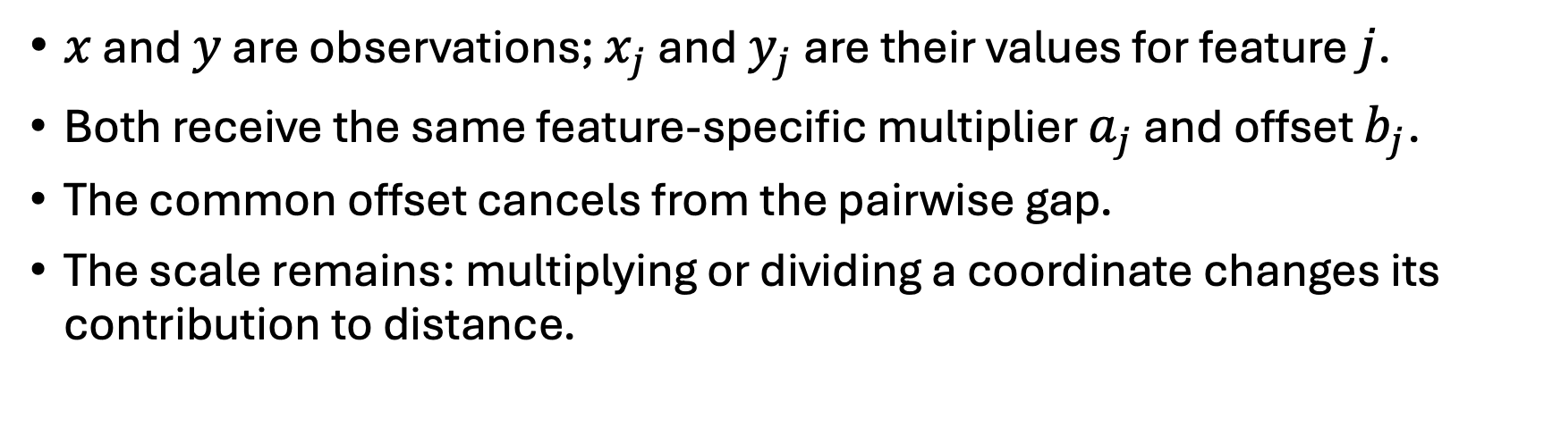
3.5 Common Shifts Cancel, Scaling Remains
$$\left|z_{j}(x)−z_{j}(y)\right|=\left|a_{j}\right|\left|x_{j}−y_{j}\right|$$
$x$ and $y$ are observations; $x_{j}$ and $y_{j}$ are their values for feature $j$.
Both receive the same feature-specific multiplier $a_{j}$ and offset $b_{j}$.
The common offset cancels from the pairwise gap.
The scale remains: multiplying or dividing a coordinate changes its contribution to distance.
Notes:
- A negative multiplier also reverses coordinate direction; distance retains only its magnitude.
[Sources]
- https://dataminingbook.info/book_html/ - 2nd ed., Section 2.4

Slide 22
3.6 Standardization Defines New Units
$$z_{j}=\frac{x_{j}−{\overset{‾}{x}}_{j}}{s_{j}}$$
Each feature has its own mean and sample standard deviation, estimated from the reference data.
The same fitted values are applied to every observation.
Subtracting the feature mean centers the values but does not change pairwise gaps.
Dividing by the sample standard deviation defines one new unit and changes pairwise gaps.
Notes:
- Use the same fitted means and standard deviations for any later record that must remain comparable.
[Sources]
- https://dataminingbook.info/book_html/ - 2nd ed., Section 2.4

Slide 23
3.7 Standardization Makes Gaps Comparable
Every feature is expressed in units of its own sample standard deviation.
A gap of 1 therefore represents a one-standard-deviation difference for any feature.
Gaps can still be larger or smaller, but they are now directly comparable numerically.
Comparability does not make feature distributions identical or determine domain importance.
Notes:
- Standardization answers “How large is this gap relative to the feature's observed variation?” It does not answer “How much should this feature matter?”
[Sources]
- https://www-users.cse.umn.edu/~kumar001/dmbook/index.php - 2nd ed., Sections 2.4.9–2.4.10
- https://scikit-learn.org/stable/modules/preprocessing.html#standardization-or-mean-removal-and-variance-scaling

Slide 24
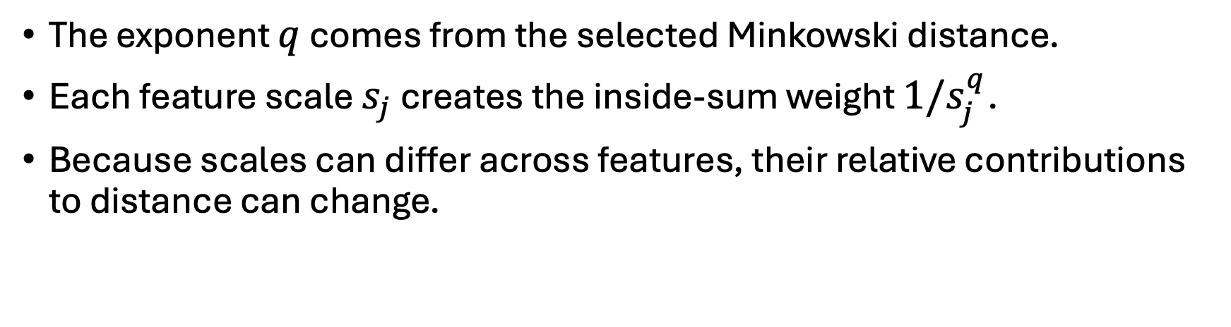
3.8 Scaling May Weight Features Differently
$${\left|\frac{x_{j}−y_{j}}{s_{j}}\right|}^{q}=\frac{1}{s_{j}^{q}}|x_{j}−y_{j}|^{q}$$
The exponent $q$ comes from the selected Minkowski distance.
Each feature scale $s_{j}$ creates the inside-sum weight $1/s_{j}^{q}$.
Because scales can differ across features, their relative contributions to distance can change.
Notes:
- For $L_2$, the inside-the-sum weight is ${1}/{s_j^2}$; for $L_1$, it is ${1}/{s_j}$.
- If every feature used one common scale, all distances would change by the same factor and rankings would remain unchanged.
[Sources]
- https://link.springer.com/book/10.1007/978-3-319-14142-8 - Chapter 3, Section 3.2.1.1
- https://dataminingbook.info/book_html/ - 2nd ed., Section 2.4

Slide 25
4 Choices Reshape Geometry
Transformations and feature construction can alter which differences dominate.

Slide 26
4.1 Nonlinear Transforms Reshape Gaps
Pair | Original gap | log1p gap
10 and 20 | 10 | 0.647
1,010 and 1,020 | 10 | 0.0098
log1p is non-affine: it compresses gaps differently depending on where they occur.
Both pairs differ by 10 on the original scale.
After log1p, the high-value pair has a much smaller gap.
Affine scaling would multiply both gaps by the same factor; this nonlinear transformation does not.
Notes:
- A log transform may express relative or multiplicative discrepancy; skew alone does not make it correct.
[Sources]
- https://www-users.cse.umn.edu/~kumar001/dmbook/index.php - 2nd ed., Section 2.3.7

Slide 27
4.2 Features Can Overweight an Idea
Encodings, interactions, engineered features, and closely related measures can contain overlapping information.
Distance treats each resulting column as a separate coordinate.
An underlying idea represented by several coordinates can therefore contribute more than once.
Direct feature duplication, whether intentional or accidental, is generally discouraged and should be explicit if used.
Notes:
- Not every encoding or interaction is redundant. Inspect whether multiple coordinates allow one underlying idea to dominate the comparison.
[Sources]
- https://www-users.cse.umn.edu/~kumar001/dmbook/index.php - 2nd ed., Sections 2.4.9–2.4.10

Slide 28
5 Historical Utility Case
Twenty-two U.S. utility records connect mixed-scale features to a representation-sensitive nearest-peer question.

Slide 29
5.1 The Historical Public Utilities Dataset
Feature | Student-facing meaning | Recorded unit
Cost | Capacity cost | Source cost per kW
Load_factor | Annual utilization | Percentage-like
Demand_growth | 1974–75 peak-demand growth | Percentage-like
Sales | Annual electricity sales | Thousands of kWh
Fuel_Cost | Fuel cost | Source cents per kWh
Shmueli et al. provide the case; the pinned dmba repository provides the values.
These five features define this comparison; omitted fields may matter for other purposes.
Notes:
- Historical 22-utility dataset; use it to test numerical sensitivity, not current business suitability.
[Sources]
- https://www.oreilly.com/library/view/machine-learning-for/9781119835197/ - 2nd ed., Chapter 16, Section 16.2
- https://github.com/gedeck/dmba/tree/9b29f4dac91fc079113db12b2b9012628d2d0fc8

Slide 30
5.2 A Controlled Peer Comparison
Question: Which recorded utility is Pacific's closest operating peer?
Baseline: five selected features with raw Euclidean distance.
Change only scale: compare raw and standardized Euclidean distance.
Then hold scale fixed: compare standardized Euclidean and Manhattan distance.
Compare peer identity and feature contributions.
State what changed and what the comparison cannot establish.
Notes:
- Direct students to the notebook section **Compare the peer results**.
- Do not preview the peer identities. The notebook owns the executable evidence.
- Keep the final two-sentence sensitivity record in the notebook.

Slide 31
5.3 Scaling Changes Pacific's Peer
Procedure | Nearest recorded peer | Evidence to retain
Raw Euclidean | Madison | Sales dominates the squared contribution
Standardized Euclidean | Hawaiian | New England is nearly tied: 1.548 versus 1.552
Changing the scale changed the peer and exposed uncertainty in the ranking.
Notes:
- The displayed distances are Hawaiian 1.548 and New England 1.552 after rounding.
[Sources]
- https://github.com/gedeck/dmba/tree/9b29f4dac91fc079113db12b2b9012628d2d0fc8 - source data; calculations use the declared five-feature procedures

Slide 32
5.4 Sensitivity Extends Beyond Pacific
Raw versus standardized Euclidean distance changes the peer for 19 of 22 anchors.
With standardization fixed, Manhattan versus Euclidean changes the peer for 5 of 22 anchors.
Assigned-anchor contribution profiles show how a changed scale changes feature influence.
These are diagnostics for this historical case, not universal rates.
Notes:
- Invite one or two assigned-anchor reports before interpreting the all-record counts.
[Sources]
- https://github.com/gedeck/dmba/tree/9b29f4dac91fc079113db12b2b9012628d2d0fc8 - source data; calculations use the declared five-feature procedures

Slide 33
5.5 State the Evidence Carefully
The comparison supports | ...but does not establish
Peer identity is sensitive to scale and metric | One objectively correct peer
Sensitivity across these 22 recorded utilities | A population rate for utility analyses
Need to declare and defend the geometry | A rule to always standardize
Sensitivity limits the claim; it does not select the answer for us
Notes:
- Repair “Hawaiian is the true peer”: it is nearest under one declared geometry and nearly tied with New England.

Slide 34
5.6 Geometry Travels Downstream
representation → distance matrix → neighbors → later methods
PCA, clustering, and anomaly detection inherit representation choices
Next: how should distance become similarity and neighbor logic?
Keep the question attached: nearest according to what?

