Slide 1



DID CRIME ACTUALLY DECREASE DUE TO COVID19?
By top experts:
Orlando Leckie Adriana Alcantara Samuel Schlunsen Robert Allison

Slide 2

OVERVIEW
Hypothesis
Data
Visualizations and comparisons
Conclusion
Q&A

Slide 3
HYPOTHESIS:
If there are less people on the street due to COVID19 quarantine protocols, then there is less crime
Information observed using a crime report data set in Chicago

Slide 4

DATA WE’LL EXPLORE AND COMPARE
Crime Type
Crime Type Distribution
Top Crimes
Crime Change Through Time Period
Crime Distribution by Area
Forecast

Slide 5
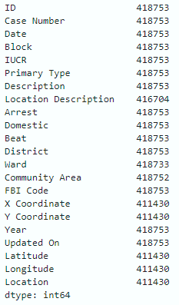
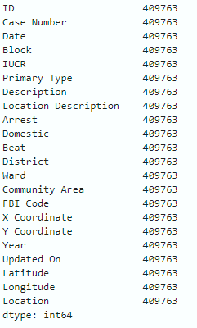
DATA
Eliminated values that were null to have a full data set:

Slide 6
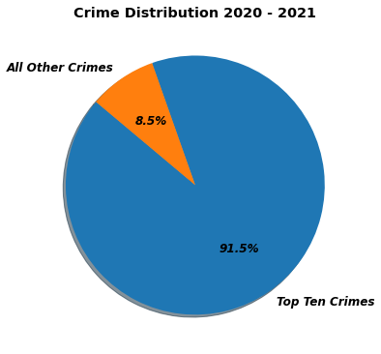
In comparison to all other crimes the “Top 10” ranked most crimes reported during this time

Slide 7
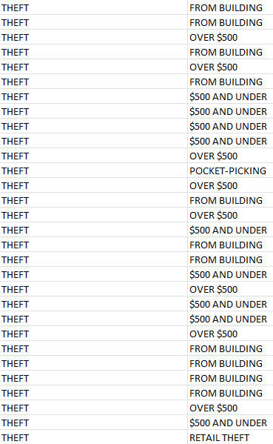
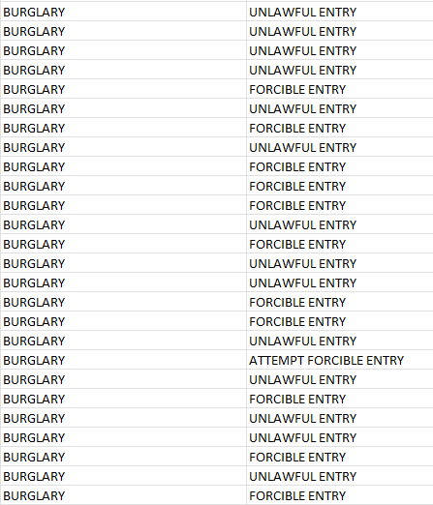
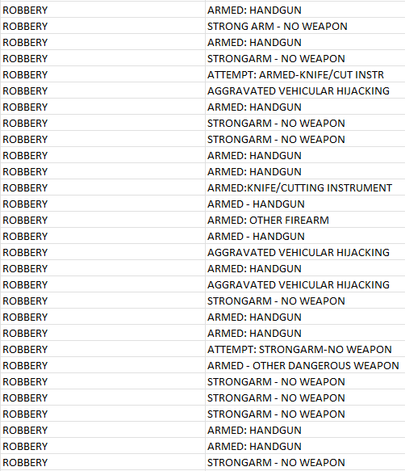
Crime Differentiation
Theft
Burglary
Robbery

Slide 8
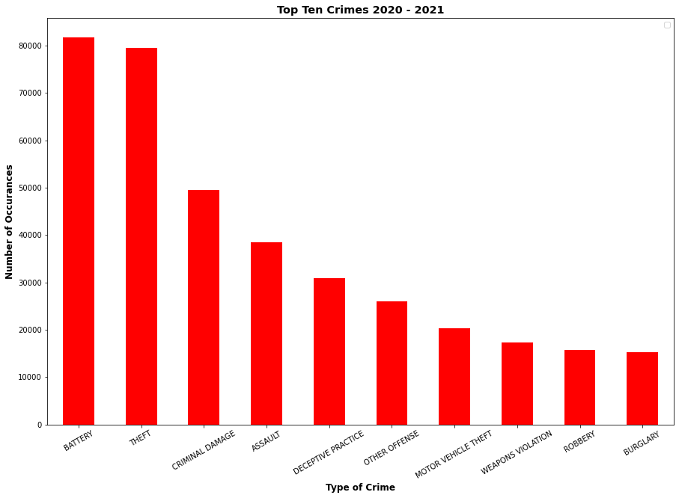

Slide 9


Separation of Crimes by Year

Slide 10
TOP 10 CRIME COMPARISONS FOR 2020/2021
 | 2020 | 2021
BATTERY | 41411 | 40320
THEFT | 40224 | 39262
CRIMINAL DAMAGE | 24695 | 24846
ASSAULT | 18206 | 20256
DECEPTIVE PRACTICE | 15904 | 15037
OTHER OFFENSE | 12396 | 13638
MOTOR VEHICLE THEFT | 9896 | 10489
BURGLARY | 8704 | 6613
WEAPONS VIOLATION | 8416 | 8945
ROBBERY | 7847 | 7902
Notes:
Number of each type of crime. What type of crime has had the largest increase? Decrease? Which crime is the highest in 2020 and how does it compare to 2021?

Slide 11
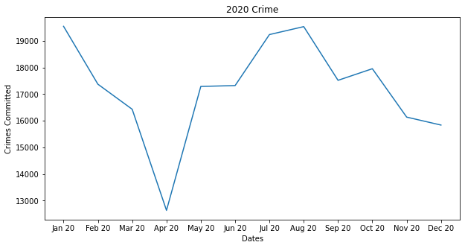
2020

Slide 12
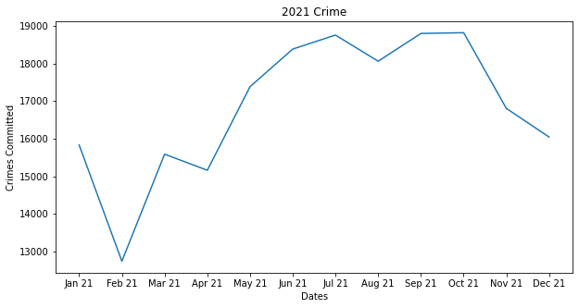
2021

Slide 13
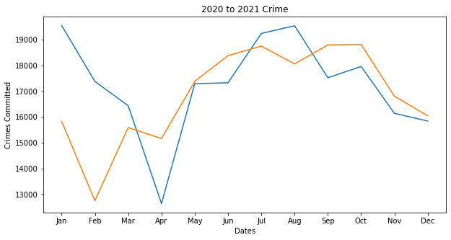

Slide 14
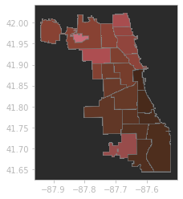
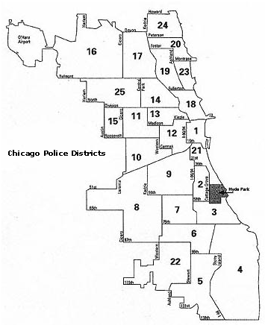

Slide 15
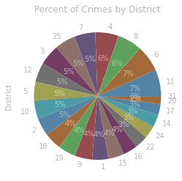
District 11 = 27692 reported crimes

Slide 16
WHAT WE CAN CONCLUDE
Over the course of the 2 years has overall crime increased or decreased?
Interesting facts during this time:
Gun shops were considered essential businesses and stayed open
A 300% increase in criminal background checks for guns in March 2020 compared to the previous year

Slide 17



Q&A

