Slide 1
Beer, Wine, and the Thanksgiving Holiday
In ‘92 at the Chicago Dominick’s Finer Foods Store
Olivia Leeson

Slide 2
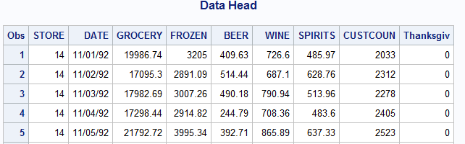

What Data?
Original Data
Chicago Booth School of Business
Dominick’s Fine Foods
Daily records from 1989 to 1994
Sales and UPC data
Data for Analysis
4 Stores in Zone 1
November, 1992
7 days up to Thanksgiving =1
https://research.chicagobooth.edu/kilts/marketing-databases/dominicks/general-files
Notes:
3500 unique product codes for 365 days in 5 years

Slide 3
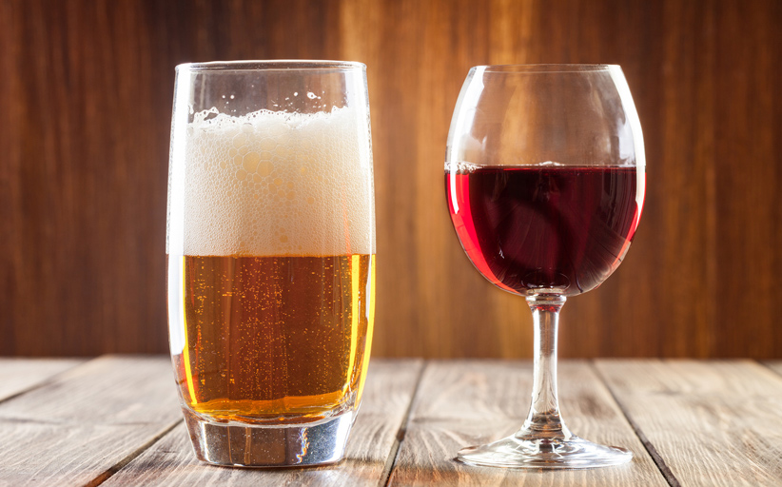
QOI
Economic Theory of Goods Sales
Are Beer and Wine Complimentary or Substitution Goods?
How does the Thanksgiving holiday affect Liquor Purchases?
Prediction
For a given number of wine sales during the Thanksgiving holiday, what do we expect our beer sales to be?
Coefficient Interpretation
What is the relationship between beer sales and wine sales holding all other variables equal?
Does the Thanksgiving holiday have an effect on Beer Sales?

Slide 4
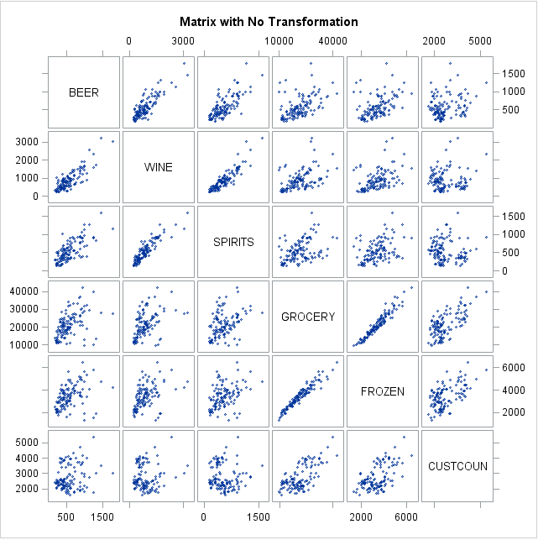
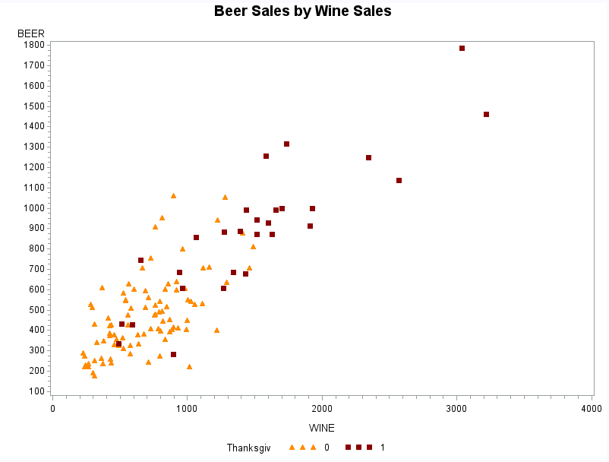
Plots
Notes:
I performed tests for all other transformations. Other transformations did not enhance the linear regression model. Our concern with the original data is that most of it is concentrated to a specific total sales range. However, the sales further along the x access still follow a similar linear regression pattern. We keep the original data.
Interesting to see the linear correlation between beer and wine. Obviously complimentary goods.
More interesting to see that there is typically a more linear relationship between grocery sales and beer sales except for the Thanksgiving observations. It appears that the thanksgiving holiday increases randomness in consumer habits.

Slide 5
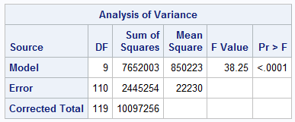
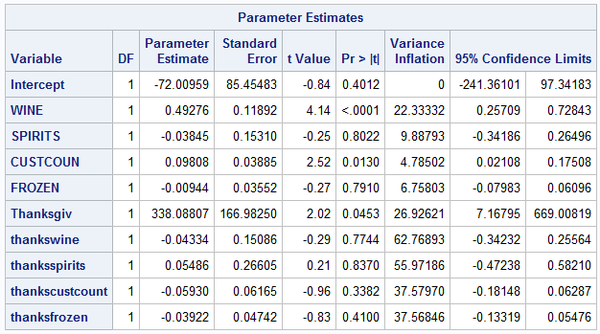


Multiple Linear Regression Model
$$\hat{Beer}=$$
$$\hat{β_{0}}+\hat{β_{1}}Wine+\hat{β_{2}}Spirits+\hat{β_{3}}Custcoun+\hat{β_{5}}Frozen+\hat{β_{7}}Thankgiv$$
$$+\hat{β_{8}}(Thanksgiv)(Wine)+\hat{β_{9}}(Thanksgiv)(Spirits)+\hat{β_{10}}(Thanksgiv)(Custcoun)+\hat{β_{11}}(Thanksgiv)(Frozen)$$
Notes:
R^2 is .7578
Adjusted R is 0.738
WINE
Customer Count
Thanksgiv - all significant at the .05 level
Significiant Coefficients:
Wine
For every $1 increase in wine sales, we expect to see a corresponding increase of beer sales of 49 cents
CustCoun
For every 1 person increase in customer we expect to see about a penny increase in beer sales
Thankgiv
For any of the 7 days leading up to and including Thanksgiving day, we expect to see an increase in beer sales of $338.09
Sake of time im not going to go into all of them

Slide 6

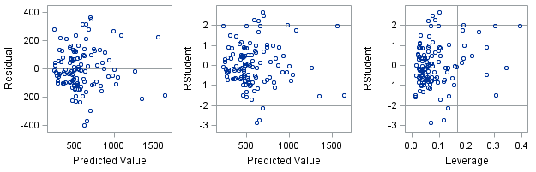
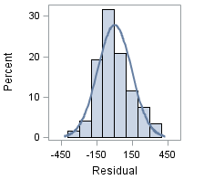
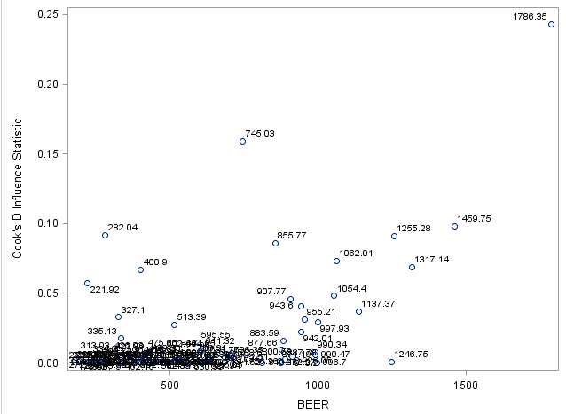
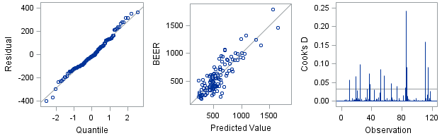
Fit Check
There it is!
Who is this?
Notes:
Obs 85 Store 62 Beer Sale $1786.35
We remove this observation to see if our results are effected.
Originally:
$$\hat{β_{8}}=338.08$$
p-Value = .0453
Then:
$$\hat{β_{8}}=295.438$$
p-Value = 0.0785

Slide 7

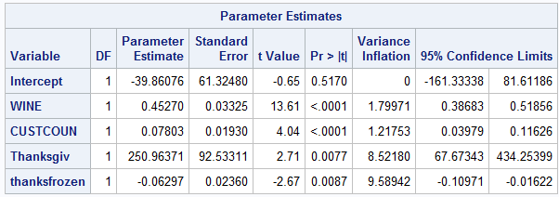
Final Model after Variable Selection
Method: Backward Selection
$\hat{Beer}= \hat{β_{0}}+\hat{β_{1}}Wine+\hat{β_{2}}Custcoun$ $+\hat{β_{3}}Thanksgiv$ $+\hat{β_{4}}(Thanksgiv)(Frozen)$
Significant Coefficients:
Wine
For every $1 increase in wine sales, we expect to see a corresponding increase of mean beer sales of 45 cents
CustCoun
For every 1 person increase in customer we expect to see about an 8 cents increase in mean beer sales
Thankgiv
For any of the 7 days leading up to and including Thanksgiving Day, we expect to see an increase in mean beer sales of $250.96
Thanksfrozen
For any of the 7 days leading up to and including Thanksgiving Day, we expect to see a 6 cents decrease in mean beer sales as frozen food sales increase
Notes:
Old adjusted R^2 - Adjusted R is 0.738
Stepwise adjusted R^2 – 0.7335
$$\hat{Beer}= \hat{β_{0}}+\hat{β_{1}}Wine+\hat{β_{2}}Custcoun$$
Backward adjusted R^2 – 0.7458
F-Value 88.28
Wine between 38 and 52 cents
Custcoun between 4 and 12 cents
Thanksfrozen between negative 11 cents to negative 2 cents
Thanksgiv between 67 and 434

Slide 8
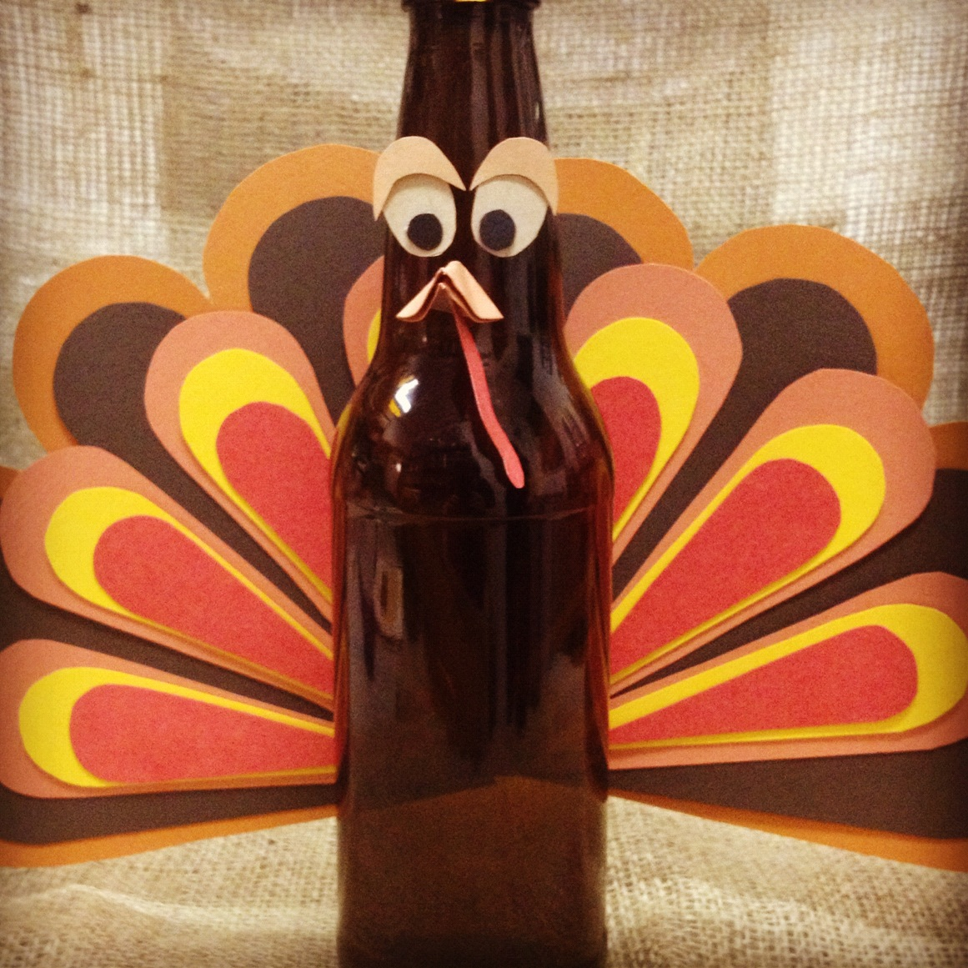
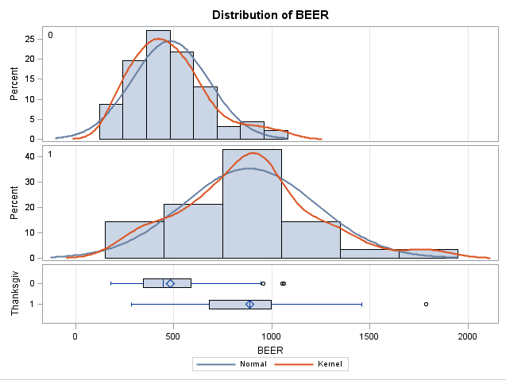

Difference in Means – Welch’s T-test
F-Value: 63.34
Pr > F : <.0001
Notes:
Distinct inequality of variance
Sample sizes are very different
Normality assumption is met
$405.00 more in beer sales during the week leading up to thanksgiving

Slide 9
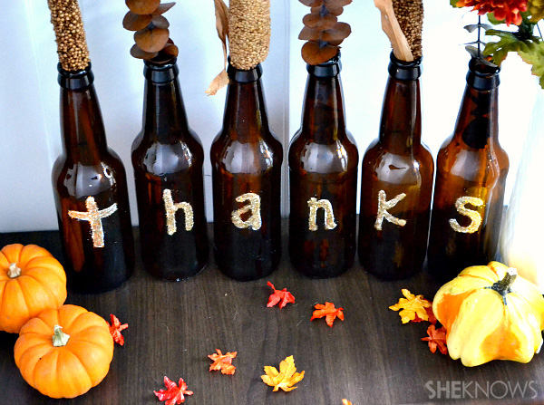
Quick Conclusion
Beer and Wine are positively correlated, suggesting they are complimentary goods.
On average, Beer Sales increase during the week leading up to Thanksgiving Day
Thanksgiving does not change the relationship (slope) between wine and beer

