Slide 1
Natural Language Processing
Lesson 1

Slide 2
Contents
BLOCK 1: Introduction
What is NLP
Why NLP is difficult?
Key NLP tasks
Some NLP history
ASSIGNMENTS:
“Bad words” – due 23Aug
“APIs tutorials” - due 30Aug
BLOCK 2: NLP Basics
Regular Expressions
Texts Normalization
Words Embeddings

Slide 3
NLP Introduction
What is NLP
Why NLP is difficult?
Key NLP tasks
Some NLP History

Slide 4
Natural language processing (NLP) is a branch of artificial intelligence that helps computers understand, interpret and manipulate human language.
NLP pursuit to fill the gap between human communication and computer understanding.

Slide 5
“Эти типы стали есть в литейном цехе”
1. Эти разновидности железных сплавов присутствуют в литейном цехе 2. Эти разновидности железных сплавов следует принимать в пищу в литейном цехе 3. Эти нехорошие люди начали принимать пищу в литейном цехе. 4. Эти разновидности [какой-то еды] начали кушать в литейном цехе.

Slide 6
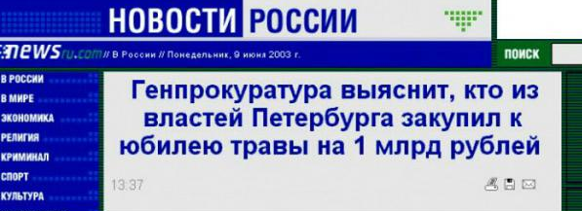
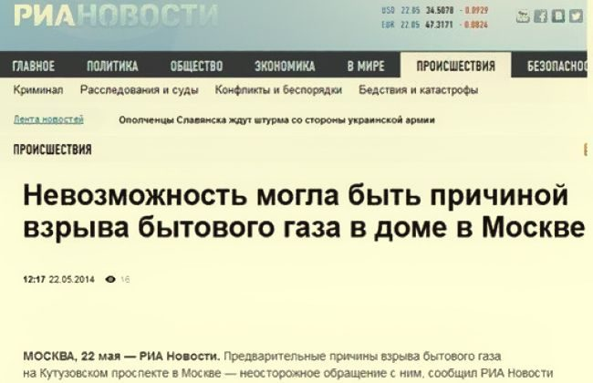
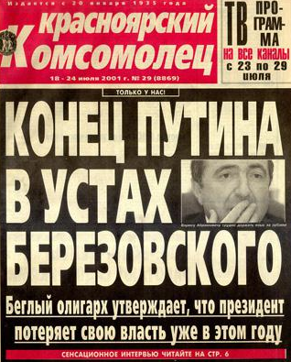
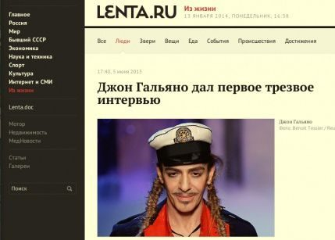
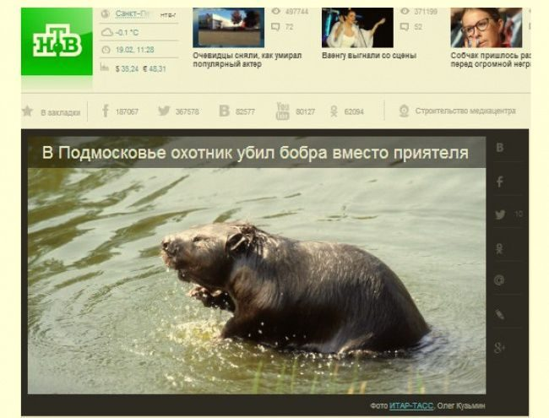
Why NLP is difficult?
Notes:
МЧС: желающим искупаться в купели надо приходить с друзьями, чтобы их могли опознать
В Уфе женщина вызвала пожарных, чтобы они могли потушить ее «горящую душу»
Полицейские с начала года 34 раза задерживали коня, зебру и медведя, вымогающих деньги у петербуржцев
На российской птицефабрике годами тайно освещали яйца

Slide 7
Why NLP is interesting?
AI poetry
there is no one else in the world. there is no one else in sight. they were the only ones who mattered. they were the only ones left. he had to be with me. she had to be with him. i had to do this. i wanted to kill him. i started to cry.
https://www.literai.com
Notes:
More examples: https://www.wired.co.uk/article/google-artificial-intelligence-poetry

Slide 8
Why NLP is interesting? Chatbots ☺
ELIZA – one of the first chatterbots (1964). Simulates Rogerian Psychologist.
PERRY – second chatterbot (1972). Simulates the thinking of a paranoid individual.
These are first programs capable of attempting the Turing Test.
PARRY encounters ELIZA -1972
ELIZA: Good Evening.
ELIZA: Tell me your problems. Please terminate input with a period or a question mark.
PARRY: People get on my nerves sometimes.
ELIZA: I am not sure I understand you fully.
PARRY: You should pay more attention.
ELIZA: Suppose you should pay more attention.
PARRY: You’re entitled to your own opinion.
ELIZA: What makes you think I am entitled to my own opinion?
PARRY: It bothers me just to be around people in general.
ELIZA: Please go on.
PARRY: I went to the track at Bay Meadows a while back.
ELIZA: What does that suggest to you?
PARRY: I went to the races…
More details+ full version: https://phrasee.co/parry-the-a-i-chatterbot-from-1972/
Notes:
https://phrasee.co/parry-the-a-i-chatterbot-from-1972/

Slide 9
NLP Introduction
What is NLP
Why NLP is difficult?
Key NLP tasks
Some NLP History

Slide 10
A few applications of NLP
Spelling correction, grammar checking
Better search engines
Information extraction
Speech recognition (and text-to-speech)
Dialogue systems
Machine translation
etc

Slide 11
NLP Introduction
What is NLP
Why NLP is difficult?
Key NLP tasks
Some NLP History

Slide 12
NLP history
The first patents for "translating machines" were applied for in the mid-1930s. Proposal by Peter Troyanskii, a Russian.
In 1950, Alan Turing published his famous article "Computing Machinery and Intelligence" which proposed what is now called the Turing test as a criterion of intelligence.
Up to the 1980s, NLP systems were based on complex sets of hand-written rules.
Starting in the late 1980s - revolution in NLP with the introduction of machine learning algorithms for language processing.
In the 2010s, deep neural network-style machine learning methods became widespread, achieve state-of-the-art results in many natural language tasks

Slide 13
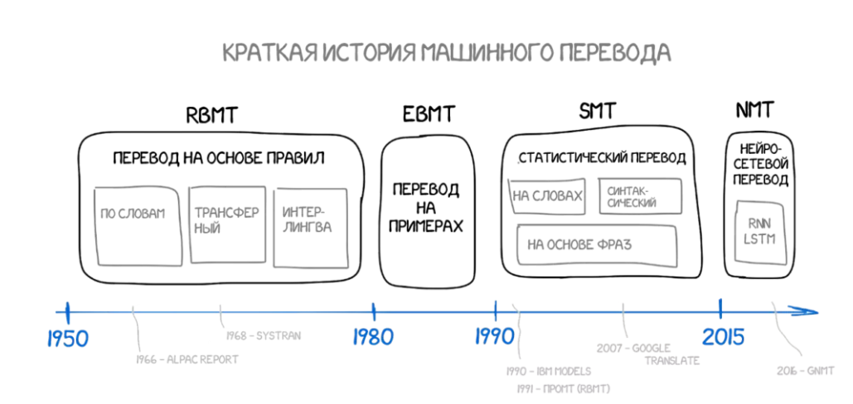
NLP history
Notes:
https://vc.ru/future/32616-mashinnyy-perevod-ot-holodnoy-voyny-do-glubokogo-obucheniya

Slide 14
Regular Expressions

Slide 15
Regular expressions
https://regex101.com - good for regexps development purposes
Pattern | Matches
[1234567890] | Any digit
[0-9] | Any digit
[A-Z] | An upper case letter
[a-z] | A lower case letter
[^0-9] | Not a digit
[^A-Z] | Not an upper case letter
[abc] | a or b or c
a|b|c | a or b or c
Pattern | Matches
{M,N} | Denotes the minimum M and the maximum N match count
{N} | Exact N occurrences
\b | Word boundary
\w | Matches an alphanumeric character, including "_"; same as [A-Za-z0-9_]
\W | Matches an non-alphanumeric character
\s | Matches whitespace [ \r\t\n\f]
\S | Matches anything BUT a whitespace
\d | Matches a digit [0-9]
\D | Matches a non-digit
Notes:
lets test regexps!
These are different letters: a aaa ababab, aabbbbbaa bab.
These are digits: 12328 97
CASE SENSITIVE?
color colour coloir
"Hello"
1 monkey.

Slide 16
Regular expressions
Pattern | Matches
colou?r | Optional previous char | color colour
oo*h! | 0 or more of previous char | oh! ooh! oooh! ooooh!
o+h! | 1 or more of previous char | oh! ooh! oooh! ooooh!
baa+ |  | baa baaa baaaa baaaaa
beg.n | Any character | begin begun begun beg3n
Pattern | Matches
^[A-Z] | Palo Alto
^[^A-Za-z] | 1 “Hello”
\.$ | The end.
.$ | The end? The end!

Slide 17
Regular expressions
Pattern | Matches
\? | ?
\. | .
\* | *
\n | New line
\t | Tab
Precedence hierarchy:
Parenthesis ()
Counters * + ? {}
Sequences and anchors the ˆmy end$
Disjunction |

Slide 18
Regular expressions
In Python use re library for work with regexps
Documentation: https://docs.python.org/3/library/re.html
The most frequently used functions:
re.match()
re.search()
re.findall()
re.split()
re.sub()
re.compile()

Slide 19
Regular expressions: class work
Exercises:
Find all prices in dollars lower than 1000 usd, with cents ($300.01)
Find all prices in dollars in range 300-500, with cents
All strings that start at the beginning of the line with an number and that end at the end of the line with a word

Slide 20
Summary
Regular expressions play a surprisingly large role
Sophisticated sequences of regular expressions are often the first model for any text processing
For many hard tasks we use machine learning classifiers
But regular expressions are used as features in the classifiers

Slide 21
Text normalization

Slide 22
Text normalization: converting it to a more convenient, standard form
Sentences segmentation
Words tokenization: splitting sentences into separate words
Lemmatization: determination of the word’s root (sing –common lemma for sang, sings, sung)
Stemming: removing suffixes & prefixes
Case Folding (lowercasing)
Removing punctuation
Removing stopwords
Expanding contractions
Spelling correction

Slide 23
Lemmatization
Reduce inflections or variant forms to base form
am, are, is → be
car, cars, car's, cars' → car
the boy's cars are different colors → the boy car be different color
Lemmatization: have to find correct dictionary headword form

Slide 24
Stemming
Reduce terms to their stems in information retrieval
Stemming is crude chopping of affixes
language dependent
e.g., automate(s), automatic, automation all reduced to automat.

Slide 25
Porter’s algorithm The most common English stemmer
Step 1a
sses → ss caresses → caress
ies → i ponies → poni
ss → ss caress → caress
s → ø cats → cat
Step 1b
(*v*)ing → ø walking → walk
sing → sing
(*v*)ed → ø plastered → plaster
…
Step 2 (for long stems)
ational→ ate relational→ relate
izer→ ize digitizer → digitize
ator→ ate operator → operate
…
Step 3 (for longer stems)
al → ø revival → reviv
able → ø adjustable → adjust
ate → ø activate → activ
…

Slide 26
Case folding
Common approach: reduce all letters to lower case
Since users tend to use lower case
Possible exception: upper case in mid-sentence?
e.g., General Motors
Fed vs. fed
SAIL vs. sail
Be careful: for sentiment analysis, MT, Information extraction
Case is helpful (US versus us is important)

Slide 27
Removing punctuation
Punctuation in many usually is unnecessary
Be careful: for sentiment analysis & smiles

Slide 28
Removing stopwords
['i', 'me', 'my', 'myself', 'we', 'our', 'ours', 'ourselves', 'you', "you're", "you've", "you'll", "you'd", 'your', 'yours', 'yourself', 'yourselves', 'he', 'him', 'his', 'himself', 'she', "she's", 'her', 'hers', 'herself', 'it', "it's", 'its', 'itself', 'they', 'them', 'their', 'theirs', 'themselves', 'what', 'which', 'who', 'whom', 'this', 'that', "that'll", 'these', 'those', 'am', 'is', 'are', 'was', 'were', 'be', 'been', 'being', 'have', 'has', 'had', 'having', 'do', 'does', 'did', 'doing', 'a', 'an', 'the', 'and', 'but', 'if', 'or', 'because', 'as', 'until', 'while', 'of', 'at', 'by', 'for', 'with', 'about', 'against', 'between', 'into', 'through', 'during', 'before', 'after', 'above', 'below', 'to', 'from', 'up', 'down', 'in', 'out', 'on', 'off', 'over', 'under', 'again', 'further', 'then', 'once', 'here', 'there', 'when', 'where', 'why', 'how', 'all', 'any', 'both', 'each', 'few', 'more', 'most', 'other', 'some', 'such', 'no', 'nor', 'not', 'only', 'own', 'same', 'so', 'than', 'too', 'very', 's', 't', 'can', 'will', 'just', 'don', "don't", 'should', "should've", 'now', 'd', 'll', 'm', 'o', 're', 've', 'y', 'ain', 'aren', "aren't", 'couldn', "couldn't", 'didn', "didn't", 'doesn', "doesn't", 'hadn', "hadn't", 'hasn', "hasn't", 'haven', "haven't", 'isn', "isn't", 'ma', 'mightn', "mightn't", 'mustn', "mustn't", 'needn', "needn't", 'shan', "shan't", 'shouldn', "shouldn't", 'wasn', "wasn't", 'weren', "weren't", 'won', "won't", 'wouldn', "wouldn't"]

Slide 29
Expanding Contractions
"didn't": "did not", "doesn't": "does not", "don't": "do not", "hadn't": "had not", "hasn't": "has not", "haven't": "have not", "he'd": "he would","he'll": "he will", "he's": "he is", "how'd": "how did", "how'd'y": "how do you", "how'll": "how will", "how's": "how is", "I'd": "I would", "I'd've": "I would have", "I'll": "I will", "I'll've": "I will have","I'm": "I am", "I've": "I have", "i'd": "i would", etc

Slide 30
Key Libraries
NLTK
Spacy
Gensim
Pymorphy - rus
Pymystem – rus
Deep Pavlov -rus

Slide 31
Text normalization: showcase

Slide 32
Words Embeddings

Slide 33
Word embeddings
Word embeddings - texts converted into numbers.
Different types of numeric representations
Frequency based embedding (deterministic)
Count Vector
TF-IDF Vector
Co-occurrence matrix
To mention: Bag of Words, n-grams
Prediction based embedding (probabilistic)
CBOW (predict central word given a context)
Skip-grams (predict context given a central word)
Notes:
https://www.analyticsvidhya.com/blog/2017/06/word-embeddings-count-word2veec/

Slide 34

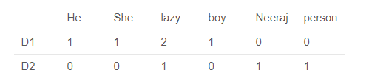
Count vectors
Issue: frequent words do not bring value…
TF-IDF might help
No syntactic & semantic meaning
Notes:
https://www.analyticsvidhya.com/blog/2017/06/word-embeddings-count-word2veec/

Slide 35
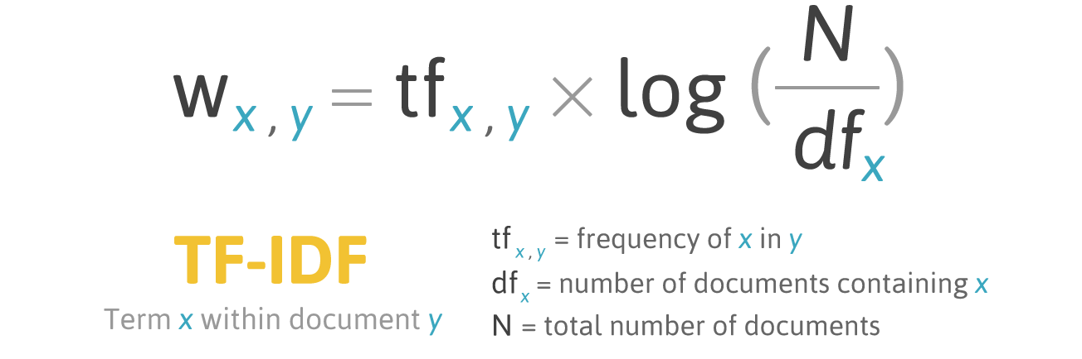
TF-IDF vectors
TF-IDF: Term Frequency – Inverse Document Frequency
Issue: no syntactic & semantic meaning, for supervised models
Notes:
http://filotechnologia.blogspot.com/2014/01/a-simple-java-class-for-tfidf-scoring.html

Slide 36
N-grams: to keep some semantics
Unigrams, bigrams, threegrams…
Today is the 28th of November.
Bigrams:
Today is
is the
the 28th
28th of
of November
One more approach…
Notes:
http://filotechnologia.blogspot.com/2014/01/a-simple-java-class-for-tfidf-scoring.html

Slide 37
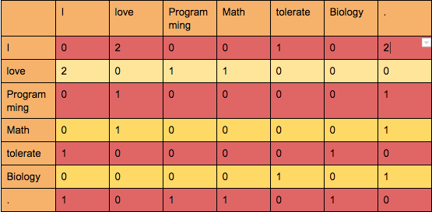
Co-occurence matrix
M – Window size
Lets take M=1, e.g. account to neighbors from the left & right of the word
I love Programming. I love Math. I tolerate Biology.
Issue: high dimensional space,
difficult to update
https://medium.com/ai-society/jkljlj-7d6e699895c4
Notes:
https://medium.com/ai-society/jkljlj-7d6e699895c4

Slide 38
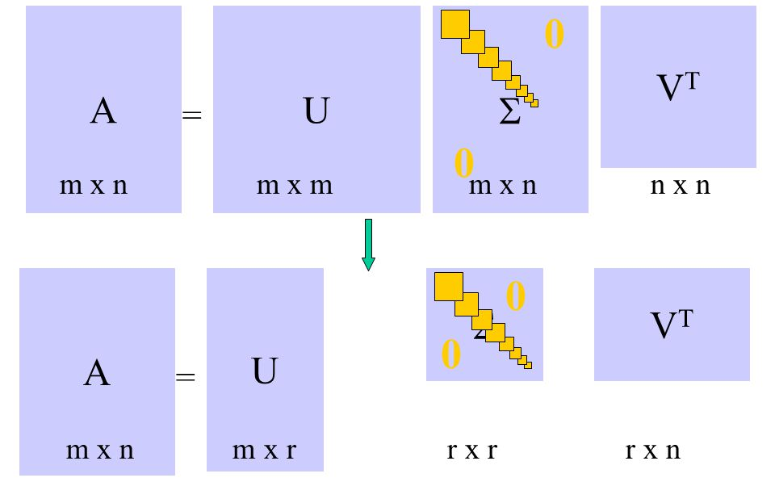
Singular Value Decomposition
Interesting semantic and syntactic relationships
Issue: the computational cost of this approach scales quadratically (O(mn²) for the nxm matrix), difficult to update
https://medium.com/ai-society/jkljlj-7d6e699895c4
Notes:
https://medium.com/ai-society/jkljlj-7d6e699895c4

Slide 39
Home Assignments

Slide 40
Home assignment “Bad words” – до 23.08.21 23.59
Задание: создать свое регулярное выражение для поиска русских матных слов, которые «шифруют», т.е. заменяют часть букв на знаки (с..ки, де**л и т.п.). При этом хорошие слова отлавливаться не должны.
Творческое задание, исчерпывающий список не требуется, но креативность поощряется.
False Positive сильно штрафуются.
Сдавать в Jupyter Notebook рабочий код вместе с тестовым набором слов, на котором проверяли действие регекса.
Отправка на почту NHryshchuk@ibagroup.eu с темой «bad_words_regexp_Full_Name»

Slide 41
Home assignment “API Tutorials”
Задание: написать в Jupyter Notebook свой тьюториал для использования API (см таблицу далее) для скрапинга текстов. В большинстве случаев это будут комментарии. Beautiful Soup – парсинг веб-страниц.
Тьюториал должен состоять из 2 частей:
Инструкция по получению API кода (в BeautifulSoup такого нет, но нужно разобраться как скрапить текст с сайтов с авторизацией).
Сам код для вытягивания текста и формирования DataFrame.
Вас будет ревьюить другой человек, его задача успешно запустить ваш код. Поэтому чем подробнее и user-friendly будет тьюториал, тем больше шансов на высокий балл.
Не откладывайте на потом: например, в Instagram могут забанить на 3 дня из-за большого количества попыток подключений ☺
Все инструкции пишите в режиме markdown. Комментарии с # для ревьюеров.
Ревьюеры: в конце тьюториала делаете Review Notes + свои комментарии можете оставлять с # в коде.
Лучшие тьюториалы выложу в дискорде. После этого задания у вас будут уже свои протестированные наработки для скрапинга текстов с разных источников ☺

Slide 42
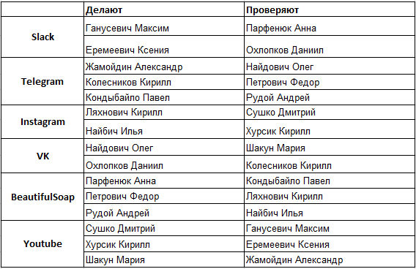
Home assignment “API Tutorials”
Отсылка на ревью коллеге из группы: до 26.08.21 23.59 (или как договоритесь)
Я должна получить проверенную работу от ревьюера до 30.08.21 23.59 на почту NHryshchuk@ibagroup.eu с темой «API_type_Author_Full_Name_Reviewer_Full_Name».

Slide 43
Topics of reports
1) Тематическое моделирование: LSA, LDA, ARTM – Найбич Илья
2) BERT: современная языковая модель для NLP - Охлопков Даниил

Slide 44
Word embeddings: showcase & class work

