Slide 1
Natural Language Processing
Lesson 2

Slide 2
Contents
BLOCK 1: Word Embeddings -2
Word2Vec
Doc2Vec
GloVe
FastText
Similarity Between Words
ASSIGNMENTS:
“Sentiment Analysis” – due 2 Sep
BLOCK 2: Naïve Bayes
Naïve Bayes Classifier
BLOCK 3: Topic Modelling
LSA
LDA
Other approaches (pLSA, LDA2Vec)

Slide 3
Word2Vec

Slide 4
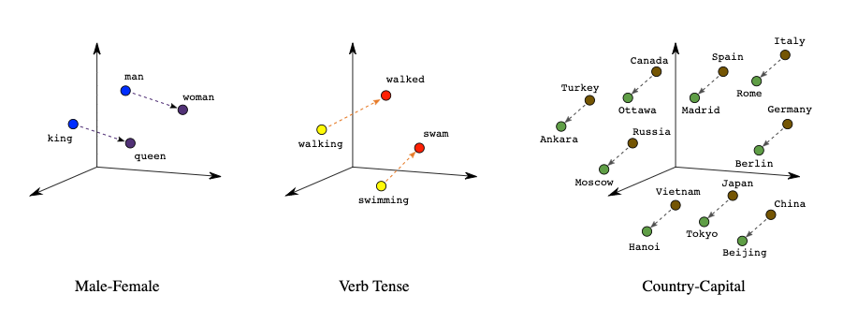
Word2vec: word analogies

Slide 5
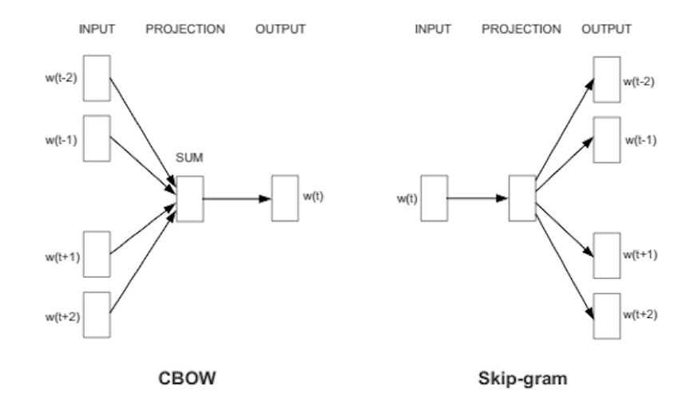
What is word2vec
Word2vec - popular technique to learn word embeddings using a two-layer (shallow) neural network. Its input is a text corpus and its output is a set of vectors.
Word2vec is a combination of two techniques – CBOW(Continuous bag of words) and Skip-gram model.
Word2vec was created and published in 2013 by a team of researchers led by Tomas Mikolov at Google
CBOW (Continuous Bag of words): predict the probability of a word given a context (context - single word or a group of words).
Several times faster to train than the skip-gram, slightly better accuracy for the frequent words
Skip – Gram model: predict the context given a word.
Works well with small amount of the training data, represents well even rare words or phrases
The cat ate _____.
___ ___ ___ food.

Slide 6
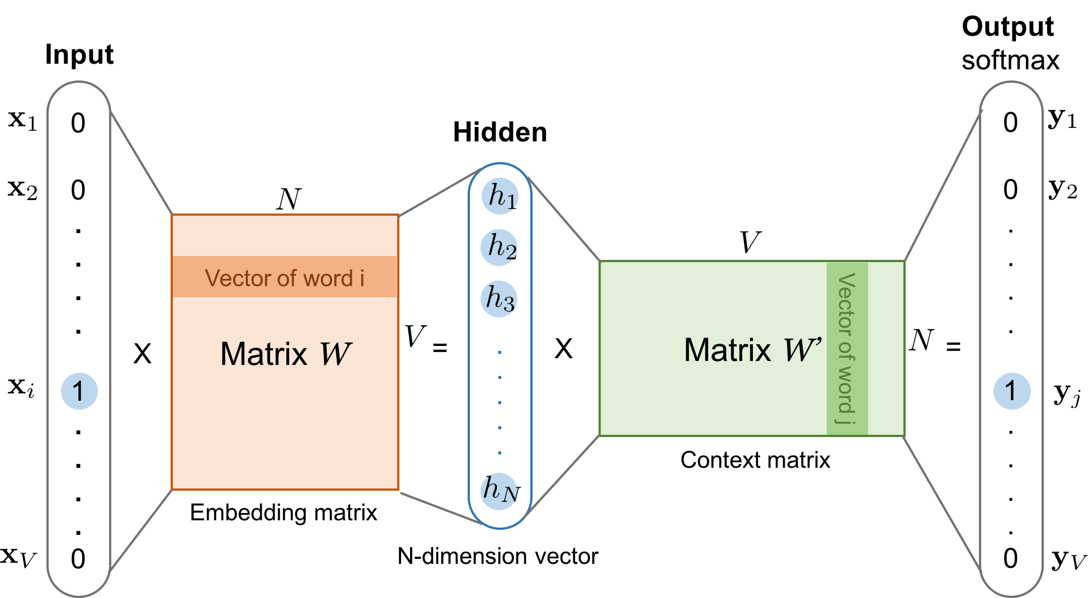

Skip-gram under the hood
___ ___ ___ food.
Notes:
Stanford University class CS224d: Deep Learning for Natural Language Processing
http://web.stanford.edu/class/cs224n/
https://yandex.by/video/search?from=tabbar&text=cn224%20word2vec
https://lilianweng.github.io/lil-log/2017/10/15/learning-word-embedding.html?source=post_page---------------------------

Slide 7
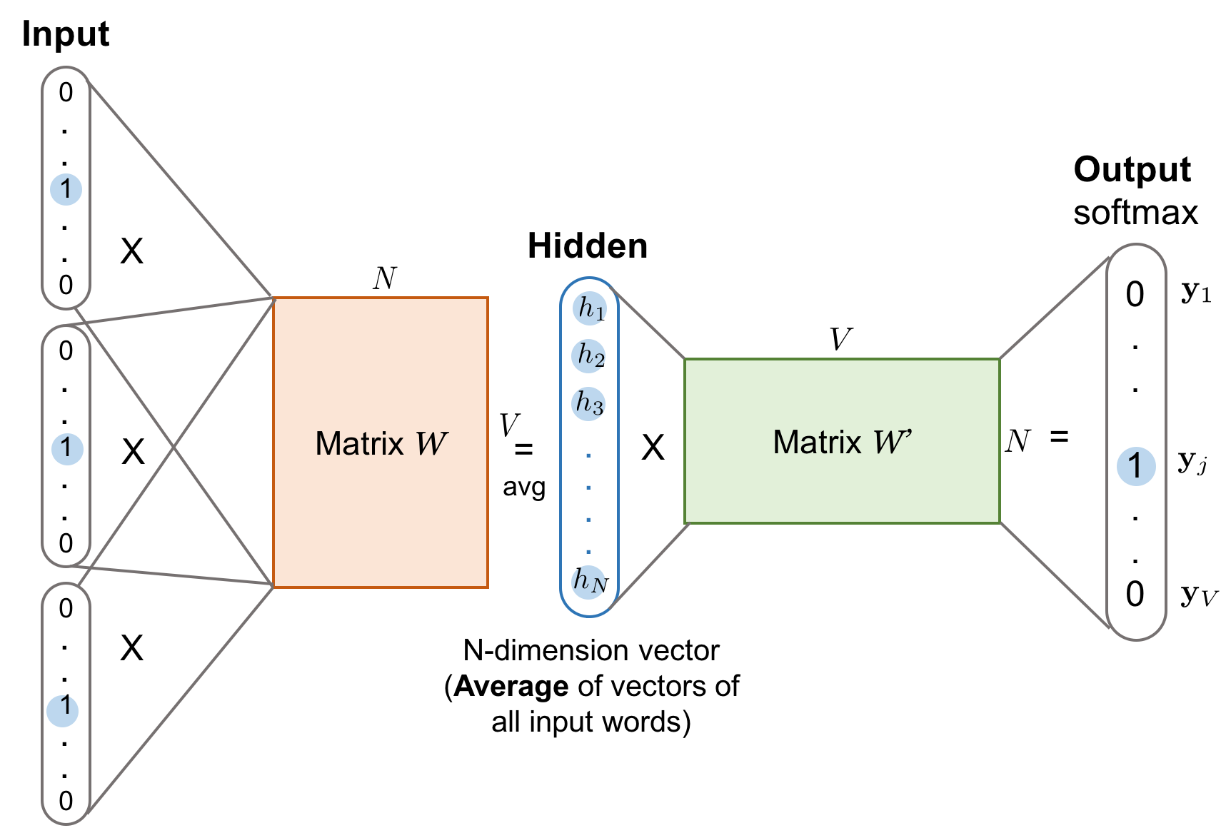
CBOW under the hood
The cat ate _____.
Notes:
Stanford University class CS224d: Deep Learning for Natural Language Processing
http://web.stanford.edu/class/cs224n/
https://lilianweng.github.io/lil-log/2017/10/15/learning-word-embedding.html?source=post_page---------------------------

Slide 8
Doc2Vec

Slide 9
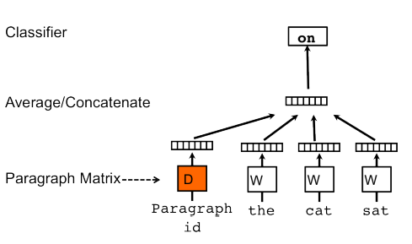
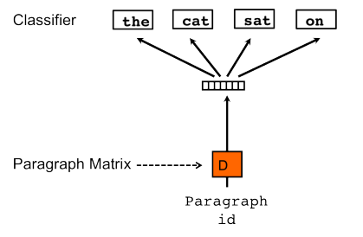
What is doc2vec
Doc2vec – technique to create a numeric representation of a document, regardless of its length.
The Doc2Vec concept: use the word2vec model and added another vector - Paragraph ID. When training the word vectors W, the document vector D is trained as well, it will hold a numeric representation of the document
Distributed Memory version of Paragraph Vector (PV-DM). It acts as a memory that remembers what is missing from the current context — or as the topic of the paragraph. The document vector intends to represent the concept of a document.
Distributed Bag of Words version of Paragraph Vector (PV-DBOW) - another algorithm, which is similar to skip-gram
Notes:
https://medium.com/wisio/a-gentle-introduction-to-doc2vec-db3e8c0cce5e

Slide 10
FastText

Slide 11
What is FastText
FastText - character n-gram model, extension to Word2Vec . Created by Facebook's AI Research lab in 2016.
FastText breaks words into n-grams (sub-words). For instance, the tri-grams for the word apple is app, ppl, and ple . The word embedding vector for apple will be the sum of all these n-grams.
Pros:
deals with out of vocab words
better representations for rare words
Cons:
longer to train
requires more memory

Slide 12
GloVe

Slide 13
What is GloVe
Global Vectors - is a model for distributed word representation.
Training is performed on aggregated global word-word co-occurrence statistics from a corpus, and the resulting representations showcase interesting linear substructures of the word vector space.
In GloVe the loss function is the difference between the product of word embeddings and the log of the probability of co-occurrence. Loss minimized with SGD, solve it as a linear regression.
It is developed as an open-source project at Stanford.

Slide 14
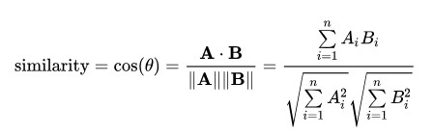
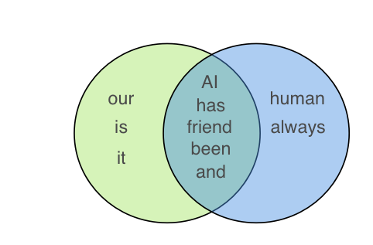
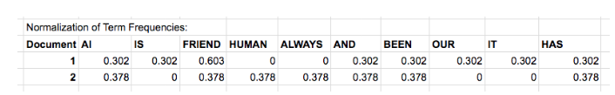
Similarity between words and sentences
Cosine similarity calculates similarity by measuring the cosine of angle between two vectors. With cosine similarity, we need to convert sentences into vectors
This is calculated as:
Cosine similarity is 0.68
Jaccard Similarity - size of intersection divided by size of union of two sets.
Let’s take example of two sentences:
Sentence 1: AI is our friend and it has been friendly Sentence 2: AI and humans have always been friendly
Jaccard similarity is 0.5
Notes:
https://towardsdatascience.com/overview-of-text-similarity-metrics-3397c4601f50

Slide 15
Naïve Bayes Classifier

Slide 16
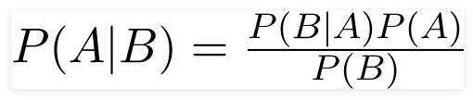
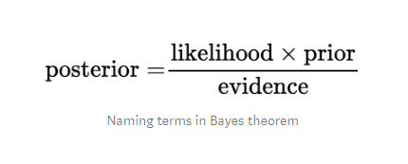
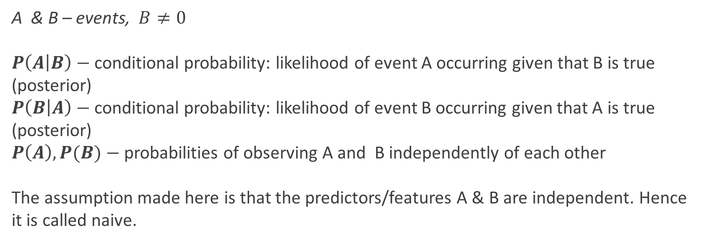
Bayes Theorem
A & B – events, $B≠0$
$P\left(A | B\right)−$conditional probability: likelihood of event A occurring given that B is true (posterior)
$P\left(B | A\right)−$conditional probability: likelihood of event B occurring given that A is true (posterior)
$P\left(A\right), P(B)−$probabilities of observing A and B independently of each other
The assumption made here is that the predictors/features A & B are independent. Hence it is called naive.

Slide 17
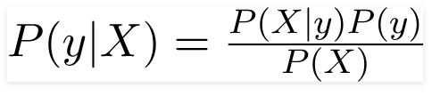

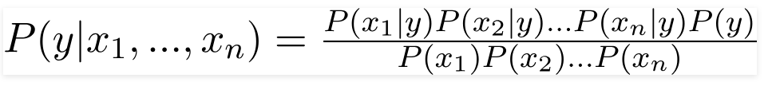


Naïve Bayes Classifier

Slide 18
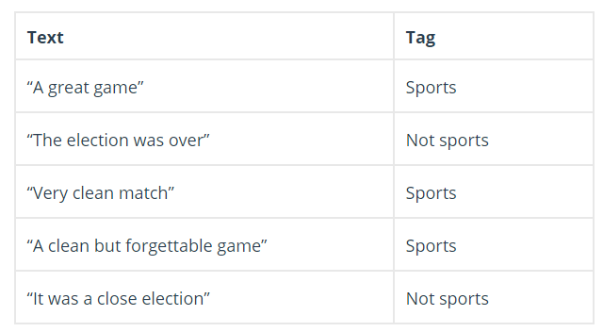

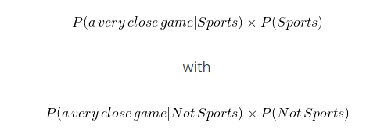
Naïve Bayes Classifier: example
To which class “A very close game” belongs to?
https://monkeylearn.com/blog/practical-explanation-naive-bayes-classifier/
There naiveness comes into place:
P(sports) = 3/5
P(not sports) = 2/5
P(game|sports) = 2/11
P(game| not sports) =0/9… Not good
Laplacian smoothing: add 1 to every count so it is never zero
P(game|sports) = (2+1)/(11+14)
P(game| not sports) =(0+1)/(9+14)
Notes:
https://monkeylearn.com/blog/practical-explanation-naive-bayes-classifier/

Slide 19
Types of Naïve Bayes Classifier
Multinomial Naive Bayes:
This is mostly used for document classification problem, i.e whether a document belongs to the category of sports, politics, technology etc. The features/predictors used by the classifier are the frequency of the words present in the document.
Bernoulli Naive Bayes:
This is similar to the multinomial naive bayes but the predictors are boolean variables. The parameters that we use to predict the class variable take up only values yes or no, for example if a word occurs in the text or not.
Gaussian Naive Bayes:
When the predictors take up a continuous value and are not discrete, we assume that these values are sampled from a gaussian distribution.

Slide 20
Naïve Bayes Classifiers Pros & Cons
Advantages:
simple technique for constructing classifiers
requires a small number of training data to estimate the parameters
despite their naive design naive Bayes classifiers have worked quite well in many complex real-world situations.
Disadvantages:
assumption that the value of a particular feature is independent of the value of any other feature, given the class variable.
can be outperformed by other approaches, such as random forest, SVM.

Slide 21
Topic Modelling

Slide 22
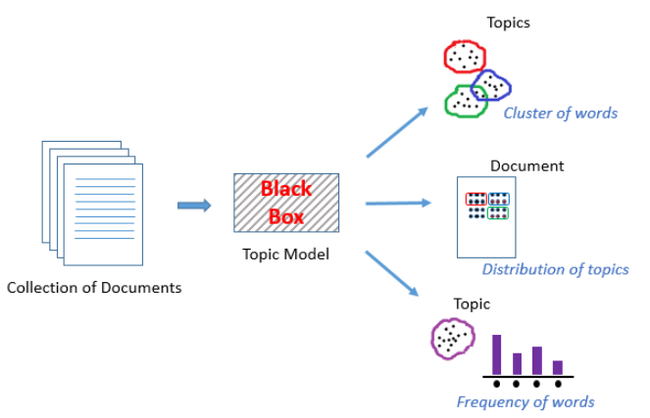
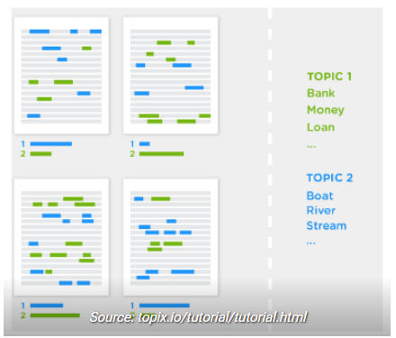
Topic Modelling - an unsupervised technique to discover topics across text documents.
It helps to explore large amounts of text data, finding clusters of words, similarity between documents, and discovering abstract topics.
https://www.analyticsvidhya.com/blog/2018/10/stepwise-guide-topic-modeling-latent-semantic-analysis
Notes:
https://www.analyticsvidhya.com/blog/2018/10/stepwise-guide-topic-modeling-latent-semantic-analysis/?__cf_waf_tk__=000066894300200000042737lNZPL0HMVU9Lr0fxP9kOUQAJPg

Slide 23
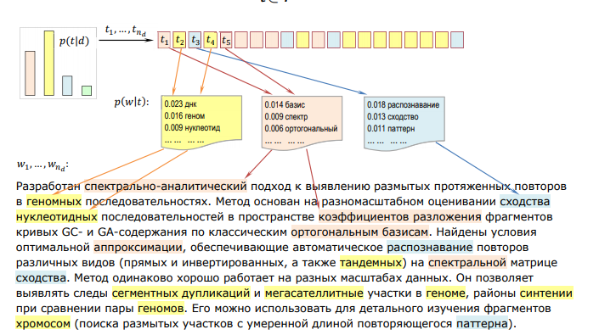
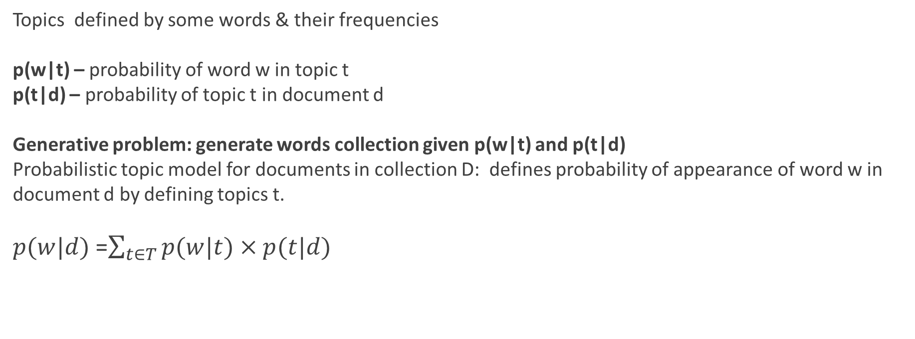
Key definitions
Topics defined by some words & their frequencies
p(w|t) – probability of word w in topic t
p(t|d) – probability of topic t in document d
Generative problem: generate words collection given p(w|t) and p(t|d)
Probabilistic topic model for documents in collection D: defines probability of appearance of word w in document d by defining topics t.
$p(w|d)$=$\sum_{t∈T}{p(w|t)×p(t|d)}$
http://www.machinelearning.ru/wiki/images/e/e6/Voron-ML-TopicModeling-slides.pdf

Slide 24
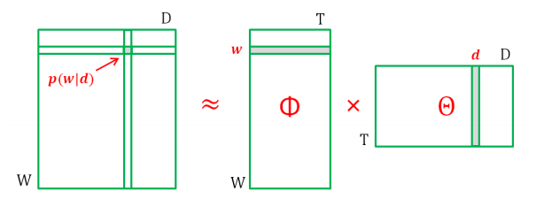
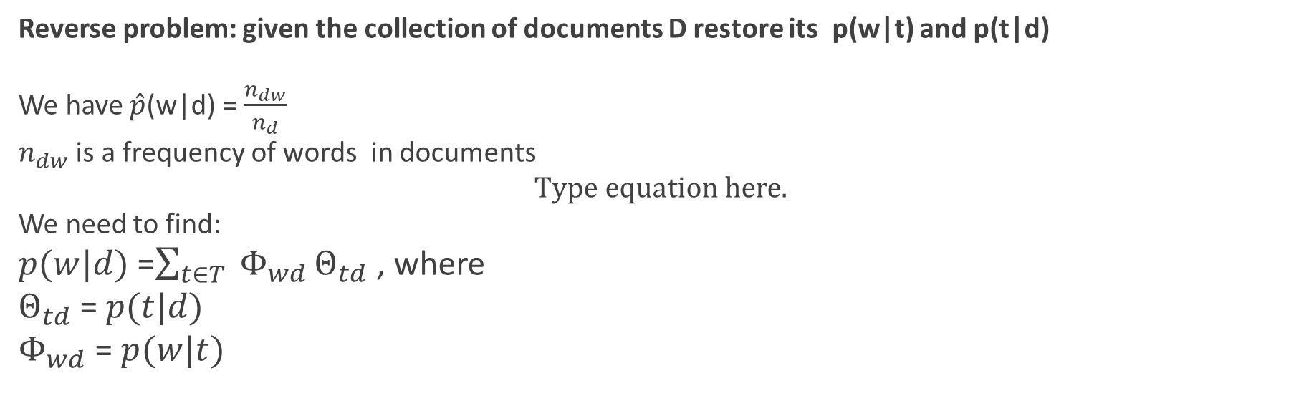
Latent Semantic Analysis (LSA)
Reverse problem: given the collection of documents D restore its p(w|t) and p(t|d)
We have $\hat{p}$(w|d) = $\frac{n_{dw}}{n_{d}}$
$n_{dw}$ is a frequency of words in documents
We need to find:
$p(w|d)$=$\sum_{t∈T}{ Φ_{wd}}Θ_{td}$ , where
$Θ_{td}$ = $p(t|d)$
$Φ_{wd}$ = $p(w|t)$
Stochastic Matrix Decomposition:
http://www.machinelearning.ru/wiki/images/e/e6/Voron-ML-TopicModeling-slides.pdf
Pros:
LSA is fast and easy to implement.
It gives decent results, much better than a plain vector space model.
Cons:
Since it is a linear model, it might not do well on datasets with non-linear dependencies.
LSA assumes a Gaussian distribution of the terms in the documents, which may not be true for all problems.
LSA involves SVD, which is computationally intensive and hard to update as new data comes up.
Notes:
http://www.machinelearning.ru/wiki/images/e/e6/Voron-ML-TopicModeling-slides.pdf

Slide 25
Latent Dirichlet Allocation (LDA)
Latent Dirichlet Allocation (LDA) is a “generative probabilistic model” for topic modelling.
Key peculiarities:
- assume topics have Dirichlet distribution distribution over distributions.
- iterative process
Step 1: tell the algorithm how many topics you think there are.
Step 2: the algorithm will assign every word to a temporary topic. Topic assignments are temporary as they will be updated in Step 3. Temporary topics are assigned to each word in a semi-random manner (according to a Dirichlet distribution). This also means that if a word appears twice, each word may be assigned to different topics.
Step 3 (iterative): the algorithm will check and update topic assignments, looping through each word in every document. For each word, its topic assignment is updated based on two criteria:
How prevalent is that word across topics?
How prevalent are topics in the document?
Notes:
https://towardsdatascience.com/latent-dirichlet-allocation-15800c852699

Slide 26
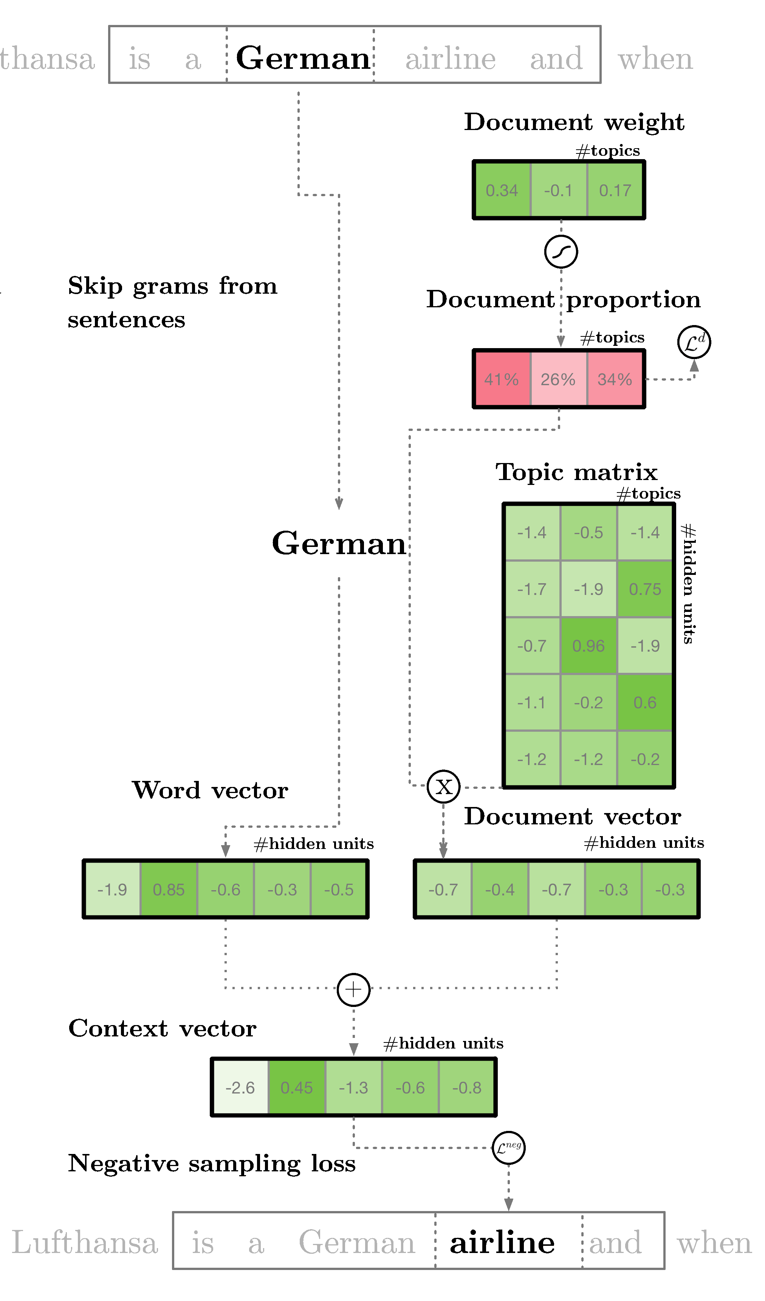
Other Approaches to Topic Modelling
pLSA - Probabilistic Latent Semantic Analysis – trained using Expectation-Maximisation Algorithm (EM)
Lda2vec (deep learning-based, 2016) – Chris Moody, multithreaded.stitchfix.com/blog/2016/05/27/lda2vec/
Notes:
https://medium.com/nanonets/topic-modeling-with-lsa-psla-lda-and-lda2vec-555ff65b0b05

Slide 27


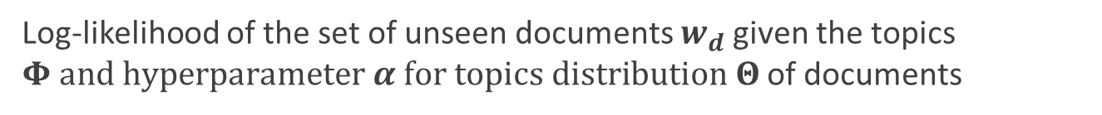
Evaluation
Extrinsic: how good it for your task. Human have to evaluate.
Intrinsic: hold-out perplexity
Perplexity is a measurement of how well topic model describes distribution of words in the test documents.
Log-likelihood of the set of unseen documents $w_{d}$given the topics $Φ and hyperparameter α for topics distribution Θ$of documents
The lower is perplexity the better
Notes:
http://qpleple.com/perplexity-to-evaluate-topic-models/

Slide 28
Home Assignments

Slide 29
Home assignment “Sentiment Analysis” – до 02.09.21 23.59
Отправить на почту ноутбук + validation_preds.csv c предсказанным сентиментом на NHryshchuk@ibagroup.eu с темой «Sentiment_analysis_Full_Name» .
Задание: подобрать параметры векторных представлений и алгоритм для задачи классификации, максимизирующие ROC AUC score.

