Slide 1
Bullying Prevention in the workplace
HR Master 2017

Slide 2
What is bullying?
Bullying at work is repeated, unreasonable behaviour directed towards a worker, or a group of workers, that creates a risk to their health and safety.
Repeated behaviour refers to the persistent nature of the behaviour and can include a range of behaviours over time.
Unreasonable behaviour means behaviour that a reasonable person, having regard for the circumstances, would see as victimising, humiliating, undermining or distressing. Whether intended or not, bullying is a health and safety risk.

Slide 3
Types of unreasonable behaviour
Types of unreasonable “repeated” behaviour that may be considered as workplace bullying, can include:
abusive, insulting or offensive language
spreading misinformation or malicious rumours
undue criticism
excluding, isolating or marginalising a person from normal work activities
withholding information that is vital for effective work performance
Unreasonable work overload, or not providing enough
setting unreasonable timelines, or constantly changing deadlines
setting tasks that are unreasonably below or beyond a person’s skill level
denying access to information, supervision, consultation or resources, resulting in detrimental effects to the worker
improper treatment in relation to accessing workplace entitlements, such as leave or training

Slide 4
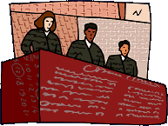
Common law tests
Employers take their employees as they find them
A perception of real events is all that is required to satisfy the test of an injury arising out of, or in the course, of employment
As long as the events are real (not imaginary), it doesn’t not matter that it’s interpreted due to flawed perceptions of the employee
If psychological injury follows from point 3, it is open to the Commission to establish causation
There is no legal basis to argue the employee’s perception passes a objective test.

Slide 5
HR Policy & Employment
Case example Mr Niklich (N), commenced employment with Goldman Sachs (G). His contract of empoyment contained a number of HR policies, including one being on bullying and harassment called “Working With Us“ (WWU).
After commencing his employment, clients were slowly reallocated to other staff members effecting his remuneration. In accoridnace with the WWU policy, N complained to his manager who essentially ignored the complaint.
Shortly after, N then took stress leave and eventually resigned. N then commenced proceedings for breach of contract arguing the WWU policy formed part of his employment contract and his employer breached his contract by failing to adhere to its own policy.
His honour found these breaches caused N to suffer a psychiatric injury, and awarded total damages of $515,869 for past lost income, loss of future income, and general damages.
The Full Federal Court confirmed the decision at first instance and stated both the employer and employee is required to:
“take every practicable step to provide and maintain a safe and healthy work environment for all people” and;
“The systems used to manage N’s complaint was unacceptable and in breach of the obligation to take every practicable step to provide and maintain a safe and healthy work environment”.

Slide 6
What is not bullying
There are five broad categories of behaviour that may not be considered workplace bullying:
Reasonable management action
Discrimination and harassment
Discriminatory, coercive or misleading conduct due to raising or acting on work health and safety issues
Workplace conflict
Workplace violence

Slide 7
What is not bullying
1. Reasonable management/administrative action (examples)
setting reasonable performance goals, standards and deadlines
allocating work and/or failure to promote after a fair process was instigated
rostering and allocating reasonable working hours
Restructuring and transferring a worker for operational reasons
informing a worker, objectively and confidentially, that their behaviour is inappropriate
informing a worker that their performance is unsatisfactory, after following established performance management guidelines
Case example
Recently, the Federal Court (FC) upheld an appeal by an employee (who had an existing stress-related depressive disorder) arguing that her employer was liable for their psychological condition.
After receiving a promotion, the employee’s illness was diagnosed and she took leave. Upon her return, she found her job had been restructured and the workload had increased. Following a group meeting, she had another meeting with her manager where he accused her of having a "negative attitude" and said:
"I don't see you having a role in corporate clients and possibly anywhere in the organisation".
The FC considered the phrase 'reasonable administrative action” and upheld the original finding by the tribunal. The Court held the employer's action was unreasonable due to the "tension-charged" nature of the one-on-one meeting the fact the employee was not given notice of the serious issues being raised. This means the meeting was causative of an aggravation of the Respondent's pre-existing condition.

Slide 8
What is not bullying
2. Discrimination and harassment
Discrimination generally occurs when someone is treated less favourably because of an unlawful matter. E.g. Race, gender, age, pregnancy. Etc.
Harassment involves unwelcome behaviour that intimidates, offends or humiliates someone because of a particular personal characteristic, such as age, race or gender. Unlike bullying, discrimination and harassment do not have to be repeated.
Case example
In the Kristy Fraser-Kirk case, she claimed $37 million in a sexual harassment case against the chief executive of David Jones, Mark McInnes for breach of contract.
This avoided the conciliation stages the tribunals require and meant the applicant could publicise it and bring pressure to bear in settling the case. Essentially apart from a statement of claim being filed, the matter was more of a media campaign which forced the board of David Jones to make way for a new CEO.
While Fraser-Kirk had sought up to $37 million in damages from David Jones, its board and McInnes, the case was settled late on Friday with a confidential payment of an estimated $850,000, of which it has been reported that the company will pay $470,000 and McInnes will pay the rest.

Slide 9
What is not bullying
3. Discriminatory, coercive or misleading conduct due to raising/acting on WHS issues
There are specific protections against discriminatory conduct for anyone who raises health and safety concerns or performs legitimate safety related functions.
4. Workplace Conflict
Workplace conflict is generally not considered as workplace bullying. Not all conflict is negative nor pose a risk to health and safety (WHS). Conflict can generate debate and lead to new ideas and innovative solutions. However, in some cases, conflict that is not properly managed may escalate to the point where it fits the criteria for workplace bullying. A single incident of unreasonable behaviour is not bullying, although it may have the potential to escalate into bullying. Single incidents can still create a risk to WHS.
5. Workplace Violence
Threats to harm someone, violence and damage to property are criminal matters that should be referred to the NSW Police. (NOTE Victoria’s Brodie’s Law)
Work related violence is also reportable to WorkCover NSW. Unlike bullying, an action does not need to be repeated to be considered violent.

Slide 10


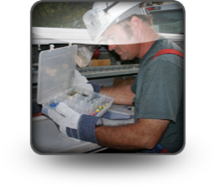

Duties and responsibilities
ACTIVITY
DUTIES
STANDARD
Primary Duty of Care
Other duties
Specific duty holders
REASONABLY PRACTICABLE
PCBU
Officers duty of care
Leadership & Governance
DUE DILIGENCE
OFFICER
Workers to take care of self and others
Includes supervisory role
REASONABLE CARE
WORKER
Other to take care of self and others
Follow instructions and report incidents
REASONABLE CARE
OTHERS at workplace

Slide 11
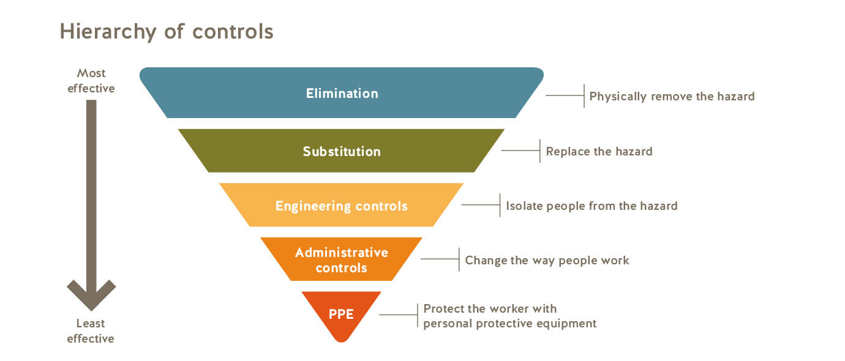
What is Reasonably Practicable
Courts and regulatory authorities will expect employers to assess the risk and use the hierarchy of controls to manage them
In working out what was reasonably practicable, courts will have regard to the cost of the control, the likelihood of it occurring and degree of harm that could occur if the risk eventuates into an illness or injury

Slide 12
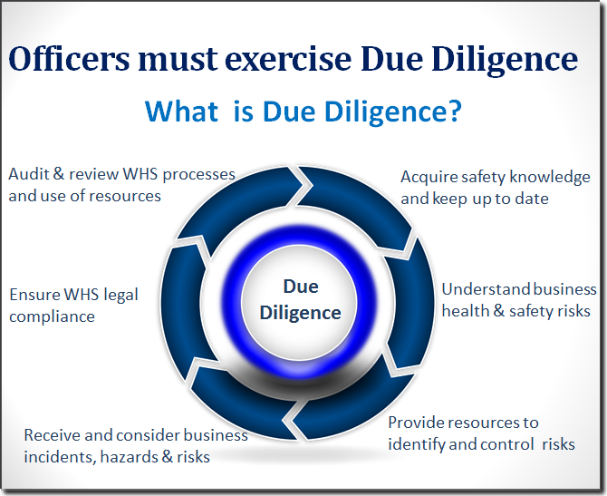
What is due diligence

Slide 13
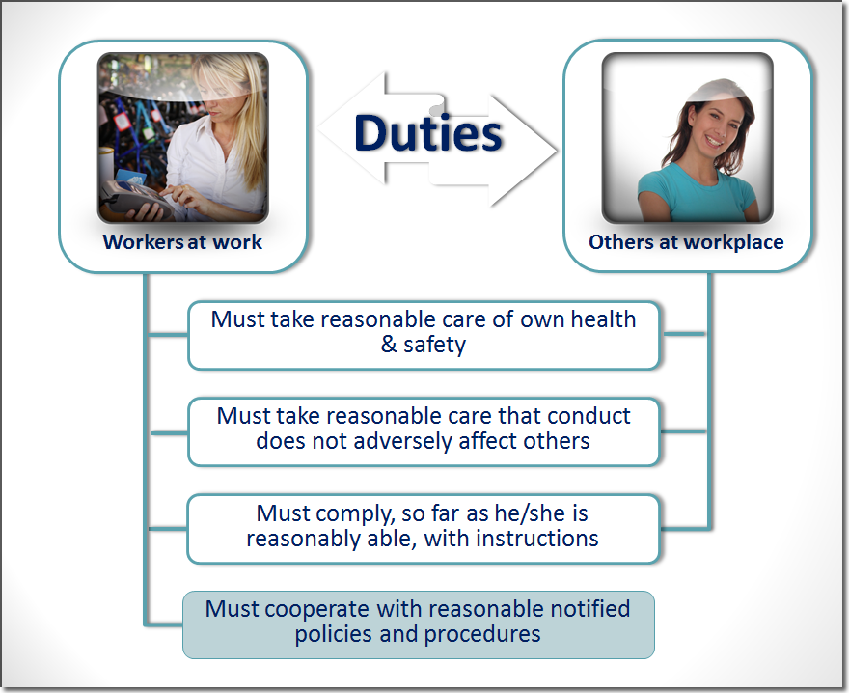
What responsibilities do workers and others have?

Slide 14
Maximum Penalties
 | Corporations | PCBU’s and Officers | Other Individuals
Category 1: Where a Court believes a person breached their duty of care under the legislation and the breach was considered as “Reckless Conduct”. | $3m | $600k / 5 years jail | 300k / 5 years jail
Category 2: Where a Court believes a person breaches a their duty of care and the risk of injury or illness for the breach was considered high. | $1.5m | $300k | $150k
Category 3: Occurs where a person breaches a general duty under the legislation: | $500k | $100k | $50k

Slide 15
Managerial Expectations
Respect for others
Take responsibility for your own actions
Never engage in activities which may encourage bullying or harassment
Take reasonable steps to stop bullying and harassment
Promptly investigate any allegations
Take seriously any reports or allegations
Publicise the bullying and harassment policy
Manage any allegation in a confidential manner

Slide 16
Employees Expectations
Respect for others
Take responsibility for your own actions
Never engage in activities which may encourage bullying or harassment
Co-operate with your manager
Report any instances of bullying and harassment
Obey all lawful instructions from your manager

