Slide 1
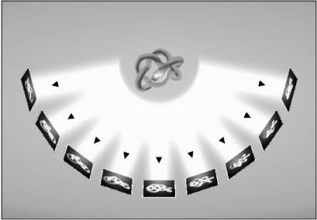
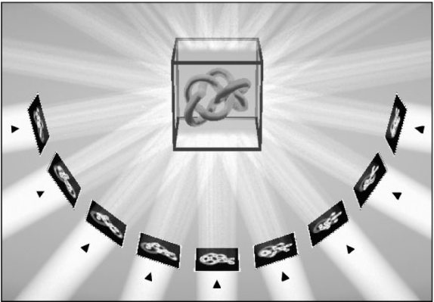

The basics of electron tomography
Oleg Abrosimov
get projection in the widest angular range ~
back-project projections
Notes:
Метод электронной томографии позволяет по набору электронно-микроскопических снимков, полученных при наклоне образца в широком угловом диапазоне, реконструировать исходный трехмерный объект. Это единственный прямой метод исследования внутреннего строения микрообъектов с разрешением в единицы нанометров.

Slide 2
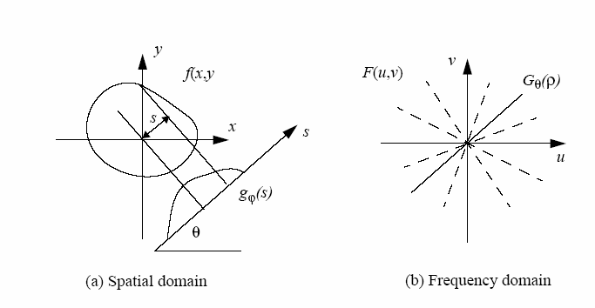
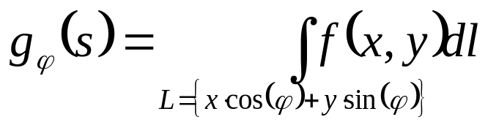
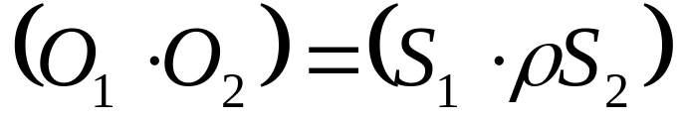

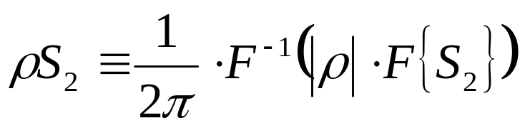
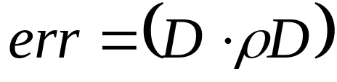
Some Math
object
The Radon transform:
shadow
the scalar multiplication of images is equal
to ro-scalar multiplication of shadows
the error calculation

Slide 3
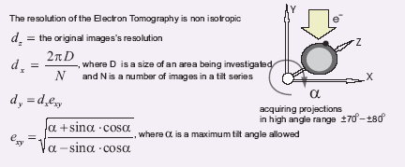
The spatial resolution
[Crowther, 1970]

Slide 4
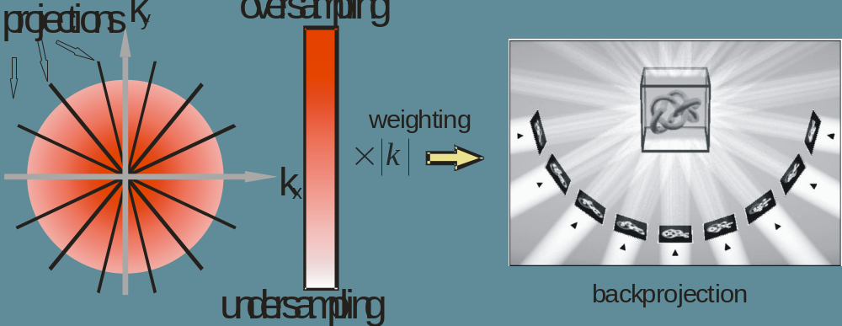
The Weighted Backprojection

Slide 5
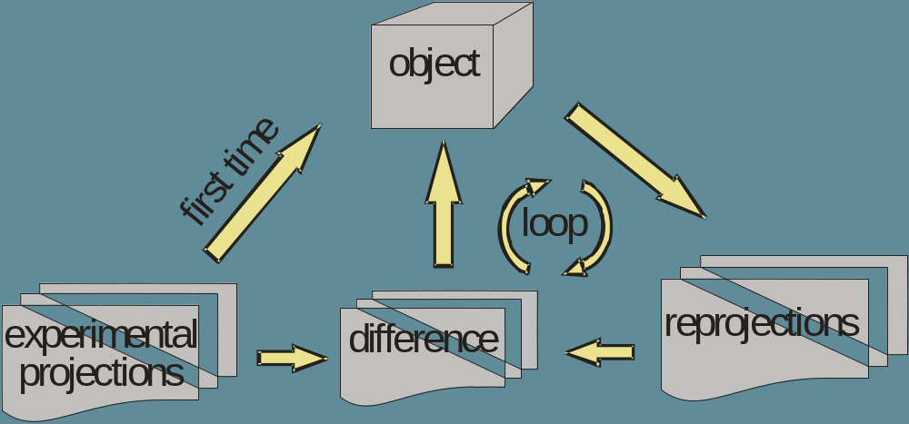
An iterative refinement

Slide 6
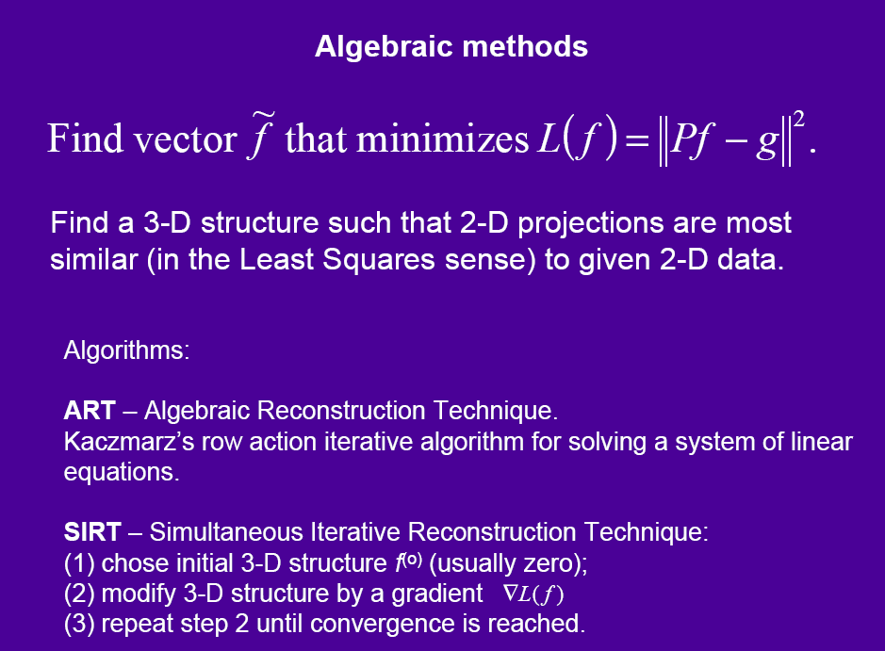

Slide 7
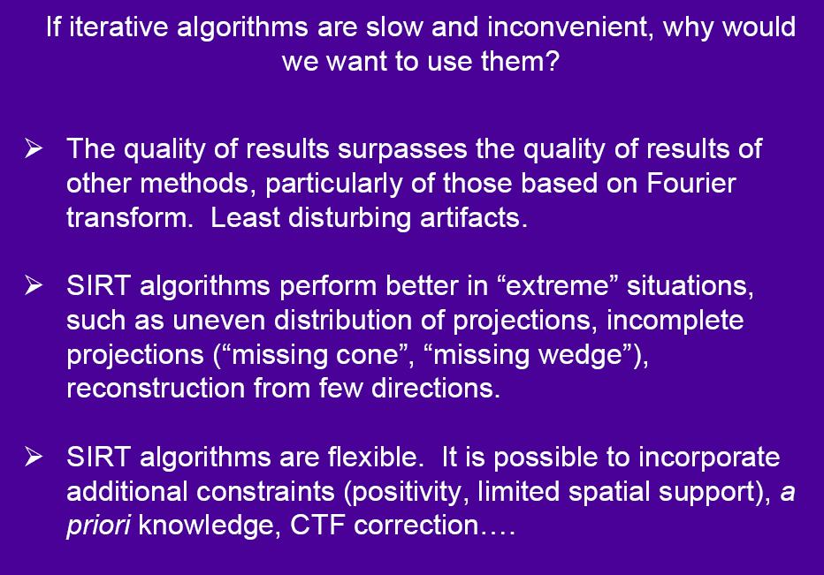

Slide 8
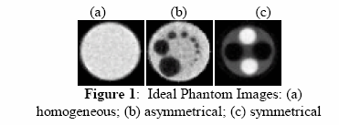
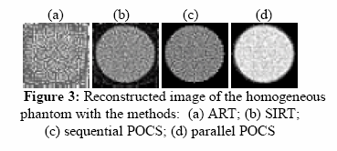
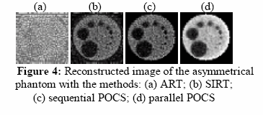
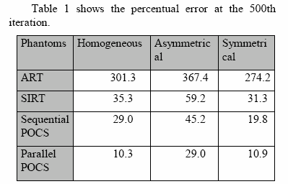
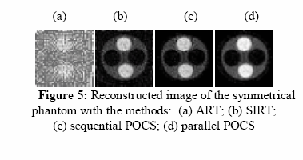
POCS stands for Projection onto Convex Sets

Slide 9
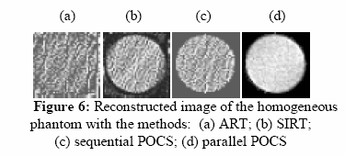
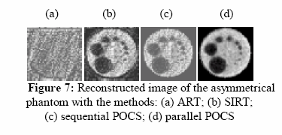
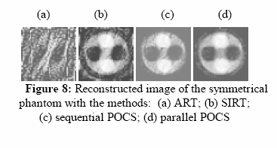
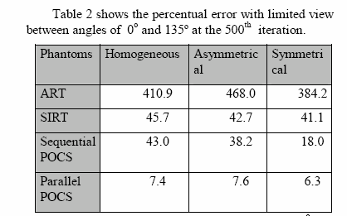

Slide 10



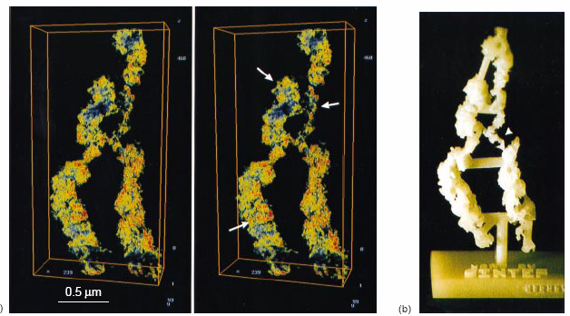
Maximum Entropy Method
-> min
It gives better results:

Slide 11
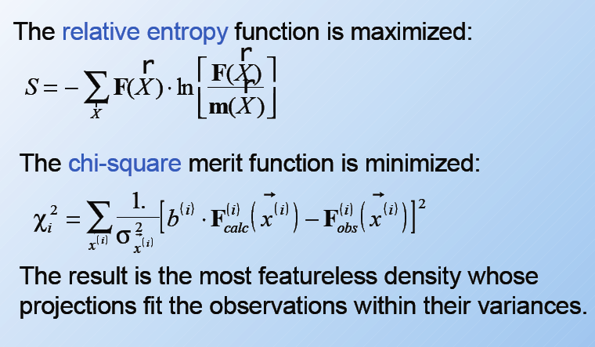
The Constrained Maximum Entropy Method

Slide 12
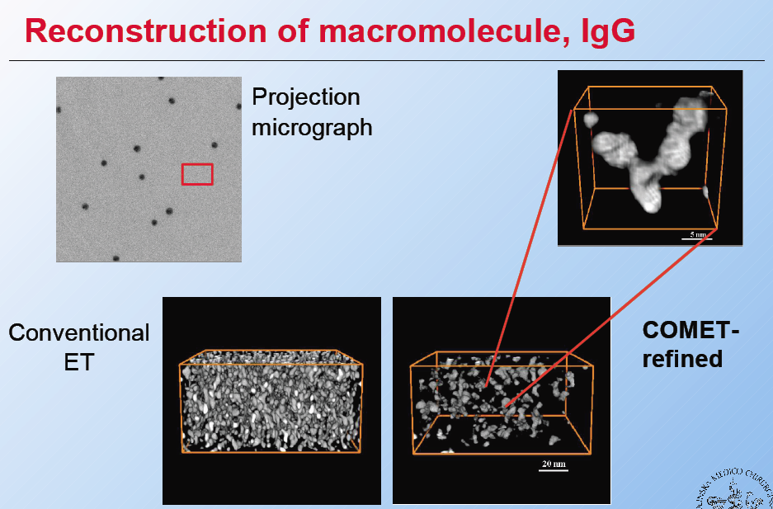

Slide 13
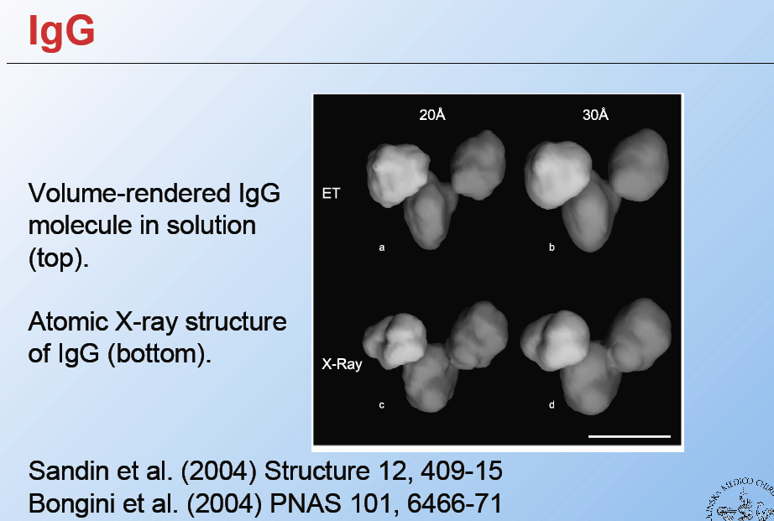

Slide 14
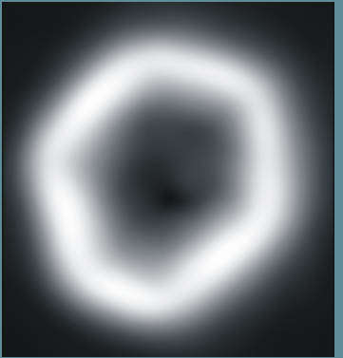
Alignment techniques
Cross-correlation + filters
Fiducial markers
Features based alignment
  The method is based on matching and tracking corner features
by hand…
low-pass + sobel
Sami Brandt, Helsinki University of Technology
Jukka Heikkonen, Helsinki University of Technology
Peter Engelhardt, University of Helsinki
Resume: alignment is challenging

Slide 15
The axis angle and position alignment
In order to find the axis’ angle one can sum up projections and optionally fourier transform it
by hand…

Slide 16
My plans for building a tomography package that just worksTM
Develop a flexible and extendable core
After this step we should be able to add any number of reconstruction or alignment algorithms without changing the core itself
It is crucial for success of the project

Slide 17
Iteration refined WBPJ
It is the simplest one reconstruction technique with reasonable speed and accuracy
We need to know what happens, that’s why we need the sources of algorithms in use
It is a base for future enhancements and comparisons
We need it for the fully automatic algorithm of projections and axis alignment by 3D optimization technique

Slide 18
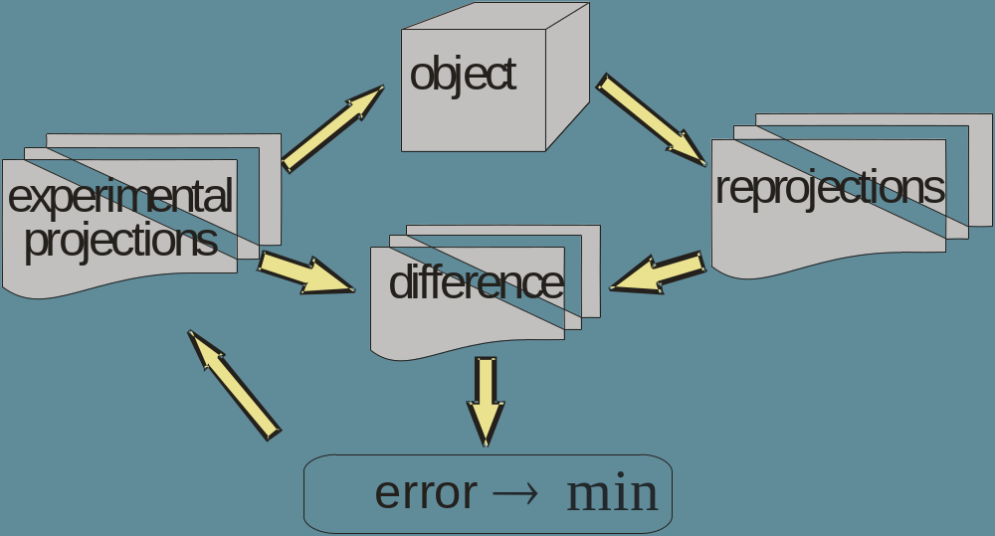
Automatic alignment algorithm
Implement the fully automatic algorithm of projections and axis alignment by 3D optimization technique
  Note: the coarse alignment should be already done
vary projections alignment
before the backprojection step

Slide 19
The parallel POCS algorithm
It gives very accurate reconstruction
  it is very flexible:
    it is possible to incorporate additional constrains:
      positivity
      a priori knowledge
      Contrast Transfer Function (CTF) correction
      …

Slide 20
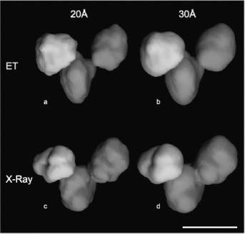
The Constrained Maximum Entropy Algorithm
It gives very good, noise free results
It can be a base for future enhancements in alignment algorithms

Slide 21
Coarse alignment procedures
filtering procedures
cross-correlation
integrate it with alignment by 3D optimization technique in order to build fully automatic alignment system

Slide 22
Parallelization
build parallel versions of all algorithms in order to distribute computations on any number of CPUs and GPUs

Slide 23
Contrast Transfer Function correction
We need it because of limited depth of focus with magnifications higher then x40000
But it works only for thin films and only in BF
  It is not very interesting for MS, but is absolutely needed for LS

Slide 24
After all we should have a system that just works and can be extended to the fully integrated solution for electron tomography

