Slide 1

PostgreSQL DB for DWH and ETL Building
PostgreSQL Database Architecture

Slide 2
Agenda
Roadmap
High-level overview
Logical Structure
Physical Structure

Slide 3
ROADMAP

Slide 4
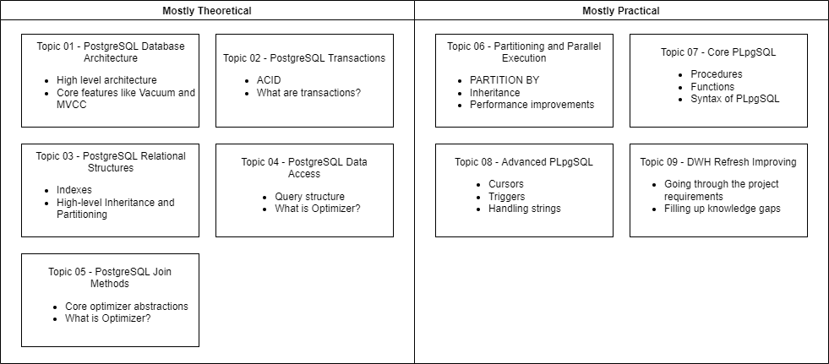
Roadmap
Notes:
Mostly theoretical are lectures that has theory that might not be applicable to their individual projects right now but are absolutely necessary for better PostgreSQL understanding.
Mostly practical topics have theory and are necessary for the project.

Slide 5
HIGH-LEVEL OVERVIEW

Slide 6
What is PostgreSQL?
PostgreSQL is a powerful, open-source object-relational database system that uses and extends the SQL language combined with many features that safely store and scale the most complicated data workloads.
Notes:
What is PostgreSQL?

Slide 7
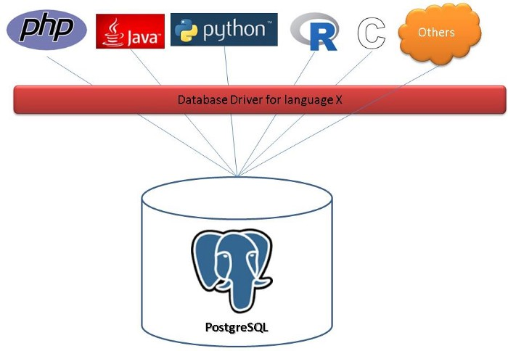
Client/server model
Notes:
PostgreSQL uses the client/server model to provide services. A PostgreSQL session consists of the two processes:
(1) A server-side process. This process manages the database files, accepts the connection between the client and the database, and operates the database on behalf of the client. The program name of this process is called postgres.
(2) Front-end applications, that is, client applications that require database operations. Client applications may be diverse in their own right: they can be a character interface tool, a graphical interface application, or a web server that displays web pages by accessing a database, or a special database management tool. Some client applications are provided with the PostgreSQL release, but most of them are developed by users.
Like a typical client/server application, the client and server can be on different hosts. At this time, they are connected via TCP/IP, you should keep this in mind, because the files that can be accessed on the client may not be accessible on the database server machine (or can only be accessed with a different file name).
The PostgreSQL server can handle multiple concurrent requests from the client. In order to handle this, it will start (“forks”) a new process for each request, and then the client and the new server process will no longer communicate directly through the original postgres process. Therefore, the main process on the server side has been running, waiting for the connection from the client; the client and the associated server-side process will only run when needed.

Slide 8
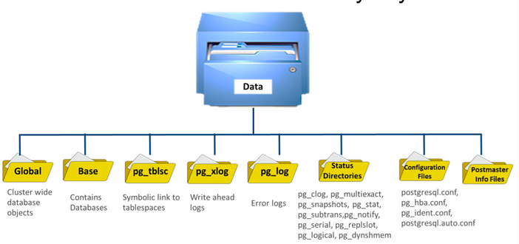
Database Cluster Data Directory Layout
Notes:
One instance of Postgres is known as a cluster
One cluster is on the disk known as a data directory.
All the data needed for a database cluster is stored within the cluster's data directory, commonly referred to as PGDATA.
Global contains cluster-wide database objects. we some files here each files some kind of tables or user info or metadata files which is related to the dictionary files or tables
Base is the main directory and contains DB, inside the directory, we can see DB directories and its one directory per DB
pg_tblsc is a directory that contains symbolic links to the tablespace locations, in case we have created the tablespace in our instance. Then link to the physical location of the tablespace
pg_wal contains transaction logs or wal segments. These files are binary-files
pg_log contains our start-up logs
Status Directories are the multiple directories that start with pg_*, a lot of status data and lots of transaction info, temporary statistic info. It is just required the information of the server and content of the directories are
temporary
PostgreSQL.conf — one of the most parameter files inside the Configuration Files directory

Slide 9
LOGICAL STRUCTURE

Slide 10
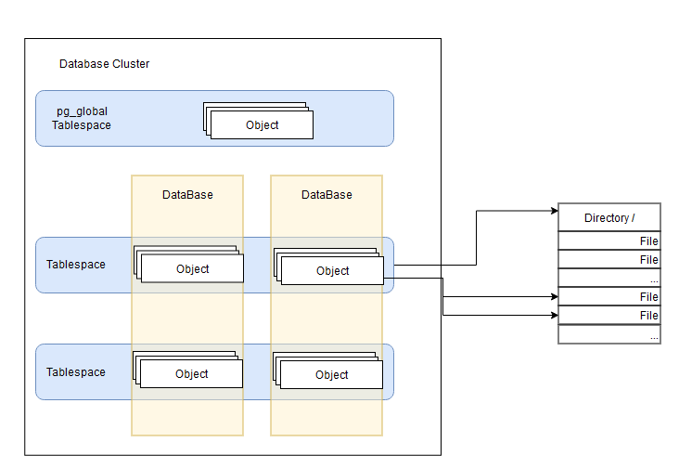
Database Cluster
Notes:
In PostgreSQL, if you have a working database, it means that you have a cluster. In PostgreSQL, a cluster refers to a set of databases, using the same configuration files, listening for requests at a common port. The databases belonging to the cluster use a common filesystem location. There is a common set of background processes and memory structures (such as shared buffers used by this set of databases).
It's possible to run multiple PostgreSQL clusters on a server (although not a recommended practice in production) as long as they are listening on different ports and have separate storage areas defined.
Every instance of a running PostgreSQL server manages one or more databases. Databases are therefore the topmost hierarchical level for organizing SQL objects (“database objects”).
All the database objects in PostgreSQL are internally managed by respective object identifiers (OIDs), which are unsigned 4-byte integers. The relations between database objects and the respective OIDs are stored in appropriate system catalogs, depending on the type of objects.
In PostgreSQL, tablespace is a link to a location in the filesystem, that is, a directory. It's a container to hold all other objects, such as tables, indexes, and so on.
Another important concept is the schema, which is a container or a namespace within a database. Any object that we create in a database (such as a table, an index, a view, and so on) gets created under a schema. We can use schemas to group together related objects within the same database.

Slide 11
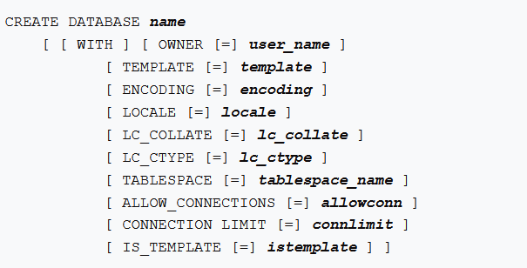

DATABASE
When connecting to the database server, a client must specify the database name
It's not possible to access objects in one database from another database directly
The first database “postgres” is always created by the initdb command
CREATE DATABASE actually works by copying an existing database. By default, it copies the standard system database named template1
Notes:
When connecting to the database server, a client must specify the database name in its connection request. It is not possible to access more than one database per connection. However, clients can open multiple connections to the same database, or different databases.
It's not possible to access objects in one database from another database directly. We can access other databases using a database link (or foreign data wrappers).
Since you need to be connected to the database server in order to create new database, the question remains how the first database at any given site can be created. The first database is always created by the initdb command when the data storage area is initialized. This database is called postgres. So, to create the first “ordinary” database you can connect to postgres.
CREATE DATABASE creates a new PostgreSQL database. To create a database, you must be a superuser or have the special CREATEDB privilege.
By default, the new database will be created by cloning the standard system database template1. A different template can be specified by writing TEMPLATE name. In particular, by writing TEMPLATE template0, you can create a pristine database (one where no user-defined objects exist and where the system objects have not been altered) containing only the standard objects predefined by your version of PostgreSQL. This is useful if you wish to avoid copying any installation-local objects that might have been added to template1.
Mandatory parameter name The name of a database to create.

Slide 12
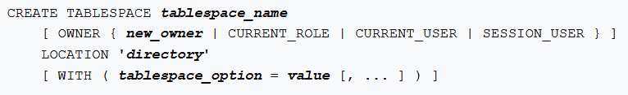
Tablespace
Tablespaces provide a physical separation of data
It’s a link to a location in the filesystem, that is, a directory
It’s an integral part of the database cluster and cannot be treated as an autonomous collection of data files
Two default tablespaces: pg_global, pg_default
Notes:
In PostgreSQL, tablespace is a link to a location in the filesystem, that is, a directory. It's a container to hold all other objects, such as tables, indexes, and so on.
When we initialized a cluster, two default tablespaces got created, one was a tablespace called pg_default. All objects which are created by users without specifying a tablespace will be created in the pg_default tablespace. The location for the default tablespace: pg_default is the base directory under PGDATA. The other one: pg_global holds the system tables shared by all the databases in the cluster.
There are many situations in which such a feature, storing data in a location other than the default location, could be useful. One scenario when we might want to use tablespaces is when we run out of space on the partition in which we initialized the database cluster. Another scenario could be that we know the usage patterns of different databases/objects and want to move specific objects to a different disk for performance reasons. A set of frequently and heavily accessed objects could be created in a tablespace that is located on a fast disk, or a database supporting a transactional system can be on a fast disk, whereas one supporting a data warehouse/reporting system, with a more relaxed response time requirement, can be on a slower disk.
Even though located outside the main PostgreSQL data directory, tablespaces are an integral part of the database cluster and cannot be treated as an autonomous collection of data files. They are dependent on metadata contained in the main data directory, and therefore cannot be attached to a different database cluster or backed up individually. Similarly, if you lose a tablespace (file deletion, disk failure, etc.), the database cluster might become unreadable or unable to start. Placing a tablespace on a temporary file system like a RAM disk risks the reliability of the entire cluster.
CREATE TABLESPACE — define a new tablespace. The tablespace name must be distinct from the name of any existing tablespace in the database cluster.
The directory must exist (CREATE TABLESPACE will not create it), should be empty, and must be owned by the PostgreSQL system user. The directory must be specified by an absolute path name.

Slide 13
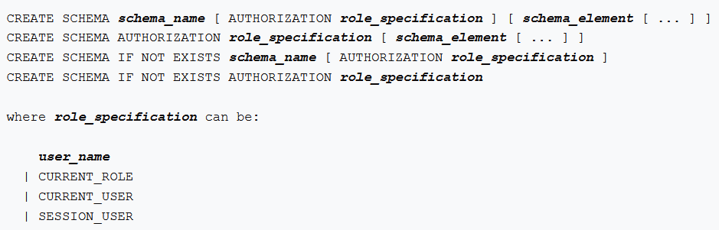
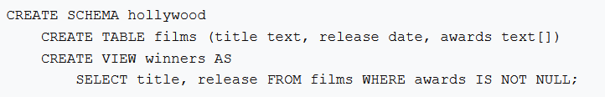
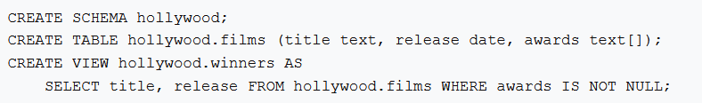
Schema
Schemas provide a logical separation of data
Access objects in different schemas from the same connection
Public is default schema
By default, users cannot access any object in schemas they do not own
Notes:
Another important concept is the schema, which is a container or a namespace within a database. Any object that we create in a database (such as a table, an index, a view, and so on) gets created under a schema. We can use schemas to group together related objects within the same database. To some extent, these can be associated to the concept of databases in MySQL. We can access objects in different schemas from the same connection. When we create objects without specifying the schema, they get created under a default schema called public.
PostgreSQL uses a setting called search_path to figure out where it should search for the object the user is trying to access.
By default, users cannot access any object in schemas they do not own. To allow users to make use of the objects in other schemas, additional privileges (for example, SELECT and UPDATE on tables) must be granted, as appropriate for the object.
Unlike databases, schemas are not rigidly separated: a user can access objects in any of the schemas in the database, assuming that the user has privileges to do so.
CREATE SCHEMA enters a new schema into the current database. The schema name must be distinct from the name of any existing schema in the current database.

Slide 14
PHYSICAL STRUCTURE

Slide 15
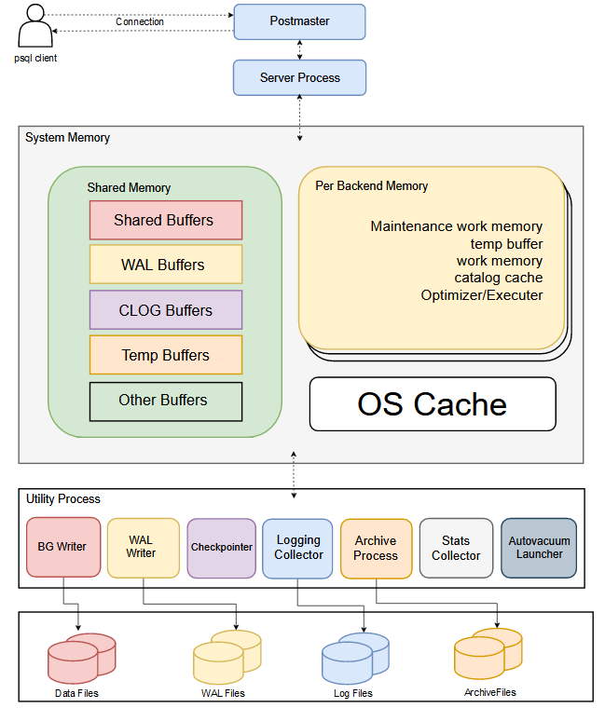
Physical Structure
Notes:
The database frontend application can perform any database action. The frontend can be a web server that wants to display a web page or a command-line tool that does maintenance tasks. PostgreSQL provides frontend tools such as psql, createdb, dropdb, and createuser and so on.
The server process manages database files, accepts connections from client applications, and performs actions on behalf of the client. The server process name is “postgres”. The main server process forks a new process for each new connection. Therefore, client and server processes communicate with each other without the intervention of the main server process. In addition, these new processes have a certain lifetime, which is determined by accepting and terminating a client connection.

Slide 16
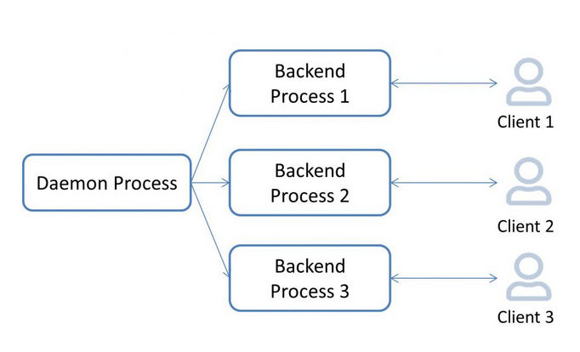
Postmaster(Daemon) Process
Notes:
Postmaster(Daemon) is the first process which gets starts when the Postgres cluster starts. The postmaster process acts as a supervisor. Postmaster act as a listener at a server-side, any new connection coming in, it will first connect to the postmaster and every time for every connection postmaster creates “postgres” process. It’s obvious that the daemon itself is a mandatory process that should be running in order for a user to connect to the database.
The backend process will, on successful authentication, start handling requests from that client. Similarly, the process is repeated for all connection requests (unless we hit the max_connections settings, in which case we get an error). As a result, an active server, after a period of time, will have the processes that were there when the server started, plus quite a few processes to serve client connections.

Slide 17
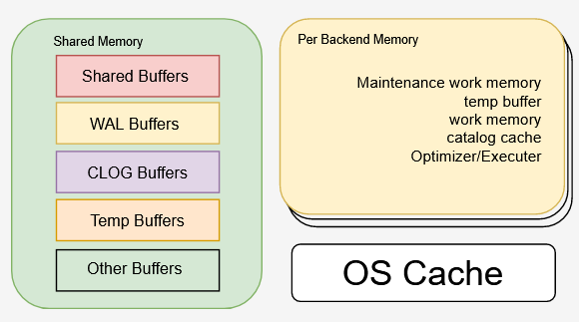
Memory And Buffers
Notes:
Shared Memory: Shared Memory refers to the memory reserved for database caching and transaction log caching. This area is used by all processes of a PostgreSQL server. When the server gets started, it occupies some of the memory from the RAM. Depending upon the various parameters like shared_buffers, wal_buffers, etc.
Once a user is connected to a database, the user typically wants to read (SELECT) data or write (UPDATE/DELETE/INSERT) data, not to mention making changes to table structure, adding indexes, and so on.
When there are thousands of users trying to read/write data to many different tables, reading from the directories/files (which we saw getting created when we installed PostgreSQL and created a database with a couple of tables) will result in a miserably non-scalable system. To make this a lot more scalable and faster, the concept of shared buffers (memory area) is introduced.
It's not this memory chunk alone that is responsible for improving the response times, but the OS cache also helps quite a bit by keeping a lot of data ready-to-serve. Together, these two caches result in a significant reduction in the actual number and volume of physical reads and writes. In addition to these two levels of caching, there could be a disk controller cache, disk drive cache, and so on. The bottom line is that these caches improve performance by reducing the physical I/O necessary.
The first thing the process will check is whether the data it wants is available in the database buffer cache. If it is not available in the database buffer cache, a request goes to the OS to fetch the specific file/block(s). There is a chance that the OS cache already has the file/block(s) and passes it to the database cache. In both these cases, a physical I/O is avoided. It's only when the data is not present in either of these caches (or other caches), that a user initialized read/write will really result in a physical I/O.
Process Memory or Backend Memory is allocated by each backend process for its own use. It is temporarily used privately by each Postgres process. By default, each session will take size of 4Mb. Eg.: If there are 100 sessions, then they will consume 400 Mb.
Work Memory: This is the amount of memory reserved for either a single sort or hash table operation in a query. A sort operation could be one of an ORDER BY, DISTINCT, or Merge join and a hash table operation could be due to a hash-join, hash-based aggregation, or an IN subquery. A single complex query may have any numbers of such sort or hash table operations, and as many chunks of memory allocations defined by the work_mem parameter will be created for each of those operations in a user connection.
Maintenance Work Memory: This is the maximum amount of memory allocation of RAM consumed for maintenance operations. A maintenance operation could be one of the VACUUM, CREATE INDEX, or adding a FOREIGN KEY to a table.
Temp Buffers: A database may have one or more temporary tables, and the data blocks (pages) of such temporary tables need a separate allocation of memory to be processed. The temp buffers defined by the temp_buffers parameter. The temp buffers are only used for access to temporary tables in a user session.

Slide 18
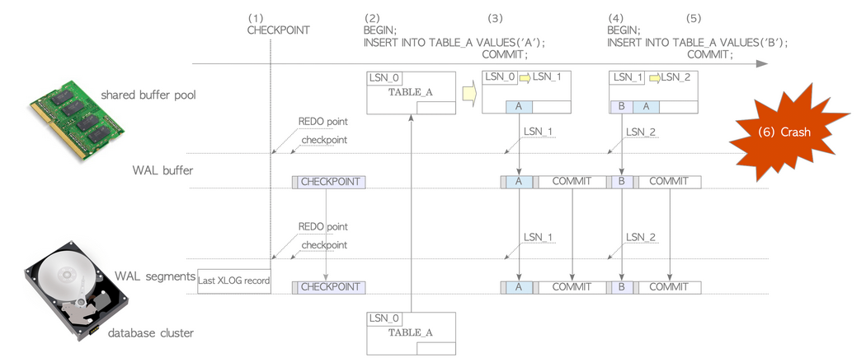
WRITE-AHEAD LOG (WAL)
WAL ensuring the Durability (D) and Atomicity (A) of ACID properties of transactions.
Also is used for:
Recovery
Incremental backup and point-in-time recovery
Replication
Notes:
The WAL writer process writes the WAL cache on the shared memory to the disk at an appropriate point in time. This way, you can reduce the pressure on the back-end process when writing its own WAL cache and improve performance. The core idea of ​​the write-ahead log is that the modification of the data file must only occur after these modifications have been recorded in the log, that is, the log is written first and then the data is written (log first). Using this mechanism can avoid frequent data writing to the disk and can reduce disk I/O. The database can use these WAL logs to recover the database after a downtime restart.
Recovery is the primary purpose of the WAL concept. Here, we are referring to recovering transactions that have been committed, but have not found their way to the data files. All the changes made to the database will find their way into the WAL segments, irrespective of whether the changes have been reflected into the data files or not. In fact, it's mandatory that changes have been written to WAL files before they are written to the data files themselves. Loss of WAL files almost certainly means lost transactions.
We can take a snapshot of the PostgreSQL filesystem and then set up a WAL archival process. The snapshot taken need not be a consistent one. The WAL segments generated will keep getting archived and we can use the snapshot and the archived WAL segment to perform a point-in-time recovery. In this process, we restore the file snapshot, and then replay the WAL segments until a specific point in time or until a transaction.
WAL segments are used for replication also. The rationale is simple. All the changes happening in the server are being recorded in the WAL segments anyway.
WAL also reduces the number of disk writes necessary to guarantee that a transaction is committed, thus improving performance. This is achieved because WAL writes are sequential. If a number of small transactions are committed, they will appear sequentially in the log. If the database were to work without WAL, a transaction commit will immediately result in writing data out to all the data files that were affected by the transaction.

Slide 19
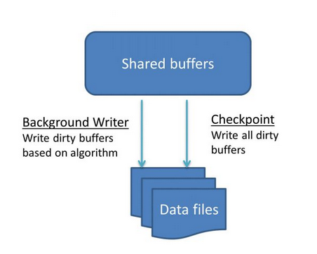
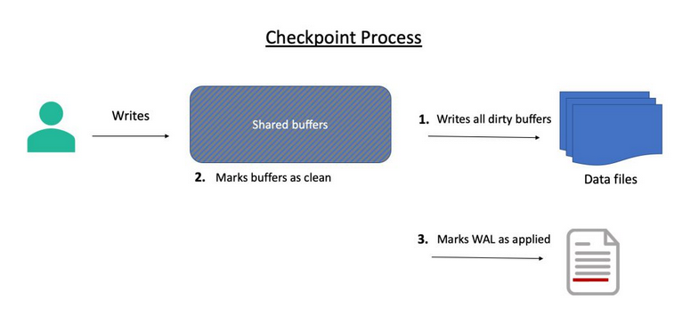
Background and Checkpoint Process
Notes:
The background writer is responsible for writing to disk specific dirty buffers based on an algorithm, whereas checkpointer writes all dirty buffers. The process takes into consideration shared memory usage data as well as information about which blocks have been used/accessed recently (least recently used). The primary objective of this process is to ensure that free buffers are available for use.
Checkpoint is a mandatory process. Once a user makes changes to the data (which has been made available in the buffer), that buffer is dirty. The fact that a user has committed a change does not mean that the change has been written to the data file. It’s the job of the checkpointer process to write the change to the data file. The checkpointer writes all dirty (modified) pages to the table and index files. The process also marks the pages as clean. It also marks the write-ahead log as applied up to this point.

Slide 20
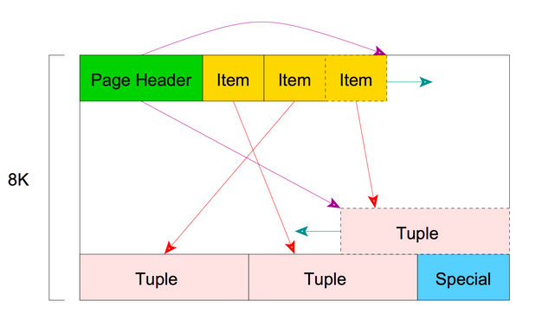
Physical Storage
Database stored together within the cluster's data directory
Tables are stored in a separate file (1Gb max file size)
The System tables in a pg_catalog schema
Rows are stored in a page
Page structure
Notes:
The data files used by a database cluster are stored together within the cluster's data directory, commonly referred to as PGDATA (after the name of the environment variable that can be used to define it). PGDATA can have different location base on your OS or installation.
Each table is stored in a separate file. For ordinary relations, these files are named after the table or index's filenode number, which can be found in the column relfilenode of the table pg_class. pg_class is system table which exist in the pg_catalog schema. When a table exceeds 1 GB, it is divided into gigabyte-sized segments. The first segment's file name is the same as the filenode; subsequent segments are named filenode.1, filenode.2, etc. This arrangement avoids problems on platforms that have file size limitations.
It's interesting to know that there is a system catalog schema which contains tables that you may want to query to find extra information. Each database contains a pg_catalog schema, which contains the system tables and all the built-in data types, functions, and operators. pg_catalog is always effectively part of the search path, so you don't need to use the prefix when you query the system tables.
Every table stored as an array of pages of a fixed size (usually 8Kb). In a table, all the pages are logically equivalent, so a particular item (row) can be stored in any page.
The structure used to store the table is a heap file. Heap files are lists of unordered records of variable size. The heap file is structured as a collection of pages (or block), each containing a collection of items. The term item refers to a row that is stored on a page.
It contains some headers which we are not going to cover, but they provide info about checksum, start of free space, end of free space, ... Items after the headers is an array identifier composed of (offset, length) pairs pointing to the actual items.
Because an item identifier is never moved until it is freed, its index can be used on a long-term basis to reference an item, even when the item itself is moved around on the page to compact free space. A Pointer to an item is called CTID (ItemPointer), created by PostgreSQL, it consists of a page number and the index of an item identifier.
The items themselves are stored in space allocated backwards from the end of unallocated space. To summarize, inside a page the pointers to the row are stored at the starts and the tuples (rows) are stored at the end of the page.

Slide 21
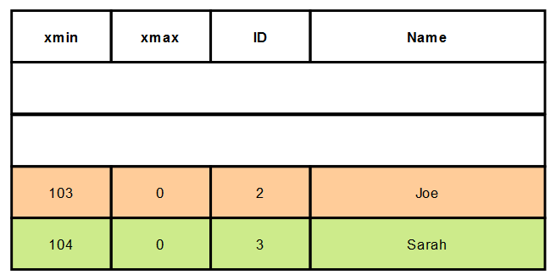
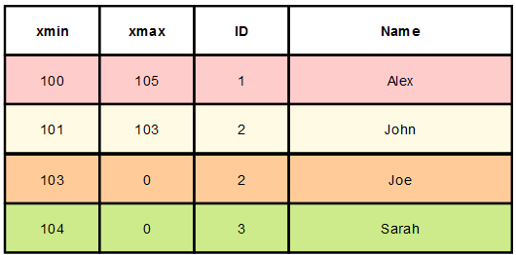
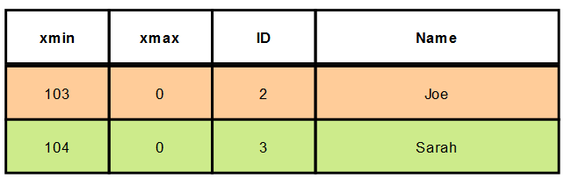
VACUUM and AUTOVACUUM
VACUUM
waste
VACUUM
FULL
Notes:
More about this in the next lecture. Assume that we delete a few records from a table. PostgreSQL does not immediately remove the deleted tuples from the data files. These are marked as deleted. Similarly, when a record is updated, it's roughly equivalent to one delete and one insert. The previous version of the record continues to be in the data file. Each update of a database row generates a new version of the row. The reason is simple: there can be active transactions, which want to see the data as it was before. As a result of this activity, there will be a lot of unusable space in the data files. After some time, these dead records become irrelevant as there are no transactions still around to see the old data. However, as the space is not marked as reusable, inserts and updates (which result in inserts) happen in other pages in the data file.
VACUUM will visit all of the pages that potentially contain modifications and find all the dead space. The free space that's found is then tracked by the free space map (FSM) of the relation. Note that VACUUM will, in most cases, not shrink the size of a table. Instead, it will track and find free space inside existing storage files. Vacuum does not lock the table.
VACUUM FULL, in addition to marking the space as reusable, removes the deleted or updated records and reorders the table data. This requires an exclusive lock on the table.
Autovacuum automates the vacuum process. It's recommended to have the autovacuum process do the cleanup of the data files unless there are specific reasons not to. In cases where the database is under heavy load for most part of the day.

Slide 22
Q & A

