Slide 1

PostgreSQL DB for DWH and ETL Building
PostgreSQL Data Access and Query Optimizer

Slide 2
Agenda
The Path of a Query
Explain Plan And Data Access
Adding Data with INSERT and COPY.

Slide 3
THE PATH OF A QUERY

Slide 4
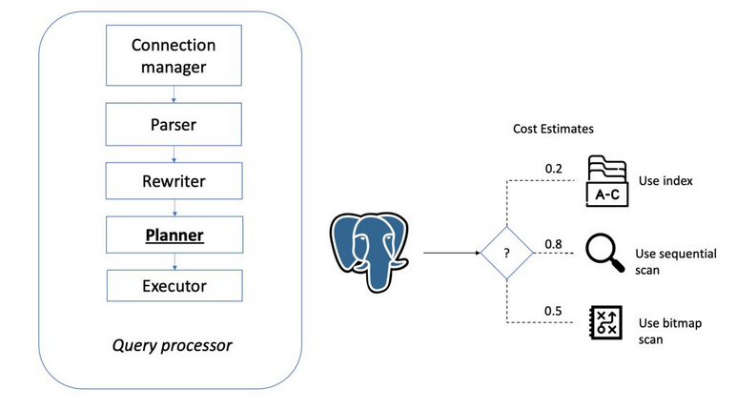
Query processor
Notes:
PostgreSQL query execution involves the following four key components:
Parser: This performs syntax and semantic checking of the SQL string
Rewriter: This changes the query is some cases; for example, if the query is against a view, the rewriter will modify the query so that it goes against the base tables instead of the view
Planner: This key component comes up with a plan of execution
Executor: This executes the plan generated by the planner
Here we give a short overview of the stages a query has to pass in order to obtain a result:
A connection from an application program to the PostgreSQL server has to be established.
The parser stage checks the query transmitted by the application program for correct syntax and then creates a query tree.
The rewrite system takes the query tree created at the parser stage and looks for any rules (stored in the system catalogs) to apply them to the query tree. It performs the transformations given in the rule bodies. One application of the rewrite system is in the creation of views. Whenever a query is executed against a view (i.e., a virtual table), the system rewrites the query in order to access base tables instead.
The planner/optimizer takes the (rewritten) query tree and creates a query plan that will be the input to the executor. It does so by first creating all possible paths leading to the same result. For example, if there is an index on a relation to be scanned, there are two paths for the scan. One possibility is a simple sequential scan and the other possibility is to use the index. Next, the cost for the execution of each path is estimated and the cheapest path is chosen. The cheapest path is expanded into a complete plan that the executor can use.
The executor recursively steps through the plan tree and retrieves rows in the way represented by the plan. The executor makes use of the storage system while scanning relations, performs sorts and joins, evaluates qualifications and finally hands back the rows.

Slide 5
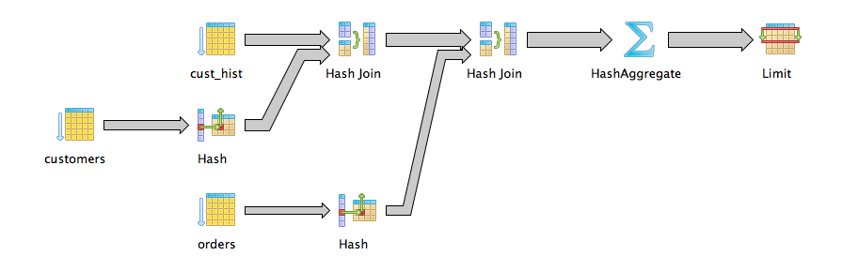
Planner/Optimizer
Notes:
The task of the planner/optimizer is to create an optimal execution plan. A given SQL query (and hence, a query tree) can be actually executed in a wide variety of different ways, each of which will produce the same set of results. If it is computationally feasible, the query optimizer will examine each of these possible execution plans, ultimately selecting the execution plan that is expected to run the fastest.
The planner's search procedure actually works with data structures called paths, which are simply cut-down representations of plans containing only as much information as the planner needs to make its decisions. After the cheapest path is determined, a full-fledged plan tree is built to pass to the executor.
The planner/optimizer starts by generating plans for scanning each individual relation (table) used in the query. The possible plans are determined by the available indexes on each relation. There is always the possibility of performing a sequential scan on a relation, so a sequential scan plan is always created.
If the query requires joining two or more relations, plans for joining relations are considered after all feasible plans have been found for scanning single relations.
When the query involves more than two relations, the final result must be built up by a tree of join steps, each with two inputs. The planner examines different possible join sequences to find the cheapest one.
The planner preferentially considers joins between any two relations for which there exist a corresponding join clause in the WHERE qualification (i.e., for which a restriction like where rel1.attr1=rel2.attr2 exists). Join pairs with no join clause are considered only when there is no other choice, that is, a particular relation has no available join clauses to any other relation. All possible plans are generated for every join pair considered by the planner, and the one that is (estimated to be) the cheapest is chosen.
The finished plan tree consists of sequential or index scans of the base relations, plus nested-loop, merge, or hash join nodes as needed, plus any auxiliary steps needed, such as sort nodes or aggregate-function calculation nodes.

Slide 6
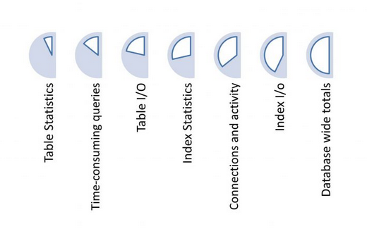
Statistics
The database statistics are exposed using views. The fastest way to spot performance issues is by using the pg_stats view
Particularly valuable statistics to monitor include table/index caching and query index usage statistics.
Statistics can help you find and sort the queries that are responsible for most of the load on the system.
Selectivity - it’s the proportion of rows from a relation that an operation will return.
Notes:
One very significant input to deciding which plan to use is the statistics the planner collects.
These statistics allow the planner to estimate how many rows will be returned after executing a certain part of the plan, which then influences the kind of scan or join algorithm which will be used. They are collected / updated mainly by running ANALYZE or VACUUM.
These statistics are stored by the planner in pg_class and in pg_statistics. Pg_class basically stores the total number of entries in each table and index, as well as the number of disk blocks occupied by them. Pg_statistic stores statistics about each column like what % of values are null for the column, what are the most common values, histogram bounds etc.
Most queries retrieve only a fraction of the rows in a table, due to WHERE clauses that restrict the rows to be examined. The planner thus needs to make an estimate of the selectivity of WHERE clauses, that is, the fraction of rows that match each condition in the WHERE clause.

Slide 7
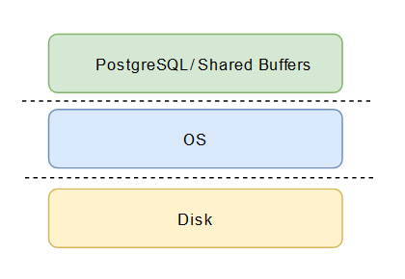
Caching
PostgreSQL caches the following:
Data in tables
Indexes
Query execution plans
Notes:
PostgreSQL caches the following for accelerating data access:
Data in tables
Indexes
Query execution plans
While the query execution plan caching focus is on saving CPU cycles; caching for Table data and Index data is focused to save costly disk I/O operation.
PostgreSQL lets users define how much memory they would like to reserve for keeping such cache for data. The relevant setting is shared_buffers in the postgresql.conf configuration file. The finite value of shared_buffers defines how many pages can be cached at any point of time.
As a query is executed, PostgreSQL searches for the page on the disk which contains the relevant tuple and pushes it in the shared_buffers cache for lateral access. Next time the same tuple (or any tuple in the same page) needs to be accessed, PostgreSQL can save disk IO by reading it in memory.
At a high level, PostgreSQL follows LRU (least recently used) algorithm to identify the pages which need to be evicted from the cache. In other words, a page which is accessed only once has higher chances of eviction (as compared to a page which is accessed multiple times), in case a new page needs to be fetched by PostgreSQL into cache.
The second time you run the query, you should notice at least a 10% performance speed increase. This represents hot cache behavior, meaning that the data needed for the query was already in either the database or OS caches. It was left behind in the cache from when the data was loaded in the first place. Whether your cache is hot, or cold (not in the cache), is another thing to be very careful of. If you run a query twice with two different approaches, the second will likely be much faster simply because of caching, regardless of whether the plan was better or worse.

Slide 8
EXPLAIN PLAN AND DATA ACCESS

Slide 9
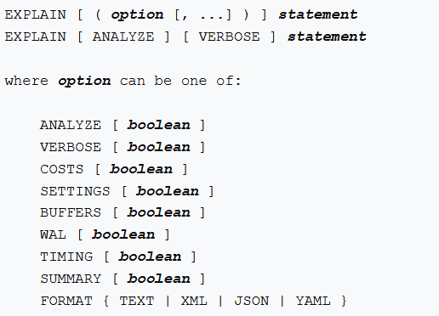
EXPLAIN Command
displays the execution plan that the PostgreSQL planner generates for the supplied statement
ANALYZE option causes the statement to be actually executed, not only planned
VERBOSE option display additional information regarding the plan
EXPLAIN can be also used for the UPDATE, DELETE, and INSERT statements
pg_statistic data should be up-to-date for all tables used in the query
Notes:
Now, we know that the planner has quite a few decisions to make and that these decisions will ultimately decide the execution time as well as consumption of resources (CPU, memory, and disk I/O).
How do we know what decision the planner will take? We can use the EXPLAIN command to find out the possible (note that it's possible) execution plan. To use EXPLAIN, we have to just prefix the EXPLAIN word to the SQL statement we want to execute
This command displays the execution plan that the PostgreSQL planner generates for the supplied statement. The execution plan shows how the table(s) referenced by the statement will be scanned — by plain sequential scan, index scan, etc. — and if multiple tables are referenced, what join algorithms will be used to bring together the required rows from each input table.
The most critical part of the display is the estimated statement execution cost, which is the planner's guess at how long it will take to run the statement.
The ANALYZE option causes the statement to be actually executed, not only planned. Then actual run time statistics are added to the display, including the total elapsed time expended within each plan node (in milliseconds) and the total number of rows it actually returned. This is useful for seeing whether the planner's estimates are close to reality.
VERBOSE will report the planner’s activities down to the columnar level.
In order to allow the PostgreSQL query planner to make reasonably informed decisions when optimizing queries, the pg_statistic data should be up-to-date for all tables used in the query.
EXPLAIN can be also used for the UPDATE, DELETE, and INSERT statements. To avoid data changes when you do this, use the following command:
BEGIN;
EXPLAIN ANALYZE ...;
ROLLBACK;

Slide 10
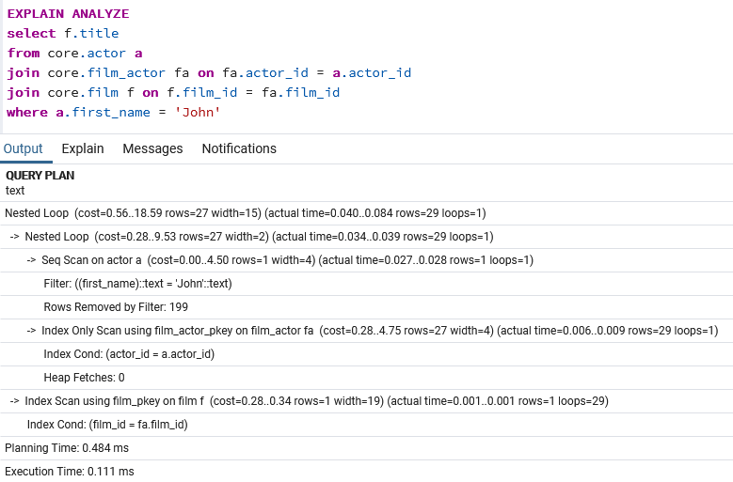
Reading the plan
Read from bottom to top
Filter, meaning a filter is being applied
Costs are estimates of the effort a node will take
rows is an estimate of the number of records the node will return
Notes:
The query plan should be read from most indented to least intended: from bottom to top. Each line with cost/rows/width is a node. The inner (child) nodes feed the outer (parent) nodes.
Let's look at each word/number and see what it means. The first part in the fourth line says Filter, meaning a filter is being applied. The data type is also mentioned. The first part of the previous line says Seq Scan on actor. The table will be scanned in a sequential manner to get the relevant records.
Then, we have cost. Costs are estimates of the effort a node will take. It's calculated in terms of a few variables (such as page reads and operator evaluations), based on the total data size and estimates of the number of rows that will be fetched.
Each cost entry has two parts: a startup cost and a total cost. Unless it's a really heavy query, startup costs for the innermost nodes are likely to be zero or close to zero. Startup cost is the work to be done to get the first row. For parent nodes, the startup cost will be close to the total cost of the child nodes, implying that the child node has to finish for the parent node to start processing data. This also means that the total cost of a parent node will be the total cost of the child nodes plus the node-specific cost of the parent itself.
The next entry: rows is an estimate of the number of records the node will return. The third entry: width is the estimated average width (in bytes) of each row.

Slide 11
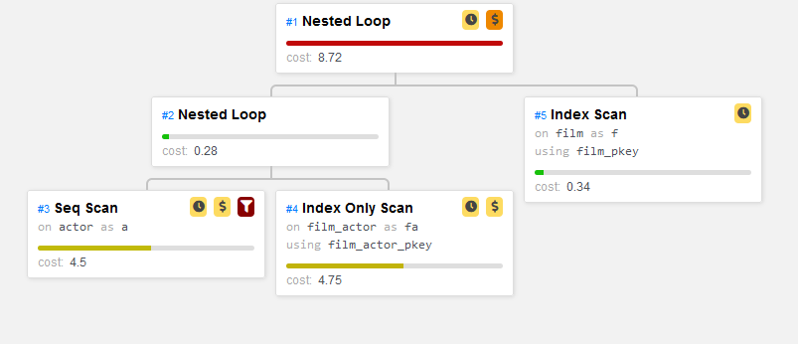
Access methods
Sequential scan (Seq Scan)
Index Scan
Bitmap heap and index scans

Slide 12
Sequential Scan Access Method
Scans the entire relation table as stored on disk.
For the seq scan to be used at-least below criteria should match :
No Index available on key, which is part of the predicate.
Majority of rows are getting fetched as part of the SQL query.
Must read through all the dead rows in a table, but will not include them in its output
Requires a single IO for each row. Read by pages.
Notes:
The Seq Scan operation scans the entire relation (table) as stored on disk.
You can expect a Seq Scan when there isn't a useful index, or when such a large portion of the table is expected to be returned so that using an index would just add needless overhead. They'll also be used when there is only a very small amount of data to access; the index overhead is disproportionately large if the table takes up only a few pages on disk.
Note that a Seq Scan must read through all the dead rows in a table, but will not include them in its output. It's therefore possible for their execution to take much longer than would be expected to produce all the required output if the table has been badly maintained and is quite bloated with dead rows.
So a sequential scan requires a single IO for each row - or even less because a page on the disk contains more than one row, so more than one row can be fetched with a single IO operation.

Slide 13
Index Scan Access Methods
Index Scan
Fetch data from index related data structure
Get the TID of corresponding data in heap
The corresponding heap page is directly accessed to get whole data
Index Only Scan
Fetch data from index related data structure
Notes:
Unlike Sequential Scan, Index scan does not fetch all records sequentially.
An index is just references to the rows in a table, stored in a data structure (usually a B-tree) based on their values in the indexed columns.
An index scan reads through the index and uses it to quickly look up the rows that match your filter (something like WHERE x > 10), and return them in the order they’re stored in the index.
Postgres then goes to look up the data in these rows from the table, in the heap, where it would have found them if it had done a sequential scan.
It checks that they are visible to the current transaction for example they haven’t been deleted or replaced by a newer version — and passes them on to the next operation.
An index scan requires several IO operations for each row (look up the row in the index, then retrieve the row from the heap).
Index Only Scan is similar to Index Scan except for the second step i.e. as the name implies it only scans index data structure. There are two additional pre-condition in order to choose Index Only Scan compare to Index Scan:
Query should be fetching only key columns which are part of the index. You’d only index the columns that you want to filter or sort on — the ones you use in ORDER BY or WHERE clauses or, in certain circumstances, a JOIN condition.
All records on the selected heap page should be visible.
Not every index type in Postgres supports index-only scans. Some, for example GIN indexes, don’t store all the underlying data that they index, so retrieving row data is impossible.

Slide 14
Bitmap Access Method
Is multi-step process that consist of :
Bitmap Index Scan:
Fetches all index data from the index data structure
Creates a bit map of all TID
Bitmap Heap Scan:
Reads through bitmap of pages
Scans data from heap corresponding to stored page and offset
Checks for visibility and predicate
Returns the tuple based on the outcome of all these checks
Notes:
Bitmap scan is a mix of Index Scan and Sequential Scan. It tries to solve the disadvantage of Index scan but still keeps its full advantage.
For each data found in the index data structure, it needs to find corresponding data in heap page.
So alternatively, it needs to fetch index page once and then followed by heap page, which causes a lot of I/O. So bitmap scan method leverage the benefit of index scan without I/O.
Bitmap scans are a multi-step process that consist of a Bitmap Heap Scan, one or more Bitmap Index Scans.
Bitmap index scans are executed by reading the index first, create bitmap – one bit for one page of the table and populating the bitmap by 1 where needed rows are placed.
The index bitmaps built by the scans can be combined with standard bit operations, including either AND (return rows that are on both lists) or OR (return rows that are on either list) when appropriate.
Bitmap Index Scan can be used instead of mutli-column index.
Bitmap Heap Scan uses a bitmap to get the heap tuple. When the number of index rows is small, it points directly to the heap tuple. If the number of rows to keep in the bitmap increases, it will point to the page that contains the row.
Bitmap Index Scans combines both cases: when you need many rows from the table, but not all of them, and when the rows that you will return are not in the same page (distributed).

Slide 15
ADDING DATA WITH INSERT AND COPY

Slide 16

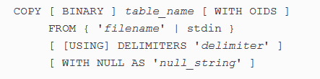
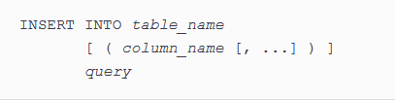
INSERT vs COPY
VS
Notes:
Once you have created your table with the necessary specifications, the next logical step is to fill the table with data.
There are generally three methods in PostgreSQL with which you can fill a table with data:
Use the INSERT INTO command with a grouped set of data to insert new values.
Use the INSERT INTO command in conjunction with a SELECT statement to insert existing values from another table.
Use the COPY command to insert values from a system file.
INSERT creates new rows in a table. You can insert one or more rows specified by value expressions, or zero or more rows resulting from a query.
In the case of INSERT, every statement has to check for locks, check for the existence of the table and the columns in the table, check for permissions, look up data types and so on.
A useful technique within PostgreSQL is to use the COPY command to insert values directly into tables from external files. Files used for input by COPY must either be in standard ASCII text format, whose fields are delimited by a uniform symbol, or in PostgreSQL’s binary table format. Common delimiters for ASCII files are tabs and commas. When using an ASCII formatted input file with COPY, each line within the file will be treated as a row of data to be inserted and each delimited field will be treated as a column value.
The COPY FROM command operates much faster than a normal INSERT command because the data is read as a single transaction directly to the target table. On the other hand, it is a very strict format, and the entire COPY procedure will fail if just one line is malformed.
In the case of COPY, this is only done once, which is a lot faster. Whenever you want to write large amounts of data, data COPY is usually the way to go.
COPY is usually a lot better than plain inserts. The reason is that INSERT has a lot of overhead.
But if you want to copy data from one table to another, INSERT INTO FROM SELECT perform better than COPY command, because it does not require saving the data to an intermediary file or going through a client-server connection.

Slide 17
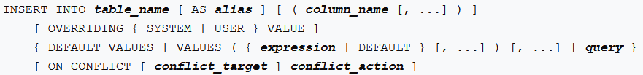
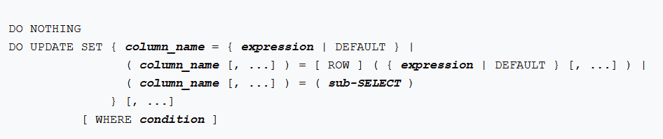
UPSERT
Notes:
INSERT statement has the optional ON CONFLICT clause which specifies an alternative action to raising a unique violation or exclusion constraint violation error. For each individual row proposed for insertion, either the insertion proceeds, or, if an arbiter constraint or index specified by conflict_target is violated, the alternative conflict_action is taken.
ON CONFLICT DO NOTHING simply avoids inserting a row as its alternative action. ON CONFLICT DO UPDATE updates the existing row that conflicts with the row proposed for insertion as its alternative action.
ON CONFLICT DO UPDATE guarantees an atomic INSERT or UPDATE outcome; provided there is no independent error, one of those two outcomes is guaranteed, even under high concurrency. This is also known as UPSERT — “UPDATE or INSERT”.
This feature is useful if you don’t know a record already exists in a table and rather than having the insert fail, you want it to either update the existing record or do nothing.
This feature requires a unique key, primary key, unique index, or exclusion constraint in place, that when violated, you’d want different behavior like updating the existing record or not doing anything.

Slide 18
Q & A

