Slide 1

PostgreSQL DB for DWH and ETL Building
PostgreSQL Join Methods

Slide 2
Agenda
Join overview
Join Strategies
Join Types
Join Order
CTE

Slide 3
JOIN OVERVIEW

Slide 4
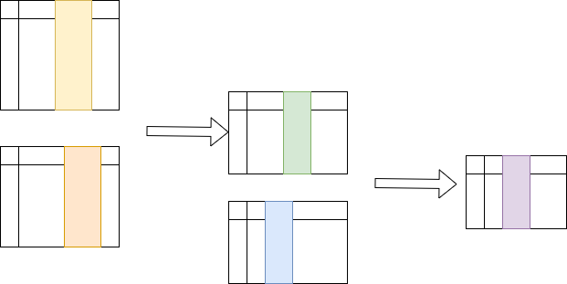
What is a Join?
A join combines the output from exactly two row sources, such as tables or views, and returns one row source. The returned row source is the data set.
Notes:
PostgreSQL join is used to combine columns from one (self-join) or more sources based on the values of the common columns between related sources. The common columns are typically the primary key columns of the first table and foreign key columns of the second table.
All the serious complexity in the planner and optimizer relates to joining tables together. Each time another table is added to a list that needs to be joined, the number of possible ways goes up dramatically. If there's, say, three tables to join, you can expect the query plan to consider every possible plan and select the optimal one. But if there are 20 tables to join, there's no possible way it can exhaustively search each join possibility. As there are a variety of techniques available to join each table pair, that further expands the possibilities.

Slide 5
How the Optimizer Executes Join Statements
Access paths
The optimizer must choose an access path to retrieve data from each table in the join statement.
Join strategies
The possible join strategy are nested loop, sort merge, and hash joins. Each join strategy has specific situations in which it is more suitable than the others.
Join types
E.g. Inner, Outer…
Join order
If more than two tables, PostgreSQL joins two of the tables and then joins the resulting row source to the next table. This process continues until all tables are joined into the result.
Notes:
Speaking about join types - we could have INNER JOINs, OUTER JOINs (LEFT, RIGHT, or FULL), or CROSS JOINs.
In these cases, PostgreSQL has to decide the join strategy. Join strategies refer to how the tables are to be joined. The planner has a couple of options here, so let's take this opportunity to understand what can go wrong if trivial approaches are used: Nested Loop, Merge Join, Hash Join. There each way two tables can be joined together gives the same output. The only difference between them is how efficient the result is to execute. Choosing the wrong join strategy leads to bad performance.
The Planner also has to decide Join Order.

Slide 6
JOIN STRATEGIES

Slide 7
Nested Loop Joins
category | Category_desc | Activations _date
Toys | ….. | 2014-04-01
cosmetics | ….. | 2014-04-01
sportwear | …. | 2014-04-01
hardware | ….. | 2014-04-01
technics | ….. | 2014-04-01
meal | ….. | 2014-04-01
utilities | ….. | 2014-04-01
software | ….. | 2014-04-01
sportfood | ….. | 2014-04-01
shoes | ….. | 2014-04-01
….. | ….. | …..
id | flag | name | category
123 | Y | product1 | meal
124 | Y | product2 | hardware
125 | Y | product3 | meal
126 | N | product4 | technics
127 | N | product5 | hardware
128 | Y | product6 | software
129 | Y | product7 | utilities
… | … | … | …
Notes:
This is the simplest and most general join strategy of all.
Observe that a nested loop join is a straightforward implementation of the abstract definition of a join, as a Cartesian product followed by a filter. As the nested loop join processes all pairs of rows from the input, the cost remains the same, although the size of the output is smaller than in the case of a Cartesian product.
PostgreSQL scans the outer relation sequentially, and for each result row it scans the inner relation for matching rows.
Nested loop joins are particularly efficient if the outer relation is small, because then the inner loop won’t be executed too often.
If the outer relation is large, nested loop joins are usually very inefficient, even if they are supported by an index on the inner relation.
The abovementioned algorithms can work with any join conditions. However, the majority of joins we will ever need to execute are natural joins, that is, the join condition requires that some attributes of R are equal to the corresponding attributes of S.
Apart from that, it is the only join strategy that can be used if no join condition uses the = operator. So it also serves as a fall-back strategy if no other strategy can be used.
Indexes can help with nested loop joins: since we scan the outer relation sequentially, no index on the outer relation will help. But an index on the join key of the inner relation can speed up a nested loop join considerably.

Slide 8
Merge Joins
id | name | Job_id
 |  | 1
 |  | 1
 |  | 4
 |  | 6
 |  | 7
 |  | 8
 |  | 8
 |  | 10
 |  | 10
 |  | 10
…. | …. | ….
Job_id | Job_name
1
2
3
4
5
6
7
8
9
10
….. | …..
1
1
2
4
5
3
6
7
8
8
9
11
10
13
12
14
15
16
17
18
Notes:
The idea here is to use sorted lists to join the results. If both sides of the join are sorted, the system can just take the rows from the top and see if they match and return them. The main requirement here is that the lists are sorted.
The inner table can be rescanned more than once if the outer one has duplicate values. That's where the normally-forwards scan on it goes backwards, to consider the additional matching set of rows from the duplication. You can only see a MERGE JOIN when joining on an equality condition, not an inequality or a range.
An index on the sort keys can speed up sorting, so an index on the join keys on both relations can speed up a merge join. However, an explicit sort is often cheaper unless an index only scan can be used.
If the table is accessed directly, an index is the obvious choice for this, but only if the returned result set is significantly smaller than the entire table. Otherwise, we encounter almost double the overhead because we have to read the entire index and then the entire table. If the result set is a large portion of the table, a sequential scan is more efficient, especially if it is being accessed in the primary key order.
The optimizer usually chooses a merge join if the involved relations are both too big for a hash that fits into work_mem. So this is the best strategy for joining really large tables.
Here is a sample plan:
For each row r in A
For each row s in B
If (r. job_id = s. job_id )
Emit output tuple (r,s)
Break;
If (r. job_id > s. job_id )
Continue;
Else
Break;
To join these two tables (table 1 and table 2), data has to be provided in a sorted order. In many cases, PostgreSQL will just sort the data. However, there are other options we can use to provide the join with sorted data.

Slide 9
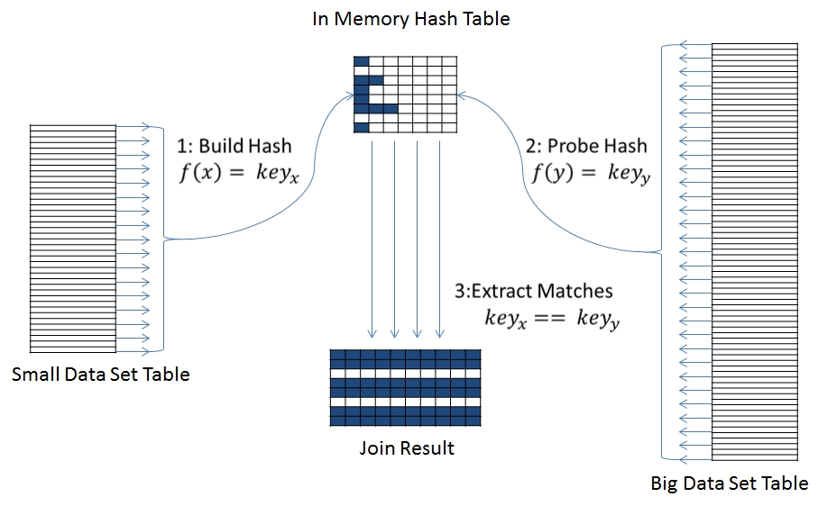
Hash Joins
Notes:
The primary alternative to a MERGE JOIN, a HASH JOIN doesn't sort its input. Instead, it creates a hash table from each row of the inner table, scanning for matching ones in the outer.
Whether a HASH JOIN is better or worse than the other possibilities depends on things such as whether input is already sorted (in which case, a MERGE JOIN may be inexpensive) and how much memory is required to execute it. The hash tables built for the inner scan here require enough memory to store all the rows, which can be large.
The basic version of the hash join algorithm includes two phases:
1. During the build phase, all tuples of R are stored in buckets according to the values of the hash function.
2. In the probe phase, each row of table S is sent to an appropriate bucket. If matching rows of table R are in the bucket, output rows are produced.
The easiest way to find matching rows in the bucket is to use nested loops.
The two phases of the hash-based algorithm are shown as separate physical operations in the execution plan. Building the hash table is an extra start-up effort, but probing the hash is much faster than scanning the inner relation.
Since we scan both relations sequentially, no index will help with a hash join. Hash joins are best if none of the involved relations are small, but the hash table for the smaller table fits in main memory (work_mem) . This is because otherwise PostgreSQL would build the hash in several batches and store them in temporary disk files, which hurts performance. In such cases the optimizer usually chooses a different join strategy like a merge join.
Looking up values in a hash table only works if the operator in the join condition is =, so you need at least one join condition with that operator.

Slide 10
Join Strategies Summary
 | Nested Loop Join | Hash Join | Merge Join
Algorithm | For each outer relation row, scan the inner relation | Build a hash from the inner relation, scan the outer relation, probe the hash | Sort both relations and merge rows
Useful indexes | Index on the join keys of the inner relation | None | Indexes on the join keys of both relations
Good if | the outer table is small | the hash table fits into work_mem | both tables are large
SET enable_hashjoin = off;
SET enable_mergejoin = off;
SET enable_nestloop = off;
Notes:
Choosing the wrong join strategy leads to bad performance:
If the optimizer underestimates a row count, it may choose a nested loop join by mistake. Then it scans the inner relation more often than it bargained for, which leads to bad performance.
If the optimizer overestimates a row count, it may choose a hash or merge join by mistake. Then it has to scan both relations completely, which can perform much worse than a nested loop join with an index on the inner relation.
Find out what the best join strategy is (perhaps PostgreSQL is doing the right thing anyway). You can disable different join strategies temporarily with the SET command, which changes a parameter in your current database session:
SET enable_hashjoin = off;
SET enable_mergejoin = off;
SET enable_nestloop = off;
Note that you cannot really disable nested loop joins, only discourage PostgreSQL from using them. If there is no join condition with an = operator, a nested loop join is the only way.

Slide 11
JOIN TYPES

Slide 12
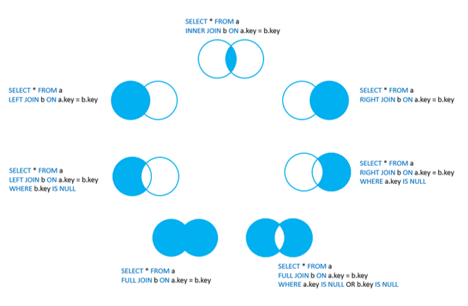
Joins
Notes:
Inner Join - join that returns only rows that satisfy the join condition. Inner joins are either equijoins or non-equijoins.
Left/Right Outer Joins - An outer join returns all rows from one table and only those rows from the joined table where the join condition is met.
Full Outer Join - A full outer join will join two tables from left-to-right and right-to-left. Records that join in both directions are output once to avoid duplication. The full outer join will return all the rows from both tables that match plus the rows that are unique to each table.
Semi or anti joins are kind of sub join types to the joining methods such as hash, merge, and nested loop, where the optimizer prefers to use them for EXISTS/IN or NOT EXISTS/NOT IN operators.
Semi join will return a single value for all the matching records from the other table. That is, if the second table has multiple matching entries for the first table's record, then it will return only one copy from the first table. However, a normal join it will return multiple copies from the first table.
Anti-join will return rows, when no matching records are found in the second table. It is quite opposite to the semi join, since it is returning records from the first table, when there is no match in the second table.
Cross Joins - The Cross Join creates a cartesian product between two sets of data. This type of join does not maintain any relationship between the sets; instead returns the result, which is the number of rows in the first table multiplied by the number of rows in the second table. For every possible combination of rows from T1 and T2 (i.e., a Cartesian product), the joined table will contain a row consisting of all columns in T1 followed by all columns in T2. If the tables have N and M rows respectively, the joined table will have N * M rows.

Slide 13
Lateral Joins
SELECT ….
, t.*
FROM t1
LEFT JOIN LATERAL (SELCT c1, c2
FROM t2
WHERE t2.x = t1.y
) AS t
ON (true)
….
LATERAL:
Is the “for each” loop of SQL
Plays well with outer and cross joins
Is great for Top-N subqueries
Can join table functions
Notes:
Suppose you perform joins on two tables or subqueries; normally, the pair participating in the join are independent units and can’t read data from each other.
LATERAL lets you share data in columns across two tables in a FROM clause: iterate over each of the results (record) and run subquery giving an access to that record.
However, it works only in one direction: the righthand side can draw from the left-hand side, but not vice versa.
Lateral is also helpful for using values from the left-hand side to limit the number of rows returned from the righthand side. (Top-N example)
Although you can achieve the same results by using window functions, lateral joins yield faster results with more succinct syntax.
You can use multiple lateral joins in your SQL and even chain them in sequence as you would when joining more than two subqueries.

Slide 14
JOIN ORDER

Slide 15
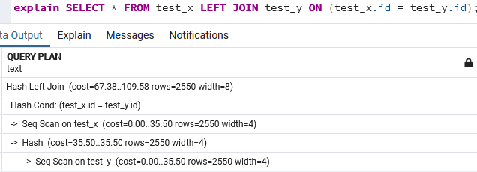
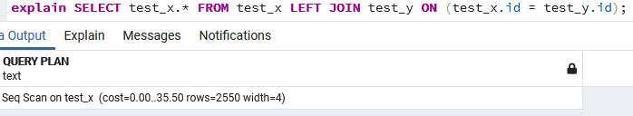
Join pruning
Join Pruning - removing joins from the plan
Using when:
No columns are selected from the right-hand side of the join
The right-hand side is unique
Notes:
In case PostgreSQL is able to detect a join which is actually not needed for execution, it will automatically remove it from the plan.
Removing joins from the plan is called join pruning and can result in significantly better performance and provide end users with much simpler plans.
There are two reasons why this is actually possible and logically correct:
No columns are selected from the right-hand side of the join; thus, looking those columns up doesn't buy us anything.
The right-hand side is unique, which means that joining cannot increase the number of rows due to duplicates on the right-hand side.
If joins can be pruned automatically, then the queries may be a magnitude faster. The beauty here is that an increase in speed can be achieved by just removing columns that may not be required by the application in any case.

Slide 16
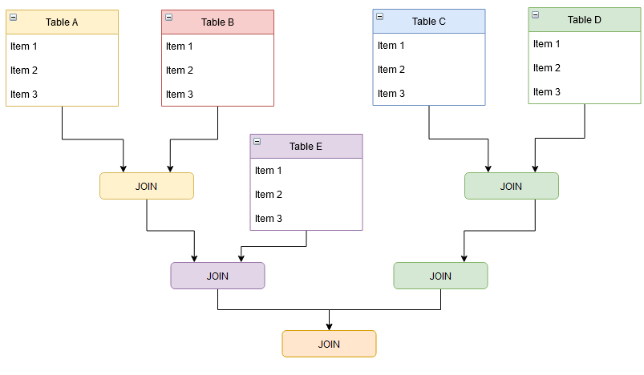
Join Order
IMPLICIT JOIN:
EXPLICIT JOIN:
SELECT *
FROM a, b
WHERE a.id = b.id;
SELECT *
FROM a
JOIN b ON (a.id = b.id);
SELECT *
FROM a
JOIN b USING (id);
SHOW join_collapse_limit ;
| 8
SET join_collapse_limit to 1;
Notes:
There are types of join notation exist:
IMPLICIT - all tables are listed in the FROM clause and are later connected in the WHERE clause.
EXPLICIT - tables are connected directly using an ON and JOIN. Explicit joins support two types of syntax constructs: ON-clauses and USING-clauses. An ON-clause is perfect in case you want to connect different columns with each other. A using clause is different: It has the same meaning, but it can only be used if the columns on both sides have the same name.N-clause. The ON-clause simply contains the conditions we want to use to join those tables together.
In the majority of all cases, an implicit join does exactly the same thing as an explicit join. However, this is no always the case. And sometimes it is necessary to specify JOIN order.
In PostgreSQL there is a variable called join_collapse_limit. The planner will rewrite explicit JOIN constructs (except FULL JOINs) into lists of FROM items whenever a list of no more than this many items would result.
In other words, this parameter caps the number of tables in a join that will be still processed by the cost-based optimizer. The default value of this parameter is 8. This means that if the number of tables in a join is eight or fewer, the optimizer will perform a selection of candidate plans, compare plans, and choose the best one. But if the number of tables is nine or more, it will simply execute the joins in the order the tables are listed in the SELECT statement.
Smaller values reduce planning time but might yield inferior query plans.
Setting it to 1 prevents any reordering of explicit JOINs. Thus, the explicit join order specified in the query will be the actual order in which the relations are joined. Because the query planner does not always choose the optimal join order, advanced users can elect to temporarily set this variable to 1, and then specify the join order they desire explicitly.
There is no official upper limit to this parameter, so it can be the maximum integer, which is 2147483647. However, the higher you set this parameter, the more time will be spent to choose the best plan. If this value is increased to 10, the number of plans to consider will increase to three million, and the number rises predictably from there—when this parameter is set to 20, the total number of plans is already too big to fit the integer.

Slide 17
CTE

Slide 18



Temporary Tables
Behave as regular tables
Visible to the current session only
Dropped when the session disconnect or explicitly before that
Can be indexed
Can be ANALIZED to use statistic
Stored in temporary tablespace
List of columns
AS SELECT …
Keep temporary tables small
Use when they are really needed
Notes:
Temporary tables are visible to the current session only and are dropped when the session disconnects if not dropped explicitly before that.
Otherwise, they are as good as regular tables, they can be used in the queries with no limitations, and they can even be indexed.
Temporary tables are often used to store intermediate results of the queries: CREATE TEMP TABLE AS SELECT
ON COMMIT - The behavior of temporary tables at the end of a transaction block can be controlled using ON COMMIT. The three options are:
PRESERVE ROWS No special action is taken at the ends of transactions. This is the default behavior.
DELETE ROWS All rows in the temporary table will be deleted at the end of each transaction block. Essentially, an automatic TRUNCATE is done at each commit. When used on a partitioned table, this is not cascaded to its partitions.
DROP The temporary table will be dropped at the end of the current transaction block. When used on a partitioned table, this action drops its partitions and when used on tables with inheritance children, it drops the dependent children.
Temporary tables require extra resources to create and maintain the data within them. These extra resources come from one of the hardest hit areas on most servers, tempdb – temporary tablespace. If you are using temporary tables, it makes sense to keep them relatively small. In some cases, however, a temporary table might be quite large for whatever reason. To ensure that performance stays good, you can tell PostgreSQL to keep more of a temporary table in RAM. temp_buffers is the parameter in postgresql.conf file you should be looking at in this case.
Also temporary tables and the statistics maintained in them can lead to recompiles. Recompiles cause quite a lot of blocking when they occur which can lead to other problems. This is the main reason to avoid them where you don't need them.

Slide 19
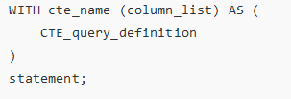
Common Table Expressions (CTE)
set the name of the CTE followed by an optional column list
specify a query that returns the result set within the body of WITH clause
use the CTE like a table or view in the statement which can be a SELECT, INSERT, UPDATE, or DELETE.
Notes:
Common table expressions, or CTEs, can be thought of as defining temporary tables that exist just for one query. Each auxiliary statement in a WITH clause can be a SELECT, INSERT, UPDATE, or DELETE; and the WITH clause itself is attached to a primary statement that can also be a SELECT, INSERT, UPDATE, or DELETE.
The idea behind the usage of a CTE was that if you need to use some possibly complex sub-select more than once, you can define it as a CTE and reference it in a query multiple times. In this case, PostgreSQL will compute results just once and reuse it as many times as needed.
Also the tables involved in the CTE are not counted against join_collapse_limit. Thus, we can effectively use PostgreSQL optimizer capabilities with queries that join a large number of tables.
For all versions below 12, a CTE was processed exactly like a temporary table. The results were materialized in main memory with possible disk failover. That means that there was no advantage to using a CTE instead of a temporary table.
PostgreSQL 12 brought a drastic change to CTE optimization. For SELECT statements with no recursion, if a CTE is used in a query only once, it will be inlined into the outer query. If it is called more than once, the old behavior will be preserved.
What is more important, the behavior described earlier is a default, but it can be overwritten by using the keywords MATERIALIZED and NOT MATERIALIZED. The first one forces the old behavior, and the second one forces inlining, regardless of all other considerations.
To create and use CTE you need:
to set the name of the CTE followed by an optional column list.
then we specify a query that returns the result set within the body of WITH clause. If not specified explicitly then the select list of the CTE_query_definition will become the column list of the CTE.
finally use the CTE like a table or view in the statement which can be a SELECT, INSERT, UPDATE, or DELETE.

Slide 20
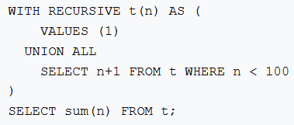
Recursive CTE
Non-recursive term
Recursive term
Termination check
Notes:
A recursive query is a query that refers to a recursive CTE. The recursive queries are useful in many situations such as querying hierarchical data like organizational structure, bill of materials, etc.
A recursive CTE has three elements:
Non-recursive term: the non-recursive term is a CTE query definition that forms the base result set of the CTE structure.
Recursive term: the recursive term is one or more CTE query definitions joined with the non-recursive term using the UNION or UNION ALL operator. The recursive term references the CTE name itself.
Termination check: the recursion stops when no rows are returned from the previous iteration.
PostgreSQL executes a recursive CTE in the following sequence:
1. Execute the non-recursive term to create the base result set (R0).
2. Execute recursive term with Ri as an input to return the result set Ri+1 as the output.
3. Repeat step 2 until an empty set is returned. (termination check)
4. Return the final result set that is a UNION or UNION ALL of the result set R0, R1, … Rn

Slide 21
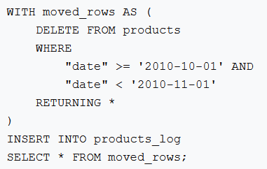
Data-Modifying CTE
Notes:
You can use data-modifying statements (INSERT, UPDATE, or DELETE) in WITH. This allows you to perform several different operations in the same query. Data-modifying statements in WITH usually have RETURNING clauses.
Example: The DELETE in WITH deletes the specified rows from one table, returning their contents by means of its RETURNING clause; and then the primary query reads that output and inserts it into other table.
Data-modifying statements in WITH are executed exactly once, and always to completion, independently of whether the primary query reads all (or indeed any) of their output. The sub-statements in WITH are executed concurrently with each other and with the main query.
Therefore, when using data-modifying statements in WITH, the order in which the specified updates actually happen is unpredictable. All the statements are executed with the same snapshot, so they cannot "see" one another's effects on the target tables.
This soften the effects of the unpredictability of the actual order of row updates, and means that RETURNING data is the only way to communicate changes between different WITH sub-statements and the main query.
Trying to update the same row twice in a single statement is not supported. This also applies to deleting a row that was already updated in the same statement: only the update is performed. Therefore you should generally avoid trying to modify a single row twice in a single statement. In particular avoid writing WITH sub-statements that could affect the same rows changed by the main statement or a sibling sub-statement. The effects of such a statement will not be predictable.

Slide 22
Q & A

