Slide 1

PostgreSQL DB for DWH and ETL Building
Partitioning and Parallel Execution

Slide 2
Agenda
Partitioning Overview
Declarative Partitioning
Partitioning Using Inheritance
New Partitioning Features
Parallel Execution
Parallel Plans

Slide 3
PARTITIONING OVERVIEW

Slide 4
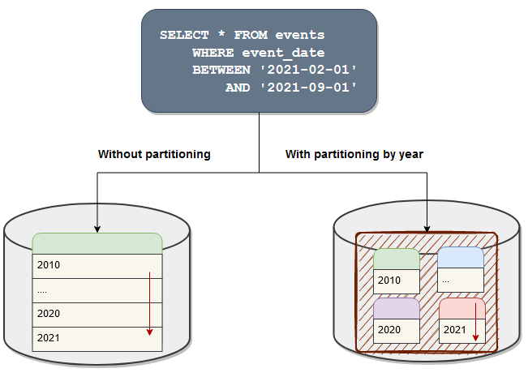
Partitioning
Partitioning helps to scale PostgreSQL by splitting large logical tables into smaller physical tables that can be stored on different storage media based on uses.
Notes:
As table size increases with data load, more data scanning, swapping pages to memory, and other table operation costs also increase.
Partitioning may be a good solution, as It can help divide a large table into smaller tables and thus reduce table scans and memory swap problems, which ultimately increases performance.
Partitioning helps to scale PostgreSQL by splitting large logical tables into smaller physical tables that can be stored on different storage media based on uses.
A table can be partitioned according to the conditions you specify. Therefore, it is necessary to set optimum conditions considering the data characteristics and the purpose of use. With partitioning, the table is split into smaller groups based on the specified criteria, but can still be treated as one table from the application.
There is no real hardline rule for how big a table must be before partitioning is an option, but based on database access trends, database users and administrators will start to see performance on a specific table start to degrade as it gets bigger. In general, partitioning should only be considered when someone says “I can’t do X because the table is too big.” For some hosts, 200 GB could be the right time to partition, for others, it may be time to partition when it hits 1TB.

Slide 5
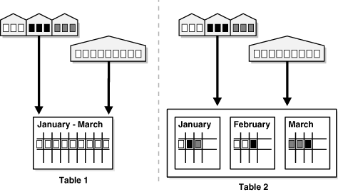
Partitioning Concept
From the perspective of a database administrator, a partitioned object has multiple pieces that can be managed either collectively or individually. This gives an administrator considerable flexibility in managing partitioned objects.
From the perspective of the application, a partitioned table is identical to a non-partitioned table; no modifications are necessary when accessing a partitioned table using SQL queries and DML statements.
Notes:
Partitioning splits a table into multiple tables, and generally is done in a way that applications accessing the table don’t notice any difference, other than being faster to access the data that it needs.
With partitioning, the table is split into smaller groups based on the specified criteria, but can still be treated as one table from the application.
So:
From the perspective of a database administrator, a partitioned object has multiple pieces that can be managed either collectively or individually. This gives an administrator considerable flexibility in managing partitioned objects.
From the perspective of the application, a partitioned table is identical to a non-partitioned table; no modifications are necessary when accessing a partitioned table using SQL queries and DML statements.

Slide 6
Partitioning Key
Each row in a partitioned table is unambiguously assigned to a single partition.
The partitioning key consists of one or more columns that determine the partition where each row is stored.
When the value in the partition key column is updated, the relevant data is moved to the appropriate partition automatically.
Notes:
PostgreSQL offers a way to specify how to divide a table into pieces called partitions.
You need to specify the column (called partition key) to be used for partitioning – values in this column will be used to create partitions.
All rows inserted into a partitioned table will be routed to the appropriate one of the partitions based on the values of the partition key column(s).
Updating the partition key of a row will cause it to be moved into a different partition if it no longer satisfies the partition bounds of its original partition.
How should a partitioning key for a table be selected?
Based on the preceding observation, the partitioning key should be chosen so that it is used by the search conditions in either a large enough number of queries or in the most critical queries.

Slide 7
Is It Useful?
OLTP systems often benefit from improvements in manageability and availability.
Data warehousing systems benefit from performance and manageability.
Notes:
Why we may need it:
1. For example if a lot of data is going to be written on a single table at some point, we need partitioning.
Apart from data, there may be other factors we should consider, like update frequency of the data, use of data over a time period, how small a range data can be divided, etc.
2. The partitioned table can be placed in different tablespaces on physical disks. This distributes disk I/O, with reads and writes being performed in parallel on different physical disks, thus improving performance.
3. By specifying the search condition in SQL, the access range can be narrowed down to a specific partition. It also makes it easier for frequently used parts of the partition to be cached in memory. In addition, this reduces disk I/O and improves access performance.
4. When using a system that retains events data for 5 years in monthly partitions, it is possible to create a new partition when the month changes, and delete the same month partition from 5 years ago.
With good planning and taking all factors into consideration, table partitioning can give a great performance boost and scale your PostgreSQL to larger datasets.

Slide 8
Benefits
Query performance can be improved dramatically in certain situations, particularly when most of the heavily accessed rows of the table are in a single partition or a small number of partitions.
When queries or updates access a large percentage of a single partition, performance can be improved by using a sequential scan of that partition instead of using an index, which would require random-access reads scattered across the whole table.
Bulk loads and deletes can be accomplished by adding or removing partitions, if the usage pattern is accounted for in the partitioning design.
Seldom-used data can be migrated to cheaper and slower storage media
Notes:
Some other benefits of partitioning:
Query performance can be increased significantly compared to selecting from a single large table.
Partition-wise-join and partition-wise-aggregate features increase complex query computation performance as well.
Bulk loads and data deletion can be much faster, as based on user requirements these operations can be performed on individual partitions. Dropping an individual partition using DROP TABLE, or doing ALTER TABLE DETACH PARTITION, is far faster than a bulk operation. These commands also entirely avoid the VACUUM overhead caused by a bulk DELETE.
Each partition can contain data based on its frequency of use and so can be stored on media that may be cheaper or slower for low-use data.
These benefits will normally be worthwhile only when a table would otherwise be very large.
The exact point at which a table will benefit from partitioning depends on the application, although a rule of thumb is that the size of the table should exceed the physical memory of the database server.

Slide 9
DECLARATIVE PARTITIONING

Slide 10
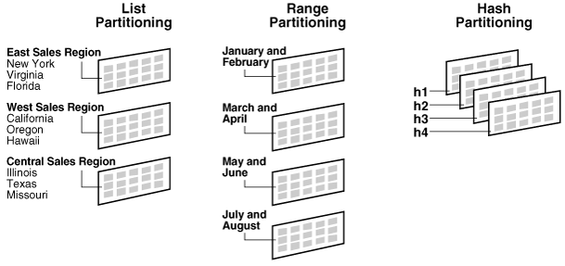
Strategies
Notes:
PostgreSQL allows you to declare that a table is divided into partitions. The table that is divided is referred to as a partitioned table. The declaration includes the partitioning method, plus a list of columns or expressions to be used as the partition key.
Postgres provides three built-in partitioning methods:
List Partitioning: Partition a table by a list of known values. This is typically used when the partition key is a categorical value, e.g., a global sales table divided into regional partitions. The partition key in this case can be the region, country or city code, and each partition will define the list of codes that map to it.
Range Partitioning: Partition a table by a range of values. This is commonly used with date fields, e.g., a table containing sales data that is divided into monthly partitions according to the sale date.
Hash Partitioning: Partition a table using a hash function on the partition key. This is especially useful when there is no obvious way of dividing data into logically similar groups and is often used on categorical partitioning keys that are accessed individually. E.g., if a sales table is often accessed by product, the table might benefit from a hash partition on the product id.
All partitions must have the same columns as their partitioned parent, partitions may have their own indexes, constraints and default values, distinct from those of other partitions.
It is not possible to turn a regular table into a partitioned table or vice versa. However, it is possible to add an existing regular or partitioned table as a partition of a partitioned table, or remove a partition from a partitioned table turning it into a standalone table.

Slide 11
List Partitioning
CREATE TABLE part_table (
id INTEGER,
val TEXT,
num NUMERIC)
PARTITION BY LIST(val);
CREATE TABLE part_table_a
PARTITION OF part_table FOR VALUES IN ('A’);
CREATE TABLE part_table_b
PARTITION OF part_table FOR VALUES IN ('B’);
CREATE TABLE part_table_def
PARTITION OF part_table DEFAULT;
Step 1
Create
a table
Step 2
Add
partitions
The table is partitioned by explicitly listing which key value(s) appear in each partition.
Notes:
General algorithm of declarative partitioning:
Start by creating a table with PARTITION BY command.
Once the partitioned table is defined, you can start adding partitions to it.
In list partitioning data is partitioned according to the specified discrete values.
The advantage of list partitioning is that you can group and organize unordered and unrelated sets of data in a natural way - group discrete data, such as regions and departments with arbitrary values.
The DEFAULT partition enables you to avoid specifying all possible values for a list-partitioned table by using a default partition, so that all rows that do not map to any other partition do not generate an error.
It’s not always useful to add a default partition. You may want to make sure that all rows are fitted nicely into the predefined partitions, as storing rows in the default partition can affect performance under some circumstances and can make maintenance more difficult.

Slide 12
Range Partitioning
CREATE TABLE part_table (
id INTEGER,
val TEXT,
num NUMERIC)
PARTITION BY RANGE(num);
CREATE TABLE part_table_s
PARTITION OF part_table FOR VALUES FROM (MINVALUE) TO (100);
CREATE TABLE part_table_l
PARTITION OF part_table FOR VALUES FROM (100) TO (1000);
CREATE TABLE part_table_xl
PARTITION OF part_table FOR VALUES FROM (1000) TO (MAXVALUE);
Data is partitioned according to the specified range.
Notes:
In Range Partition data is partitioned according to the specified range.
A range partition is created to hold values within a range provided on the partition key. Both minimum and maximum values of the range need to be specified, where minimum value is inclusive and maximum value is exclusive.
For example, if one partition's range is from 1 to 100, and the next one's range is from 100 to 1000, then value 100 belongs to the second partition not the first.
A MINVALUE/MAXVALUE literals can be defined for the lowest and highest partition.
Range partition does not allow NULL values.
Effective when you want to access time-series data, by specifying date such as year and month.

Slide 13
Hash Partitioning
CREATE TABLE part_table (
id INTEGER,
val TEXT,
num NUMERIC)
PARTITION BY HASH(id);
CREATE TABLE part_table_p1
PARTITION OF part_table FOR VALUES WITH (MODULUS 3, REMAINDER 0);
CREATE TABLE part_table_p2
PARTITION OF part_table FOR VALUES WITH (MODULUS 3, REMAINDER 1);
CREATE TABLE part_table_p3
PARTITION OF part_table FOR VALUES WITH (MODULUS 3, REMAINDER 2);
Data is partitioned by specifying a modulus and a remainder for each partition. Each partition will hold the rows for which the hash value of the partition key divided by the modulus will produce the specified remainder.
Notes:
In a Hash Partitioning data is partitioned by specifying a modulus and a remainder for each partition.
Each partition will hold the rows for which the hash value of the partition key divided by the modulus will produce the specified remainder.
Effective when you want to avoid access concentration to a specific table by distributing data almost evenly.
Example: Create a hash partition that evenly divides 1,000 pieces of data into 3 partitions. Split into 3 partitions (n is the hash value created from the value in the partition key) :
n % 3 = 0 → Allocates to partition 1
n % 3 = 1 → Allocates to partition 2
n% 3 = 2 → Allocates to partition 3

Slide 14
Composite Partitioning
CREATE TABLE part_table (
id INTEGER,
val TEXT,
num NUMERIC)
PARTITION BY LIST(val);
CREATE TABLE part_table_a
PARTITION OF part_table FOR VALUES IN (‘A’)
PARTITIONED BY RANGE(num);
CREATE TABLE part_table_a_s
PARTITION OF part_table_a FOR VALUES FROM (MINVALUE) TO (100);
CREATE TABLE part_table_a_xl
PARTITION OF part_table_a FOR VALUES FROM (100) TO (MAXVALUE);
Notes:
It is also possible to create additional partitions under a partition, as shown, to create a more detailed partition setup.
This setup is called a composite partition, or subpartition.
For example, for the part_table (partition table), you can create a list partition divided by values like A, B, C, and underneath that, create a range partition divided by num.
Access performance is improved because you can narrow down the partitions to be searched, such as when you want to retrieve the A value data of a specific num range.
PostgreSQL does not create a system-defined subpartition when not given it explicitly, so if a subpartition is present at least one partition should be present to hold values.
In the case of HASH-LIST, HASH-RANGE, and HASH-HASH composite partitions, users need to make sure all partitions are present at the subpartition level as HASH can direct values at any partition based on hash value.

Slide 15
Partition Maintenance
ALTER TABLE part_table ATTACH PARTITION part_table_x
FOR VALUES(‘X’);
ALTER TABLE part_table DETACH PARTITION part_table_a;
DROP TABLE part_table_a;
ALTER TABLE part_table_x SET TABLESPACE cheap_tbs;
Notes:
When managing huge amounts of data, it’s sometimes necessary to set up some sort of lifecycle policy.
Partitions makes it easier to maintain and implement such policies.
A useful feature is the ability to attach and detach partitions from a partitioned table. Managing a large table in small chunks makes it easier to implement data loading processes.
Using partitions, we can attach an existing table into a partitioned table via a single ATTACH PARTITION command;
The benefit of this approach is that ATTACH is a DDL command. DDL commands manipulate table metadata, so they happen near instantly with minimal interference to ongoing queries on the table.
For example, old partitions can be detached by using DETACH PARTITION command and deleted easily with DROP TABLE command.
Just like attaching a partition, detaching a partition is a DDL command which causes minimal interference to ongoing operations and happens near instantly. Also, removing this large chunk of the table will not cause any bloat because the data is dropped and not deleted.
Storage parameters can also be set at the partition level. For example, old partitions can be moved to tablespace using cheaper storage by SET TABLESPACE command.

Slide 16
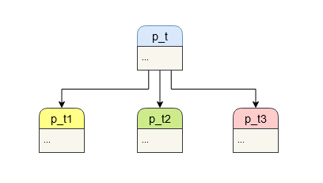
Partitioned Indexes
CREATE INDEX p_t_idx ON ONLY p_t(column);
CREATE INDEX p_t_1_idx ON p_t_1(column);
ALTER INDEX p_t_idx ATTACH PARTITION p_t_1_idx;
Any index created on a partition table will be created as well on each existing child tables.
Any future partition added will gain the same index as well.
Notes:
It is possible to create indexes on partitioned tables so that they are applied automatically to the entire hierarchy. This is very convenient, as not only will the existing partitions become indexed, but also any partitions that are created in the future will.
To avoid long lock times, it is possible to use CREATE INDEX ON ONLY the partitioned table; such an index is marked invalid, and the partitions do not get the index applied automatically. The indexes on partitions can be created individually and attached to the index on the parent using ALTER INDEX .. ATTACH PARTITION.
Once indexes for all partitions are attached to the parent index, the parent index is marked valid automatically.
This technique can be used with UNIQUE and PRIMARY KEY constraints too; the indexes are created implicitly when the constraint is created.
Unique constraints (and primary keys) on partitioned tables must include all the partition key columns.
Primary key and unique constraints on partitioned tables cannot be referenced by foreign keys. In a data warehouse environment, partitioned tables are normally used for fact tables, which are usually not referenced by foreign key constraints.

Slide 17
PARTITIONING USING INHERITANCE

Slide 18
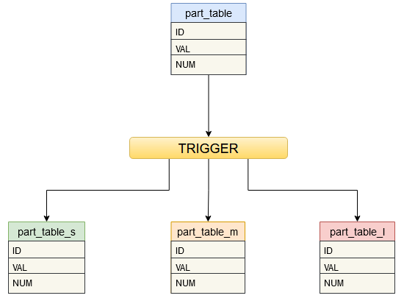
Partitioning Using Inheritance
CREATE TABLE part_table
(id INTEGER,
val TEXT,
num NUMERIC);
CREATE TABLE part_table_s (
CHECK (num >= MINVALUE and num < 100)
) INHERITS (part_table);
CREATE TABLE part_table_m (
CHECK (num >= 100 and num < 1000)
) INHERITS (part_table);
CREATE TABLE part_table_l(
CHECK (num >= 1000 and num < MAXVALUE)
) INHERITS (part_table);
Notes:
Before PostgreSQL 10, Postgres users partitioned their data using inheritance based partitioning. The method used constraints to define the partitions and rules or triggers to route the data to appropriate partition.
Table inheritance allows to extract a common set of columns into a parent, master table with children defining additional fields.
This kind of partition allows for several features not supported by declarative partitioning, such as:
For declarative partitioning, partitions must have exactly the same set of columns as the partitioned table, whereas with table inheritance, child tables may have extra columns not present in the parent.
Table inheritance allows for multiple inheritance.
Declarative partitioning only supports range, list and hash partitioning, whereas table inheritance allows data to be divided in a manner of the user's choosing.
Some operations require a stronger lock when using declarative partitioning than when using table inheritance.

Slide 19
How to Partition a Table
Step 1: Create parent table
Step 2: Create child tables that each inherit from the parent table. Add non-overlapping CHECK constraints to the child tables to define the allowed key values in each.
Step 3: For each child table, create an index on the key column(s), as well as any other indexes you might want
Step 4: Create partition function that will hold logic of “on-insert” trigger
Step 5: Create trigger and attach it to the parent table to be partitioned
Notes:
To create partitioning with table inheritance use the following steps:
1. Create the "master" table, from which all of the “child” tables will inherit. This table will contain no data. Do not define any check constraints on this table, unless you intend them to be applied equally to all child tables. There is no point in defining any indexes or unique constraints on it, either.
2. Create several "child" tables that each inherit from the master table. Normally, these tables will not add any columns to the set inherited from the master. Just as with declarative partitioning, these tables are in every way normal PostgreSQL tables. Add non-overlapping table constraints to the child tables to define the allowed key values in each.
3. For each child table, create an index on the key column(s), as well as any other indexes you might want.
4. We want our application to be able to say INSERT INTO part_table ... and have the data be redirected into the appropriate child table. We can arrange that by attaching a suitable trigger function to the master table.
5. After creating the function, we create a trigger which calls the trigger function.

Slide 20
Partition Maintenance
ALTER TABLE part_table_s NO INHERIT part_table;
DROP TABLE part_table_s;
ALTER TABLE part_table_new INHERIT part_table;
Notes:
To remove old data quickly, simply drop the child table that is no longer necessary by using DROP TABLE command.
Use ALTER TABLE ... NO INHERIT... command to remove the child table from the inheritance hierarchy table but retain access to it as a table in its own right.
To add a new child table to handle new data, create an empty child table just as the original children were created before.
If you are using manual VACUUM or ANALYZE commands, don't forget that you need to run them on each child table individually.
The schemes shown here assume that the values of a row's key column(s) never change, or at least do not change enough to require it to move to another partition.
An UPDATE that attempts to do that will fail because of the CHECK constraints. If you need to handle such cases, you can put suitable update triggers on the child tables, but it makes management of the structure much more complicated.

Slide 21
NEW PARTITIONING FEATURES
Notes:
PostgreSQL contains features to improve the performance of DML operations on partitioned tables by enhancing the planner and the executor to use partition metadata more effectively.
Those features include a new implementation of partition pruning, execution-time partition pruning (also known as dynamic pruning), partition-wise join and aggregation.

Slide 22
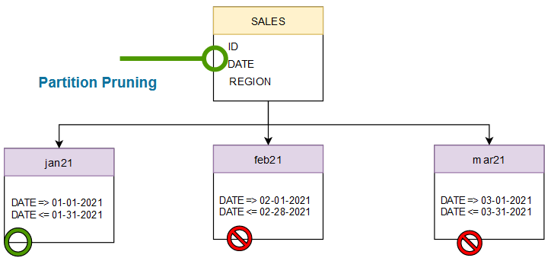
Partition Pruning
Partition pruning is a query optimization technique that improves performance for declaratively partitioned tables.
SELECT count(*) FROM Sales
WHERE date = ’01-15-2021’
Notes:
PostgreSQL 11 implements a new mechanism that analyzes query's conditions (including table join conditions, about which more below), extracts parameters that are compared with the partitioning column from such conditions, and determines partition bounds that satisfy the query by comparing the parameter values directly with them. For example, in this case, it will find the value of the smallest range bound that is greater than the value being searched (2018-11-05) by looking it up in the sorted array of upper bounds of all partitions using a binary search.
In other words, Partition pruning is the ability to skip scanning of partitions that would not contain data requested by queries.
With partition pruning enabled, the planner will examine the definition of each partition and prove that the partition need not be scanned because it could not contain any rows meeting the query's WHERE clause. When the planner can prove this, it excludes (prunes) the partition from the query plan
When querying a:
list-partitioned table, partition pruning is effective when the WHERE clause compares a literal value to the partitioning key using operators like equal (=) or AND.
range-partitioned table, partition pruning is effective when the WHERE clause compares a literal value to a partitioning key using operators such as equal (=), less than (<), or greater than (>).
hash-partitioned table, partition pruning is effective when the WHERE clause compares a literal value to the partitioning key using an operator such as equal (=).
Note that partition pruning is driven only by the constraints defined implicitly by the partition keys, not by the presence of indexes. Therefore it isn't necessary to define indexes on the key columns.
Partition pruning can be enabled/disabled using the enable_partition_pruning setting.

Slide 23
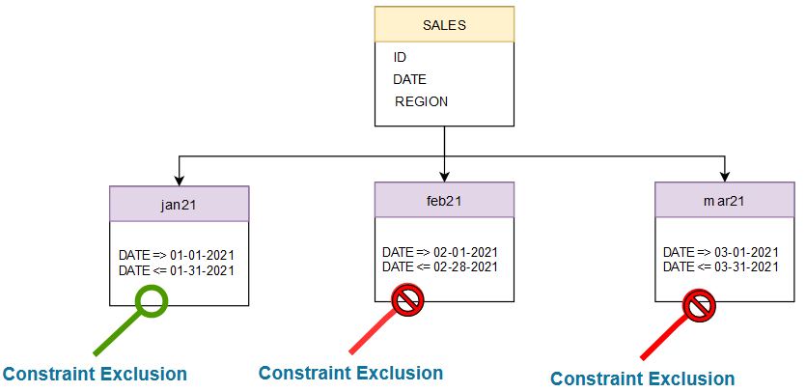
Constraint Exclusion
Constraint exclusion compares query's conditions with partition's constraint (shaped like CHECK constraints) to mark partitions whose constraint contradicts the query conditions as excluded.
SELECT count(*) FROM Sales
WHERE date = ’01-15-2021’
Notes:
Older PostgreSQL versions (including 10) don't compare the values directly with the partition bounds.
Instead, it relies on a related optimization feature of PostgreSQL called constraint exclusion. Constraint exclusion is a query optimization technique similar to partition pruning.
Constraint exclusion compares query's conditions with partition's constraint (shaped like CHECK constraints) to mark partitions whose constraint contradicts the query conditions as excluded.
constraint exclusion needs to consider each partition individually and is itself computationally expensive, so it does not scale with the number of partitions.
Constraint exclusion only works when the query's WHERE clause contains constants (or externally supplied parameters).

Slide 24
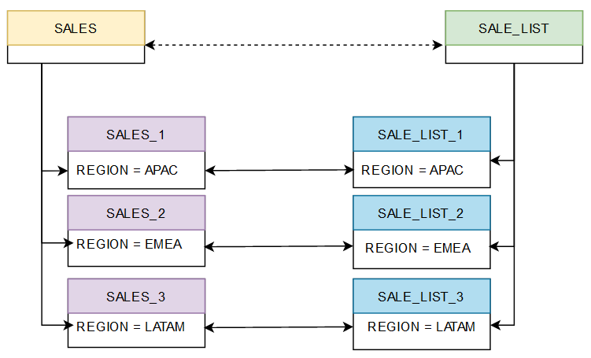
Partition-wise join
Partition-wise joins can be applied when two tables are being joined and both tables are partitioned on the join key, or when a reference partitioned table is joined with its parent table. Partition-wise joins break a large join into smaller joins that occur between each of the partitions, completing the overall join in less time.
SELECT count(*) FROM Sales
JOIN Sale_List ON Sales.Region = Sale_List.Region
Notes:
If two partitioned tables are joined on their common partition key using an equality join condition, it makes sense to join their partitions which respectively contain same set of data, instead of joining them in whole.
From the Example it should be clear that any rows of the partition sales_1 won't match the rows of partitions on the other side sales_list_2 and sales_list_3.
So, it makes sense to join sales_1 to only sales_list_1, and similarly sales_2 to only sales_list_2 and sales_2 to only sales_list_3
PostgreSQL can create a plan of this shape using mechanism in the planner called partitionwise join.
The main advantage of being able to create a plan like this is that the planner can select a better join algorithm for individual pairs of partitions than it can for the whole table join (due to better accuracy of statistics on individual smaller partitions than on the whole table), resulting in an overall better plan. A major limitation currently is that both partitioned tables must have exactly matching partition bounds.

Slide 25
Partition-wise aggregation
An aggregation step applied to a partitioned table can be divided into multiple aggregation steps, one for each of its partitions and their outputs combined if necessary.
QUERY PLAN
───────────────────────────────────────────────────
Finalize Aggregate
Output: count(*)
-> Append
-> Partial Aggregate
Output: PARTIAL count(*)
-> Seq Scan on sales_1
-> Partial Aggregate
Output: PARTIAL count(*)
-> Seq Scan on sales_2
-> Partial Aggregate
Output: PARTIAL count(*)
-> Seq Scan on sales_3
(12 rows)
SELECT count(*) FROM Sales
Notes:
Aggregation is another operation for which it helps to divide it into smaller independent units.
For example, an aggregation step applied to a partitioned table can be divided into multiple aggregation steps, one for each of its partitions and their outputs combined if necessary.
for COUNT(*) PostgreSQL would first calculate the partial counts for individual partitions and finalize the count for the whole query once all partitions have been processed.
If the aggregation is grouped and the grouping key matches the partition key, then each partition's aggregation output is the final output for a given grouping key, because the same key cannot be present in more than one partition.
Similar to joins, the main advantage of planner's ability to apply a given aggregation operation to individual partitions is that it can make better decisions regarding the algorithm to use for aggregation. For example, it it can prefer hash-based aggregation over sort-based aggregation, because the former is cheaper but is only considered for smaller input sizes.

Slide 26
PARALLEL EXECUTION

Slide 27
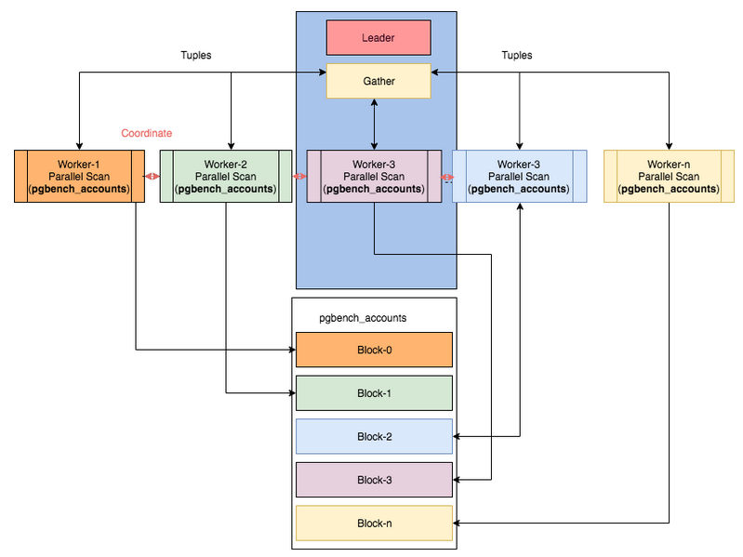
Components of Parallelism
Notes:
Parallelism in PostgreSQL was introduced from version 9.6.
Parallelism is where a single process can have multiple PROCESSES (not threads). PostgreSQL doesn’t support threads at all. to query the system and utilize the multicore in a system.
Parallel execution can be viewed as yet another way to split up the query: creating multiple query processes that divide the workload of a SQL statement and executing it in parallel or at the same time.
There are three important components of parallelism in PostgreSQL:
-process itself (query),
-gather,
-workers.
Without parallelism the process itself handles all the data, however, when planner decides that a query or part of it can be parallelized, it adds a Gather node within the parallelizable portion of the plan and makes a gather root node of that subtree.
Query execution starts at the process (leader) level and all the serial parts of the plan are run by the leader. Workers are the threads that run in parallel with part of the tree (partial-plan) that needs to be parallelized. The relation’s blocks are divided amongst threads such that the relation remains sequential. The workers coordinate/communicate using shared memory, and once workers have completed their work, the results are passed on to the leader for accumulation.
Any parallel algorithm has a certain part that must be executed on a single unit. Also, additional overheads appear as a cost of synchronizations between parallel processes. For these reasons, parallel processing is mostly beneficial when bulk amounts of data are processed.

Slide 28
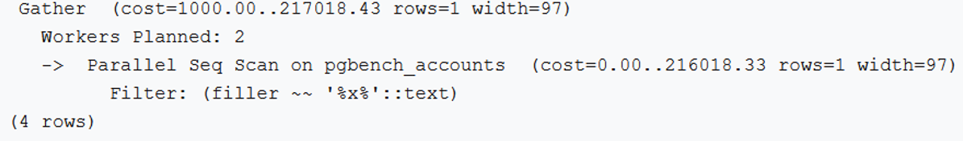
Parallel Querying
A gather node consists exactly one plan
The plan divided among workers
The worker runs as separate backend processes
The results of workers are collected by a leader
The total number of background workers is limited by: max_worker_processes and max_parallel_workers
Notes:
When the optimizer determines that parallel query is the fastest execution strategy for a particular query, it will create a query plan which includes a Gather or Gather Merge node.
A gather node contains exactly one plan, which it divides amongst what are called workers. Each worker runs as separate backend processes, each process working on a portion of the overall query. The results of workers are collected by a worker acting as the leader. The leader does the same work as other workers but has the added responsibility of collecting all the answers from fellow workers. If the gather node is the root node of a plan, the whole query will be run in parallel. If it’s lower down, only the subplan it encompasses will be parallelized.
The total number of background workers that can exist at any one time is limited by both max_worker_processes and max_parallel_workers. Therefore, it is possible for a parallel query to run with fewer workers than planned, or even with no workers at all.
The cost of organizing additional workers (even one) significantly increases the total time of the query.
Generally, parallelization is rarely worthwhile for queries that finish in a few milliseconds. But for queries over a ginormous dataset that normally take seconds or minutes to complete, parallelization is worth the initial setup cost.

Slide 29
Parallel Operations
Parallel sequential scans
Parallel index scans (b-trees only)
Parallel bitmap heap scans
Parallel joins (all types of joins)
Parallel b-tree creation (CREATE INDEX)
Parallel aggregation
Parallel append
VACUUM
CREATE INDEX
Notes:
The planner classifies operations involved in a query as either parallel safe, parallel restricted, or parallel unsafe. A parallel safe operation is one which does not conflict with the use of parallel query. A parallel restricted operation is one which cannot be performed in a parallel worker, but which can be performed in the leader while parallel query is in use. When a query contains anything which is parallel unsafe, parallel query is completely disabled for that query.
The following are the most important operations that can be done in parallel:
sequential scans
index scans (b-trees only)
bitmap heap scans
joins (all types of joins)
b-tree creation (CREATE INDEX)
aggregation
append
VACUUM
CREATE INDEX

Slide 30
PARALLEL PLANS

Slide 31
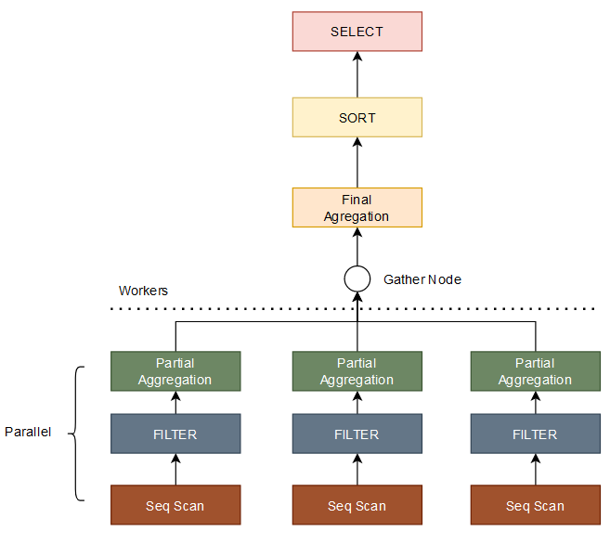
Parallel Plan
Parallel-aware operators perform scattering:
Parallel Scans
Parallel Joins
Parallel Aggregation
Notes:
Because each worker executes the parallel portion of the plan to completion, it is not possible to simply take an ordinary query plan and run it using multiple workers.
Each worker would produce a full copy of the output result set, so the query would not run any faster than normal but would produce incorrect results.
Instead, the parallel portion of the plan must be what is known internally to the query optimizer as a partial plan; that is, it must be constructed so that each process which executes the plan will generate only a subset of the output rows in such a way that each required output row is guaranteed to be generated by exactly one of the processes. Generally, this means that the scan on the driving table of the query must be a parallel-aware scan.

Slide 32
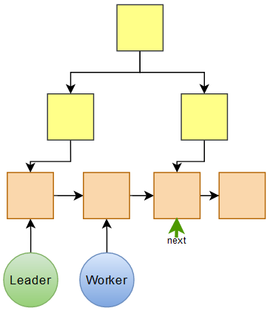
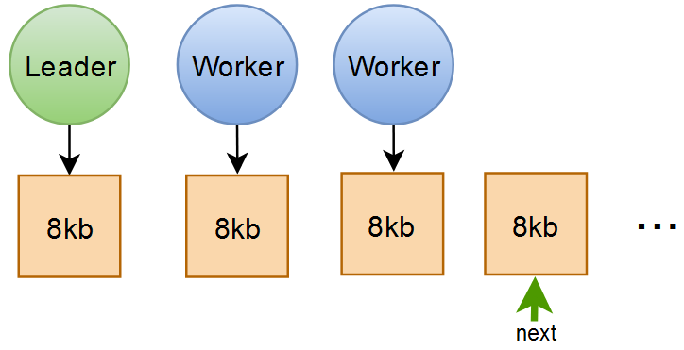
Parallel Scans
Parallel Seq Scan
Parallel Index Scan
Notes:
The following types of parallel-aware table scans are currently supported:
parallel sequential scan, the table's blocks will be divided among the workers. Blocks are handed out one at a time, so that access to the table remains sequential. A sequential scan is a scan on a table in which a sequence of blocks is evaluated one after the other. This, by its very nature, allows parallelism.
parallel index scan or parallel index-only scan, the workers take turns reading data from the index. Currently, parallel index scans are supported only for btree indexes. In a parallel version of B-Tree, a worker scans the B-Tree and when it reaches its leaf node, it then scans the block and triggers the blocked waiting worker to scan the next block. The results of a parallel btree scan are returned in sorted order within each worker process.
parallel bitmap heap scan - to parallelize a bitmap heap scan, we need to be able to divide blocks among workers in a way very similar to parallel sequential scan. To do that, a scan on one or more indexes is done and a bitmap indicating which blocks are to be visited is created. This is done by a leader process, i.e. this part of the scan is run sequentially. However, the parallelism kicks in when the identified blocks are passed to workers, the same way as in a parallel sequential scan.

Slide 33
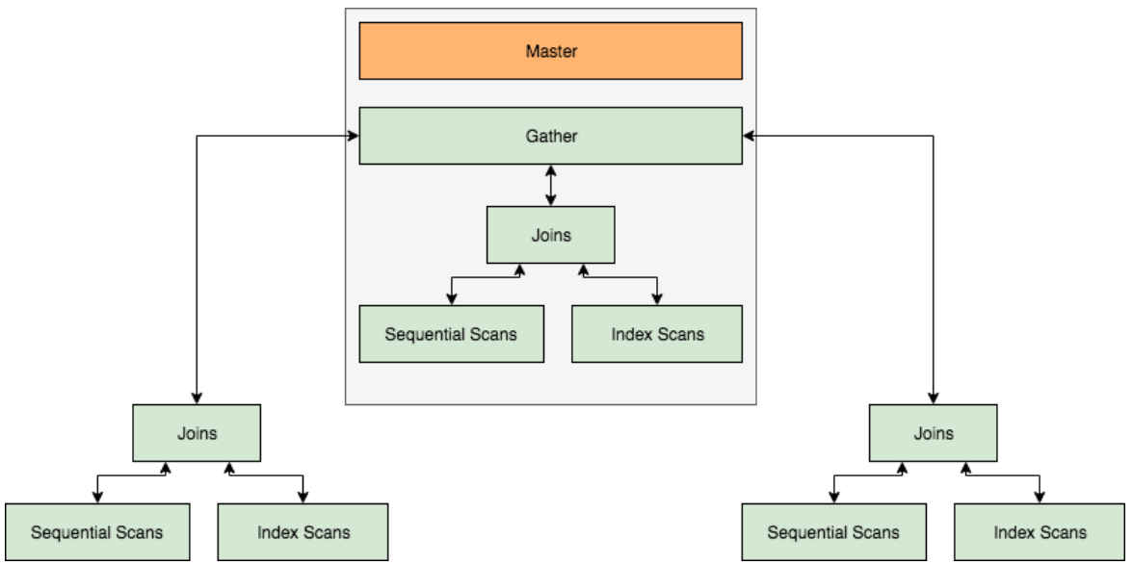
Parallel Joins
Notes:
Just as in a non-parallel plan, the driving table may be joined to one or more other tables using a nested loop, hash join, or merge join.
Depending on the join type, the inner side may also be a parallel plan.
In a nested loop join, the inner side is always non-parallel. Although it is executed in full, this is efficient if the inner side is an index scan, because the outer tuples and thus the loops that look up values in the index are divided over the workers.
In a merge join, the inner side is always a non-parallel plan and therefore executed in full. This may be inefficient, especially if a sort must be performed, because the work and resulting data are duplicated in every worker.
In a hash join (without the "parallel" prefix), the inner side is executed in full by every worker to build identical copies of the hash table. This may be inefficient if the hash table is large or the plan is expensive.
In a parallel hash join, the inner side is a parallel hash that divides the work of building a shared hash table over the cooperating processes.

Slide 34
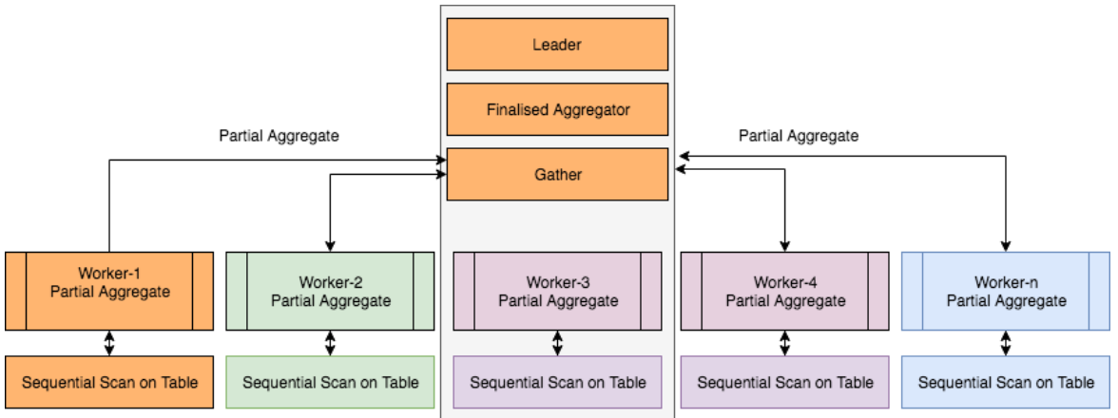
Parallel Aggregates
Notes:
In databases, calculating aggregates are very expensive operations. When evaluated in a single process, these take a reasonably long time.
In PostgreSQL, the ability to calculate these in parallel was added by simply dividing these in chunks (a divide and conquer strategy).
This allowed multiple workers to calculate the part of aggregate before the final value(s) based on these calculations was calculated by the leader.
More technically speaking, Partial Aggregate nodes are added to a plan tree, and each Partial Aggregate node takes the output from one worker.
These outputs are then emitted to a Finalize Aggregate node that combines the aggregates from multiple (all) Partial Aggregate nodes.
So effectively, the parallel partial plan includes a Finalize Aggregate node at the root and a Gather node which will have Partial Aggregate nodes as children.

Slide 35
Q & A

