Slide 1

PostgreSQL DB for DWH and ETL Building
Core PL/pgSQL

Slide 2
Agenda
PL/pgSQL Overview
User-defined Functions
User-defined Procedures
Exception Processing
Transaction Management

Slide 3
PL/PGSQL OVERVIEW

Slide 4
What is PL\pgSQL
Procedural
Language
postgres
Structured
Query
Language
PL\pgSQL
SQL
Notes:
PL\pgSQL procedural language adds many procedural elements, e.g., control structures, loops, and complex computations, to extend standard SQL. It allows you to develop complex functions and stored procedures in PostgreSQL that may not be possible using plain SQL.
SQL is the language PostgreSQL (and most other Relational Databases) use as query language. It's portable and easy to learn. But every SQL statement must be executed individually by the database server.
That means that your client application must send each query to the database server, wait for it to process it, receive the results, do some computation, then send other queries to the server. All this incurs inter process communication and may also incur network overhead if your client is on a different machine than the database server.
With PL/pgSQL you can group a block of computation and a series of queries inside the database server, thus having the power of a procedural language and the ease of use of SQL, but saving lots of time because you don't have the whole client/server communication overhead. Your application will enjoy a considerable performance increase by using PL/pgSQL.
So benefits of PL\pgSQL that it:
can be used to create functions, procedures, and triggers,
adds control structures to the SQL language,
can perform complex computations,
inherits all user-defined types, functions, procedures, and operators,
can be defined to be trusted by the server,
is easy to use.

Slide 5





Other Procedural Languages
RUBY
TCL
Notes:
PostgreSQL allows user-defined functions to be written in other languages besides SQL and C. These other languages are generically called procedural languages (PLs).
For a function written in a procedural language, the database server has no built-in knowledge about how to interpret the function's source text.
The handler could either do all the work of parsing, syntax analysis, execution, etc. itself, or it could serve as “glue” between PostgreSQL and an existing implementation of a programming language. The handler itself is a C language function compiled into a shared object and loaded on demand, just like any other C function.
There are some procedural languages available in the standard PostgreSQL distribution:
PL/pgSQL,
PL/Tcl,
PL/Perl,
PL/Python.
There are additional procedural languages available that are not included in the core distribution.

Slide 6
Block Structure
[ <<label>> ]
[ declare
declarations ]
begin
statements;
...
end [ label ];
Declaration section is optional. Declare here all variables used within the body section.
Body section is required. Place the code here.
Block ended with “;”
Block may have optional label
Notes:
PL\pgSQL is a block-structured language, therefore, a PL\pgSQL function or stored procedure is organized into blocks:
Each block has two sections: declaration and body. The declaration section is optional while the body section is required. A block is ended with a semicolon (;) after the END keyword.
The declaration section is where you declare all variables used within the body section. Each statement in the declaration section is terminated with a semicolon (;).
The body section is where you place the code. Each statement in the body section is also terminated with a semicolon (;).
A block may have an optional label located at the beginning and at the end. You use the block label when you want to specify it in the EXIT statement of the block body or when you want to qualify the names of variables declared in the block.

Slide 7
Anonymous Block
DO $$
<<ab_example>>
BEGIN
RAISE NOTICE 'current time: %', now();
END ab_example;
$$ LANGUAGE 'plpgsql';
DO execute an anonymous code block
The name of the procedural language the code is written in LANGUAGE
Use the dollar-quoted string constant syntax to make block more readable
It is possible to divide a large block into smaller and more logical subblocks
Notes:
The example illustrates a very simple block. It is called an anonymous block.
The idea is to run code that is needed only once. This kind of code execution is especially useful for dealing with administrative tasks. Anonymous code blocks don't take parameters and are not permanently stored in the database, since they don't have names.
DO — execute an anonymous code block. The code block is treated as though it were the body of a function with no parameters, returning void. It is parsed and executed a single time. Notice that the DO statement does not belong to the block.
The name of the procedural language the code is written in LANGUAGE. If omitted, the default is plpgsql.
The code in the block must be surrounded by single quotes. If it has any single quote, you need to escape it by doubling it. However, to avoid it we used the dollar-quoted string.
PL\pgSQL allows you to place a block inside the body of another block.
The block nested inside another block is called a subblock. The block that contains the subblock is referred to as an outer block.
Typically, you divide a large block into smaller and more logical subblocks.

Slide 8
Variables
var_name data_type [:= expression];
do $$
declare
counter integer := 1;
first_name varchar(50);
last_name varchar(50);
begin
/*do something*/
end $$;
select select_column
into variable_name
from table_expression;
do $$
declare
p_title text;
begin
select title
into p_title
from some_table
where id = 999;
end; $$
Notes:
Before using a variable, you must declare it in the declaration section of the PL/pgSQL block.
Specify a name(meaningful name)
Associate specific data type with variable
Assign a default value(optional). If you don’t do so, the initial value of the variable is NULL.
When you declare a variable in a subblock which is the same name as another variable in the outer block, the variable in the outer block is hidden in the subblock.
The select into statement allows you to select data from the database and assign the data to a variable. In this syntax, you place the variable after the into keyword. The select into statement will assign the data returned by the select clause to the variable.

Slide 9
TYPE and ROWTYPE
var_name table_name.column_name%type;
var_name var_name%type;
do $$
declare
p_title some_table.title%type;
selected_row some_table%rowtype;
begin
-- get title of id 999
select title
into p_title
from some_table
where film_id = 999;
-- select row with id 999
select *
into selected_row
from some_table
where id = 999;
-- show the titles
raise notice 'The title % is equal to %',
title,
selected_row.title;
end; $$
row_variable table_name%ROWTYPE;
row_variable view_name%ROWTYPE;
var_name record;
Notes:
The %type provides the data type of a table column or another variable. Typically, you use the %type to declare a variable that holds a value from the database or another variable.
advantages of this kind of declaration:
you don’t need to know the type of the column or reference that you are referencing.
if the data type of the referenced column name (or variable) changes, you don’t need to change the definition of the function.
To store the whole row of a result set returned by the select into statement, you use the row-type variable or row variable. To access the individual field of the row variable, you use the dot notation (.):
row_variable.field_name.
Moreover, PostgreSQL provides a “type” called the record that is similar to the row-type. A record variable is similar to a row-type variable. It can hold only one row of a result set.
Unlike a row-type variable, a record variable does not have a predefined structure. The structure of a record variable is determined when the select or for statement assigns an actual row to it.
To access a field in the record, you use the dot notation (.)
If you attempt to access a field in a record variable before it is assigned, you will get an error. In fact, a record is not a true data type. It is just a placeholder. Also, a record variable can change its structure when you reassign it.

Slide 10
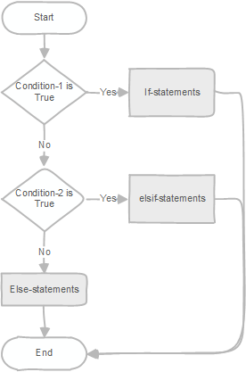
Control Structures: IF-THEN-ELSE
if condition_1 then
statements_1;
elsif condition_2 then
statements_2;
…
elsif condition_n then
statements_n;
else
alternative-statements;
END if;
if condition then
statements;
else
alternative-statements;
END if;
Notes:
PL/pgSQL provides you with three forms of the if statements.
if then - to execute statements when a condition is true
if then else - to execute statements when a condition is true and execute other statements when the condition is false
if then elsif - to evaluate multiple conditions and execute statements when the corresponding condition is true
The if and if then else statements evaluate one condition. However, the if then elsif statement evaluates multiple conditions. If a condition is true, the corresponding statement in that branch is executed.

Slide 11
Control Structures: CASE
Simple case statement
Search case statement
case search-expression
when expression_1 [, expression_2, ...] then
when-statements
[ ... ]
[else
else-statements ]
END case;
case
when boolean-expression-1 then
statements
[ when boolean-expression-2 then
statements
... ]
[ else
statements ]
end case;
Notes:
Besides the if statement, PostgreSQL provides you with case statements that allow you to execute a block of code based on a condition.
The case statement selects a when section to execute from a list of when sections based on a condition.
The case statement has two forms:
Simple case statement - compares the result of the search-expression with the expression in each when branch using equal operator ( =) from top to bottom.
Searched case statement - evaluates the Boolean expressions sequentially from top to bottom until it finds an expression that evaluates to true

Slide 12
Control Structures: LOOP
<<outer>>
loop
statements;
continue <<outer>> [when condition]
<<inner>>
loop
/* ... */
exit <<inner>>
end loop;
end loop;
do $$
declare
n integer := 5;
counter integer := 0 ;
begin
loop
exit when counter = n ;
counter := counter + 1 ;
raise notice '%', counter;
end loop;
end; $$
[ <<label>> ]
while condition loop
statements;
end loop;
...
while counter < n loop
raise notice 'Counter %', counter;
counter := counter + 1;
end loop;
...
Notes:
The loop defines an unconditional loop that executes a block of code repeatedly until terminated by an exit or return statement. It’s possible to place a loop statement inside another loop statement. When a loop statement is placed inside another loop statement, it is called a nested loop. When you have nested loops, you need to use the loop label so that you can specify it in the exit and continue statement to indicate which loop these statements refer to.
The exit statement allows you to terminate a loop including an unconditional loop, a while loop, and a for loop. Depending on the label, the exit statement will terminate the corresponding loop. If you don’t use the label, the exit statement will terminate the current loop.
The continue statement prematurely skips the current iteration of the loop and jumps to the next one. The continue statement can be used in all kinds of loops including unconditional loops, while loops, and for loops. You can specify the label of the loop that you want to skip the current iteration. As well as the when condition which is a Boolean expression that specifies the condition to skip the current iteration of the loop. If the condition is true, then the continue will skip the current loop iteration.
=while loop=
The while loop statement executes a block of code until a condition evaluates to false. In this syntax, PostgreSQL evaluates the condition before executing the statements. If the condition is true, it executes the statements. After each iteration, the while loop evaluates the condition again.
=for loop=
the for loop creates an integer variable loop_counter which is accessible inside the loop only. By default, the for loop adds the step to the loop_counter after each iteration. However, when you use the reverse option, the for loop subtracts the step from loop_counter.
the from and to are expressions that specify the lower and upper bound of the range.
the step that follows the by keyword specifies the iteration step. It defaults to 1. The for loop evaluates this step expression once only.
Iti is also possible to use the for loop statement to iterate over a result set of a query.
=foreach loop=
The FOREACH loop is much like a FOR loop, but instead of iterating through the rows returned by a SQL query, it iterates through the elements of an array value. (In general, FOREACH is meant for looping through components of a composite-valued expression; variants for looping through composites besides arrays may be added in future.)
Without SLICE, or if SLICE 0 is specified, the loop iterates through individual elements of the array produced by evaluating the expression. The target variable is assigned each element value in sequence, and the loop body is executed for each element. With a positive SLICE value, FOREACH iterates through slices of the array rather than single elements. The SLICE value must be an integer constant not larger than the number of dimensions of the array.

Slide 13
Control Structures: LOOP FOR
[ <<label>> ]
for loop_counter in ([ reverse ] from.. to [ by step ] ) loop
statements
end loop [ label ];
do $$
begin
-- simple loop
for counter in 1..5 loop
raise notice 'counter: %', counter;
end loop;
-- loop with step = 2
for counter in 1..6 by 2 loop
raise notice 'counter: %', counter;
end loop;
end; $$
Notes:
=for loop=
the for loop creates an integer variable loop_counter which is accessible inside the loop only. By default, the for loop adds the step to the loop_counter after each iteration. However, when you use the reverse option, the for loop subtracts the step from loop_counter.
the from and to are expressions that specify the lower and upper bound of the range.
the step that follows the by keyword specifies the iteration step. It defaults to 1. The for loop evaluates this step expression once only.
If the lower bound is greater than the upper bound (or less than, in the REVERSE case), the loop body is not executed at all. No error is raised.
If a label is attached to the FOR loop then the integer loop variable can be referenced with a qualified name, using that label.

Slide 14
Looping over a result set
[ <<label>> ]
FOR target IN query LOOP
statements
END LOOP [ label ];
do
$$
declare
rec record;
begin
for rec in select id, title
from some_table
order by id desc, title
limit 5
loop
raise notice '%(title: %)’,
rec.id,
rec.title;
end loop;
end;
$$
Notes:
It is also possible to use the for-loop statement to iterate over a result set of a query.
The target is a record variable, row variable, or comma-separated list of scalar variables. The target is successively assigned each row resulting from the query and the loop body is executed for each row.
The query used in this type of FOR statement can be any SQL command that returns rows to the caller: SELECT is the most common case, but you can also use INSERT, UPDATE, or DELETE with a RETURNING clause.
If the loop is terminated by an EXIT statement, the last assigned row value is still accessible after the loop.

Slide 15
Control Structures: LOOP FOR EACH
do
$$
declare
arr int[];
x int;
begin
arr := ARRAY[1,2,3,4,5,6,7,8,9,10];
FOREACH x SLICE 0 in ARRAY arr
loop
raise notice '%', x;
end loop;
end;
$$
[ <<label>> ]
FOREACH target [ SLICE number ] IN ARRAY expression loop
statements
END LOOP [ label ];
Notes:
=foreach loop=
The FOREACH loop is much like a FOR loop, but instead of iterating through the rows returned by a SQL query, it iterates through the elements of an array value. In general, FOREACH is meant for looping through components of a composite-valued expression;
Without SLICE, or if SLICE 0 is specified, the loop iterates through individual elements of the array produced by evaluating the expression. The target variable is assigned each element value in sequence, and the loop body is executed for each element. With a positive SLICE value, FOREACH iterates through slices of the array rather than single elements. The SLICE value must be an integer constant not larger than the number of dimensions of the array.
Although the target is usually just a single variable, it can be a list of variables when looping through an array of composite values (records). In that case, for each array element, the variables are assigned from successive columns of the composite value.

Slide 16
USER-DEFINED FUNCTIONS

Slide 17
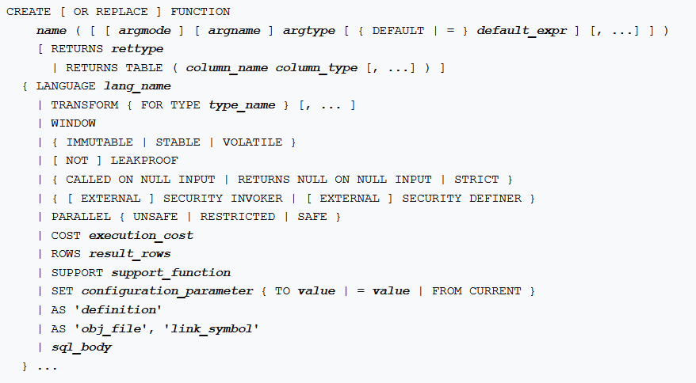
Create Function
Notes:
The create function statement allows you to define a new user-defined function. If you want to replace the existing function, you can use the or replace keywords.
If you drop and then recreate a function, the new function is not the same entity as the old; you will have to drop existing rules, views, triggers, etc. that refer to the old function. Use CREATE OR REPLACE FUNCTION to change a function definition without breaking objects that refer to the function.
A function can have zero or many parameters.
You could also specify the datatype of the returned value after the returns keyword. It is possible for a function to return no value; in this case, a function is specified as RETURNS VOID.
Some additional CREATE FUNCTION options:
IMMUTABLE - The function will always return the same output for the same input. Think of arithmetic functions. Only immutable functions can be used in the definition of indexes.
STABLE - The function will return the same value for the same inputs within the same query.
VOLATILE - The function can return different values with each call, even with the same inputs. Think of functions that change data or depend on environment settings like system time. This is the default.
STRICT - A function marked with this qualifier will always return NULL if any inputs are NULL.
ROWS - Applies only to functions returning sets of records.
PARALLEL - This qualifier allows the planner to run in parallel mode.

Slide 18
Parameters
IN | OUT | INOUT
The default | Explicitly specified | Explicitly specified
Pass a value to function | Return a value from a function | Pass a value to a function and return an updated value.
in parameters act like constants | out parameters act like uninitialized variables | inout parameters act like an initialized variables
Cannot be assigned a value | Must assign a value | Should be assigned a value
create or replace function test (
a int,
inout x int,
inout y int,
out mx int
) language plpgsql
as $$
begin
select x,y, max(x) into y, x, mx
from some_table
where some_column = a
group by x,y;
end; $$;
select some_function(1,2);
select some_function(a=>1,b=>2);
select some_function(1,b=>2);
Notes:
The parameter modes determine the behaviors of parameters. PL/pgSQL supports three parameter modes: in, out, and inout. A parameter takes the in mode by default if you do not explicitly specify it.
The out parameters are defined as a part of the argument list and are returned back as a part of the result. The out parameters are very useful in functions that need to return multiple values.
The inout mode is the combination in and out modes.
It means that the caller can pass an argument to a function. The function changes the argument and returns the updated value.
PostgreSQL provides you with three ways to call a user-defined function:
Using positional notation - you need to specify the arguments in the same order as parameters.
Using named notation - you use the => to separate the argument’s name and its value.
Using the mixed notation. Note! that you cannot use the named arguments before positional arguments (a=>1, b) – error occurres

Slide 19
RETURN
create function get_count(p_from int, p_to int)
returns int
language plpgsql
as $$
declare
v_count integer;
begin
select count(*)
into v_count
from some_table
where length between p_from and p_to;
return v_count;
end;$$;
-- functions returning a scalar type
RETURN 1 + 2;
RETURN scalar_var;
-- functions returning a composite type
RETURN composite_type_var;
RETURN (1, 2, 'three'::text); -- must cast columns to correct types
Notes:
RETURN with an expression terminates the function and returns the value of expression to the caller.
In a function that returns a scalar type, the expression's result will automatically be cast into the function's return type as described for assignments. But to return a composite (row) value, you must write an expression delivering exactly the requested column set.
If you declared the function with output parameters, write just RETURN with no expression. The current values of the output parameter variables will be returned.

Slide 20
RETURN TABLE
CREATE FUNCTION function_name(/*function_params*/)
RETURNS TABLE (
/* definitions of columns */
)
AS $$
DECLARE
-- variable declaration
BEGIN
RETURN QUERY
/* query definition */
END;
$$ LANGUAGE plpgsql;
create or replace function get_info (
p_pattern varchar)
returns table ( title varchar,
id int)
language plpgsql
as $$
begin
return query
select title, id
from some_table
where title ilike p_pattern;
end;$$;
SELECT * FROM get_info('%have%');
Notes:
Also, it is possible to define a function that returns a table. Instead of returning a single value, this syntax allows you to return a table with a specified column list. For example, we could return a query result of a SELECT statement. The columns in the SELECT statement must match with the columns of the table that we want to return.
When a PL/pgSQL function is declared to return SETOF sometype (and a table as well), in that case, the individual items to return are specified by a sequence of RETURN NEXT or RETURN QUERY commands, and then a final RETURN command with no argument is used to indicate that the function has finished executing.
RETURN QUERY appends the results of executing a query to the function's result set.
In an example:
The RETURNS TABLE syntax, along with definitions of the columns, informs Postgres that this function should return a table.
In the function body, we use the RETURN QUERY syntax followed by the SELECT statement. The types and number of columns specified in the SELECT statement must match those of the columns we want to return. The result of the SELECT query is the result of the function.

Slide 21
RETURN NEXT
CREATE FUNCTION function_name(/*function_params*/)
RETURNS TABLE (
/* definitions of columns */
)
AS $$
DECLARE
curr_rec record;
BEGIN
FOR curr_rec IN (/* query/set you want to loop through */)
LOOP
/* some custom logic */
RETURN NEXT;
END LOOP;
END;
$$ LANGUAGE plpgsql;
create or replace function get_info ( p_pattern varchar)
returns table ( title varchar,
id int)
language plpgsql
as $$
declare
v_rec record;
begin
for v_rec in(
select title, id
from some_table
where title ilike p_pattern
) loop
title := upper(v_rec.title) ;
id := v_rec.id;
return next;
end loop; end;$$;
SELECT * FROM get_info('%have%');
Notes:
RETURN NEXT can be used with both scalar and composite data types; with a composite result type, an entire “table” of results will be returned.
RETURN NEXT and RETURN QUERY do not actually return from the function — they simply append zero or more rows to the function's result set. Execution then continues with the next statement in the PL/pgSQL function.
A final RETURN, which should have no argument, causes control to exit the function.
As an alternative to the RETURN QUERY syntax, Postgres allows you to process rows individually and append them to the final table that is returned by your function. This approach requires having a loop defined along with the RETURN NEXT command.
Since we want to process each record individually, before we append a given record to the final table, we create a FOR LOOP statement to loop through the upcoming events. The final table is built in each iteration of the FOR LOOP as the RETURN NEXT command adds the current row to the final result set.
RETURN NEXT and RETURN QUERY store the entire result set before returning from the function. That means performance might be poor for very large result sets.

Slide 22
USER-DEFINE PROCEDURES

Slide 23
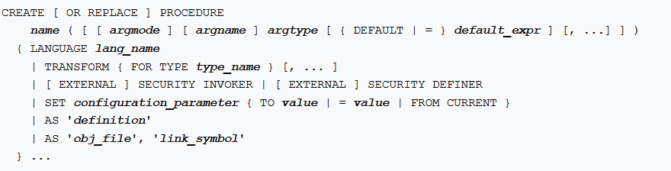

Create Procedure
Notes:
A drawback of user-defined functions is that they cannot execute transactions. In other words, inside a user-defined function, you cannot start a transaction, and commit or rollback it.
A function is part of a normal SQL statement and is not allowed to start or commit transactions. You can run it inside a SELECT statement.
PostgreSQL 11 introduced stored procedures that support transactions.
A procedure, in contrast, is able to control transactions and even run multiple transactions one after the other. However, you cannot run it inside a SELECT statement. Instead, you have to invoke CALL.
If CALL is executed in a transaction block, then the called procedure cannot execute transaction control statements. Transaction control statements are only allowed if CALL is executed in its own transaction.
To define a new stored procedure, you use the create procedure statement.
A stored procedure can accept zero or more parameters. You can use other procedural languages for the stored procedure such as SQL, C, etc.
Parameters in stored procedures can have the in and inout modes. They cannot have the out mode. A stored procedure does not return a value. You cannot use the return statement with a value inside. However, you can use the return statement without the expression to stop the stored procedure immediately.
If you want to return a value from a stored procedure, you can use parameters with the inout mode.

Slide 24
Create Procedure Example
create or replace procedure transfer(
sender int,
receiver int,
amount dec
)
language plpgsql
as $$
begin
-- subtracting the amount from the sender's account
update accounts
set balance = balance - amount
where id = sender;
-- adding the amount to the receiver's account
update accounts
set balance = balance + amount
where id = receiver;
commit;
end;$$
CALL transfer(1,2,1000);
Notes:
The following example creates a stored procedure named transfer that transfers a specified amount of money from one account to another.
To call a stored procedure, you use the CALL statement.
For example, this statement invokes the transfer stored procedure to transfer $1,000 from account 1 to account 2.

Slide 25
EXCEPTION PROCESSING

Slide 26
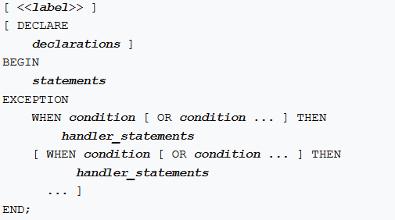
Errors Handling
Notes:
By default, any error occurring in a PL/pgSQL function aborts execution of the function and the surrounding transaction. You can trap errors and recover from them by using a BEGIN block with an EXCEPTION clause.
If no error occurs, BEGIN EXCAPTION block simply executes all the statements, and then control passes to the next statement after END. But if an error occurs within the statements, further processing of the statements is abandoned, and control passes to the EXCEPTION list.
The list is searched for the first condition matching the error that occurred.
If a match is found, the corresponding handler_statements are executed, and then control passes to the next statement after END.
If no match is found, the error propagates out as though the EXCEPTION clause were not there at all: the error can be caught by an enclosing block with EXCEPTION, or if there is none it aborts processing of the function.

Slide 27
Errors Handling Example
DO
$$
declare
v_rec record;
v_id int = 2000;
begin
-- select info
select id, title
into strict v_rec
from some_table
where id = v_id;
-- catch exception
exception
when no_data_found then -- or "when sqlstate 'P0002' then"
raise exception 'Row id % not found', v_id;
when too_many_rows then -- or "when sqlstate 'P0003' then"
raise exception 'Search query returns too many rows’;
when others then
raise exception '% %', sqlstate, sqlerrm;
end; $$ language plpgsql;
Notes:
The condition names can be no_data_found in case of a select statement return no rows or too_many_rows if the select statement returns more than one row. For a complete list of condition names on the PostgreSQL website.
It’s also possible to specify the error condition by SQLSTATE code. For example, P0002 for no_data_found and P0003 for too_many_rows.
Typically, you will catch a specific exception and handle it accordingly. To handle other exceptions rather than the one you specify on the list, you can use the when others then clause.
Within an exception handler, the special variable SQLSTATE contains the error code that corresponds to the exception that was raised.
The special variable SQLERRM contains the error message associated with the exception. These variables are undefined outside exception handlers.

Slide 28
Information about an Error
RETURNED_SQLSTATE | text | the SQLSTATE error code of the exception
COLUMN_NAME | text | the name of the column related to exception
CONSTRAINT_NAME | text | the name of the constraint related to exception
PG_DATATYPE_NAME | text | the name of the data type related to exception
MESSAGE_TEXT | text | the text of the exception's primary message
TABLE_NAME | text | the name of the table related to exception
SCHEMA_NAME | text | the name of the schema related to exception
PG_EXCEPTION_DETAIL | text | the text of the exception's detail message, if any
PG_EXCEPTION_HINT | text | the text of the exception's hint message, if any
PG_EXCEPTION_CONTEXT | text | line(s) of text describing the call stack at the time of the exception
...
EXCEPTION WHEN OTHERS THEN
GET STACKED DIAGNOSTICS text_var1 = MESSAGE_TEXT,
text_var2 = PG_EXCEPTION_DETAIL,
text_var3 = PG_EXCEPTION_HINT;
END;
Notes:
Exception handlers frequently need to identify the specific error that occurred.
There are two ways to get information about the current exception in PL/pgSQL: SQLERRM and SQLSATET special variables which discussed before and the GET STACKED DIAGNOSTICS command.
Each item in GET STACKED DIAGNOSTICS command is a key word identifying a status value to be assigned to the specified variable (which should be of the right data type to receive it). The currently available status items are shown in Table.
The GET STACKED DIAGNOSTICS command reports information about the execution state as of a previous error, whereas the GET DIAGNOSTICS command, retrieves information about current execution state.

Slide 29
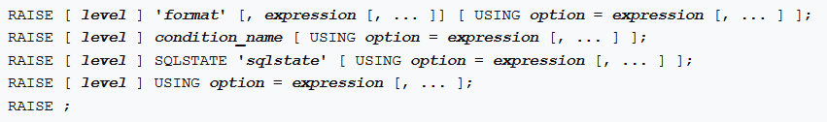
RAISE
DEBUG
LOG
INFO
NOTICE
WARNING
EXCEPTION
MESSAGE
DETAIL
HINT
ERRCODE
COLUMN
CONSTRAINT
DATATYPE
TABLE
SCHEMA
Example:
...
RAISE EXCEPTION ‘Nonexistent ID → %’, user_id
USING HINT = ‘Please check your user ID’;
Notes:
Use the RAISE statement to report messages and raise errors.
The level option specifies the error severity.
Allowed levels:
DEBUG,
LOG,
INFO,
NOTICE,
WARNING,
EXCEPTION, with EXCEPTION being the default. EXCEPTION raises an error (which normally aborts the current transaction);
the other levels only generate messages of different priority levels.
After level if any, you can write a format (which must be a simple string literal, not an expression). The format string specifies the error message text to be reported. The format string can be followed by optional argument expressions to be inserted into the message. Inside the format string, % is replaced by the string representation of the next optional argument's value. Write %% to emit a literal %. The number of arguments must match the number of % placeholders in the format string, or an error is raised during the compilation of the function.
You can attach additional information to the error report by writing USING followed by option = expression items. Each expression can be any string-valued expression. The allowed option key words are:
MESSAGE -Sets the error message text. This option can't be used in the form of RAISE that includes a format string before USING.
DETAIL - Supplies an error detail message.
HINT - Supplies a hint message.
ERRCODE - Specifies the error code (SQLSTATE) to report, either by condition name, as shown in Appendix A, or directly as a five-character SQLSTATE code.
COLUMN
CONSTRAINT
DATATYPE
TABLE
SCHEMA - Supplies the name of a related object.

Slide 30
TRANSACTION MANAGEMENT

Slide 31
COMMIT-ROLLBACK
CREATE PROCEDURE load_with_transform()
AS $load$
DECLARE
v_cnt int;
v_record record;
BEGIN
FOR v_record IN (SELECT * FROM data_source) LOOP
BEGIN
PERFORM transform (v_rec.id);
CALL insert_data(v_rec.*);
v_cnt:=v_cnt+1;
IF v_cnt>=5000 THEN
COMMIT;
v_cnt:=0;
END IF;
EXCEPTION
WHEN OTHERS THEN
ROLLBACK;
END;
END LOOP;
COMMIT;
END;
$load$ LANGUAGE plpgsql;
COMMIT after each 5000 rows
or ROLLBACK in case of any issue
Notes:
The most important difference between how functions and stored procedures are executed is that you can commit or roll back a transaction within a procedure body.
At the start of the procedure execution, a new transaction starts, and any COMMIT or ROLLBACK command within a function body will terminate the current transaction and start a new one.
A new transaction is started automatically after a transaction is ended using these commands, so there is no separate START TRANSACTION command.
One of the use cases is the bulk data load. We find it beneficial to commit changes in reasonably sized portions, for example, every 5000 records.
In an example a data is processed before loading and COMMIT when we process 5000 records. An additional commit upon exiting the loop is necessary for the remaining records, processed after the last in-loop commit.
In case of any issue occurs in EXCEPTION block perform ROLLBACK.

Slide 32
Limitation
CALL proc1() → CALL proc2() → CALL proc3()
CALL proc1() → SELECT func2() → CALL proc3()
Notes:
There are a few limitations of using transaction in procedures.
Transaction control is only possible in CALL or DO calls from the top level or nested CALL or DO calls without any other intervening command and not one called from another procedure or function instance.
For example, if the call stack is CALL proc1() → CALL proc2() → CALL proc3(), then the second and third procedures can perform transaction control actions.
But if the call stack is CALL proc1() → SELECT func2() → CALL proc3(), then the last procedure cannot do transaction control, because of the SELECT in between.

Slide 33
Q & A

