Slide 1

PostgreSQL DB for DWH and ETL Building
PostgreSQL Relational Structures

Slide 2
Agenda
Types of Tables
Types of Indexes
Materialized View
Foreign Data Wrappers

Slide 3
TYPES OF TABLES

Slide 4
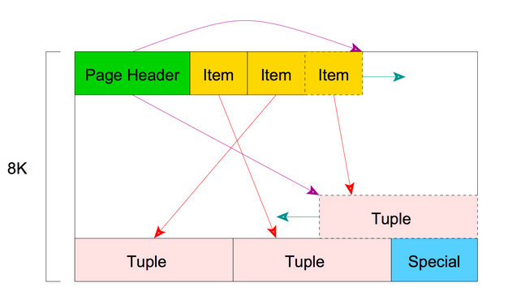
Several words about storage
Database stored together within the cluster's data directory
Tables are stored in a separate file (1Gb max file size)
The System tables in a pg_catalog schema
Datafiles are divided into a pages
Page structure
Notes:
Each table or index whose size is less than 1GB is a single file stored under the database directory it belongs to. Tables and indexes as database objects are internally managed by individual OIDs. When the file size of tables and indexes exceeds 1GB, PostgreSQL creates a new file and uses it. If the new file has been filled up, next new file will be created, and so on.
Inside the data file, it is divided into pages (or blocks) of fixed length, the default is 8192 byte (8 KB). Those pages within each file are numbered sequentially from 0, and such numbers are called as block numbers. If the file has been filled up, PostgreSQL adds a new empty page to the end of the file to increase the file size.
It's interesting to know that there is a system catalog schema which contains tables that you may want to query to find extra information. Each database contains a pg_catalog schema, which contains the system tables and all the built-in data types, functions, and operators. pg_catalog is always effectively part of the search path, so you don't need to use the prefix when you query the system tables.
Every table stored as an array of pages of a fixed size (usually 8Kb). In a table, all the pages are logically equivalent, so a particular item (row) can be stored in any page.
The structure used to store the table is a heap file. Heap files are lists of unordered records of variable size. The heap file is structured as a collection of pages (or block), each containing a collection of items. The term item refers to a row that is stored on a page.
Internal layout of pages depends on the data file types. An empty space between the end of line pointers and the beginning of the newest tuple is referred to as free space or hole.
To identify a tuple within the table, tuple identifier (TID) is internally used. A TID comprises a pair of values: the block number of the page that contains the tuple, and the offset number of the line pointer that points to the tuple.
Looking carefully at the database subdirectories, you will find out that each table has two associated files suffixed respectively with '_fsm' and '_vm'. Those are referred to as free space map and visibility map, storing the information of the free space capacity and the visibility on each page within the table file, respectively. Indexes only have individual free space maps and don't have visibility map.
Each heap and index relation, except for hash indexes, has a Free Space Map (FSM) to keep track of available space in the relation
Each heap relation has a Visibility Map (VM) to keep track of which pages contain only tuples that are known to be visible to all active transactions; it also keeps track of which pages contain only frozen tuples

Slide 5
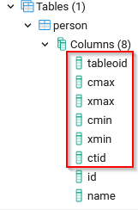
System Columns
tableoid - The OID of the table containing this row
xmin - The identity (transaction ID) of the inserting transaction for this row version.
cmin - The command identifier (starting at zero) within the inserting transaction.
xmax - The identity (transaction ID) of the deleting transaction, or zero for an undeleted row version.
cmax - The command identifier within the deleting transaction, or zero.
ctid - The physical location of the row version within its table.
Notes:
Every table has several system columns that are implicitly defined by the system. Therefore, these names cannot be used as names of user-defined columns. (Note that these restrictions are separate from whether the name is a key word or not; quoting a name will not allow you to escape these restrictions.) You do not really need to be concerned about these columns; just know they exist.
tableoid - The OID of the table containing this row. This column is particularly handy for queries that select from inheritance hierarchies (see Section 5.10), since without it, it's difficult to tell which individual table a row came from. The tableoid can be joined against the oid column of pg_class to obtain the table name.
xmin - The identity (transaction ID) of the inserting transaction for this row version. (A row version is an individual state of a row; each update of a row creates a new row version for the same logical row.)
cmin - The command identifier (starting at zero) within the inserting transaction.
xmax - The identity (transaction ID) of the deleting transaction, or zero for an undeleted row version. It is possible for this column to be nonzero in a visible row version. That usually indicates that the deleting transaction hasn't committed yet, or that an attempted deletion was rolled back.
cmax - The command identifier within the deleting transaction, or zero.
ctid - The physical location of the row version within its table. Note that although the ctid can be used to locate the row version very quickly, a row's ctid will change if it is updated or moved by VACUUM FULL. Therefore ctid is useless as a long-term row identifier. A primary key should be used to identify logical rows.

Slide 6
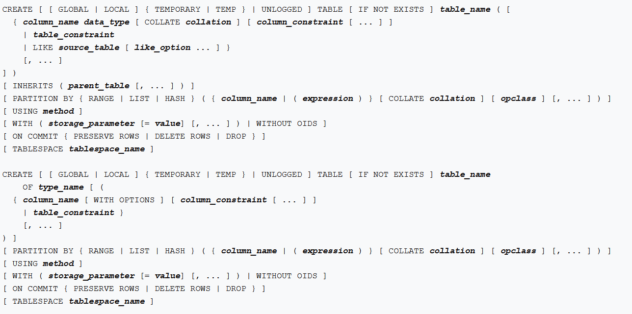
CREATE TABLE command
TEMPORARY or TEMP - Temporary tables are automatically dropped at the end of a session, or optionally at the end of the current transaction
UNLOGGED - Data written to unlogged tables is not written to the write-ahead log, which makes them considerably faster than ordinary tables.
INHERITS - Creates a persistent relationship between the new child table and its parent table(s).
PARTITION BY - Specifies a strategy of partitioning the table. The table thus created is called a partitioned table.
LIKE - Specifies a table from which the new table automatically copies all column names, their data types, and their not-null constraints.
Notes:
CREATE TABLE will create a new, initially empty table in the current database. The table will be owned by the user issuing the command.
If a schema name is given (for example, CREATE TABLE myschema.mytable ...) then the table is created in the specified schema. Otherwise it is created in the current schema. Temporary tables exist in a special schema, so a schema name cannot be given when creating a temporary table. The name of the table must be distinct from the name of any other table, sequence, index, view, or foreign table in the same schema.
CREATE TABLE also automatically creates a data type that represents the composite type corresponding to one row of the table. Therefore, tables cannot have the same name as any existing data type in the same schema.
The optional constraint clauses specify constraints (tests) that new or updated rows must satisfy for an insert or update operation to succeed. A constraint is an SQL object that helps define the set of valid values in the table in various ways.
There are two ways to define constraints: table constraints and column constraints. A column constraint is defined as part of a column definition. A table constraint definition is not tied to a particular column, and it can encompass more than one column. Every column constraint can also be written as a table constraint; a column constraint is only a notational convenience for use when the constraint only affects one column.

Slide 7
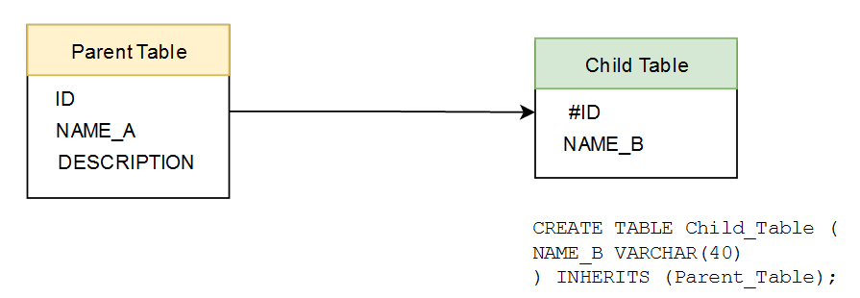
Inherited Table
table can inherit from zero or more other tables
a query can reference either all rows of a table or all rows of a table plus all of its descendant tables
all check constraints and not-null constraints on a parent table are automatically inherited by its children, unless explicitly specified otherwise
Notes:
PostgreSQL stands alone as the only database product offering inherited tables. When you specify that a table (the child table) inherits from another table (the parent table), PostgreSQL creates the child table with its own columns plus all the columns of the parent table.
PostgreSQL will remember this parent-child relationship so that any subsequent structural changes to the parent automatically propagate to its children. Parent-child table design is perfect for partitioning your data.
When you query the parent table, PostgreSQL automatically includes all rows in the child tables. Not every trait of the parent passes down to the child.
Notably, primary key constraints, foreign key constraints, uniqueness constraints, and indexes are never inherited. Check constraints are inherited, but children can have their own check constraints in addition to the ones they inherit from their parents.

Slide 8
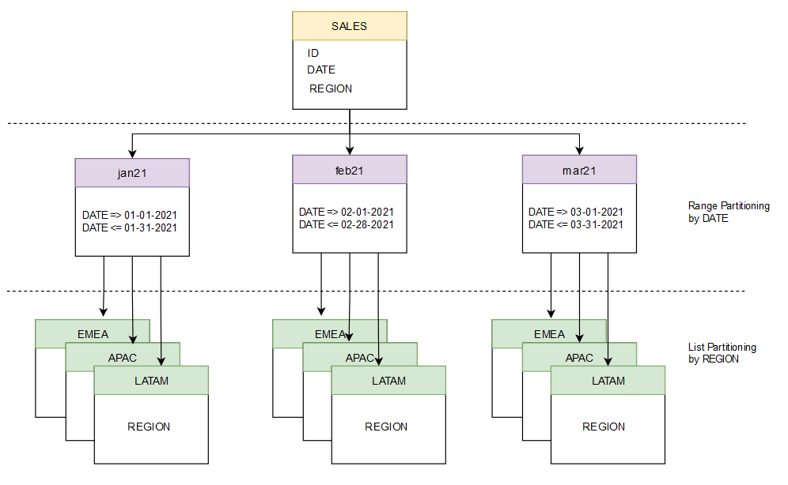
Partitioned Table
Data can be inserted into the core table and is rerouted automatically to the matching partition
All tables in a partition must have the same exact columns
Each partitioned table belongs to a single partitioned group
The parent of the partition can’t have primary keys, unique keys, or indexes, although the child partitions can
All inserts are redirected to a matching child partition
Notes:
Partitioned tables are much like inherited tables in that they allow partitioning of data across many tables and the planner can conditionally skip tables that don’t satisfy a query condition. Internally they are implemented much the same, but use a different DDL syntax.
Although partitioned tables replace the functionality of inherited tables in many cases, they are not complete replacements. Here are some key differences between inherited tables and partition tables:
When partitions are used, data can be inserted into the core table and is rerouted automatically to the matching partition. This is not the case with inherited tables, where you either need to insert data into the child table, or have a trigger that reroutes data to the child tables.
All tables in a partition must have the same exact columns. This is unlike inherited tables, where child tables are allowed to have additional columns that are not in the parent tables.
Each partitioned table belongs to a single partitioned group. Internally that means it can have only one parent table. Inherited tables, on other hand, can inherit columns from multiple tables.
The parent of the partition can’t have primary keys, unique keys, or indexes, although the child partitions can. This is different from the inheritance tables, where the parent and each child can have a primary key that needs only to be unique within the table, not necessarily across all the inherited children.
Unlike inherited tables, the parent partitioned table can’t have any rows of its own. All inserts are redirected to a matching child partition and when no matching child partition is available, an error is thrown.

Slide 9
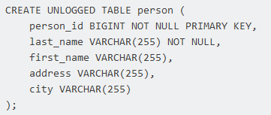
Unlogged Table
Large data sets that take a lot of time to import and are only used a couple of times
Dynamic data that after a server crashes will not be that useful anyway, such as user sessions.
Static data that you can afford losing and re-importing in the unlikely event of a server crash.
Notes:
For ephemeral data that could be rebuilt in the event of a disk failure or doesn’t need to be restored after a crash, you might prefer having more speed than redundancy. The UNLOGGED modifier allows you to create unlogged tables. These tables will not be part of any write-ahead logs. The big advantage of an unlogged table is that writing data to it is much faster than to a logged table—10−15 times faster in our experience.
If you accidentally unplug the power cord on the server and then turn the power back on, the rollback process will wipe clean all data in unlogged tables. Another consequence of making a table unlogged is that its data won’t be able to participate in PostgreSQL replication.
You can use unlogged tables in following scenarios:
Large data sets that take a lot of time to import and are only used a couple of times (finance, scientific computing, and even big data).
Dynamic data that after a server crashes will not be that useful anyway, such as user sessions.
Static data that you can afford losing and re-importing in the unlikely event of a server crash.
Finally, unlike temporary tables, unlogged ones are not dropped at the end of a the session or the current transaction, and under normal operations (that is, no crashes) they are, in fact, persistent and operate normally — but faster.

Slide 10

CLUSTER
Physically reordered based on the index information
Lock the table while CLUSTER is running
Data can only be organized according to one index
The clustered state of a table will not be maintained as changes are made to a table during normal operations
Notes:
In PostgreSQL, there is a command called CLUSTER that allows us to rewrite a table in the desired order. It is possible to point to an index and store data in the same order as the index.
CLUSTER instructs PostgreSQL to cluster the table specified by table_name based on the index specified by index_name. The index must already have been defined on table_name.
When a table is clustered, it is physically reordered based on the index information. Clustering is a one-time operation: when the table is subsequently updated, the changes are not clustered. That is, no attempt is made to store new or updated rows according to their index order.
When a table is clustered, PostgreSQL remembers which index it was clustered by.
There are some things to consider before blindly running it on a production system:
The CLUSTER command will lock the table while it is running. You cannot insert or modify data while CLUSTER is running. This might not be acceptable on a production system.
Data can only be organized according to one index. You cannot order a table by zip code, name, ID, birthday, and so on, at the same time. This means that CLUSTER will make sense if there are search criteria that are used most of the time.
The performance difference between a clustered and a nonclustered table will depend on the workload, the amount of data retrieved, cache hit rates, and a lot more.
The clustered state of a table will not be maintained as changes are made to a table during normal operations. Correlation will usually deteriorate as time goes by.

Slide 11
TYPES OF INDEXES
Notes:
PostgreSQL comes with a lavish framework for creating and fine-tuning indexes. The art of PostgreSQL indexing could fill a tome all by itself. PostgreSQL is packaged with several types of indexes. If you find these inadequate, you can define new index operators and modifiers to supplement. If still unsatisfied, you’re free to invent your own index type.
PostgreSQL also allows you to mix and match different index types in the same table with the expectation that the planner will consider them all. For instance, one column could use a BTree index while an adjacent column uses a GiST index, with both indexes contributing to speed up the queries.
You can create indexes on tables (with the exception of foreign tables) as well as materialized views.

Slide 12
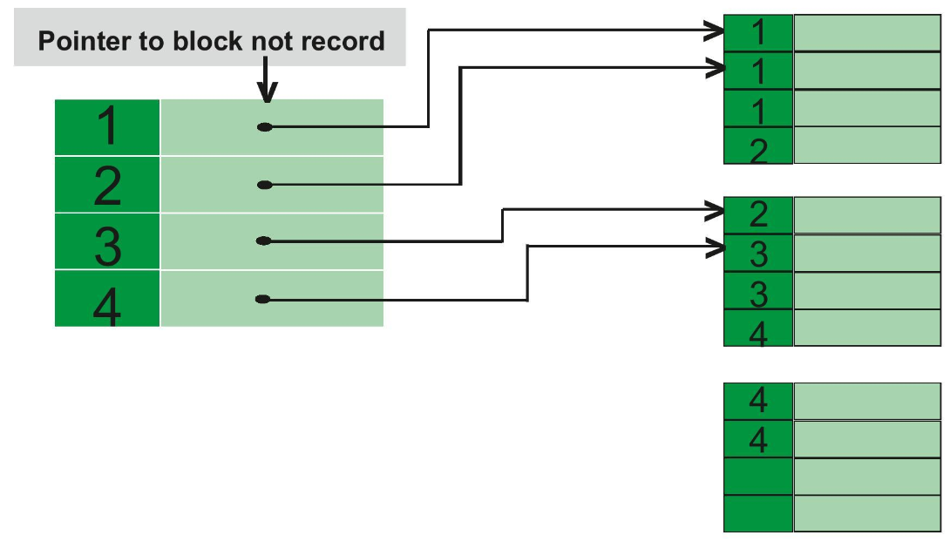
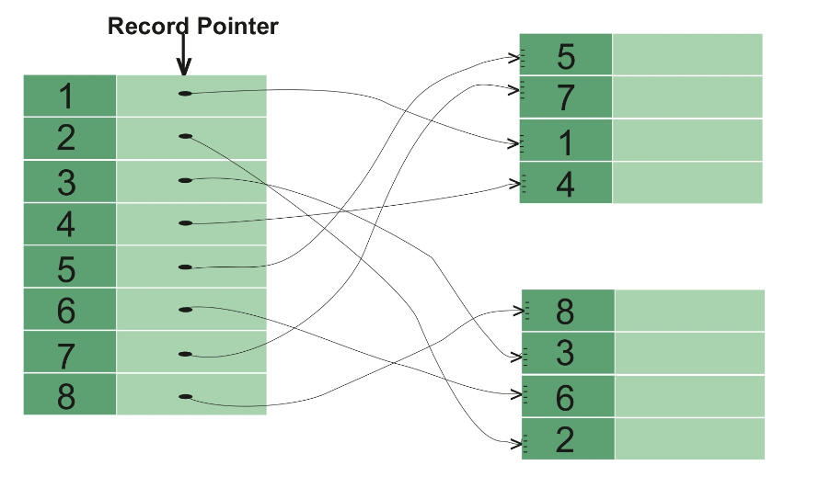
Clustered vs Non-Clustered
NON-CLUSTERED INDEX
Slower
Requires more memory for operations
Index is the copy of data.
A table can have multiple non-clustered index
Does not have inherent ability of storing data on the disk
Store both value and a pointer to actual row that holds data
Leaf nodes are not the actual data itself rather they only contains included columns
Index key defines order of data within index.
Logical order of index does not match physical stored order of the rows on disk.
CLUSTERED INDEX
Faster
Requires less memory for operations
Index is the main data.
A table can have only one clustered index
Has inherent ability of storing data on the disk
Store pointers to block not data
Leaf nodes are actual data itself
Clustered key defines order of data within table
Table records are physically reordered to match the index.
Notes:
Clustered indexes are the unique index per table that uses the primary key to organize the data that is within the table. The clustered index ensures that the primary key is stored in increasing order, which is also the order the table holds in memory.
Clustered indexes have to be explicitly declared in the case of Postgres.
Created when the table is created.
Use the primary key sorted in ascending order.
Non-clustered indexes are sorted references for a specific field, from the main table, that hold pointers back to the original entries of the table. Non-clustered indexes point to memory addresses instead of storing data themselves. The data is stored in one place, and index is stored in another place. Since, the data and non-clustered index is stored separately, then you can have multiple non-clustered index in a table. This makes them slower to query than clustered indexes but typically much faster than a non-indexed column.

Slide 13
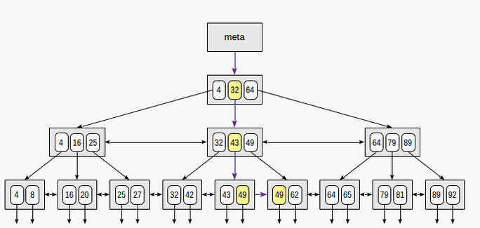
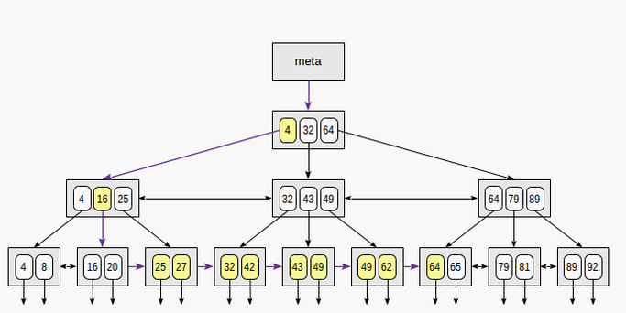
Balanced Tree(B-tree) Index
Search by indexed-field = 49
Search by 23 <= indexed-field <= 64
These indexes are the standard index type. They are excellent for highly selective indexes (few rows correspond to each index entry) and primary key indexes.
Notes:
There is no better explanation than this video: https://youtu.be/aZjYr87r1b8
The standard index type is the B-tree, where the B stands for balanced. A balanced tree is one where the amount of data on the left and right side of each split is kept even, so that the amount of levels you have to descend to reach any individual row is approximately equal.
The B-tree can be used to find a single value or to scan a range, searching for key values that are greater than, less than, and/or equal to some value. They also work fine on both numeric and text data. Recent versions of PostgreSQL can also use an index to find (or avoid) null values in a table.
B-trees have a few important traits:
B-trees are balanced, that is, each leaf page is separated from the root by the same number of internal pages. Therefore, search for any value takes the same time.
B-trees are multi-branched, that is, each page (usually 8 KB) contains a lot of (hundreds) TIDs. As a result, the depth of B-trees is pretty small, actually up to 4–5 for very large tables.
Data in the index is sorted in nondecreasing order (both between pages and inside each page), and same-level pages are connected to one another by a bidirectional list. Therefore, we can get an ordered data set just by a list walk one or the other direction without returning to the root each time.

Slide 14
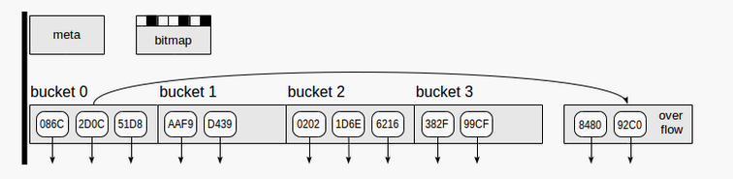
Hash Index
Meta page - page number zero, which contains information on what is inside the index.
Bucket pages - main pages of the index, which store data as "hash code - TID" pairs.
Overflow pages - structured the same way as bucket pages and used when one page is insufficient for a bucket.
Bitmap pages - which keep track of overflow pages that are currently clear and can be reused for other buckets.
Notes:
Hash indexes store only the hash value of the data being indexed, thus there are no restrictions on the size of the data column being indexed.
Each hash index tuple stores just the 4-byte hash value, not the actual column value. As a result, hash indexes may be much smaller than B-trees when indexing longer data items such as UUIDs, URLs, etc. The absence of the column value also makes all hash index scans lossy.
The hash index type can be useful in cases where you are only doing equality (not range) searching on an index, and you don't allow null values in it.
The search by Hash indexes is faster than the search performed by B-tree indexes even if hash indexes do not support the index-only scan method.
Hash indexes support only single-column indexes and do not allow uniqueness checking.
The idea of hashing is to associate a small number (from 0 to N−1, N values in total) with a value of any data type. Association like this is called a hash function. The number obtained can be used as an index of a regular array where references to table rows (TIDs) will be stored. Elements of this array are called hash table buckets - one bucket can store several TIDs if the same indexed value appears in different rows.
The more uniformly a hash function distributes source values by buckets, the better it is. But even a good hash function will sometimes produce equal results for different source values - this is called a collision. So, one bucket can store TIDs corresponding to different keys, and therefore, TIDs obtained from the index need to be rechecked.

Slide 15
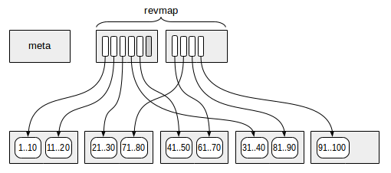
BRIN
Advantages
Faster to create and maintain than BTREE indexes
Much smaller than BTREE indexes
Where data is naturally grouped, they may be near the speed of BTREE (for example, date added or a sequence number)
CLUSTER may allow some uses where data doesn't naturally fall into the heap in appropriate groupings
In some cases, will yield many of the benefits of partitioning with less setup effort
Limitations
Not useful If the values are randomly spread across the table
Lookups not as fast as other index types
Notes:
block range indexes (BRIN) that is incredibly helpful in efficiently searching over large time series data and has the benefit of taking up significantly less space on disk than a standard B-tree index. A block range index entry points to a page (the atomic unit of how PostgreSQL stores data) and stores two values: the page's minimum value and the maximum value of the item to be indexed.
In fact, when used appropriately, a BRIN index will not only outperform a B-tree but will also save over 99% of space on disk
Unlike indexes with which we've already got acquainted, the idea of BRIN is to avoid looking through definitely unsuited rows rather than quickly find the matching ones. This is always an inaccurate index: it does not contain TIDs of table rows at all.
This works as follows. The table is split into ranges that are several pages large (or several blocks large, which is the same). The index stores summary information on the data in each range. As a rule, this is the minimal and maximal values, but it happens to be different. Assume that a query is performed that contains the condition for a column; if the sought values do not get into the interval, the whole range can be skipped; but if they do get, all rows in all blocks will have to be looked through to choose the matching ones among them.
It will not be a mistake to treat BRIN not as an index, but as an accelerator of sequential scan. We can regard BRIN as an alternative to partitioning if we consider each range as a "virtual" partition.
The first (more exactly, zero) page contains the metadata.
Pages with the summary information are located at a certain offset from the metadata. Each index row on those pages contains summary information on one range.
Between the meta page and summary data, pages with the reverse range map (abbreviated as "revmap") are located. Actually, this is an array of pointers (TIDs) to the corresponding index rows.
When adding a new version of a row to a table page, we determine which range it is contained in and use the map of ranges to find the index row with the summary information. When new ranges occur, the size of "revmap" can increase.
When a row is deleted, ... nothing happens. We can notice that sometimes the minimal or maximal value will be deleted, in which case the interval could be reduced. But to detect this, we would have to read all values in the range, and this is costly.
Finally, updating a row is just a deletion of the outdated version and addition of a new one.

Slide 16
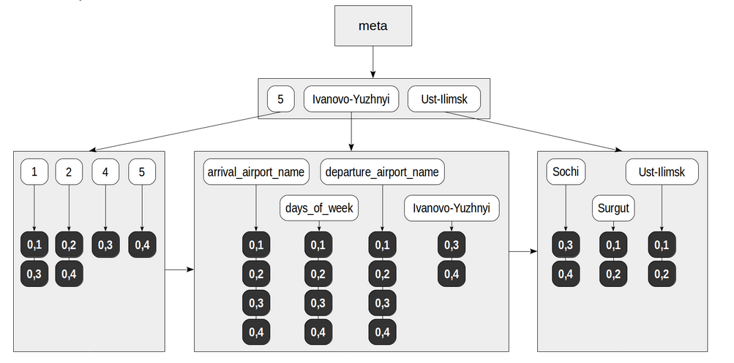
GIN
Notes:
GIN is the abbreviated Generalized Inverted Index. This is a so-called inverted index. It manipulates data types whose values are not atomic, but consist of elements. We will call these types compound. And these are not the values that get indexed, but individual elements; each element references the values in which it occurs.
GIN is useful when an index must map many values to one row, whereas B-Tree indexes are optimized for when a row has a single key value. GINs are good for indexing array values as well as for implementing full-text search.
A good analogy to this method is the index at the end of a book, which for each term, provides a list of pages where this term occurs. The access method must ensure fast search of indexed elements, just like the index in a book. Therefore, these elements are stored as a familiar B-tree (a different, simpler, implementation is used for it, but it does not matter in this case). An ordered set of references to table rows that contain compound values with the element is linked to each element. Orderliness is inessential for data retrieval (the sort order of TIDs does not mean much), but important for the internal structure of the index.
Elements are never deleted from GIN index. It is taken to be that values containing elements can disappear, arise, or vary, but the set of elements of which they are composed is more or less stable. This solution considerably simplifies algorithms for concurrent work of several processes with the index.
If the list of TIDs is pretty small, it can fit into the same page as the element (and is called "the posting list"). But if the list is large, a more efficient data structure is needed, and we are already aware of it — it is B-tree again. Such a tree is located on separate data pages (and is called "the posting tree").
So, GIN index consists of the B-tree of elements, and B-trees or flat lists of TIDs are linked to leaf rows of that B-tree.
Data insertion or update in GIN index is pretty slow. Each document usually contains many lexemes to be indexed. Therefore, when only one document is added or updated, we have to massively update the index tree.
Among the rest, GIN indexes are good thanks to their compactness. First, if one and the same lexeme occurs in several documents (and this is usually the case), it is stored in the index only once. Second, TIDs are stored in the index in an ordered fashion, and this enables us to use a simple compression: each next TID in the list is actually stored as its difference from the previous one; this is usually a small number, which requires much fewer bits that a complete six-byte TID.

Slide 17
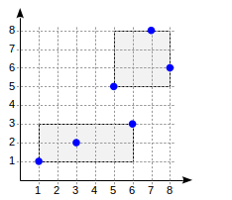
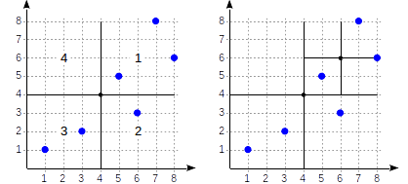
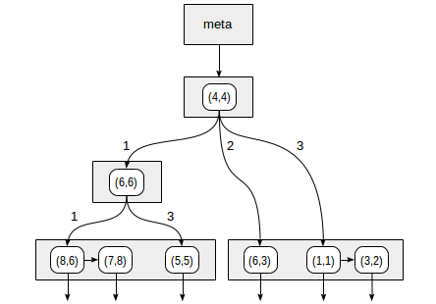
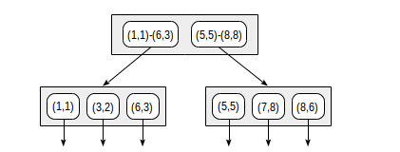
GiST and SP-GiST
Notes:
The Generalized Search Tree (GiST) is balanced, and it implements indexing schemes for new data types in a familiar balanced tree structure. It can index complex data such as geometric data and network address data. It can also implement different strategies such as B-tree or R-tree as well.
What is the difference? "btree" index is strictly connected to the comparison semantics: support of "greater", "less", and "equal" operators is all it is capable of (but very capable!) However, modern databases store data types for which these operators just make no sense: geodata, text documents, images, ...
GiST indexes allow you to build general balanced tree structures, and can be used for operations beyond equality and range comparisons. They are used to index the geometric data types, as well as full-text search.
GiST is a height-balanced tree that consists of node pages. The nodes consist of index rows.
Each row of a leaf node (leaf row), in general, contains some predicate (boolean expression) and a reference to a table row (TID). Indexed data (key) must meet this predicate.
Each row of an internal node (internal row) also contains a predicate and a reference to a child node, and all indexed data of the child subtree must meet this predicate. In other words, the predicate of an internal row comprises the predicates of all child rows. This important trait of GiST index replaces simple ordering of B-tree.
Search in GiST tree uses a specialized consistency function ("consistent") - one of the functions defined by the interface and implemented in its own way for each supported operator family.
The search starts with a root node, as a normal tree search. The consistency function permits to find out which child nodes it makes sense to enter (there may be several of them) and which it does not. The algorithm is then repeated for each child node found. And if the node is leaf, the row selected by the consistency function is returned as one of the results.
Let's once again note that the consistency function does not need to have anything to do with "greater", "less", or "equal" operators. The semantics of the consistency function may be quite different and therefore, the index is not assumed to return values in a certain order.
A GiST index is lossy, meaning that the index may produce false matches, and it is necessary to check the actual table row to eliminate such false matches.
The SP-GiST index refers to a space partitioned GiST index. It is useful for indexing non-balanced data structures using the partitioned search tree. It is best suited for overlapping geometries and heterogeneous distributions. It can implement various trees such as quad-trees, k-d trees, and radix trees.
SP-GiST access method is to split the value domain into non-overlapping subdomains each of which, in turn, can also be split. Partitioning like this induces non-balanced trees (unlike B-trees and regular GiST). The space here is often just what we are used to call a space, for example, a two-dimensional plane. But we will see that any search space is meant, that is, actually any value domain.
An internal node of SP-GiST tree stores references to child nodes; a label can be defined for each reference. Besides, an internal node can store a value called a prefix. Actually this value is not obligatory a prefix; it can be regarded as an arbitrary predicate that is met for all child nodes.
Leaf nodes of SP-GiST contain a value of the indexed type and a reference to a table row (TID). The indexed data itself (search key) can be used as the value, but not obligatory: a shortened value can be stored. In addition, leaf nodes can be grouped into lists. So, an internal node can reference not only one value, but a whole list. Same way as in GiST, the main function to define for search is the consistency function.

Slide 18
MATERIALIZED VIEW

Slide 19
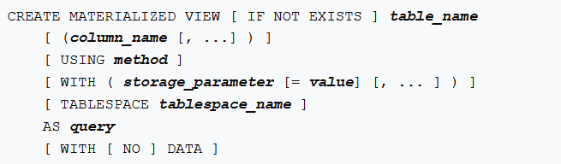

Materialized View
Notes:
For large data sets, sometimes VIEW does not perform well because it runs the underlying query every time the VIEW is referenced. PostgreSQL provides the ability to instead create a MATERIALIZED VIEW, so that the results of the underlying query can be stored for later reference.
Materialized views are similar to views because they also depend on other tables for their data, although there are a couple of differences.
SELECTs against views will always fetch the latest data, whereas SELECTs against materialized views might fetch stale data.
The other key difference is that materialized views actually contain data and take up storage space (proportionate to the volume of data), whereas views do not occupy significant space on disk. Materialized views are used mostly to capture summaries or snapshots of data from base tables. Some latency/staleness is acceptable.
When we use materialized views to store precalculated aggregates, there are two advantages.
First, we avoid the overhead of doing the same calculation multiple times. Materialized views that provide summaries tend to be small compared to the base tables. So, we will save on the cost of scanning big tables. This is the second advantage.
When we use materialized views to store data from foreign tables, we make the query performance more predictable. We also eliminate the data transfer that occurs when we access foreign tables multiple times.
Indexes can also be created against a MATERIALIZED VIEW to make queries even faster.
Current limitations of materialized views include:
You can’t use CREATE OR REPLACE to edit an existing materialized view. You must drop and re-create the view even for the most trivial of changes. Use DROP MATERIALIZED VIEW name_of_view. Annoyingly, you’ll lose all your indexes.
You need to run REFRESH MATERIALIZED VIEW to rebuild the cache. PostgreSQL doesn’t perform automatic recaching of any kind.
Refreshing materialized views is a blocking operation, meaning that the view will not be accessible during the refresh process. You can lift this quarantine by adding the CONCURRENTLY keyword to your REFRESH command, provided that you have established a unique index on your view. The trade-off is concurrent refreshes could take longer to complete.

Slide 20
FOREIGN DATA WRAPPERS

Slide 21
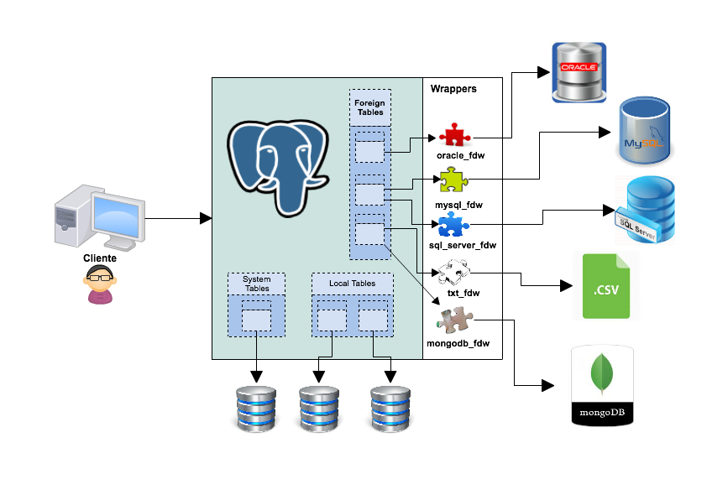
Foreign Data Wrappers
Notes:
Foreign data wrappers are a standardized way of handling access to remote objects from SQL databases.
We can use PostgreSQL's foreign data wrappers to access data from various data sources including:
Relational databases (such as Oracle and MySQL)
NoSQL databases (such as MongoDB, Redis, and CouchDB)
Various types of files
Queries against such sources do not have predictable performance. We can create materialized views on the foreign tables created on such data sources.
There are two foreign data wrappers that ship with PostgreSQL:
file_fdw to create foreign tables that represent flat files (Postgres 9.1 and later),
postgres_fdw to create foreign tables that represent tables in another PostgreSQL database (Postgres 9.3 and later).
You can also define your own wrapper, or use a third party wrapper.
The steps usually involve:
1. Installing the extension.
2. Creating a server object. This provides details of the server (such as IP and
port or path).
3. Creating user mapping. This involves providing the authentication information to connect to other databases. This step may or may not be necessary depending on the type of server object.
4. Creating the foreign table. This creates a table that maps to another table or file on the server object.

Slide 22
Q & A

