Slide 1
Procedural Dungeon Generation
Olivier Legat

Slide 2
Introduction
What is Procedural Content Generation (PCG)?
Generating the level of a virtual environment.
Generating props of the level.

Slide 3
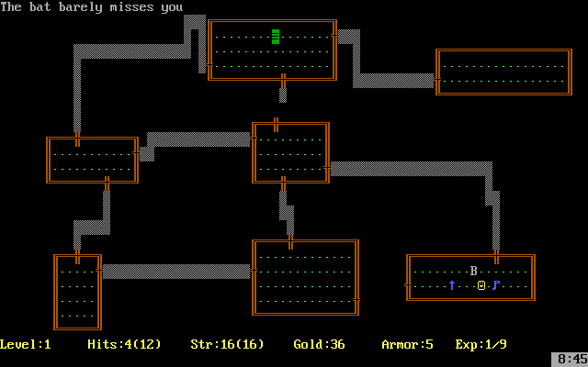
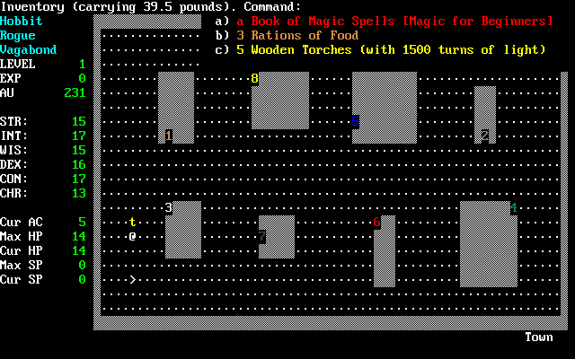
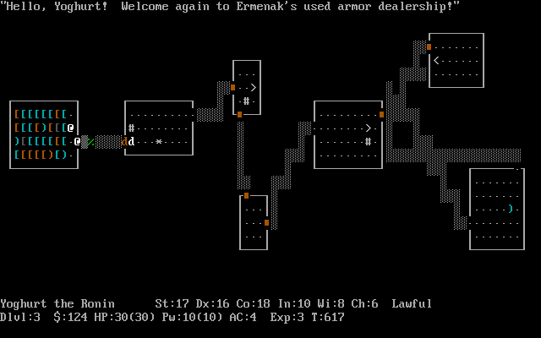
What’s a Dungeon?
Rogue (1980)
NetHack (1985)
Moria (1984)

Slide 4
Aims & Objectives
Develop a generic dungeon-generation framework that supports:
Using different algorithms to generate dungeons (maximise code re-use).
Generating and rendering a 3D environment.
Interact with the environment through collision.

Slide 5
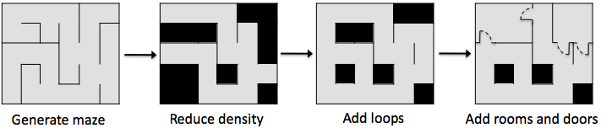
How to do it?
Generate a perfect maze by creating a spanning-tree.
Tweak the maze and adds rooms.

Slide 6
Advantages / Disadvantages
Advantages:
Quickly produces a level.
Potentially infinite content.
Disadvantages:
Repetitive content / lack of uniqueness.
Not as “pretty” as man-made levels.

